Slide 1

Basketball and drugs: Wastewater-based epidemiological estimation of discharged drugs during basketball games in Kentucky
Alex Montgomery
Undergraduate Chemistry Student
Murray State University, Murray, KY

Slide 2
Illicit and Prescribed Drugs Abuse
  In global scale
  Drug use leads to drug abuse
  35 M people suffer globally in 2019
  Opioids: two-thirds of drug-related deaths in 2017
  In the U.S.
  Prescription Drug Abuse: deaths quadrupled from 1999 to 2018
  Illicit drugs: ~9.0 M people abused heroin, cocaine, and methamphetamine in 2017
  Centers for Disease Control and Prevention. U.S. State Prescribing Rates, 2018.
  Drug Enforcement Agency. 2018 National Drug Threat Assessment, 2018.
  United Nations Office on Drug and Crime. World Drug Report 2019, 2019
Notes:
Illicit and prescription drug use has been on the rise (UNODC, 2019)

Slide 3
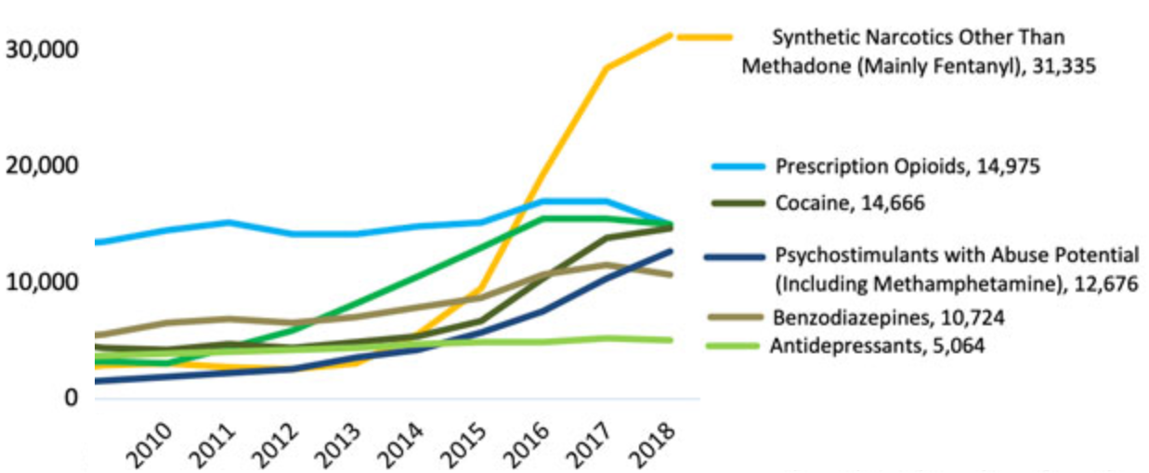
National Drug Overdose Issue
Notes:
Synthetic narcotics followed by the prescription opioids and heroin dominants the overdose death (?) profile
In 2017 => 70,000 drug overdose deaths (CDC); Opioids: 68% of all DOD
Tracking the transshipment, finding smugglers, what being consumed or where? Its all being a global battle between “users” and “law enforcement/public health personnel”

Slide 4
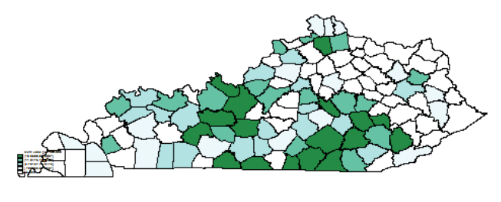
Determination of Drug Prevalence
in a Community
Performed traditionally through Survey and statistics
Police department records
Drug-related crime statistics
Survey questionnaires
Self-reported information
“Drug Enforcement Administration agents seized more than 2,200 pounds of methamphetamine”
Notes:
About 30% of overdose deaths in KY is due to heroin
Not-to-Forget: these drug pr
Methamphetamine usage in Kentucky
evention program are restricted more to the urban communities whereas rural communities are left behind due to the budgetary limitations.

Slide 5
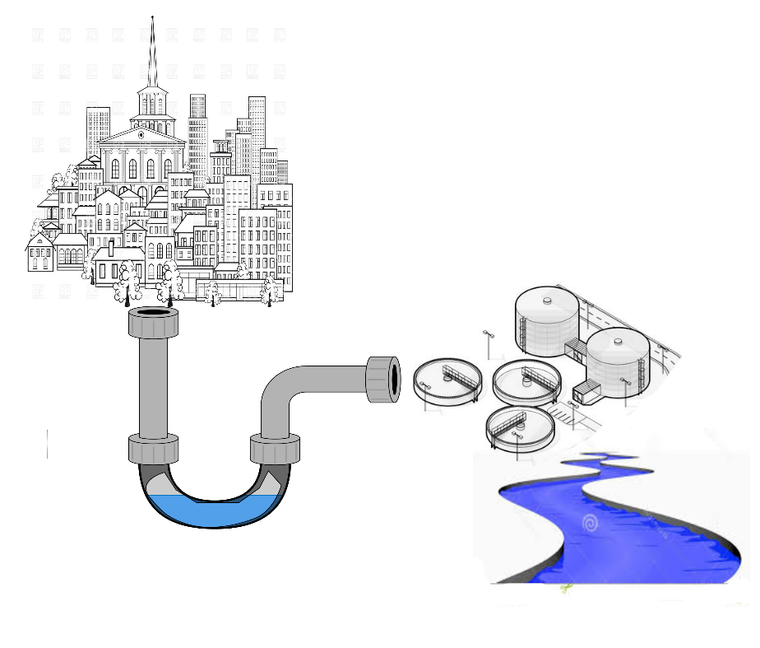
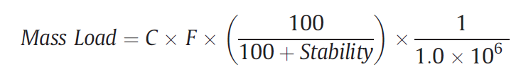
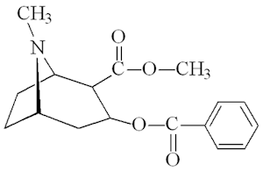
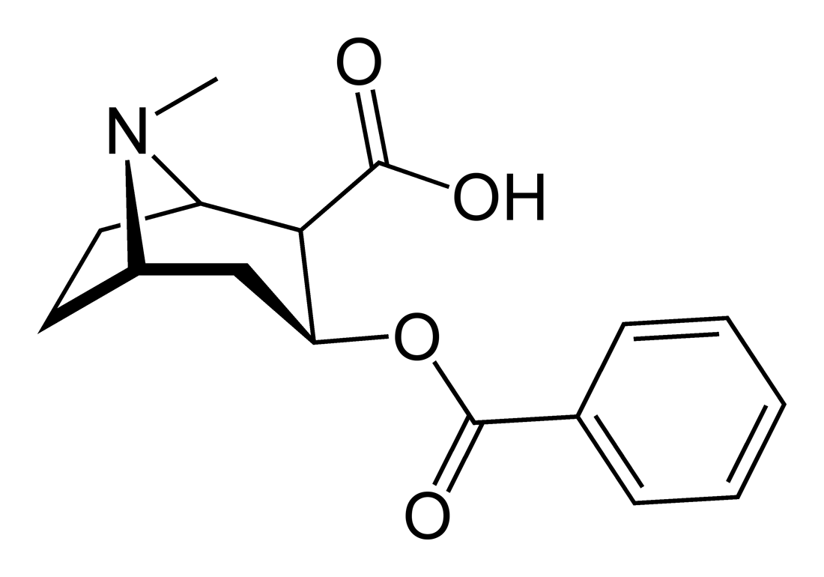
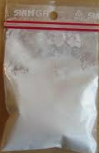
Wastewater-Based Epidemiology
Notes:
Error attributed to population
Often unavailable or inaccurate
How this differs from WWTP
Samples collected at the stadium
Total attendance was recorded
Number of people using the restroom was counted

Slide 6
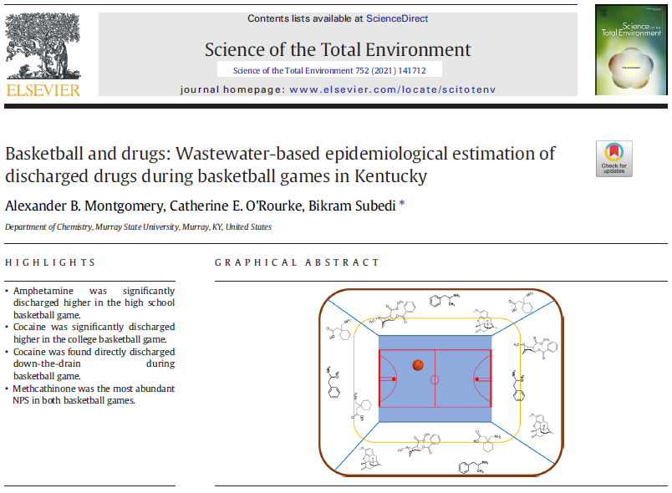

Slide 7
Target Illicit and Prescribed Psychotics

Slide 8
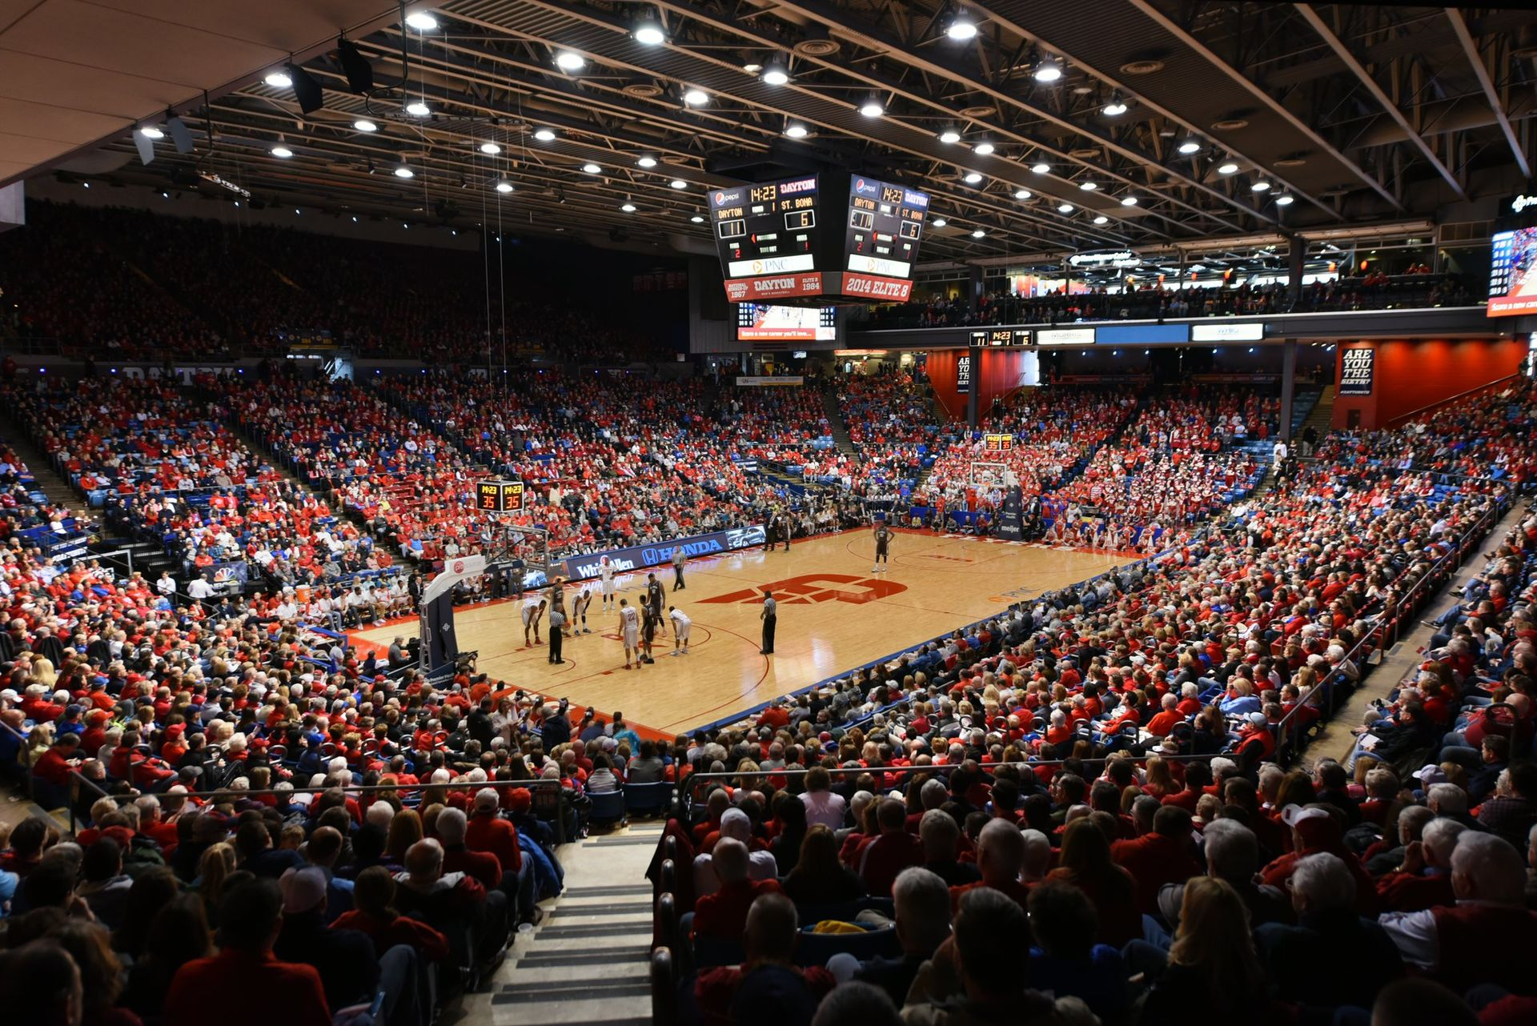
Drug Consumption at Sporting Events
Adolescents and adults in their twenties are among the highest risk for illicit drug use
Amphetamine and cocaine spiked at a Mississippi Football game
Cocaine spiked during the Super Bowl
Miech et al., Monitoring the Future National Survey Results on Drug Use, 2020.
Gerrity et al., Temporal variability of pharmaceuticals and illicit drugs in wastewater and the effects of a major sporting event, 2011.
Gul et al, LC-MS-MS method for stimulants in wastewater during football games, 2016

Slide 9
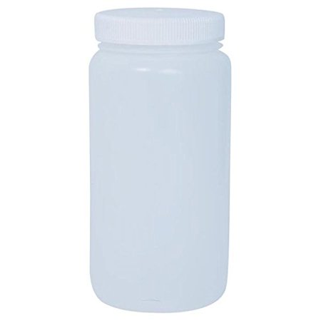
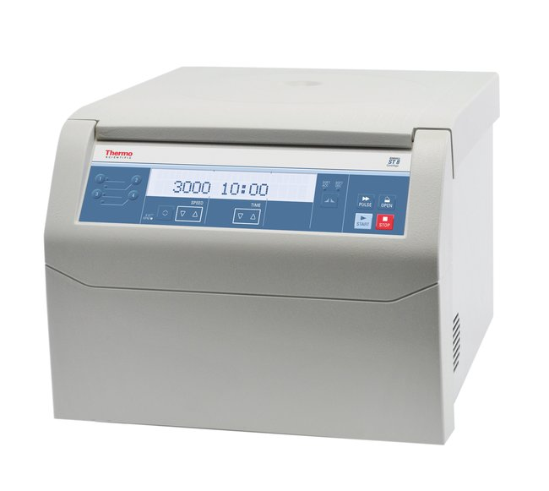
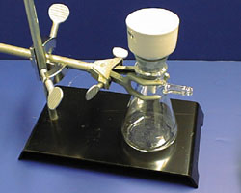
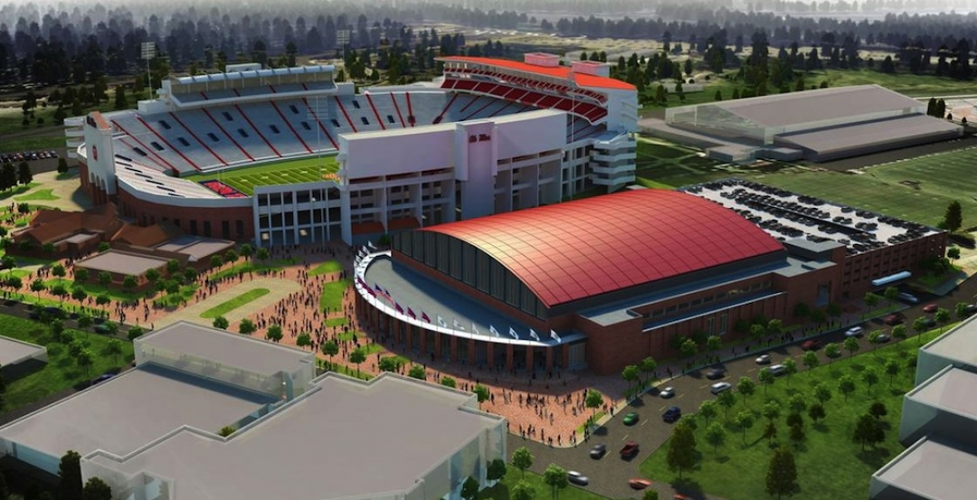
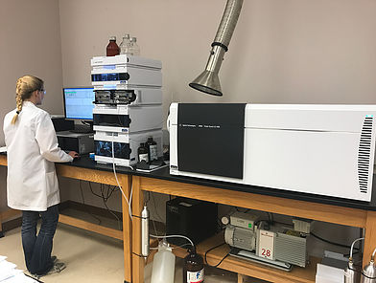
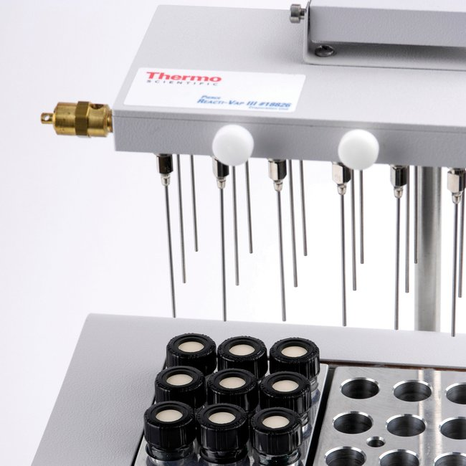
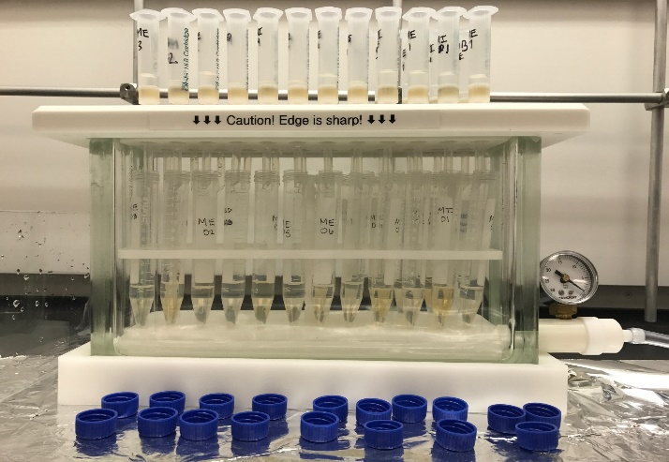
Analytical Method
Basketball Stadium
Polypropylene Sampling Bottle
Centrifuge
Vacuum Filtration
Internal Standards
UPLC-MS/MS
Solvent Evaporator
Solid Phase Extractor
Notes:
Extracted within 12 hour of sample collection!

Slide 10
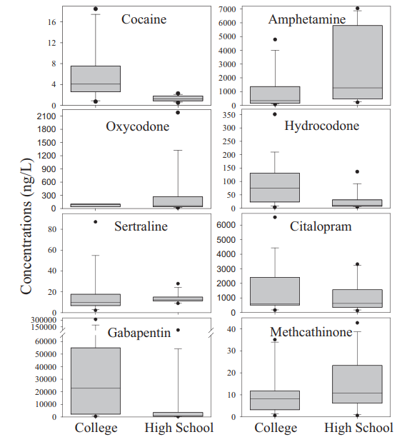
Drug Concentrations for College and High School Basketball Games

Slide 11

Acknowledgement
Dr. Bikram Subedi
Huichang Chae
Isaac Bowers
Katherine Veach
Cheyenne Siffel
Houston Hampton
Jones/Ross Research Center, Chemistry Department, Murray State University
City Officials

