Slide 1
Analyzing the parameter space of a wound-healing model with three-dimensional geometry
Gloria Huang
Western Kentucky University
Mathematics Department

Slide 2
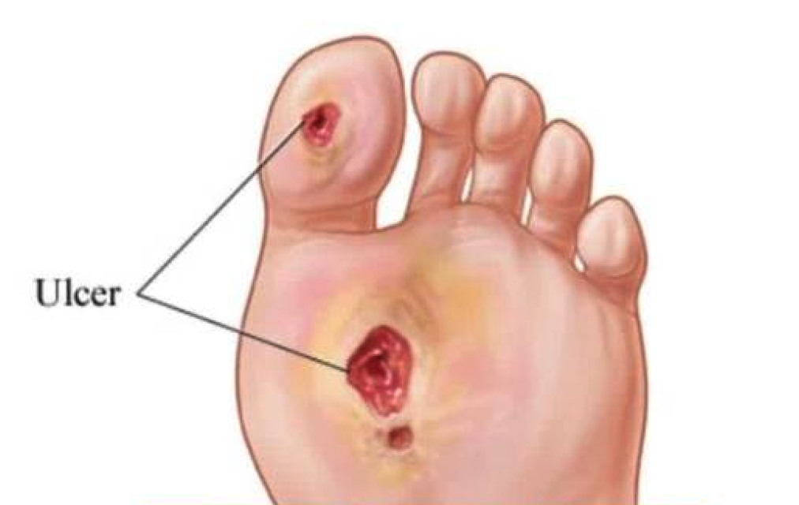
Introduction
Wound-healing consists of a series of four carefully regulated stages: hemostasis, inflammation, proliferation, and remodeling.
Chronic wounds have a prolonged presence in the inflammatory stage.
An upward of 50 billion is spent annually
in the treatment of chronic wounds.
My research is aiming to combat the
unpredictable nature of chronic wounds
through analyzing a mathematical model.

Slide 3
4 State Variables
Matrix Metalloproteinases (MMPs)
The Inhibitors of MMPs (TIMPs)
Extracellular Matrix (ECM)
Fibroblasts

Slide 4
Mathematical Model

Slide 5
Parameters in the Model
Parameter | Description
k₁ | Production of MMPs
k₂ | Half Maximal Concentration of MMPs
k₃ | Natural Decay of MMPs
k₄ | Interaction Between MMPs and TIMPs
k₅ | Production of TIMPs
k₆ | Half Maximal Concentration of TIMPs
k₇ | Natural Decay of TIMPs
k₈ | Growth of ECM
k₉ | Interaction Between MMPs and ECM
k₁₀ | Natural Decay of ECM
k₁₁ | Proliferation of Fibroblasts
f_{i} | Initial Condition of FIbroblast Equation

Slide 6
Patient Data
A study was conducted by Muller et al. (2008) to measure the levels of MMP-1, TIMP-1, and ECM in the wound fluid of sixteen type-2 diabetic patients over a twelve-week period.
Measurements were taken of the percent wound closure, MMP-1, and TIMP-1.
MMP-1 and TIMP-1 levels were measured as a ratio.

Slide 7
Purpose
Finding the parameters in the mathematical model with the strongest influence can increase the predictive power of the model, and therefore optimize treatment. The insights gathered from this research can then be applied to other chronic wound classifications.

Slide 8
Parameter Identifiability
Sensitive parameters are of more importance in the model.
Can the parameter be uniquely determined?
Identifiability determines significance in the model and the wound healing process.
My research aims to find the sensitive and identifiable parameters in the model.

Slide 9
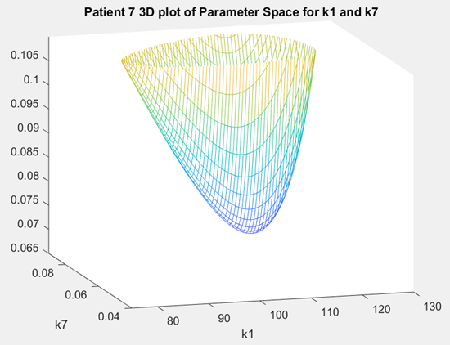
3-Dimensional Geometry
A combination of two parameters was selected to be varied while keeping the other ten parameters at fixed values.
X-axis: First Parameter
Y-axis: Second Parameter
Z-axis: Sum of Squared Errors
The minimum value of the 3-D graph was
compared to the actual patient data values to
determine identifiability.

Slide 10
Parameter Space
Each parameter was assigned a range in which it was allowed to vary.
Corresponding to the bounds on the axes.
Growth parameters varied from 0-200.
Loss parameters varied from 0-1.
Ranges were refined after each construction to better capture the geometry.

Slide 11
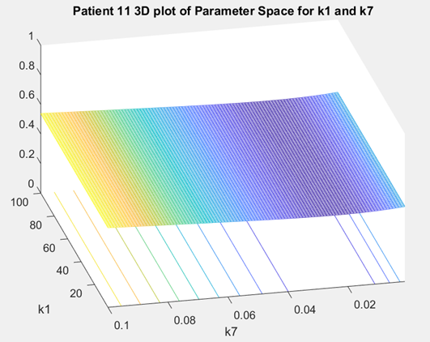
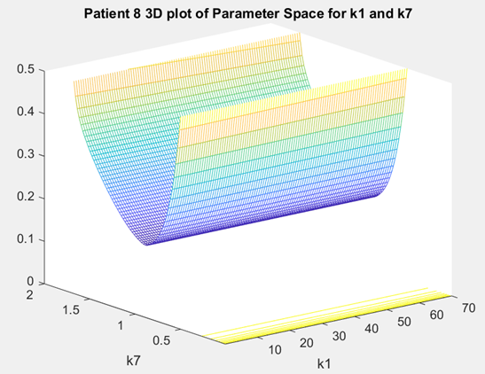
Figure 3: None Identifiable
Figure 1: Both Identifiable
Figure 2: One Identifiable

Slide 12
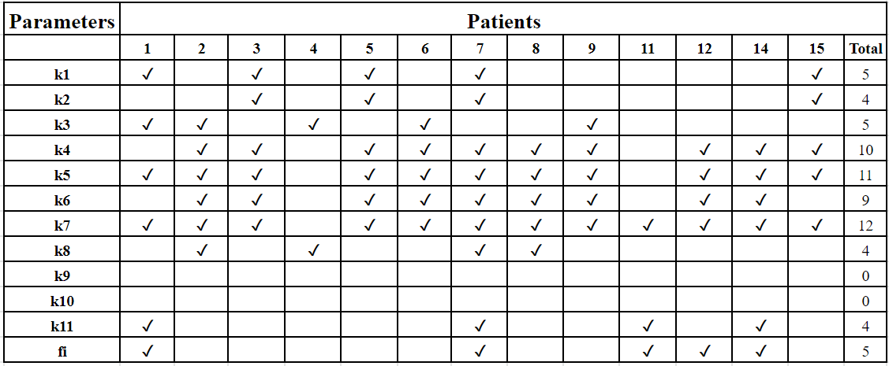
Identifiability Results
k₄ ,k₅ ,k₆ ,k₇ were able to be identified most often

Slide 13
Conclusions
The parameters able to be identified most often were:
k₄ : The Interaction Between MMPs and TIMPs
k₅ :The Production of TIMPs
k₆ : Half Maximal Concentration of TIMPs
k₇ : The Natural Decay of TIMPs
TIMPs levels should be carefully monitored by healthcare professionals in order for success in the healing of chronic wounds.
TIMPs
MMPs
ECM

Slide 14
Parameter Subset Selection
Eigenvalues were generated for the twelve parameters using a subset selection technique.
The eigenvalues correspond to changes in the parameter values from solving the differential equation system.
Larger eigenvalues = Greater identifiability
k₃ ,k₄ ,k₅ ,k₆ , and k₇ and had eigenvalues with the largest magnitudes and therefore are the most identifiable.

Slide 15
Eigenvalue Ratios
The ratios of the eigenvalue combinations were a likely predictor of the three-dimensional geometry shape. Smaller ratios indicated a bowl shaped graph.

Slide 16
Future Work
Use the Delayed Rejection Adaptive Metropolis Algorithm to confirm results.
Pairwise plots will be generated.
Plots with a similar shape and location to geometry graphs would confirm results.

