Slide 1


The photocatalytic single electron oxidation of ene-ynamides with 2,6-lutidine N-oxide
Jason Zhang
Department of Chemistry
Western Kentucky University

Slide 2
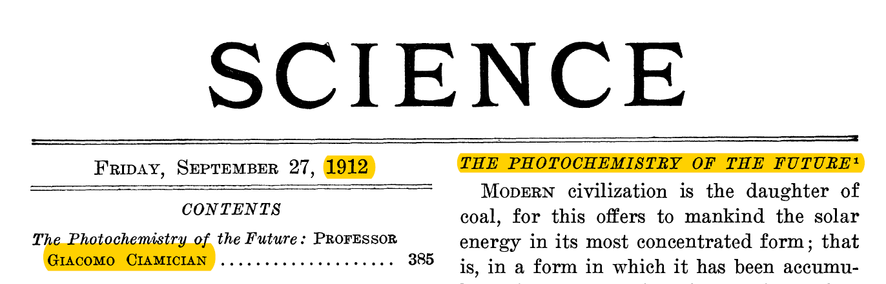
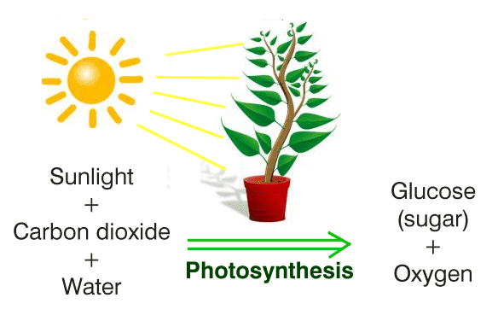
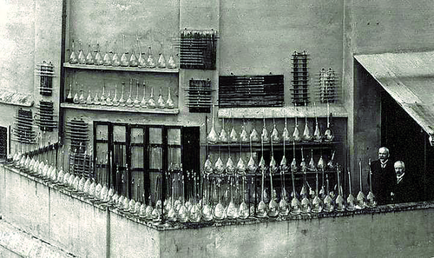
PHOTOSYNTHESIS

Slide 3
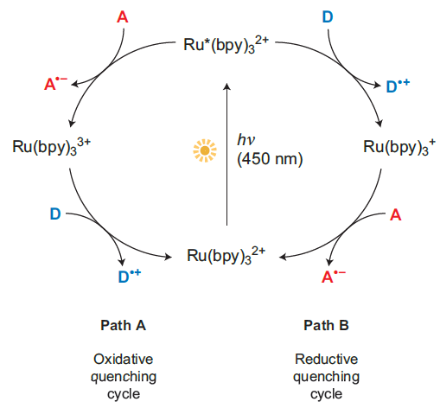

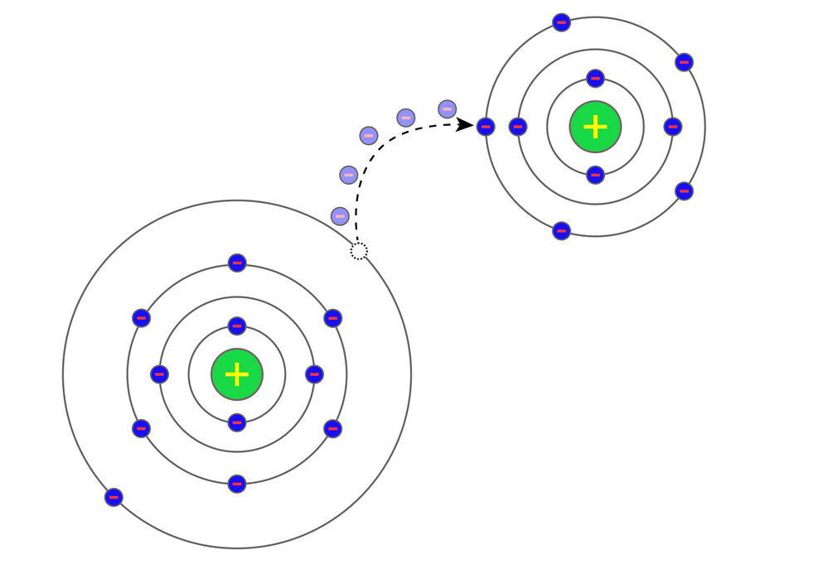

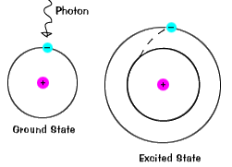


Visible Light Photocatalysis in Organic Synthesis
Oxidation is where one compound loses an electron
Reduction is where one compound gains an electron
Nat. Chem. 2010, 2, 527.
Chem. Rev. 2013, 113, 5322.
Chem. Rev. 2016, 116, 10075.
Oxidative and Reductive Quenching Cycles of a Photoredox Catalyst

Slide 4
Acc. Chem. Res. 2016, 49, 1997.
Angew. Chem. Int. Ed. 2018, 57, 2174
Nat. Chem. 2014, 6, 720.
J. Am. Chem. Soc. 2012,134, 18577.
Alkene Oxidation = +1.25 V vs. SCE
Alkyne Oxidation = +1.75 V vs. SCE
Synlett 2014, 25, 1191.

Slide 5
Research Problem:
Is it possible to use a photocatalyst and visible light to oxidize alkynes to form synthetically important compounds?
Alkyne Oxidation = +1.75 V vs. SCE
Alkyne Oxidation with redox auxiliary = +1.32 V vs. SCE
Chemeurj 2019, 25, 6638.

Slide 6
Our Approach:
We approach the research problem by reacting a wide variety of alkynes with 2,6-lutidine N-oxide with a photocatalyst in the presence of visible light and looked at resulting NMR spectroscopy. One such family of compounds, termed ene-ynamides, were able to be oxidized. We focused on expanding the scope of that reaction.

Slide 7
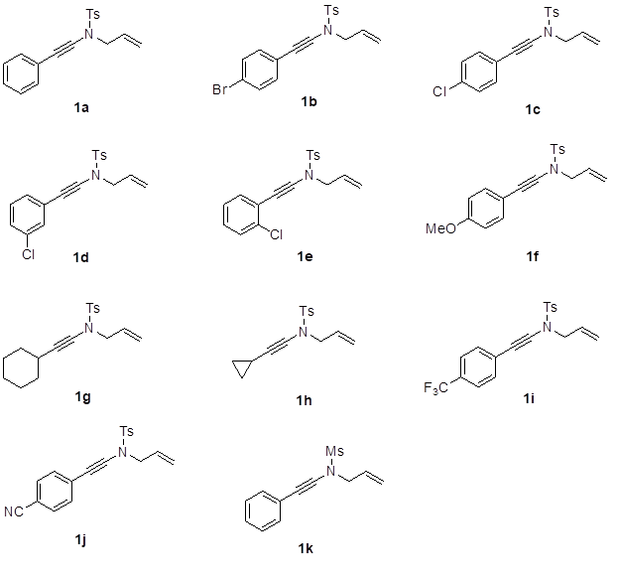
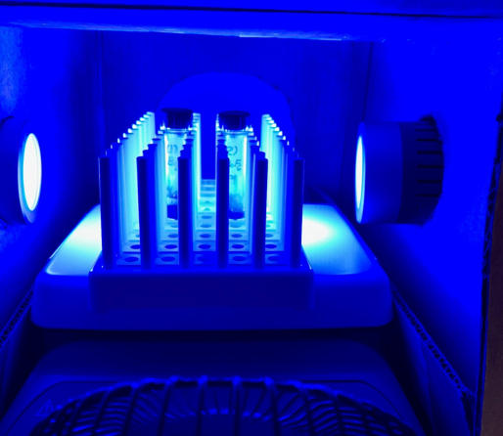
Scope of Reaction for Ene-Ynamides:

Slide 8
Hypothesis:

Slide 9
Metal-Free Photoredox Catalyzed Cyclization of Ene-Ynamide
[Radical Acceptor]
Blocked
ortho- position
precursor to Milnacipran, an important antidepressant

Slide 10
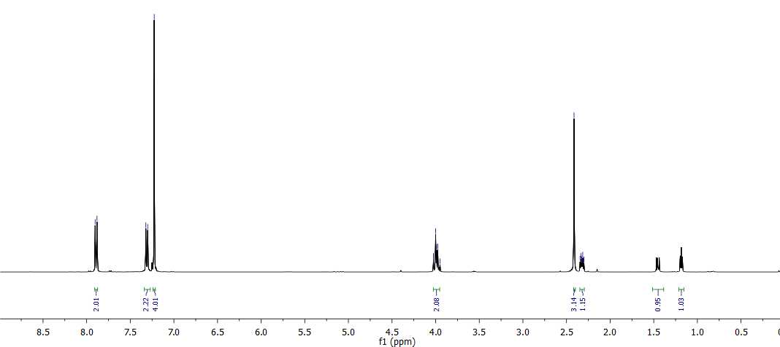
NMR Spectroscopy:

Slide 11
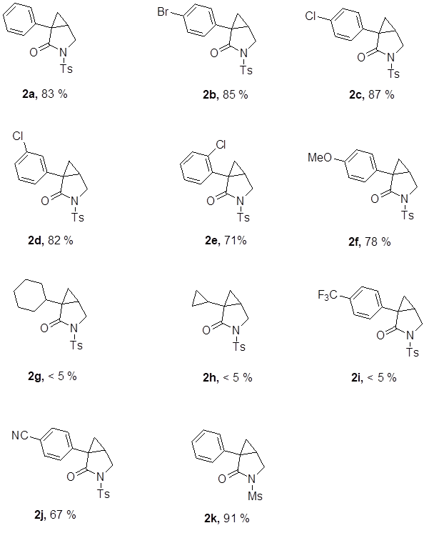
Results:

Slide 12
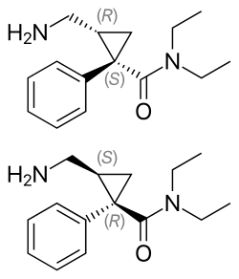
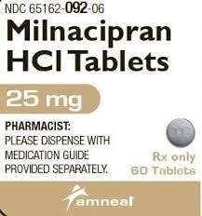
Discussion and Conclusion:
We discovered a metal-free photocatalytic reaction can be used to synthesize important intermediates for drugs, such as the useful antidepressant Milnacipran.
We generalized this reaction to a wide variety of ene-ynamides with moderate yields.
J. Am. Chem. Soc. 2013, 135, 8201.
Org. Lett. 2013, 15, 2374.

Slide 13
Future Works:

Slide 14

Acknowledgements:
I would like to thank my mentor Dr. Yongming Deng for allowing me to participate in this research.
I would also acknowledge my group members Jonathan Markham, Brad Bankhead, and Steve Chen.
I would like to thank ACS Petroleum Research Fund (PRF # 60206-UNI1) for their support of this research

