Slide 1
Aging and pareidolia:
Perceiving emotion in inanimate objects
Emily E. Knapp, BriAnna M. Lowe, and Andrew Mienaltowski
Department of Psychological Sciences
Western Kentucky University
Bowling Green, KY 42101
Project completed with funding support from the Kentucky Academy of Science (23204237; Special Research Grant)

Slide 2
Background
Aging associated with deficits in facial emotion recognition (Hayes et al., 2020)
Anger, fear, and sadness
Select a single emotion label for each face from basic, universal categories with one objectively correct answer per face (Ekman & Cordaro, 2011)
Consistency of age-related deficit depends on number of labels people asked to consider at one time, suggesting cognitive demand drives deficit (Orgeta, 2010)
Notes:
Past research in emotion recognition has found that older adults have deficits in perceiving emotions, especially anger, fear, and sadness. These experiments used a forced-choice task, where participants are given a list of emotion categories and must select one label to represent their perception of the stimulus. Each stimulus has an objectively correct answer and participants are given a score that represents their individual “accuracy,” or emotion perception ability.
However, the presence of age-related deficits is heavily dependent on the number of labels people are asked to apply. This suggests that the deficits that older adults often show in emotion judgment tasks may not be due to their perceptual abilities but instead due to the increased cognitive demand of weighing multiple possible responses for each stimulus.

Slide 3
Background
Emotional expression include facial, vocal, and postural cues, as well as anticipated context of social interaction (Barrett et al., 2019)
Influenced by sociocultural display norms
Categories are imposed constructs
Facial stimuli include sociocultural cues that bias emotion perception, like gender, race, and age
Image source: Interdisciplinary Affective Science Laboratory; www.affective-science.org
Notes:
Facial cues are only one source of emotional information. Recent research has shown that emotion perception is also dependent on other cues, including body posture and vocal cues, and that perception of emotion is influenced by sociocultural norms. Sociocultural cues such as gender or race have the ability to bias an individual’s perception of emotion in facial stimuli.
Research examining the impact of the aging process on emotion perception often simply present individual static faces. As a result, the participants’ responses are not always supported by other ecologically valid cues and also may be impaired by sociocultural bias.

Slide 4
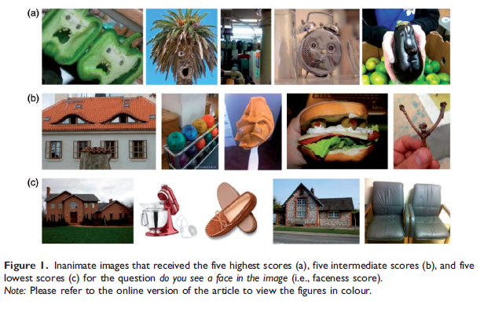
Background
Pareidolia - images of inanimate objects that have features resembling faces
Eye- and mouth-related features contribute to face perception (Omer et al., 2019)
Pareidolia images offer means to reduce sociocultural impact of human categories when studying emotion perception
Image source: Omer (2019); doi: 10.1177/0301006619838734
Notes:
This study uses pareidolia images as stimuli. Pareidolia is the phenomenon of perceiving face-like features in everyday inanimate objects. By using these non-human images as stimuli, the influence of sociocultural factors on participants’ emotion perception can be greatly reduced or removed from consideration.
Pareidolia images also have no objectively correct response. Whereas static facial images often include overly-expressive features of posed actors, perception of emotion in pareidolia images is not guaranteed and instead is dependent upon the cluster of facial features perceived as possibly communicating emotion. The utility of these images lies in how they allow scientists to understand how people construct emotion from visual cues where clearly emotion cannot actually exist.

Slide 5
Current Study
Examine age differences in emotion perception in pareidolia images
How common are the basic, universal categories in free labeling?
Does forced-choice of categories change how stimuli are characterized?
Explore how cognitive functioning influences emotion perception
Do age-related cognitive deficits predict limits to emotion perception?
Does maturation alter emotion labeling process?
Notes:
In our study, we had two main goals.
First, we wanted to explore whether there were age differences in basic emotion perception. Specifically, across adulthood, do people use the basic, universal categories proposed by other scientists when labeling emotion in the images? Also, how well do the labels freely offered by participants match those selected later on in the study when given the same images to consider in a forced-choice task? So does limiting the labels available to the participant alter how the stimuli are perceived.
Second, we wanted to explore how cognitive functioning influences emotion perception. Participant cognitive ability was assessed across three different measures, two which show age-related deficits and one which shows age-related growth. If aging is linked to cognitive deficits, do these age-related cognitive deficits predict the labeling process in emotion perception? On the other hand, perhaps maturation in some abilities in adulthood, like verbal ability, predicts emotion perception ability. Work in this area tends to be deficit focused, so this possible link between maturation and emotion perception has not been examined before.

Slide 6
Participants
Age by Decades | 20s (n = 42) | 30s (n = 42) | 40s (n = 40) | 50s (n = 40) | 60s (n = 50) | 70s (n = 20) | All (n = 234)
Age | M = 25.7 (SD = 2.5) | M = 34.0 (SD = 2.8) | M = 44.3 (SD = 3.2) | M = 55.5 (SD = 2.4) | M = 65.7 (SD = 2.8) | M = 73.3 (SD = 2.3) | M = 48.1 (SD = 16.3)
Gender | 20 F, 20 M | 26 F, 16 M | 20 F, 20 M | 21 F, 19 M | 28 F, 22 M | 10 F, 10 M | 122 F, 112 M
Adults 20-77 years of age recruited from Amazon Mechanical Turk (MTurk)
Premium MTurk filters used to sample participants by age/gender batches
Provided informed consent (IRB #20-063) while completing study on PsyToolkit platform
Data set includes only participants who consented to participate, completed the study, and were compensated
Notes:
Participants in this study were aged 20-77 and were recruited from Amazon Mechanical Turk. When recruiting participants, filters available on MTurk were used to create sessions specific for different age brackets and for men and women. These restrictions help reduce the prevalence of bots and participants who misrepresent their demographic characteristics simply to collect money for participating.
Within each decade of adulthood, the average age was near to the middle of the decade. Participants provided informed consent on the Psytoolkit platform before completing the study. The data include only participants who consented to participate, completed the study, and were compensated for their time.

Slide 7
Method
Brief Demographics Form
Pareidolia Task (15 pareidolia images)
Free label emotion in image
Rate stimulus characteristics (eye- and mouth-region contribution; intensity)
Forced-choice selection of label (1 of 5 ; Young et al., 2002)
Center for Epidemiological Studies Depression Inventory (Radloff, 1977)
Cognitive Tasks
Verbal Ability: Advanced Vocabulary Test (Ekstrom et al., 1976)
Processing Speed: Number Comparison Test (Ekstrom et al., 1976)
Working Memory: Corsi Blocks (Kessels et al., 2000)
Notes:
Participants who consented to participating in the study first filled out a brief demographics survey. They then began the pareidolia task, where they first provided their own labels for each stimulus, then they rated stimulus characteristics like the intensity of expression and the contribution of the eye-region and mouth-region of each stimulus to their perception of emotion.
Then participants observed the same stimuli a third time and completed a forced-choice task in which they selected a label from universal categories for each of the 15 stimuli. The label options for each stimulus were selected based on a confusion chart common in emotion research. The options included the category most commonly offered in a pilot study, neutral, two confusable categories, and one clearly incorrect category of an opposing valence.
Finally, participants completed a depression inventory and three brief cognitive tasks, which included the Advanced Vocabulary Test - a test of verbal ability, the Number Comparison Test - a test of processing speed, and Corsi Blocks - a visuospatial working memory task.

Slide 8
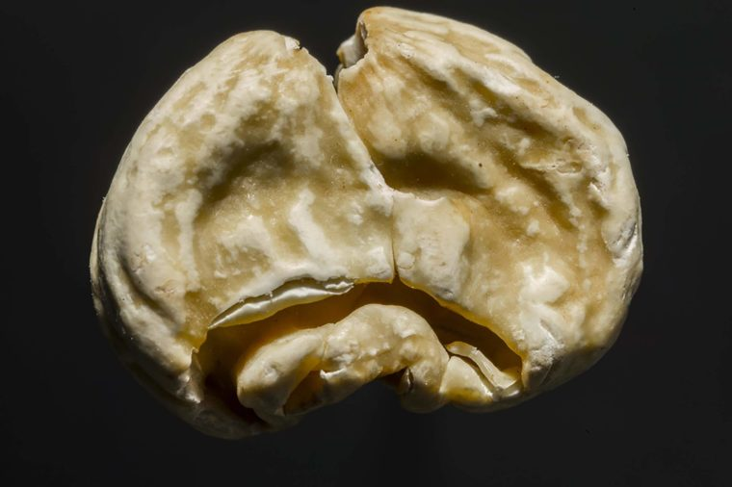
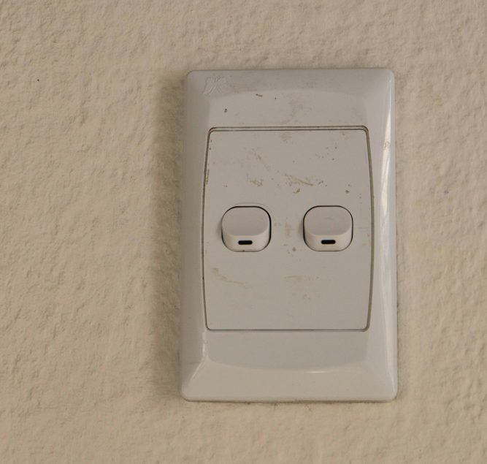
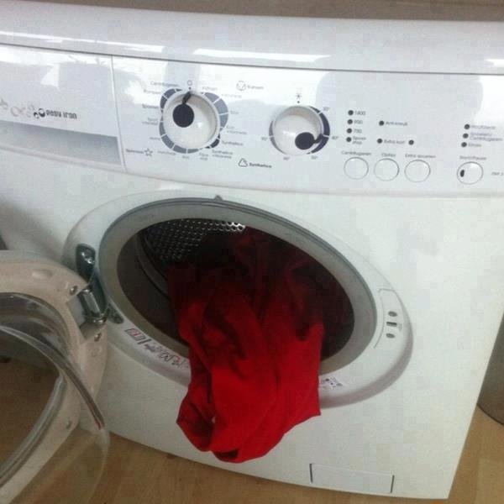
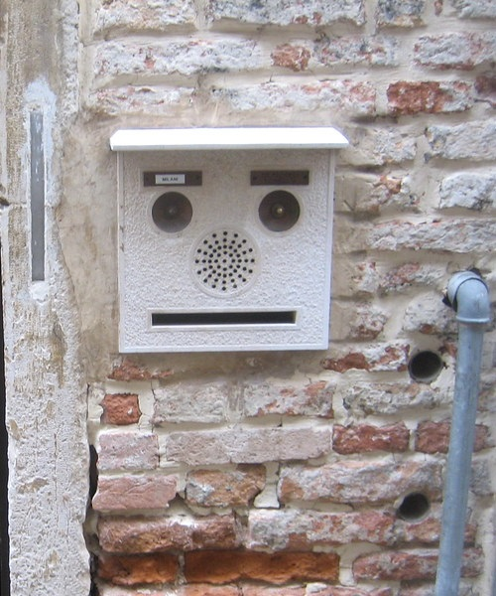
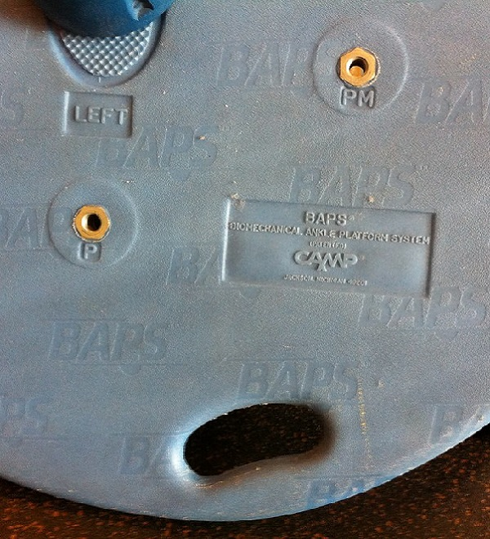
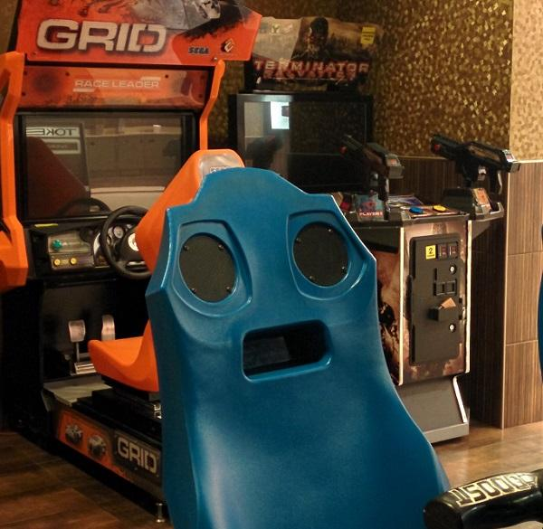
Stimuli
Images were retrieved from Google Image, Flickr, and other public image sources
Notes:
These images are the 15 pareidolia stimuli participants were asked to label while completing the study. These images were obtained online through different public image sources, including Google Images and Flickr.

Slide 9
Results - Stimuli
sad 62.0% 53.4%
angry 75.2% 49.6%
happy 81.2% 78.6%
surprise 46.6%
other 61.5% 60.3% 53.0% 45.3% 56.8% 71.8% 49.6% 50.9%
Responses provided for free labeling coded into categories: “angry,” “disgust,” “fear,” “happy,” “sad,” “surprise,” “neutral,” and “other”
Notes:
During the free labeling task, participants were shown the stimuli and asked to provide an emotional label. The responses were then coded into one of the seven Ekman labels: disgust, fear, happy, sad, surprise, and neutral.
These results represent the percentage of participants whose responses aligned with the listed universal Ekman label.
If a participant’s free-label response did not fall into any of the Ekman categories, then it was coded as “other”. More than 50% of participant responses were coded as “other” in this task. For 8 of the 15 stimuli, a label other than one that is considered basic or universal was more common than any one universal label.

Slide 10
Results - Cognitive functions
Chronological age was associated with cognitive functions
Corsi Memory, r = -.326***
Vocabulary: Correct items, r = .367*** | Incorrect items, r = -.221***
Number Comparison: Correct items, r = -.310*** | Incorrect items, r = -.233***
Number Comparison: Median RT, r = .377***
With age, verbal ability improves, but working memory and processing speed decline
Also with age, people grow more cautious in responding, answering incorrectly less and taking more time to respond
* p < .05, ** p < .01, *** p < .001
Notes:
Correlation analyses were performed to first examine the relationship between advancing age and cognitive functions.
Advancing age was associated with declining performance on the Corsi memory test of working memory. It was also associated with poorer processing speed, specifically fewer items correct and longer response times on the number comparison test.
For the vocabulary test, advancing age was associated with a greater performance in verbal ability, with older adults showing a greater number of correct items and fewer incorrect items.
Generally, advancing age, although associated with longer response times, was also associated with fewer incorrect responses on the vocabulary and number comparison test. This suggests that aging supports a tendency to be more cautious when responding.

Slide 11
Results - Pareidolia Task
Chronological age was not associated with many aspects of emotion perception
Forced-label selection accuracy, r = -.010
Number of universal categories offered for 15 stimuli, r = -.054
Range of universal categories, r = .091
Chronological age was associated with the number of different labels used to describe the emotion in the images, r = .175**
* p < .05, ** p < .01, *** p < .001
Notes:
After examining the relationship between chronological age and cognitive performance, we next moved on to examining the relationships between chronological age and performance in our emotion perception tasks.
Age was not related to many aspects of emotion perception. Contrary to prior studies of emotion perception using static images, when participants were restricted to categorizing stimuli using the Ekman labels, no age differences emerged. Also during the free labeling task, aging did not impact the frequency of use of the Ekman labels or the number of different Ekman labels offered by participants.
We did however, observe a positive relationship between advancing age and the number of different labels used to describe an image. In other words, as people get older, there is a greater tendency to offer different label words. This is perhaps a reflection of the perception of more nuance in how emotion is expressed as people age

Slide 12
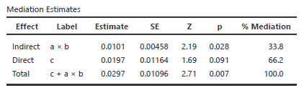
Results - Mediation
Verbal ability mediates the relationship between age and number of labels
Correct Vocabulary
a = .0772
b = .1303
Age (in years)
c’ = .0197
Number of labels
Notes:
To further explore a possible explanation for the relationship between chronological age and the number of different word labels offered by participants, we examined the mediation ability of our cognitive measures.
Verbal ability completely mediated the relationship between age and number of labels provided. This indicates that older participants with greater vocabulary scores provided a significantly greater number of labels. This supports the idea that, as we age, emotion perception may evolve to include more nuanced descriptors for the collection of emotion cues that we evaluate.

Slide 13
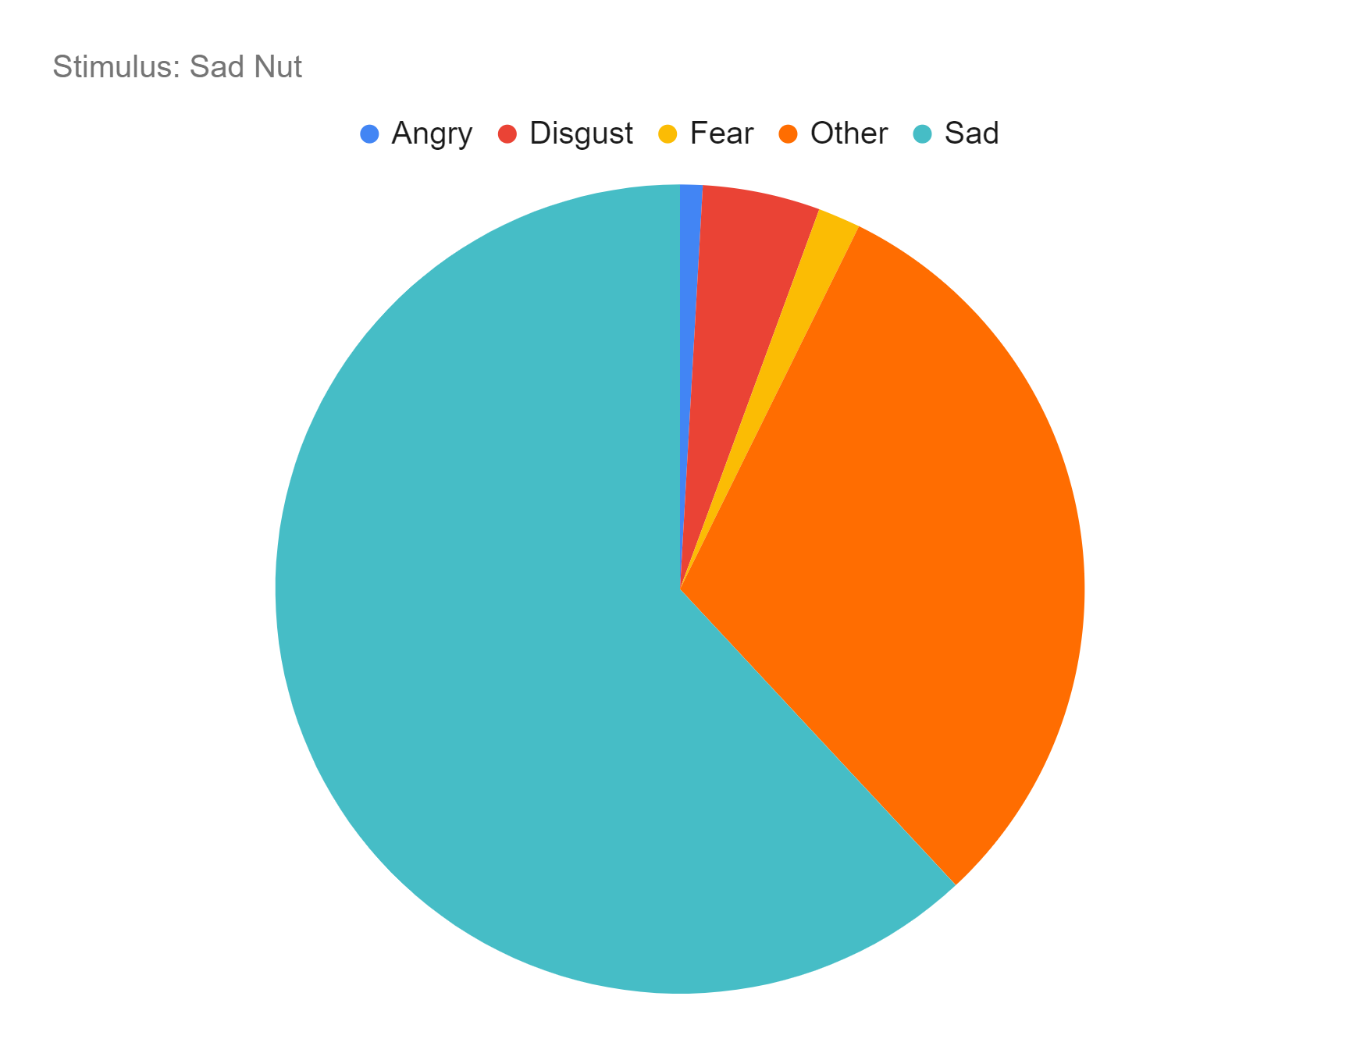
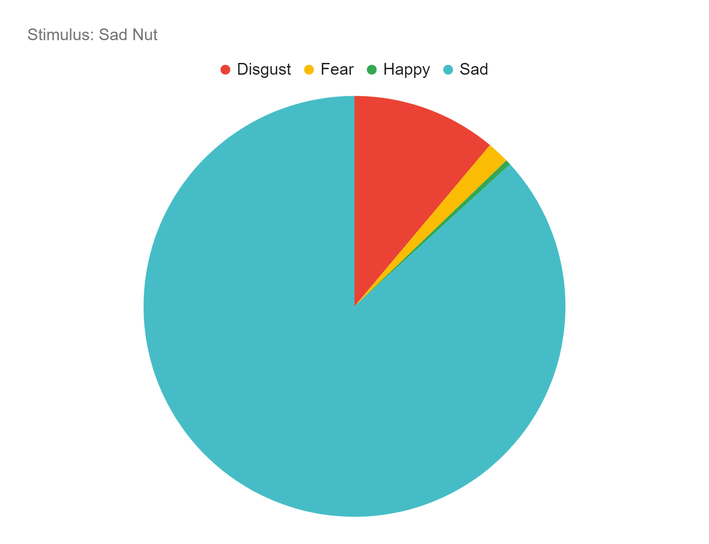
Results - Free Label versus Forced-Choice
Label consistency greater when choice restricted than when free labeling
Free-labeling: universal label stated by ≥ 50% of people for 6/15 of stimuli
Forced-choice: universal label selected by ≥ 50% of people for 14/15 of stimuli
Free label
Forced choice
Notes:
Another of our goals was to better understand how emotion perception may be dependent upon the way that people are asked to describe or categorize stimuli.
When comparing the results for free-labeling and forced-choice, we observed that consistency in label choice was greater when participants were limited in their response choices. In other words, forced choice tasks reinforce the universality of emotion perception. Clearly, though free-labeling demonstrates that there is much variability in what emotion is perceived.
For the sad walnut, the category word “sad” was selected far more often by participants than it was spontaneously offered during free labeling.

Slide 14
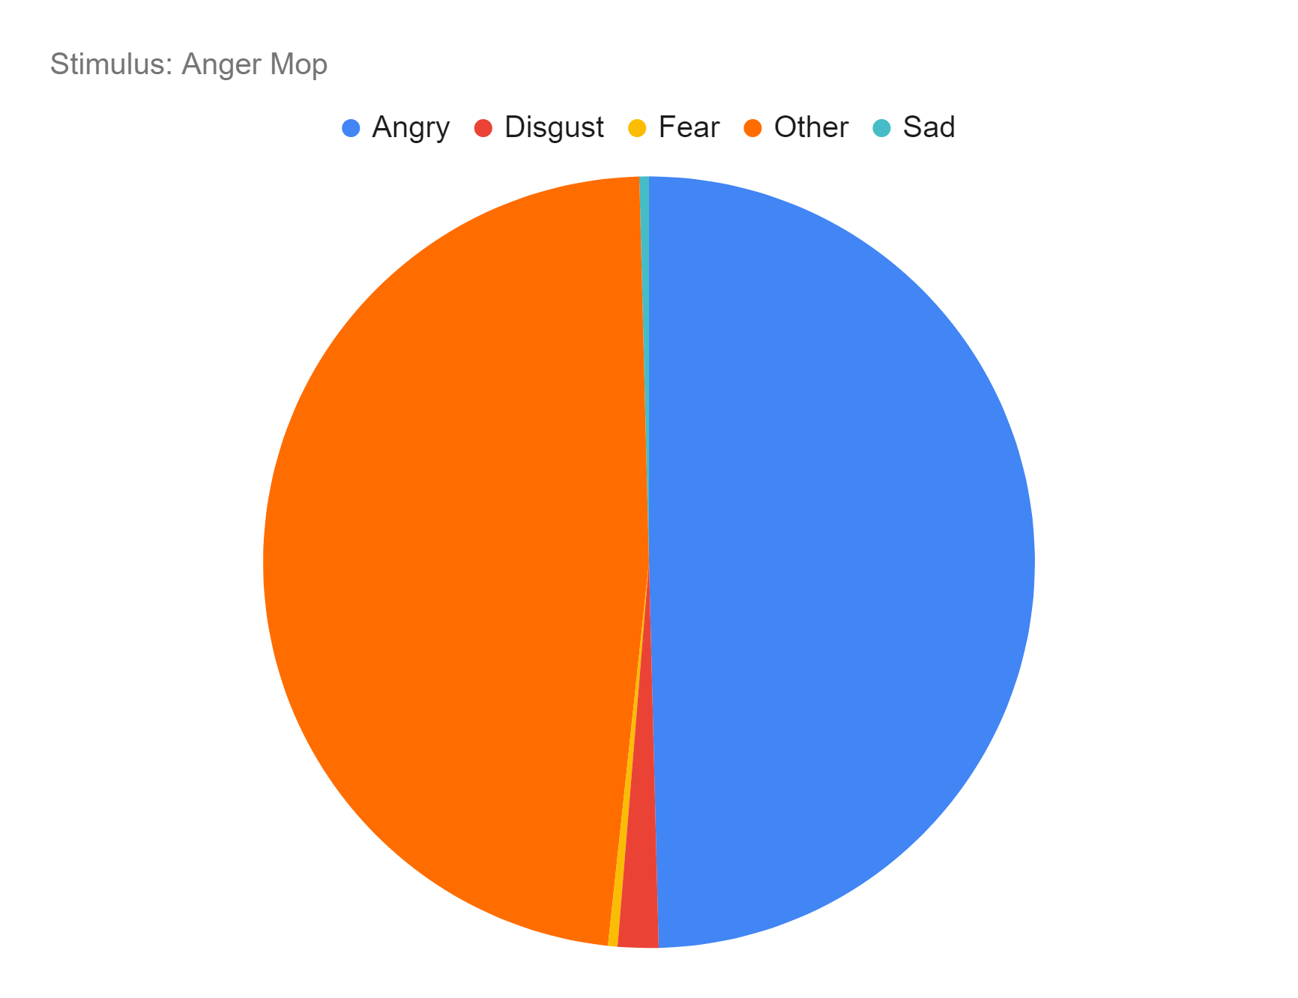
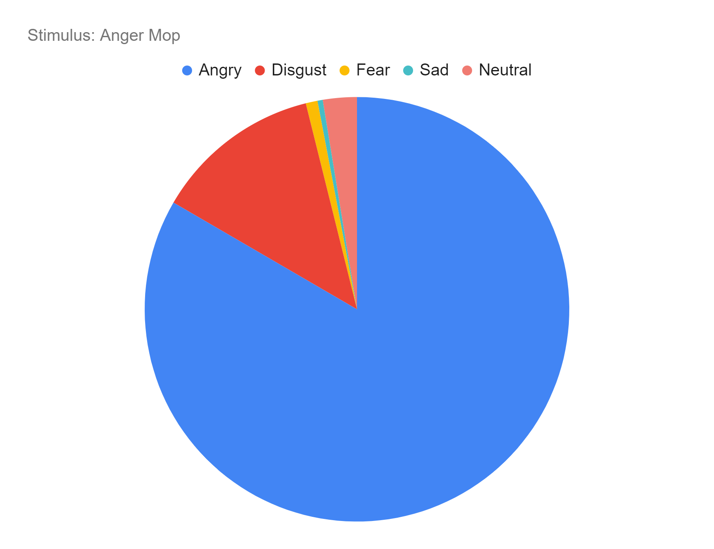
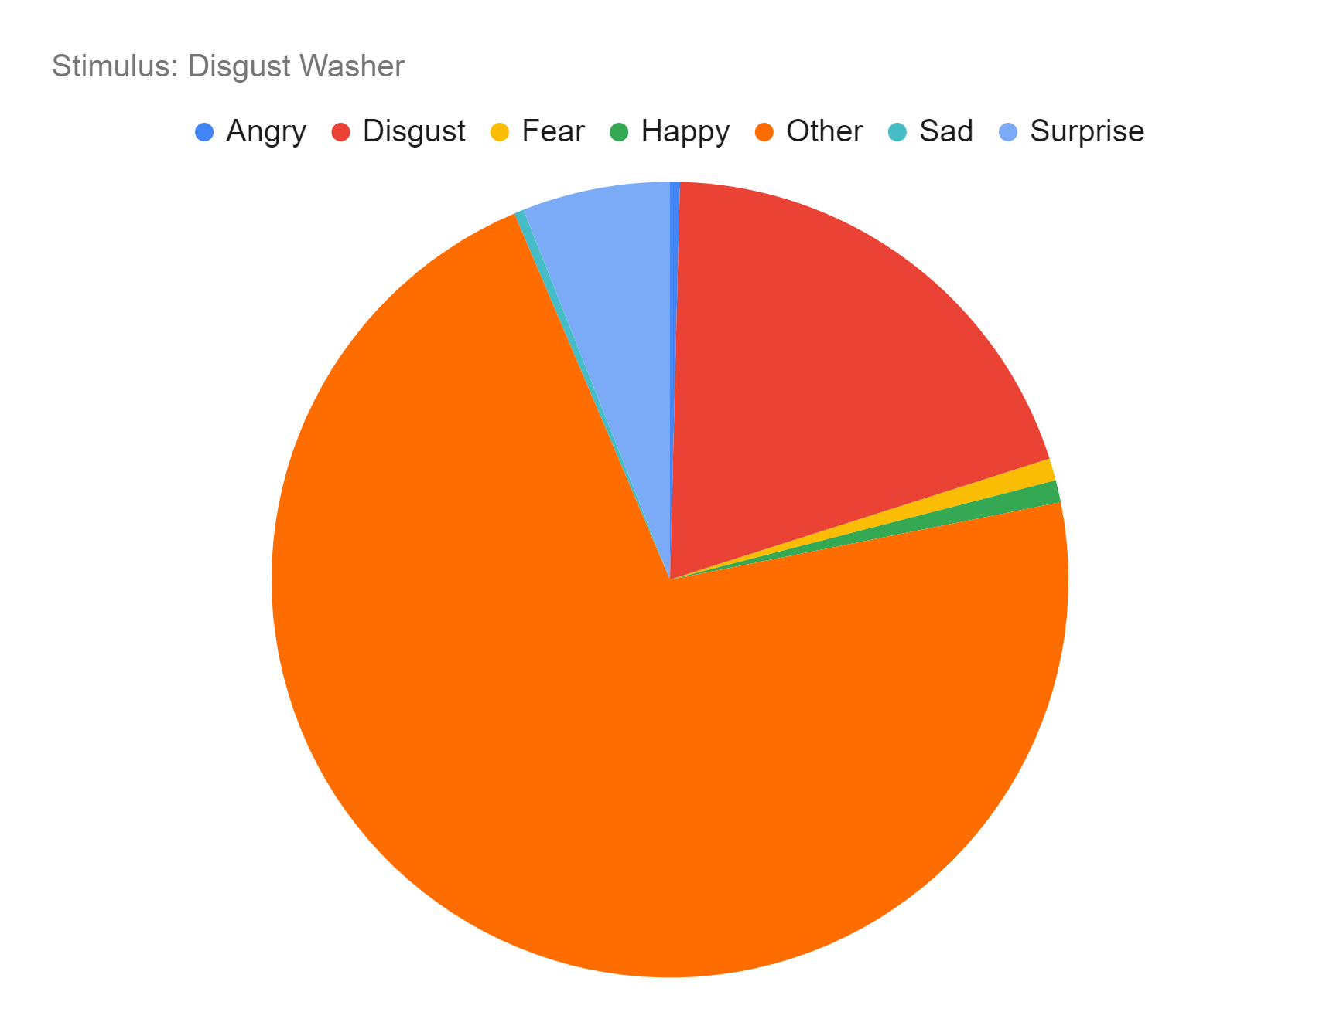
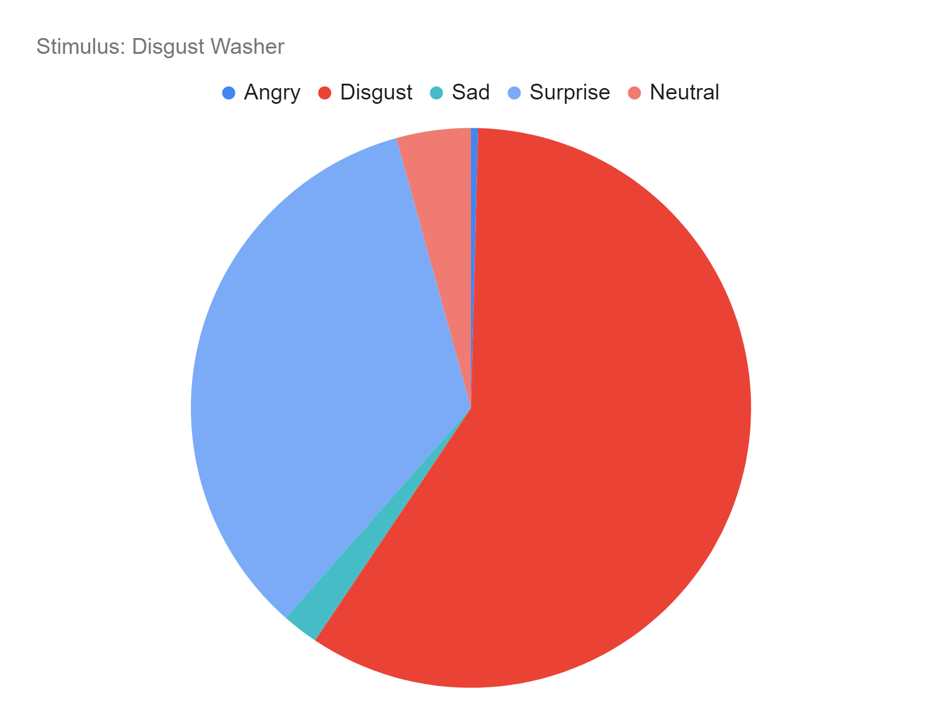
Results - Free Label versus Forced-Choice
Free label
Forced choice
Notes:
These are additional examples of how participants’ label choices varied based on whether they were asked to select a label or spontaneously generate one.
The mop stimulus was originally coded as “anger” in a pilot study. Here participants did spontaneously offer the angry label more often than any other label. However, in the forced-choice judgment task, the anger label jumped from being in play 50% of the time to being selected over 80% of the time.
The second image was originally coded as “disgust” in a pilot study. In the forced choice task, disgust was selected more frequently than other possible labels. But when participants were not constrained and freely offered their own label, the word disgust or a label clearly reflecting disgust was far less common.

Slide 15
Conclusions
Aging was not linked to an emotion perception deficit for pareidolia images
More years of age → greater verbal ability → use of a greater number of unique labels
Perhaps aging linked to perception of more distinct emotional subcategories
Using different terms to capture the same emotion suggests greater complexity in emotion perception, so perhaps past methods have underestimated older adults’ emotion perception skills
Providing emotion categories limits participants’ responses and may not reflect their genuine perception
When allowed to free label, the breadth of number of labels provided is greater
Labels freely given often outside “universal” categories, indicating categories create constraints
Notes:
Overall, age was not associated with an emotion perception deficit in this study.
In fact, with vocabulary mediating the relationship between age and number of labels, it may be that advanced age is associated with the perception of a greater number of distinct categories.
As we grow older in adulthood, our language for characterizing the emotional states of others becomes more nuanced, perhaps to account for a wider range of observed emotional states in our social partners.
The findings from this study suggest that past methods of examining emotion perception run the risk of underestimating older adults’ abilities.
Providing different labels for the same emotion may suggest more complex emotion perception abilities that are not uncovered using forced-choice tasks.
It does appear that providing participants’ with emotion categories constrains emotion perception.
During free labeling, participants provided a wider range of labels and these were often outside of the “universal” categories.

Slide 16
References
Barrett, L. F., et al. (2019). Emotional expressions reconsidered: Challenges to inferring emotion from human facial movements. Psychological Science in the Public Interest, 20(1), 1-68. https://doi.org/10.1177/2F1529100619832930
Ekman, P., & Cordaro, D. (2011). What is meant by calling emotions basic. Emotion Review, 3(4), 364-370. https://doi.org/10.1177/2F1754073911410740
Ekstrom, R. B., et al. (1976). Manual for kit of factor-referenced cognitive tests. Princeton, NJ: ETS.
Hayes, G. S., et al. (2020). Task characteristics influence facial emotion recognition age-effects: A meta-analytic review. Psychology and Aging, 35(2), 295-315. https://psycnet.apa.org/doi/10.1037/pag0000441
Kessels, R. P. C., et al. (2000). The Corsi block-tapping task: Standardization and normative data. Applied Neuropsychology, 7(4), 252-258. https://doi.org/10.1207/s15324826an0704_8
Omer, Y, et al. (2019). What is a face? Critical features for face detection. Perception, 48(5), 437-446. https://doi.org/10.1177/2F0301006619838734
Orgeta, V. (2010). Effects of age and task difficulty on recognition of facial affect. Journals of Gerontology B: Psychological Sciences, 65B(3), 323-327. https://doi.org/10.1093/geronb/gbq007
Radloff, L. S. (1977). The CES-D Scale: A self-report depression scale for research in the general population. Applied Psychological Measurement, 1(3), 385-401. https://doi.org/10.1177/2F014662167700100306

