Slide 1

Synthesis of a novel hydroxamate-Ru(II) complex and its promising photoluminescence properties
Kuntebommanahalli Thimmaiah*, Mark Montgomery,
T. Padma, Darrell Barnes, Ashish Pagare, Paul Grisham,
Lindsay Massie, Piya Adris, and Sarah Holt
Natural Science Division, Northwest Mississippi Community College, Desoto Center, Southaven, MS 38671

Slide 2
Introduction: The photochemical and photophysical properties of ruthenium complexes have been studied because of their use as photocatalysts, photosensitizers, photoelectochemical cells, chemiluminescent and electroluminescent systems. The properties of ruthenium complexes can be modified by using appropriate nitrogen donor ligands (pyridine (py), 2,2’-bipyridine (bpy), pyridazine (pyd), 1,10-phenonthrolein (phen), bipyrazine (bpz) and so on. Fluorescence quenching or enhancement is currently receiving a lot of attention in the light of its application in sensing cationic, anionic or neutral species. Ru(II) based complexes are highly fluorescent in nature, and show strong metal to ligand charge transfer absorption bands. In the present work, synthesis and fluorescence behavior of hydroxamate ruthenium complex and its use as an ON-OFF sensor for Cu²⁺ and Ni²⁺ have been studied with particular attention to the quenching mechanism.

Slide 3
Fluorescence Quenching
Collisional Quenching (dynamic) is observed with the collision of an excited state fluorophore and another molecule in solution (ions, oxygen, halogen, other fluorophores (self quenching)), which can undergo electron transfer, spin-orbit coupling, and intersystem crossing to the excited triplet state without chemical alteration, resulting in deactivation of the fluorophore and return to the ground state.
In Static Quenching, fluorophores form a reversible complex with the quencher molecule in the ground state, and does not rely on diffusion or molecular collisions.

Slide 4
Data analysis. The dynamic quenching process involves a collision between the fluorescent probe molecule in its excited state and a ground state quencher during the lifetime of the excited probe molecule according to the Stern-Volmer equation:
[Φ_{o} / Φ_{q}] = [F_{o}/F_{q}], where Φ_{o} and Φ_{q} refer to the fluorescence quantum yield in the absence and presence of the quencher, respectively. The ratio of the quantum yields is directly proportional to the ratio of the fluorescence intensity of the probe molecule in the absence (F_{o}) and presence (F_{q}) of the quencher.
This forms the basis for quantitative determination of a quencher analyte by fluorescence measurements based upon dynamic or static quenching.

Slide 5
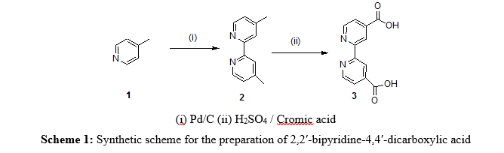
(1) 4-picoline
(2) 4,4’-dimethyl-2,2’-bipyridine
(3) 2,2'-bypyridine-4,4'-dicarboxylic acid

Slide 6
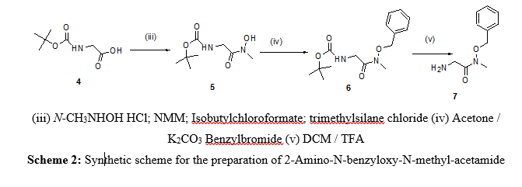
(4) N-(tert-Butoxycarbonyl)glycine
(5) [(Hydroxy-methyl-carbamoyl)-methyl]-carbamic
acid tert-butyl ester
(6) [(Benzyloxy-methyl-carbamoyl)-methyl]-carbamic
acid tert-butyl ester
(7) 2-Amino-N-benzyloxy-N-methyl-acetamide

Slide 7
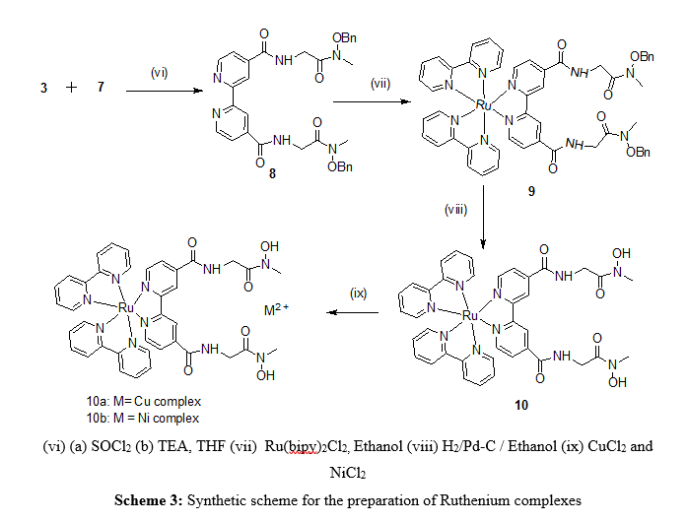
(8) Di-substituted Bipyridyl Compound
(9) O-Benzylated Ru (II) Fluorescent Probe
Hydroxamate-Ru (II) Fluorescent Complex
(10a) Hydroxamate-Ru (II)-Cu (II) Binuclear Complex (Quencher)
(10b) Hydroxamate-Ru (II)-Ni (II) Binuclear Complex (Quencher)

Slide 8
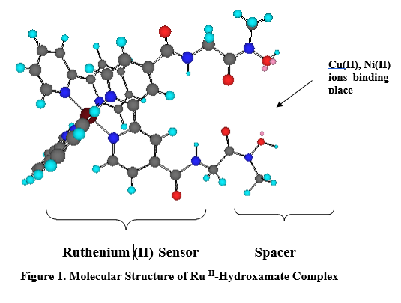


Slide 9
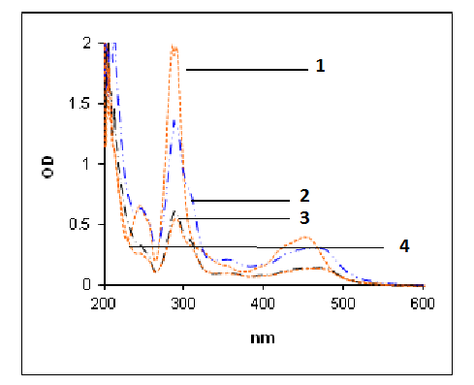
Absorption spectra of 10, 10a, and 10b:
Bands for 10, 10a, and 10b in 400-650 nm due to MLCT (metal-to ligand charge transfer) transitions.
Bands at 250-300 nm due to LC (ligand centered)
transitions of bipyridine
ligand.
The absorption coefficients of the binuclear complexes are more than that of mononuclear complex 10. This may be due to the involvement of Ni (II) and Cu (II) binding to Ru (II)-Hydroxamate complex.
Comparison of UV/Vis spectra of curve-1-[Ru (bipy)₃]Cl₂, curve-2 (compound 10), curve-3 (10a=Ru (II)-Ni (II) complex) and curve-4 (10b= Ru (II)-Cu (II) complex)

Slide 10
Absorption and Emission Spectral Data of
Ru (II)-Hydroxamate Binuclear Complexes

Slide 11
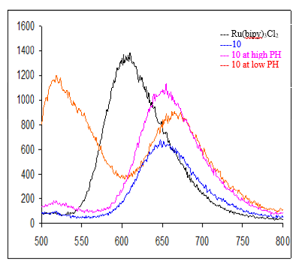
Comparison of Fluorescence Spectra

Slide 12
Emission Spectral Data
At higher pH (~12), the oxygen of hydroxamate group is deprotonated and comp10 showed different fluorescent spectra compared to neutral pH condition. When comp10 was excited at 450 nm the emission wavelength appears at 653nm. The fluorescence of [Ru(bipy)₃]Cl₂ is three times intense than comp10. This may be due to the deprotation of the hydroxamate group. Where as at low pH, the emission λ_{max} showed bathochromic shift toward 667 nm. This shows that fluorescence of the comp10 depends on the pH of the solution.

Slide 13
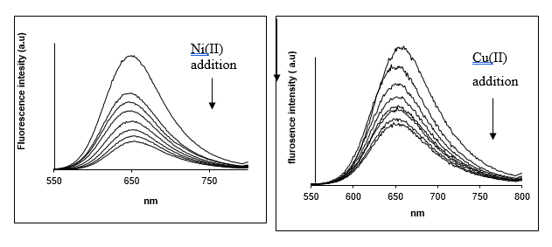
Cu (II) and Ni (II) Ions Quench the Fluorescence of Ru (II)-Hydroxamate Complex (Titration)
Gradual quenching of 10 by Cu (II).
First quenching is very fast by Ni (II) (nearly half of fluorescence). Later, gradual and uniform quenching.
Suggests that there is a possible electron transformation between two metal centers.

Slide 14
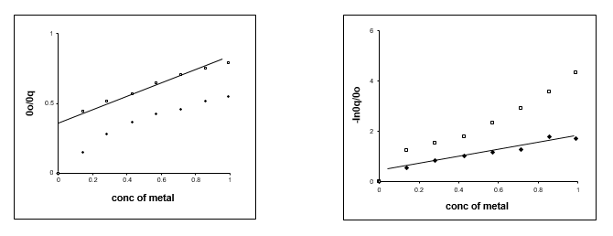
Plots of Dynamic Quenching (left) and Static Quenching (right) of compd 10 with Cu (II) (♦) or Ni (II) (□)
Quenching was compared with two well known models:Stern-Volmer (Dynamic) and Perrin (Static) models. The models suggest whether the quenching is intermolecular or intramolecular. The φ₀/φ_{q} of 10a and 10b was measured from graph and it is clear that in case of Ni (II), the stern-Volmer model was observed revealing quenching of metal to ligand intermolecularly. Whereas –ln φ_{q}/φ_{o} ratio suits for Cu (II) binding 10 according to Static quenching, an intramolecular one.

Slide 15
Conclusions
Synthesized highly fluorescent Ruthenium based hydroxamate receptor complexes.
Binding of complex with Cu (II) and Ni (II) ions strongly quench the fluorescence of the Ruthenium complex.
Ni (II) ions follow dynamic quenching model, whereas Cu (II) ions follow static quenching models.
Quenching is due to electron or energy transformation between two metals.
The fluorescent hydroxamate base Ru (II) complex behaves as an ON-OFF sensor (switch) for Cu (II) and Ni (II) ions.

