Slide 1

Lunar Eclipse Around the World: A Collection of Zenith Sky Brightness Curves
Kevin Adkins
Jennifer Birriel
Morehead State University
Dept. of Physics, Earth Science and Space Systems Engineering
Notes:
Give a short summary of what we discussed last year: Lunar eclipses can be investigated using the Unihedron SQM, and then dive right into what I’ll discuss today:
Understanding variations of the eclipse across the world (Geography, weather, etc.)
Measurements to make: length, umbral diameter, etc.
Eclipses are great for the classroom!

Slide 2
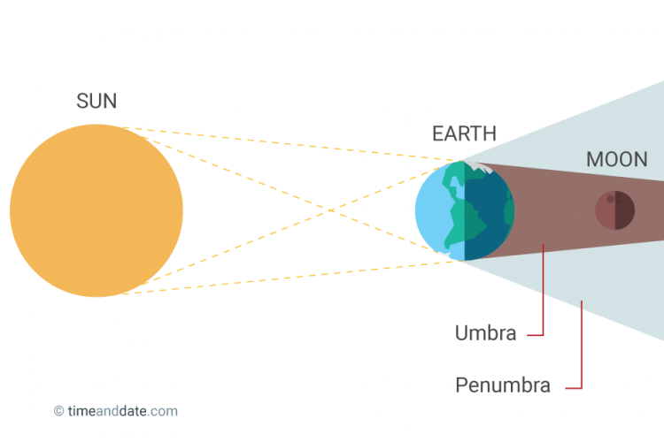

Lunar Eclipses…
… are interesting laboratories!
First, the anatomy of an eclipse:

Slide 3
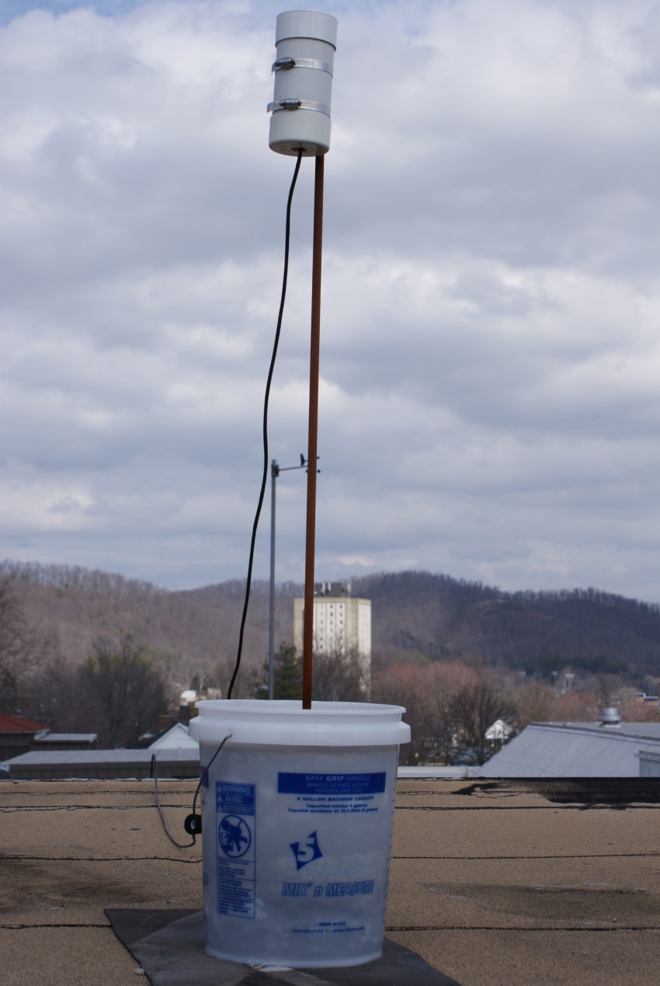
Data Collection with an SQM
Unihedron Sky Quality Meters have multiple advantages:
  Reasonably priced and portable
  Quick readings
Automated models take readings at user-defined intervals!
  -LE, -LU
  Powered by and transfers data by Ethernet or USB
  Data is ready for plotting as it comes from the SQM

Slide 4

Example Data (2014)
SQM reads in MPSAS, an inverse scale: higher is darker
Data plotted intuitively, downward on the plot shows a decrease in brightness
These data extracted from historical plots using WebPlotDigitizer

Slide 5
A Call for Data
January 20-21, 2019 was a total lunar eclipse
Put out a call for lunar eclipse SQM zenith sky brightness (ZSB) data from this eclipse
Received data from 10 new sites!
  California (1)
  San Luis Potosi, Mexico (1)
  Ontario, Canada (1)
  Chile (1)
  Barcelona, Spain (2)
  Veneto, Italy (4)
For all, the total eclipse was supposedly fully visible
Look at the qualitative features of the data first

Slide 6

Eclipse phases labeled on the plots
Curve follows our intuition
Bumps are supposed passing clouds
  Could be understood with all-sky imagery

Slide 7
Weather Effects

Slide 8
Lunar Altitude Effects

Slide 9


Slide 11
Measurement: Eclipse length
Look at duration of U2-U3 eclipse phases
The predicted length of the eclipse was 62 minutes
Many sites do not agree with the time of totality!
Why?
  Bad weather
  Didn’t actually see the full eclipse as advertised?!
An interesting activity for students to start thinking about measurement
Location | Measured Length (min)
Borrego Springs, CA, USA | 80
San Luis Potosi, Mexico | 75
Morehead, KY, USA | 65
Grimsby, Ontario, Canada | 95
La Silla Observatory, Chile | 70
COU Station, Lleida, Spain | 75
Montseny, Barcelona, Spain | 65
Monte Baldo, Veneto, Italy | 50
Montebello, Veneto, Italy | 75
Cima Ekar, Veneto, Italy | 60
Passo Valles, Veneto, Italy | 35
*All measurements have a conservative ±8 min. uncertainty

Slide 12
Totality Brightness Comparison
The brightness at totality depends on a number of factors
  Weather and light pollution
Totality brightness should resemble a clear new moon night
  Clouds increase light pollution brightness
Excellent agreement between sites that are clear!
Location | Totality (mpsas) | New Moon (mpsas)
San Luis Potosi, Mexico | 19.6 ± 0.1 | 19.4 ± 0.3
Morehead, KY, USA | 19.1 ± 0.1 | 19.3 ± 0.3
La Silla Observatory, Chile | 21.8 ± 0.1 | 22.0 ± 0.3
COU Station, Lleida, Spain | 21.3 ± 0.1 | 21.7 ± 0.4
Montseny, Barcelona, Spain | 21.3 ± 0.1 | 20.8 ± 0.7
Monte Baldo, Veneto, Italy | 20.6 ± 0.1 | 20.6 ± 0.3
Passo Valles, Veneto, Italy | 20.9 ± 0.1 | 21.3 ± 0.3
*±0.3 mpsas uncertainty applied to account for seasonal variations
*Spain has long-term observations with uncertainty

Slide 13
Umbral Shadow
Estimating the size of Earth’s shadow is a simple calculation during an eclipse, we need:
  The time to travel one full lunar diameter
  The time to travel through Earth’s entire shadow
We have all of these on the plot!

Slide 14
Umbral Shadow Cont.
Average for a “central” eclipse: D_{umbra} = 2.65D_{moon}

Slide 15
Umbral Shadow Comparison
Using all locations where reasonable measurements can be made, we have good agreement
Average value is much lower than known umbral diameter, why?
  This eclipse was not central!
  Denominator is too large
A data-driven way for students to learn uncertainty propagation and measurement
Location | Measured Ratio
Borrego Springs, CA, USA | 2.2 ± 0.3
Morehead, KY, USA | 1.9 ± 0.3
La Silla Observatory, Chile | 2.0 ± 0.2

Slide 16
Conclusions & Future
The data here start to fill a gap in photometry of lunar eclipses
The qualitative features are very interesting when comparing various geographic locations
Future observing campaigns should include all-sky imaging and weather data
These plots can be useful for classrooms at all levels that can be as involved as an instructor wants it to be:
  Measurement and uncertainty
  Error propagation
  Size of Earth’s shadow

Slide 17

References
Timeanddate.com
https://www.timeanddate.com/eclipse/total-lunar-eclipse.html
Birriel, J.J. and Adkins J.K. “Estimating the size of Earth’s umbral shadow using sky brightness light curves during a lunar eclipse,” Am. J. Phys., 87, 994 (2019)
Birriel, J.J. and Adkins, J.K. “Sky Brightness at Zenith During the January 2019 Total Lunar Eclipse,” J. Amer. Assoc. Var. Star Obs., Vol 47, No. 1 (2019)
Birriel, J.J., Adkins, J.K., Bertolo, A., Ehlert, R., McKeag, M., Ribas, S.J., Tekatch, A., “A Gallery of Sky Brightness Curves from the January 2019 Total Lunar Eclipse,” J. Amer. Assoc. Var. Star Obs., Vol 48, No. 1 (2020)

Slide 18
Location | Visible Eclipse Phases | SQM Interval (min) | Device Type
Borrego Springs, CA, USA | P1 – P4 | 0.5 | SQM-LU
San Luis Potosi, Mexico | P1 – P4 | 5.0 | SQM-LE
Morehead, KY, USA | P1 – P4 | 2.0 | SQM-LE
Grimsby, Ontario, Canada | P1 – P4 | 5.0 | SQM-LE
La Silla Observatory, Chile | P1 – P4 | 3.0 | SQM-LE
COU Station, Lleida, Spain | P1 – U4 | 0.7 | SQM-LE
Montseny, Barcelona, Spain | P1 – U4 | 0.8 | SQM-LE
Monte Baldo, Veneto, Italy | P1 – U4 | 5.0 | SQM-LE
Montebello, Veneto, Italy | P1 – U4 | 5.0 | SQM-LE
Cima Ekar, Veneto, Italy | P1 – U4 | 5.0 | SQM-LE
Passo Valles, Veneto, Italy | P1 – U4 | 5.0 | SQM-LU

Slide 19
Non-Central Lunar Eclipse

