Slide 1
Abiotic factors, not mycorrhizal associations, are strong predictors of growth and abundance of the invasive grass Microstegium vimineum.
Kimberly Koenig & Dr. Sarah Emery
University of Louisville
Biology Department

Slide 2
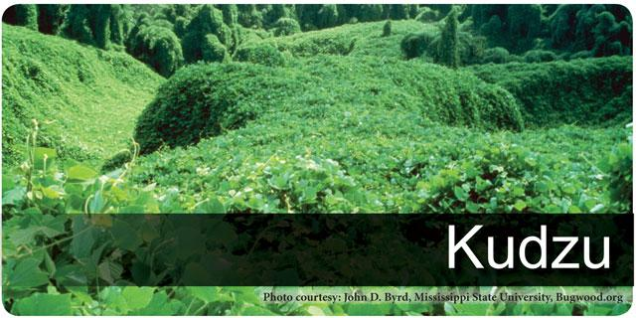
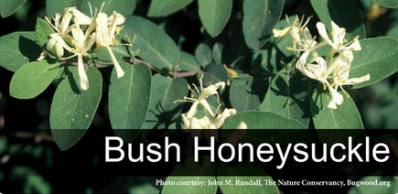
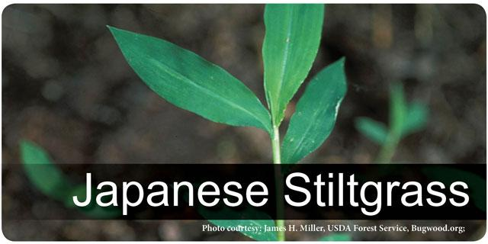
Invasive Species
Non-native to the ecosystem
Causes economic or environmental harm
forestry.ca.uky.edu
Impacts: (Droste et al. 2010)
Reduce native plant diversity
Alter ecosystem processes
Change physical features of habitats
forestry.ca.uky.edu
forestry.ca.uky.edu

Slide 3
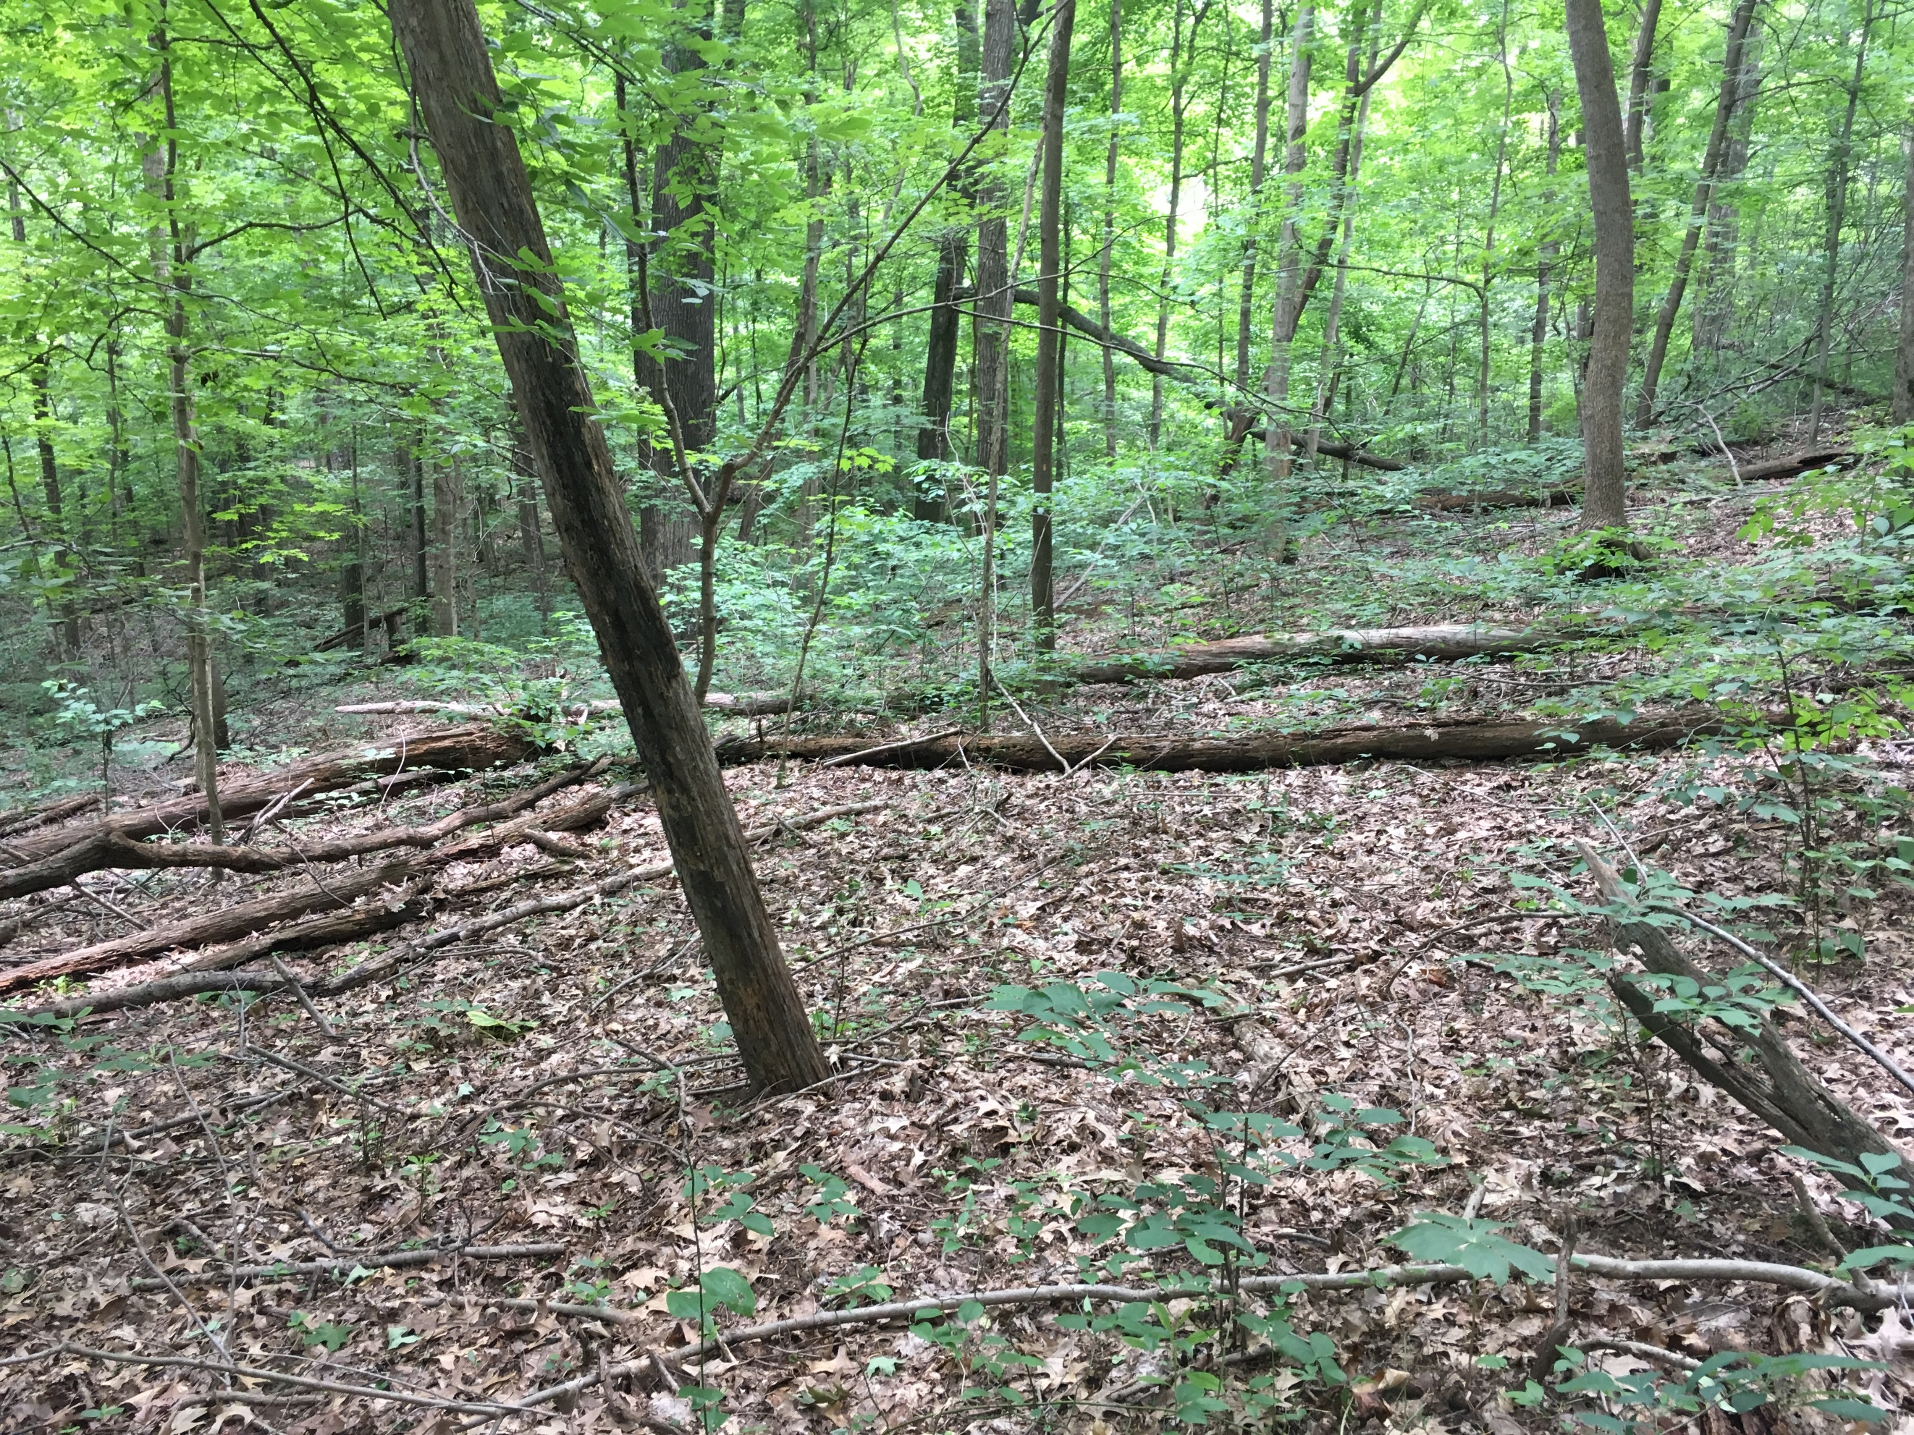
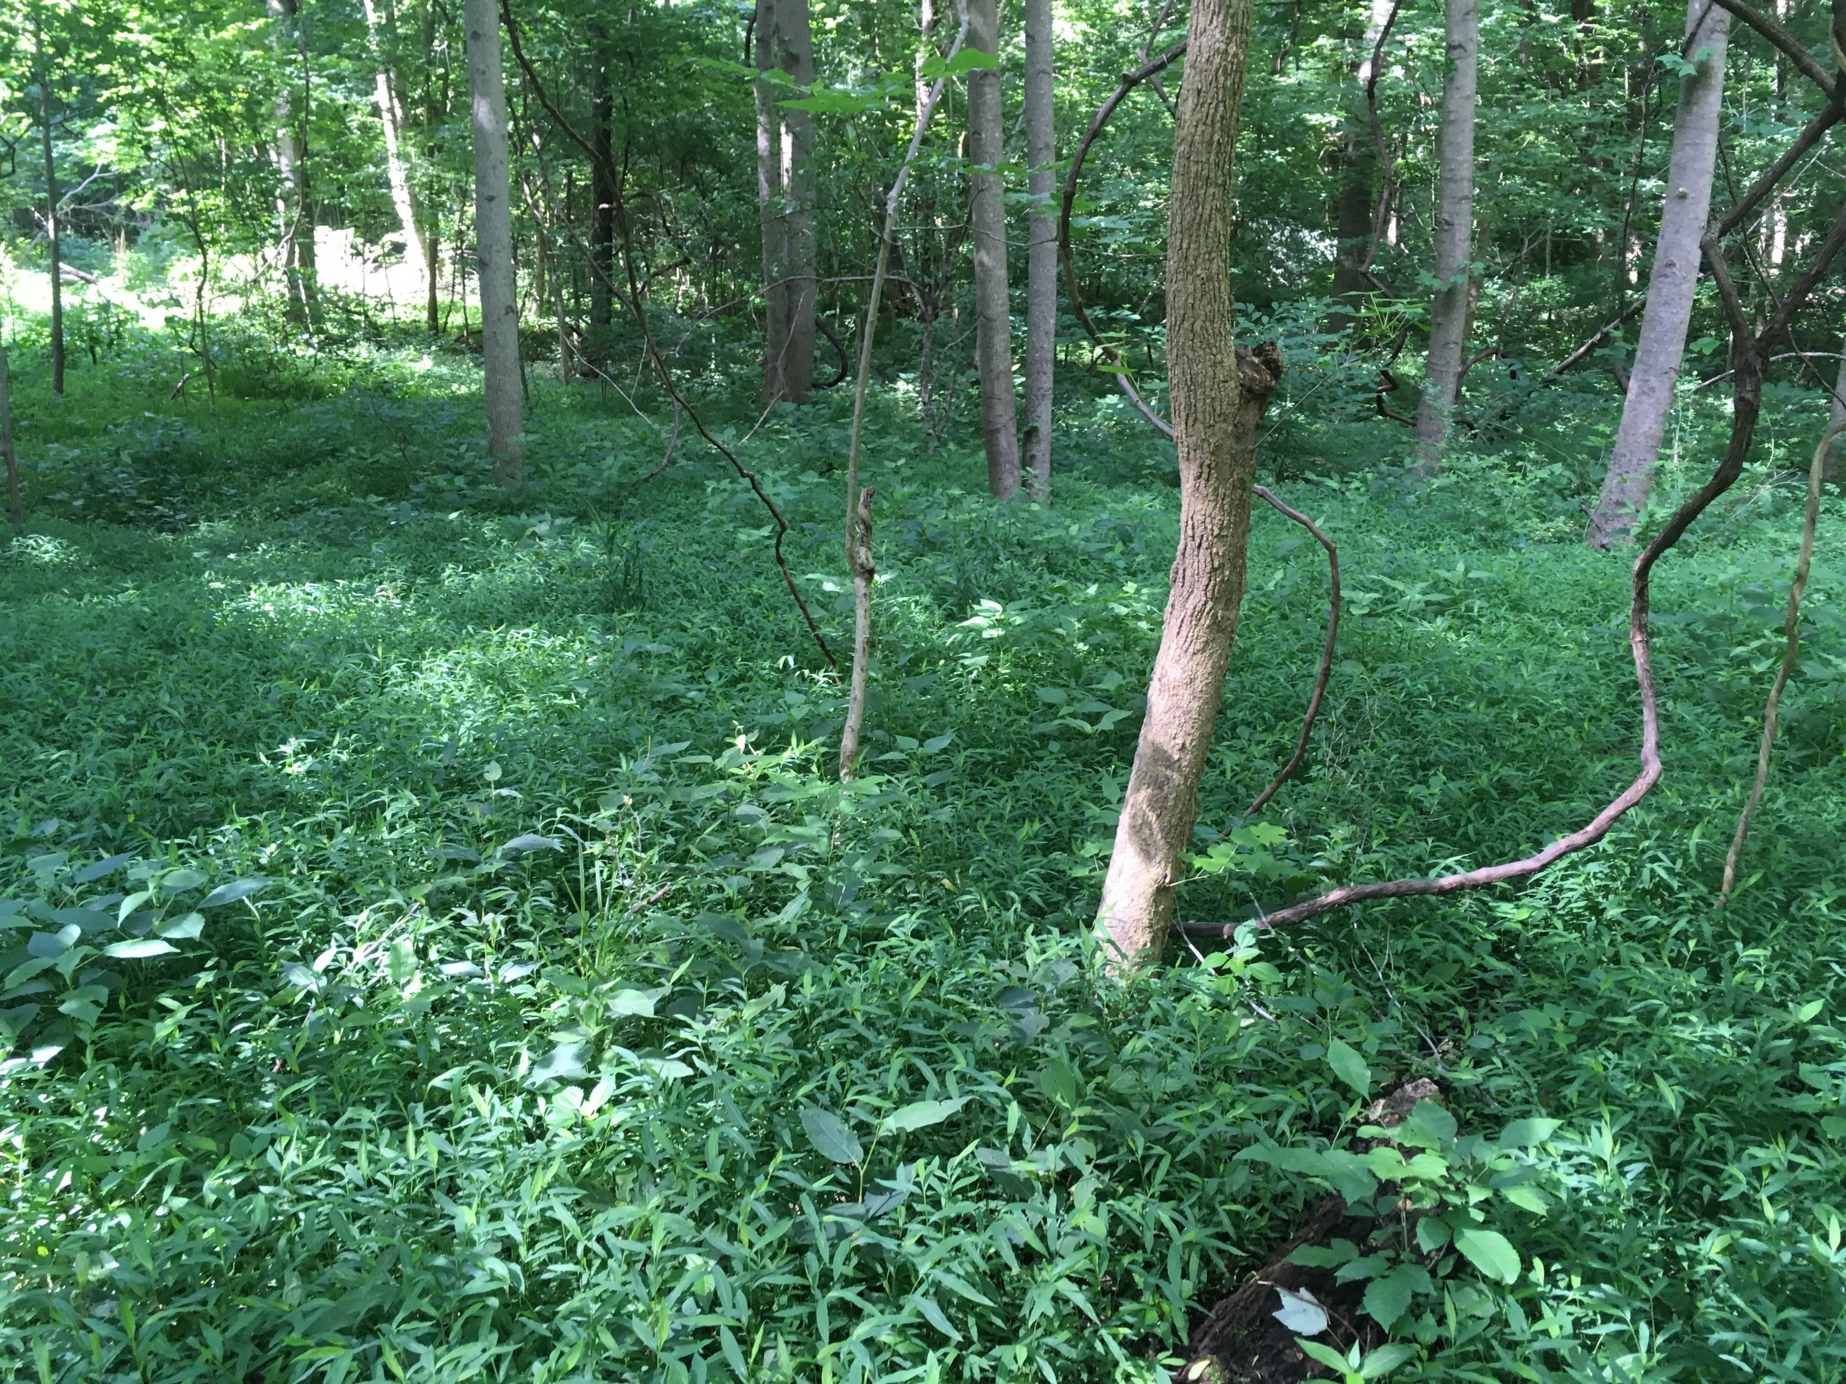
Noninvaded
Oak-Hickory Forest
Invaded
Oak-Hickory Forest

Slide 4
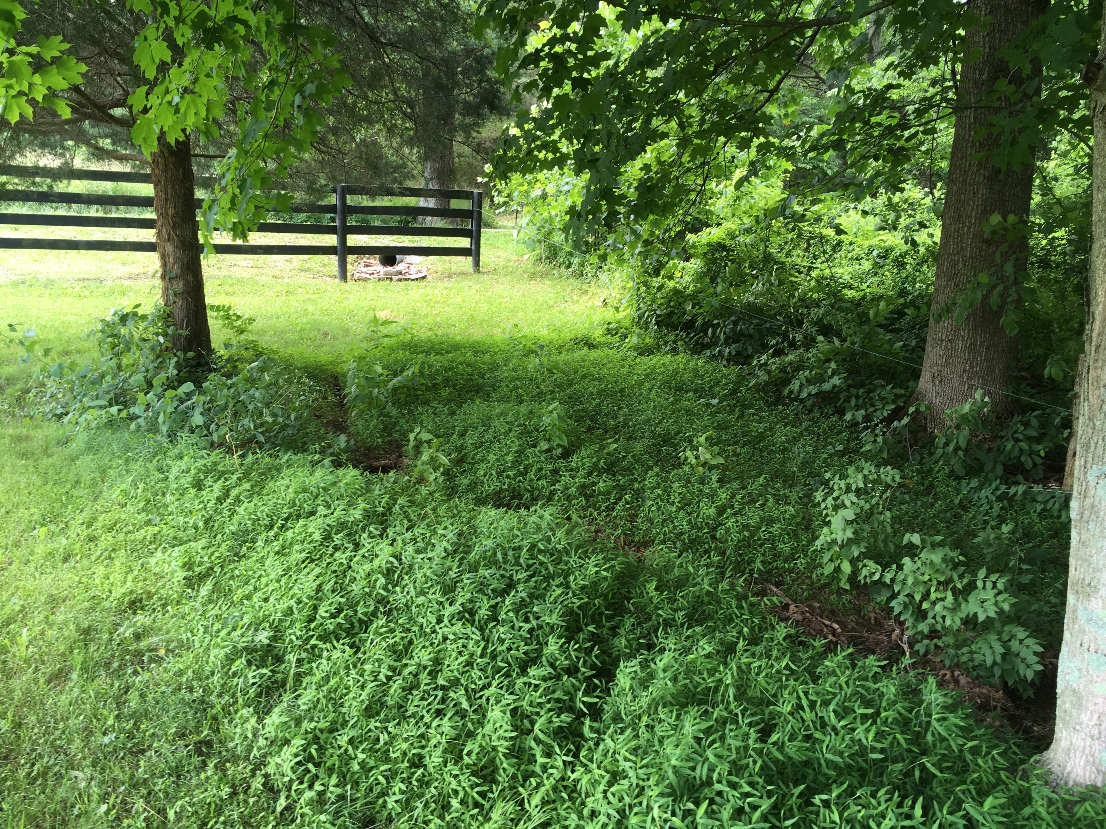
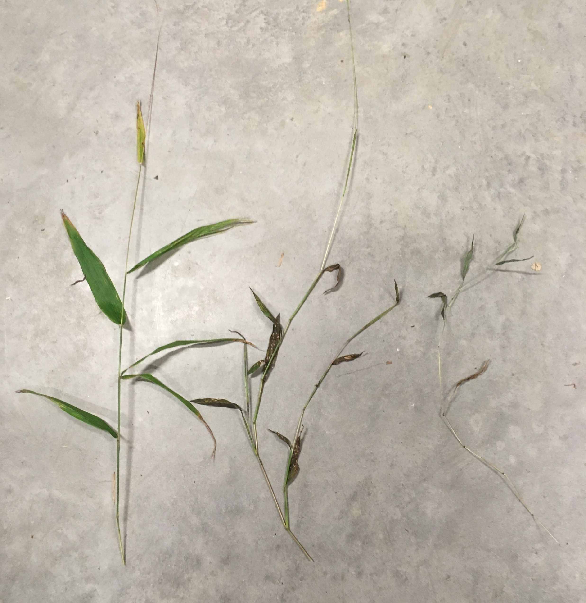
Abiotic factors facilitating invasion spread:
Microstegium habitat preferences:
high light
soil moisture
basic pH
disturbance
Differences in growth traits across light gradients:
L: forest interior
M: edge (full sun)
R: edge (full shade)

Slide 5
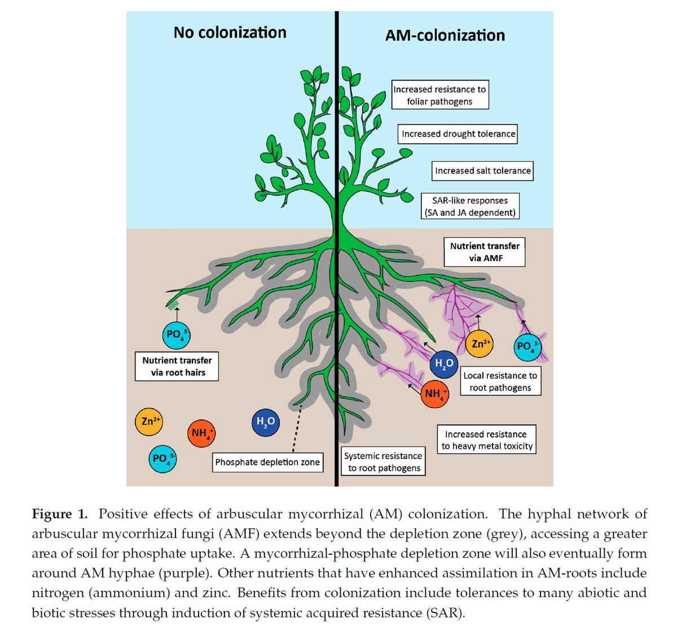
Arbuscular Mycorrhizal Fungi (AMF)
symbiosis between plant root and fungal species
evolved with land plants 460 mya
(Rua et al. 2016))
(Jacott et al. 2017)

Slide 6
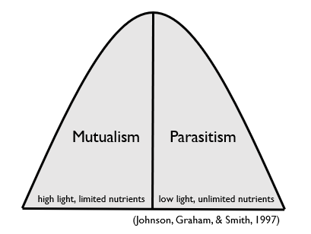
Continuum of Mycorrhizal Associations
Mutualism
benefits to plant outweigh costs
limited nutrients: increased nutrient uptake increases biomass and reproduction
high light: plenty of photosynthate to allocate to AMF
Parasitism
costs to plant outweigh the benefits
fertilization eliminates nutrient limitation so AMF becomes superfluous and inhibiting
low light limits photosynthetic abilities so allocation to AMF restricts growth and fitness

Slide 7
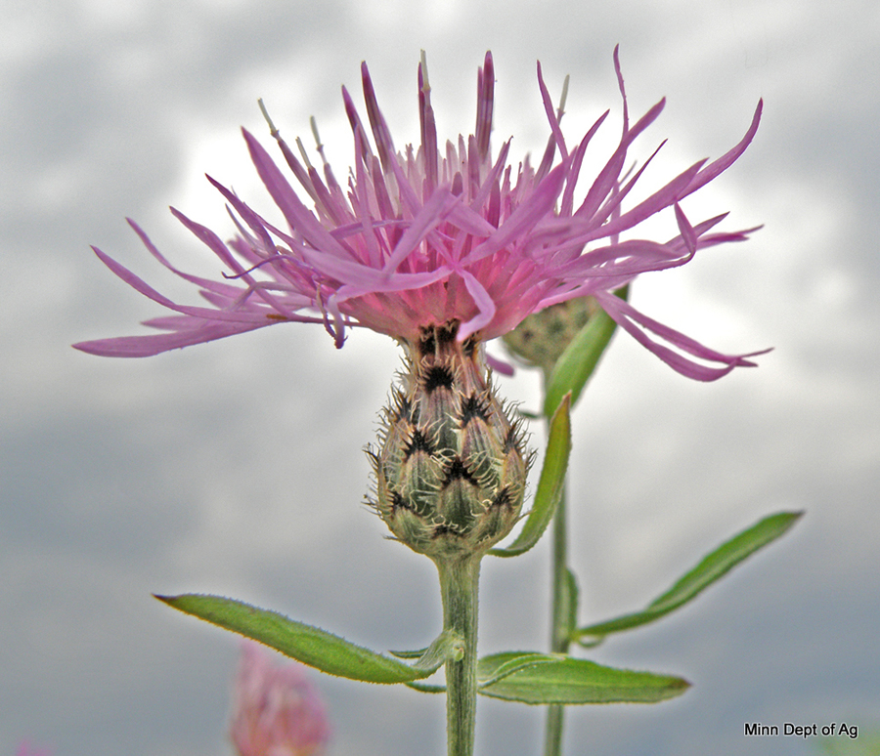
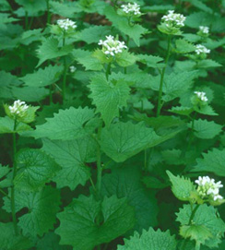
Arbuscular Mycorrhizal Fungi (AMF) & Plant Invasion
Spotted Knapweed
Garlic Mustard
https://www.mda.state.mn.us/plants
https://dnr.wi.gov

Slide 8
Questions
Which biotic and/or abiotic factors contribute to Microstegium invasion?
Q1: Do invaded soils contain more AMF ERH than native soils?
H1: Microstegium invaded soils will have higher mycorrhizal extraradical hyphal (ERH) abundance.
Q2: Does soil AMF abundance and Microstegium root colonization by AMF vary across abiotic gradients?
H2: Soil AMF ERH abundance and AMF root colonization of Microstegium will be higher in stressful environments.
Q3: Which biotic or abiotic factors best predict Microstegium cover
and growth traits of specific leaf area (SLA) and tiller height?
H3: Microstegium abundance will be higher in areas with less canopy cover and higher soil moisture.
Average specific leaf area (SLA) will be higher in low light and average tiller height will be higher in high light.

Slide 9
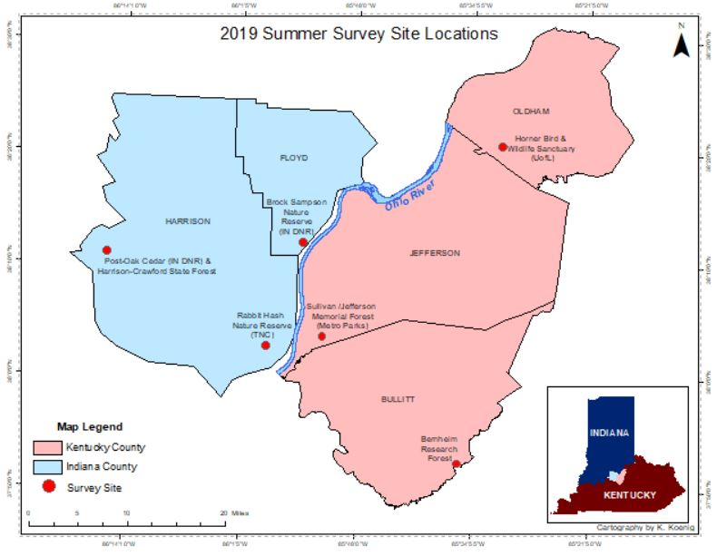
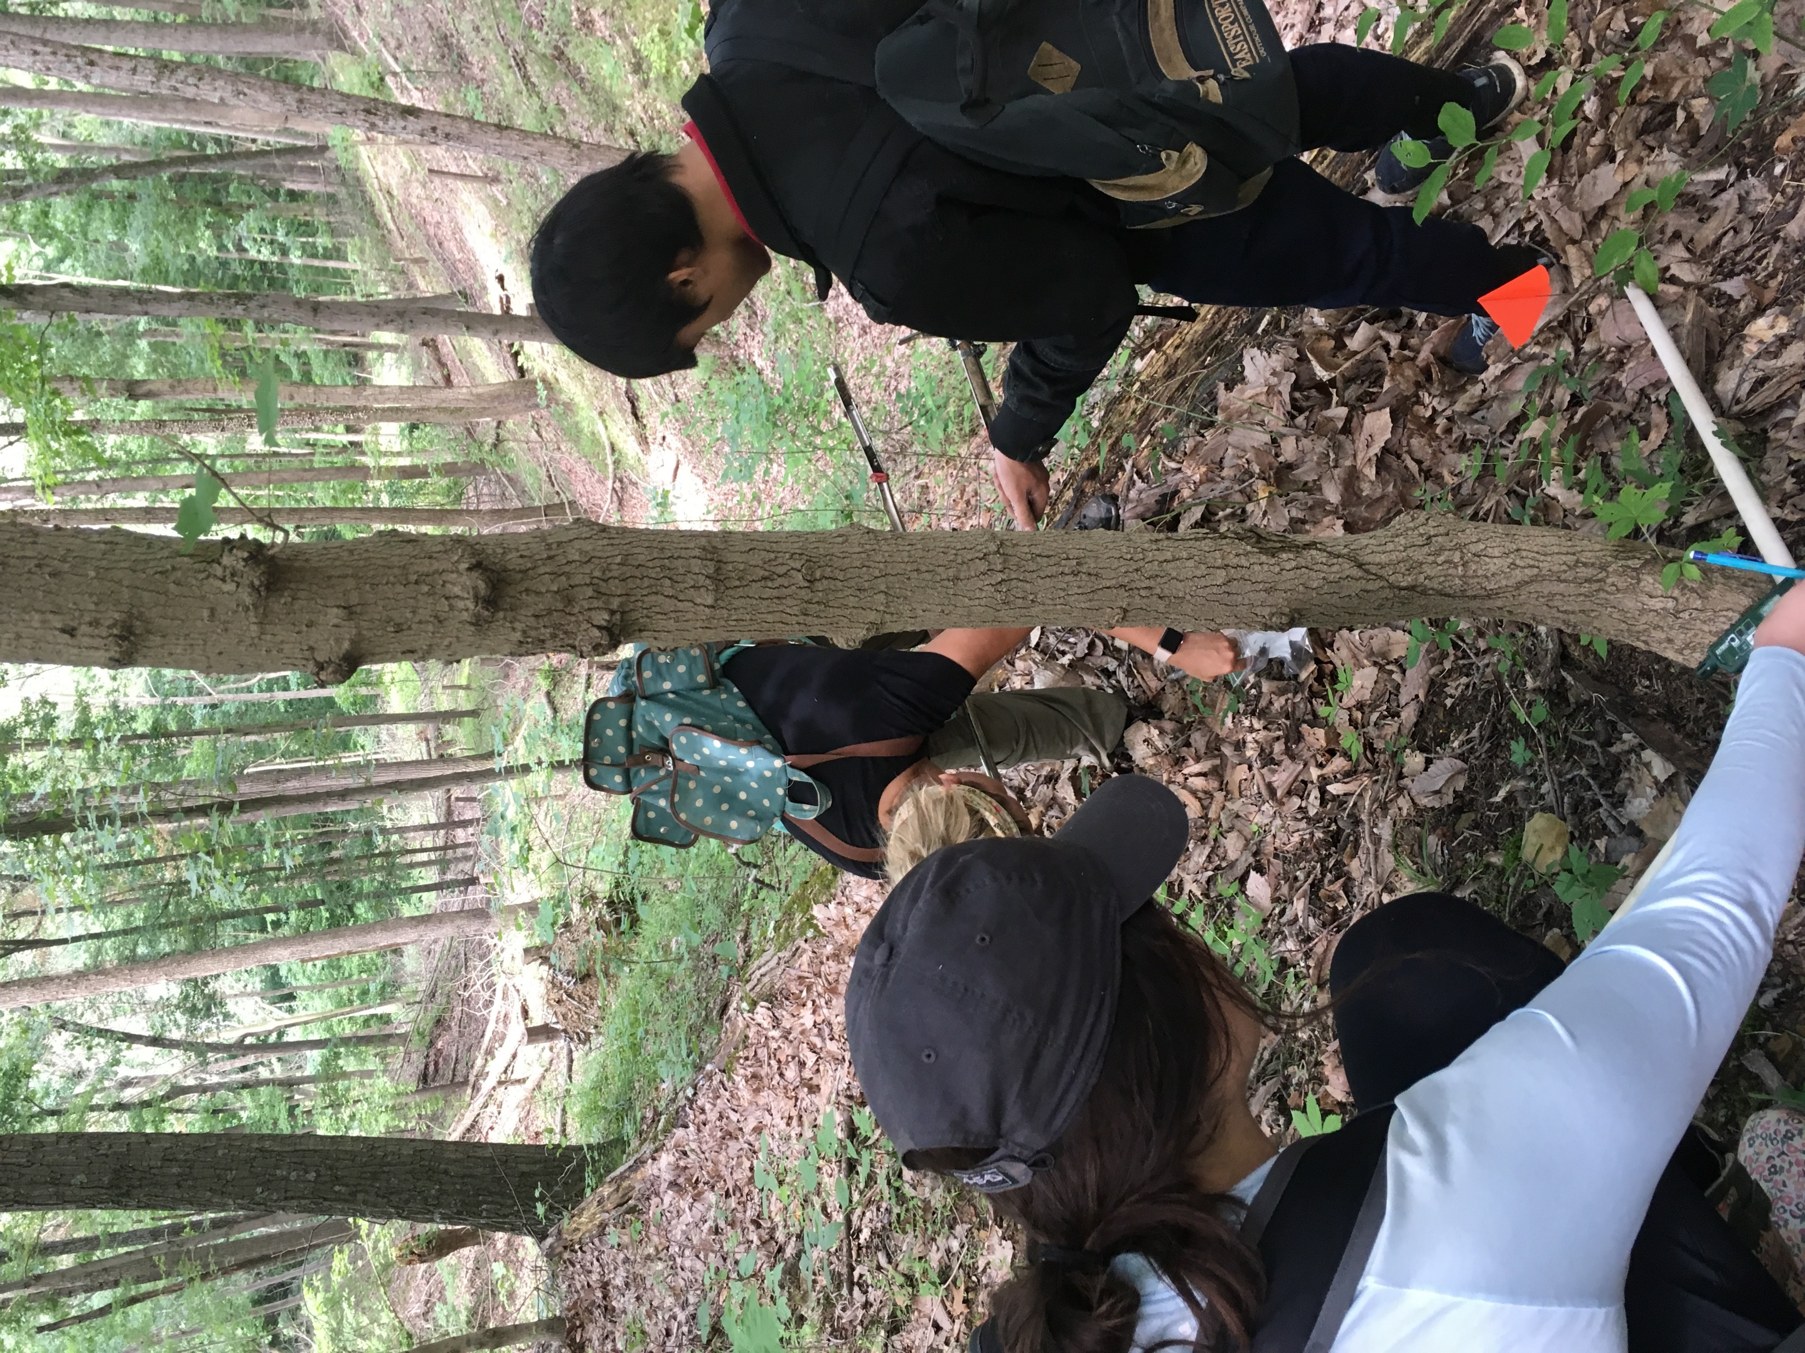
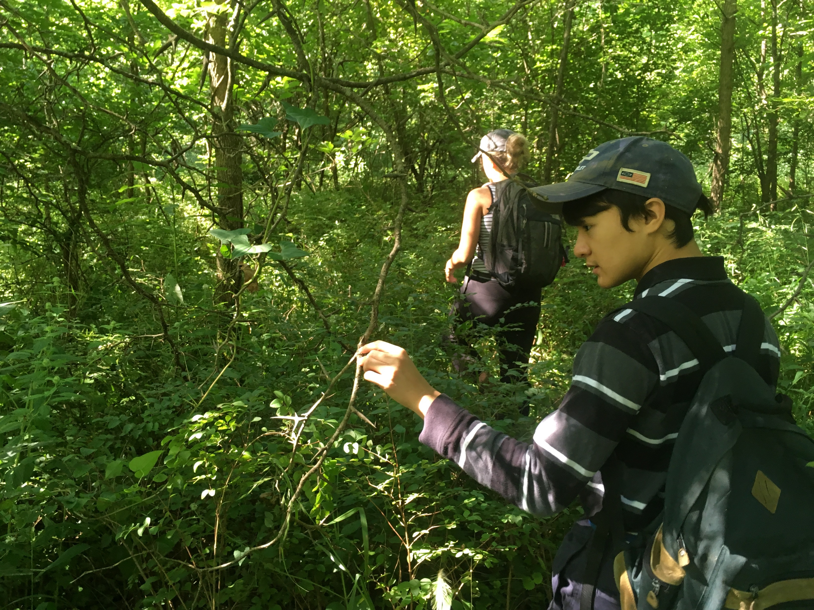
Research Sites:

Slide 10
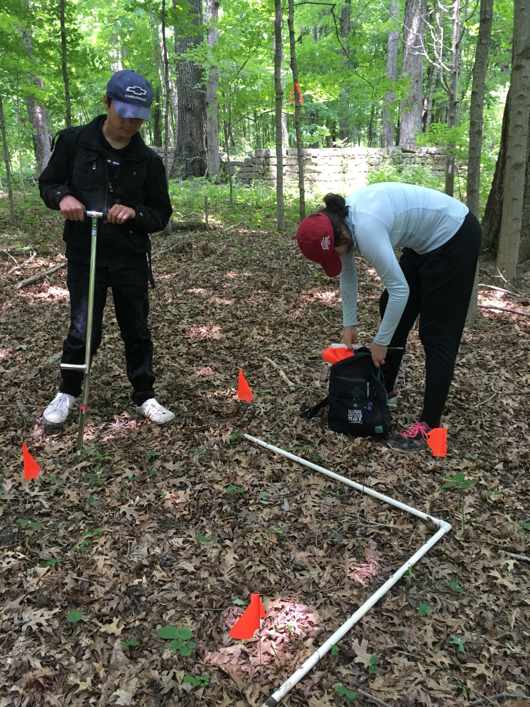

Slide 11
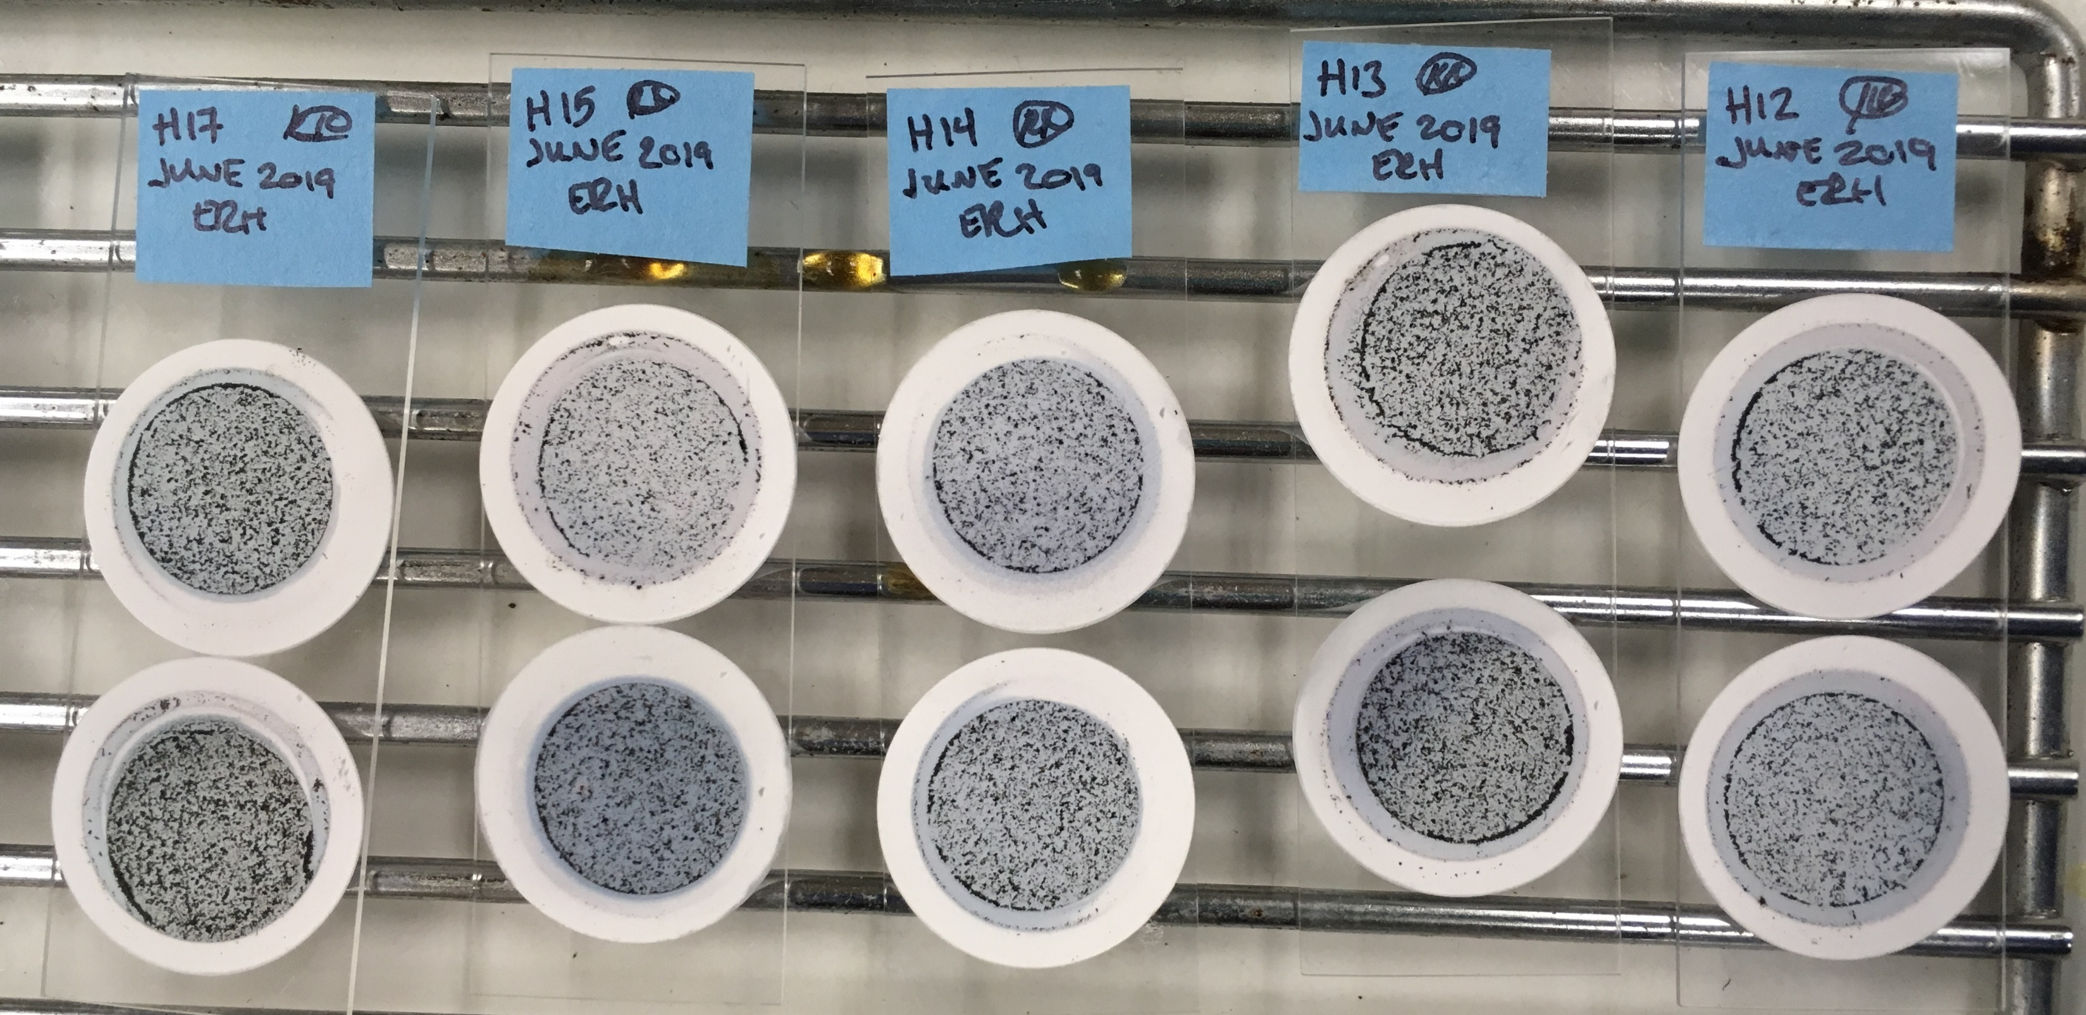
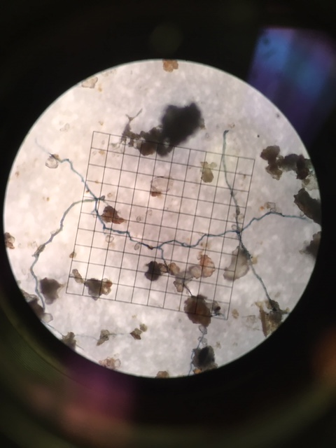
Data Collected:
Plot measures:
elevation, slope, aspect
Abiotic measures:
canopy cover (%)
soil moisture content
soil nutrient analysis: pH, N, P, etc.
Microstegium data:
percent cover
average specific leaf area
average tiller height
Fungal data:
soil extraradical hyphal (ERH) density
Microstegium root % AMF colonization
(Emery and Rudgers 2014; McGonigle et al. 1990)

Slide 12
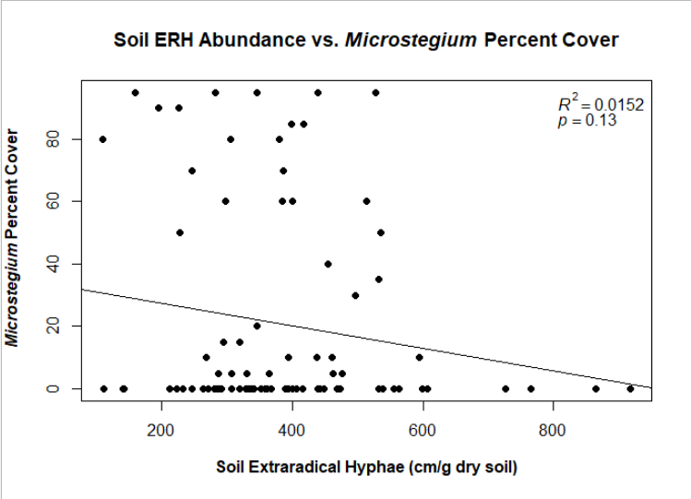
Q1: Do invaded soils contain more AMF ERH than native soils?
H1: Microstegium invaded soils will have higher abundance of mycorrhizal extraradical hyphal (ERH) colonization.
Conclusion:
Not supported, ERH does NOT vary between invaded and noninvaded soil.
Results do not support the enhanced mutualism hypothesis.

Slide 13
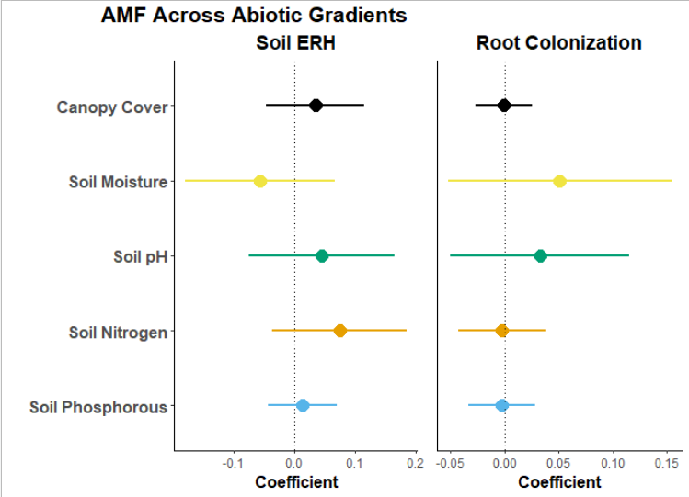
Q2: Does soil AMF ERH abundance and Microstegium root colonization by AMF vary across abiotic gradients?
H2: Soil AMF extraradical hyphal (ERH) abundance and root colonization of Microstegium will be higher in stressful environments.
Conclusion:
Not supported;
no difference in ERH or root colonization across abiotic gradients

Slide 14
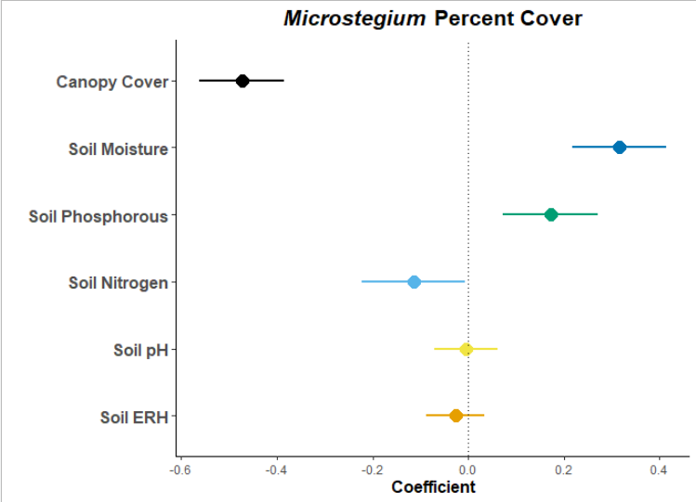
Q3: Which biotic or abiotic factors best predict Microstegium cover?
H3: Microstegium abundance will be higher in areas with less canopy cover and higher soil moisture.
Conclusion:
Microstegium cover is most strongly associated with canopy cover (preference for high light) and high soil moisture. Soil phosphorous and soil nitrogen are also strong predictors.

Slide 15
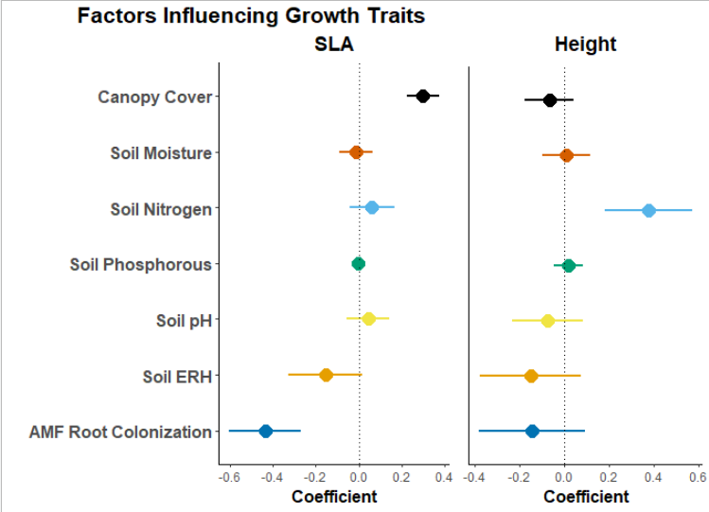
Q3: Which biotic or abiotic factors best predict Microstegium growth traits of specific leaf area and tiller height?
H3: Average specific leaf area (SLA) will be higher in low light and average tiller height will be higher in high light.
Conclusion:
SLA is positively associated with canopy cover and negatively associated with root colonization and soil ERH abundance.
Height is positively associated with soil nitrogen and negatively associated with root colonization and soil ERH abundance.

Slide 16
Results Summary
Which biotic and/or abiotic factors contribute to Microstegium invasion?
1. No difference in soil ERH between invaded and noninvaded soils.
2. Soil ERH and root colonization do not differ across abiotic gradients.
3. Microstegium cover is greatest with high light and moist soil.
SLA is most strongly predicted by percent canopy cover.
Height is most strongly predicted by soil nitrogen levels.

Slide 17
Acknowledgements
Kentucky Academy of Science Marcia Athey & Botany Fund
UofL Graduate Student Council
UofL Center for Geographic Information Services
Bernheim Research Forest
Jefferson County Metro Parks
The Nature Conservancy of Indiana
Indiana Department of Natural Resources
University of Kentucky Louisville Extension Office
Dr. Sarah Emery
Dr. Flory, Dr. Masters, Dr. Yanoviak, Dr. Day
Binod Basyal, Aaron Sexton, Kylea Garces
Jessica Raley, Lyndon To, Katie Marx, & Jason Koenig

