Slide 1
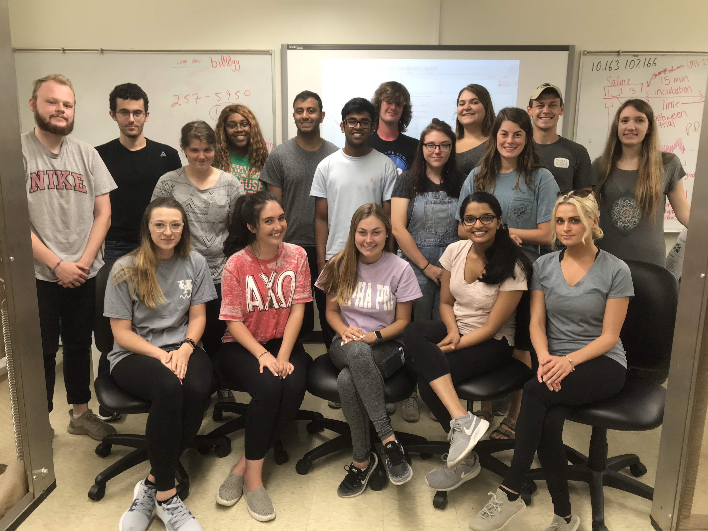
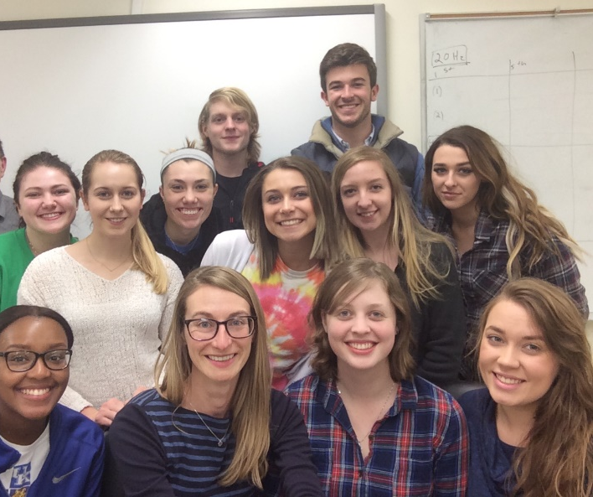
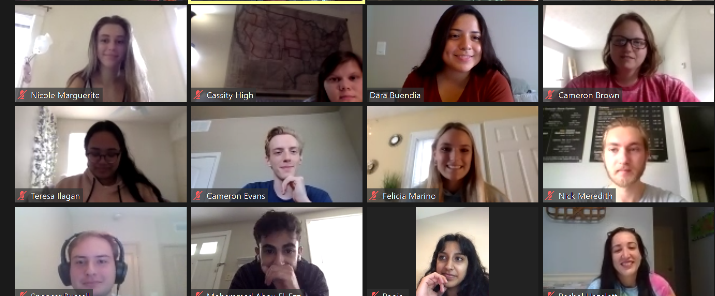
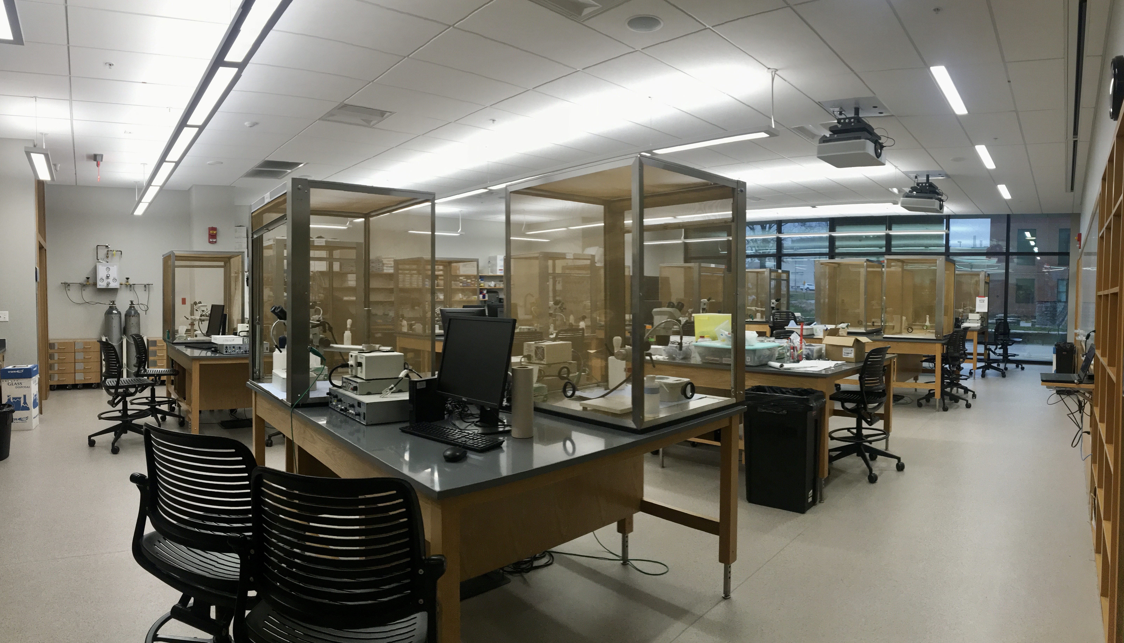
Conducting authentic curriculum undergraduate research experiences (ACUREs) in teaching laboratories
Dara Buendia Castillo, Catherine Stanley,Pooja Naidugari, Shelby McCubbin, Blair Nethery,
Esther Dupont-Versteegden and Robin L. Cooper
University of Kentucky. Lexington, KY
INTRODUCTION
APPROACH
Pros
Encourages student engagement and practical application of course content
Helps students understand the scientific process
Fosters team work
Motivates students to get involved in research for their continuing education
This report is bringing attention to an approach we have been using for the last 4 years in our neurophysiology lab, where a broad amount of content needs to be covered, in addition to embedding an ACURE component. Many advanced specialized laboratory courses have standardized labs developed, which have turned into cookie cutter laboratory exercises. The trick is to use those well-developed labs, but tweak them to develop a novel research project around the class content for the full semester or portion of the course.
1
Beta test projects before course
7
Publish findings
2
Obtain Undergraduate involvement in beta testing
6
Present research at local, regional, and national meetings
Cons
In person or via zoom
Summer time commitment
Finding resources under tight regulation for course expenses
Possible conflicting power dynamic
Lack of student involvement/ interest
Students may not follow proper methodology during experimentation
Data analysis may be not be conducted in the same manner
3
Collect data under defined conditions
5
Review paper with class participants
COMPLETED PROJECTS
4
Implement beta-test project in the classroom
References
Stretch activated channels in proprioceptive chordotonal organs of crab and crayfish are sensitive to Gd3+ but not amiloride, ruthenium red or low pH.
The effects of potassium and muscle homogenate on proprioceptive responses in crayfish and crab.
The effect of CO2, intracellular pH and extracellular pH on mechanosensory proprioceptor responses in crayfish and crab.
Investigating the effects of homocysteine as a agonist on invertebrate glutamatergic synapses.
Investigating potential effects of clove oil (eugenol) in model crustaceans.
Bernard, J., Danley, M., Krall, R.M., Sharp, K.A., Cooper, R.L. (2020). Authentic curriculum undergraduate research experimentation to learn about the effects of septicemia on cardiac function: frog and larval Drosophila models. Association for Biology Laboratory Education. San Diego, California. (Conference cancelled due to COVID-19
Bakshi, A., Patrick, L. E., & Wischusen, E. W. (2016). A framework for implementing course-based undergraduate research experiences (CUREs) in freshman biology labs. The American Biology Teacher, 78(6), 448-455.
Harrison, M., Dunbar, D., Ratmansky, L., Boyd, K., & Lopatto, D. (2011). Classroom-based science research at the introductory level: changes in career choices and attitude. CBE—Life Sciences Education, 10(3), 279-286

