Slide 1
Studying urbanization in Louisville and Lexington, metropolitan cities in Kentucky.
Manisha Hamal, Jeremy Sandifer, Buddhi Gyawali, and Kirk W. Pomper
College of Agriculture, Community, and the Sciences. Kentucky State University, Frankfort, KY 40601

Slide 2
Introduction
Urbanization: conversion of other types of land to uses associated with population and economy growth
Urbanization affects social, economic and environmental aspects of human life
Reduces greenery and increases impervious surface area (Li et al., 2009)
Impervious surface: that prevents the infiltration of water into the soil
Roads and rooftops are the most noticeable types of impervious surface (Amold Jr and Gibbons, 1996).
Arnold Jr, C. L., & Gibbons, C. J. (1996). Impervious surface coverage: the emergence of a key environmental indicator. Journal of the American planning Association, 62(2), 243-258.
Li, J. J., Wang, X. R., Wang, X. J., Ma, W. C., & Zhang, H. (2009). Remote sensing evaluation of urban heat island and its spatial pattern of the Shanghai metropolitan area, China. Ecological Complexity, 6(4), 413-420.
Yuan, F., & Bauer, M. E. (2007). Comparison of impervious surface area and normalized difference vegetation index as indicators of surface urban heat island effects in Landsat imagery. Remote Sensing of environment, 106(3), 375-386.

Slide 3
Land surface temperature (LST): an important factor of a phenomenon called urban heat island (UHI); increased temperature in urban area compared to its surrounding rural areas due to trapped heat (Zakšek and Oštir, 2012)
Normalized difference vegetative index (NDVI): a measure of surface reflectance and gives a quantitative estimation of vegetation growth and biomass
Its value varies between -1 and +1, where positive values indicate vegetated areas and negative values signify non-vegetated surface features such as water, barren, clouds, and snow.
Studies show that NDVI values being used as major indicator of urban climate (Gallo et al. 1993; Lo et al. 1997).
LST and NDVI, used for the analysis of percent impervious surface area (ISA) (Yuan & Bauier, 2007)
Gallo, K. P., et al. "The use of NOAA AVHRR data for assessment of the urban heat island effect." Journal of Applied Meteorology 32.5 (1993): 899-908.
Lo, C. P., Quattrochi, D. A., & Luvall, J. C. (1997). Application of high-resolution thermal infrared remote sensing and GIS to assess the urban heat island effect. International journal of Remote sensing, 18(2), 287-304.
Zakšek, K., & Oštir, K. (2012). Downscaling land surface temperature for urban heat island diurnal cycle analysis. Remote Sensing of Environment, 117, 114-124.

Slide 4
Objective
To study urbanization using the values of LST, NDVI and percent ISA in Louisville and Lexington, metropolitan cities of Kentucky.

Slide 5
Hypothesis
There is significant variations in LST, NDVI and percent ISA values in Lexington and Louisville, metropolitan cities.

Slide 6
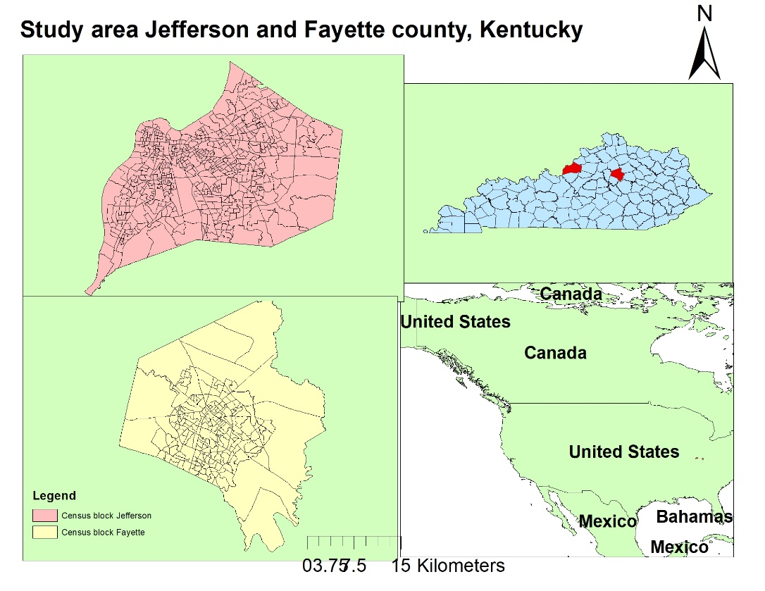
Methodology
Study area
Latitude: 38°11’37” N, 38°03’38” N
Longitude: 085°38’36” W, 084°28’49” W
Elevations: 137-307 m and 190-307 m
County | No. of block groups | Area (Km²) | Population | Population density (per Km²)
Jefferson | 575 | 1,030 | 741,096 | 776
Fayette | 208 | 740 | 295,804 | 399
Table 1: Area and demography of the counties
Source: 2010 Census Gazetteer

Slide 7
Data source and analysis
Landsat data (2018) were obtained using United States Geological Survey (USGS, 2018) Earth Explorer
The KY vector map was downloaded from Kentucky Geography Network (KyGeoportal)
Tiger census block group map layers and National Land Cover Dataset (NLCD) from Geospatial data Gateway.
Projection of the data used was North American Datum (NAD) 1983 with State Plane projected coordinate system .
Data set | Sensor | Path/Row | Acquisition date | Spatial Resolution
Landsat 8-OLI | TIRS | 21/33 | 06/16/2018 | 30m×30m
Landsat 8-OLI | TIRS | 20/34 | 06/09/2018 | 30m×30m
Table 2: Landsat data used information
https://kygeoportal.ky.gov/
https://rthexplorer.usgs.gov /

Slide 8
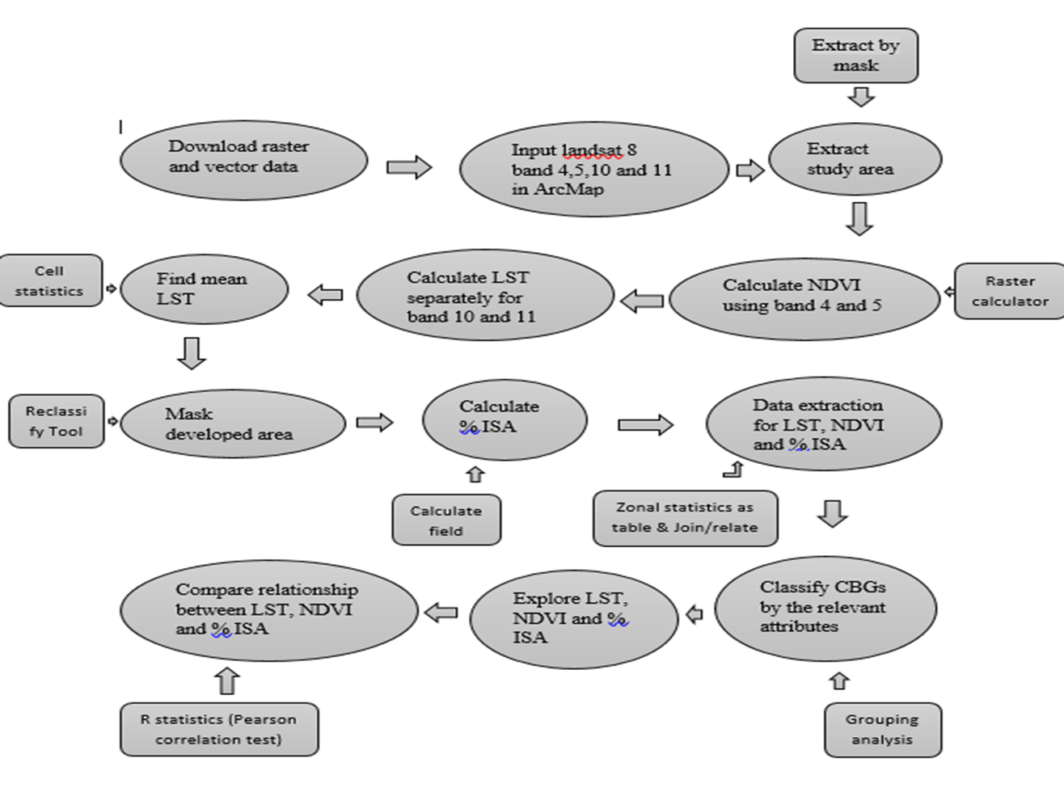
Workflow of methodology

Slide 9
top-of-atmospheric spectral radiance (L_{λ}) (Ihlen, 2019)
L_{λ} = ML * Q_{cal} + AL
Where L_{λ} = Spectral radiance
ML = Radiance multiplicative scaling factor for the band (0.0003342)
AL = Radiance additive scaling factor for the band (0.1)
Q_{cal} = band 10 image
$NDVI=\frac{NIR\left(band5\right)−R\left(band4\right)}{NIR\left(band5\right)+R\left(band4\right)}$ (Ihlen, 2019)
$\text{TIRS} \text{band} \text{data} \text{was} \text{converted} \text{from} \text{spectral} \text{radiance} \text{to} \text{brightness} \text{temperature}\text{ (}\text{BT}\text{)}$:
$$BT=\frac{K_{2}}{\ln\left[\left(K_{1}∕Lλ\right)+1\right]}−272⋅15$$
where K₁ and K₂ are band thermal conversion constants
Ihlen, V. (2019) Landsat 8 (L8) Data Users Handbook [version 5.0]. Retrieved from https://prd-wret.s3-us-west-2.amazonaws.com/assets/palladium/production/atoms/files/LSDS-1574_L8_Data_Users_Handbook-v5.0.pdf on 04/02/2020

Slide 10
P_{v} was calculated as square of $\frac{NDVI − NDVImin}{NDVImax− NDVImin}$
Where P_{v} is proportion of vegetation
Land surface emissivity (e) was calculated as: e = 0.004 * P_{v} + 0.986
$LST=\frac{BT}{1+\left[\left(w∗(BT∕p\right){∗L}_{n}e\right]}$ (Yuan & Bauier, 2007)
Where, LST is land surface temperature in °C
BT is brightness temperature in °C
w is wavelength of emitted radiance (11.5µm)
e land surface emissivity
p = h*c/σ (1.438×10⁻² mK)

Slide 11
Results
Mean LST and percent ISA of Jefferson County was higher than Fayette County.
Although, the minimum NDVI value was found to be lower in Jefferson County than Fayette County, no any difference was seen in mean NDVI values between the counties
Significant negative correlation was observed between LST and NDVI (r = -0.56, p-value < 0.05)
Negative relation between NDVI and percent ISA which was also significant (r = -0.65, p-value < 0.05)
Whereas, a significant positive correlation between LST and percent ISA (r = 0.85, p-value < 0.05)

Slide 12
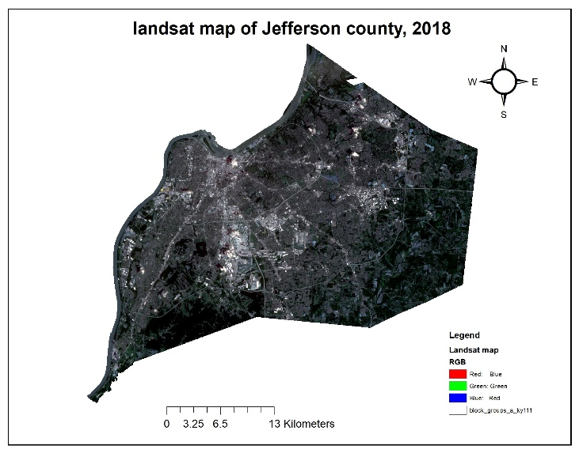
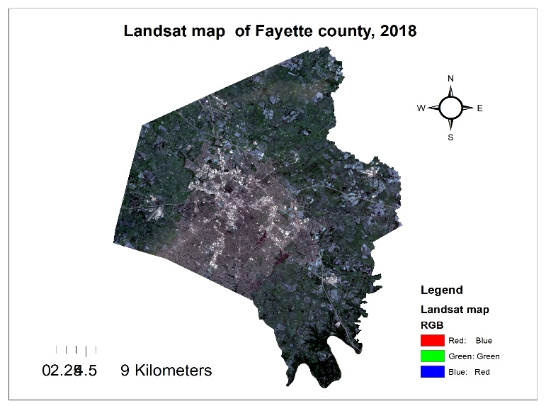
(a)
(b)
Figure 1: Landsat map of Jefferson (a) and Fayette county (b), 2018

Slide 13
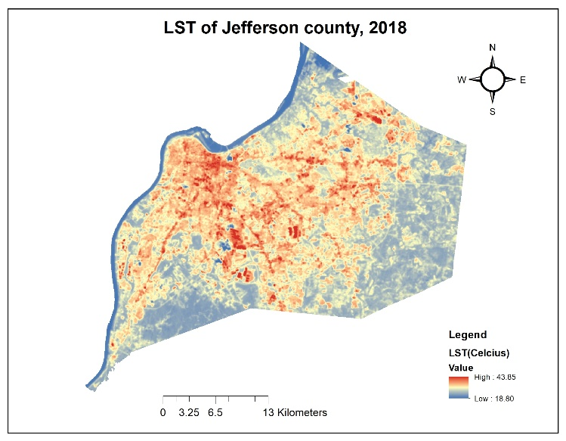
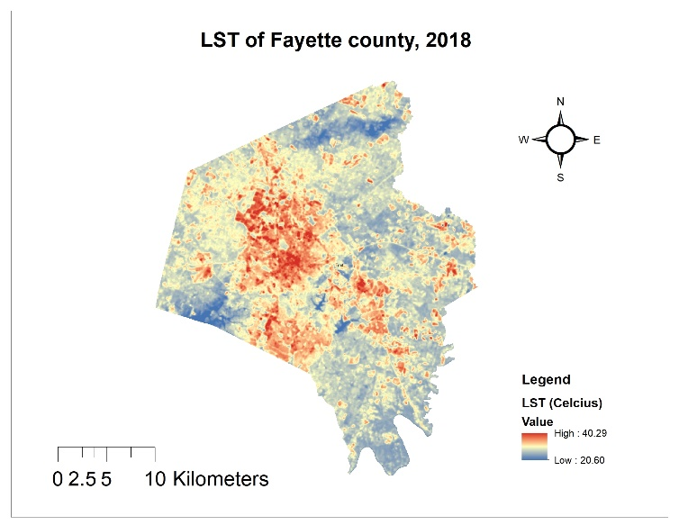
(a)
(b)
Figure 2: LST of Jefferson (a) and Fayette (b) county, 2018

Slide 14
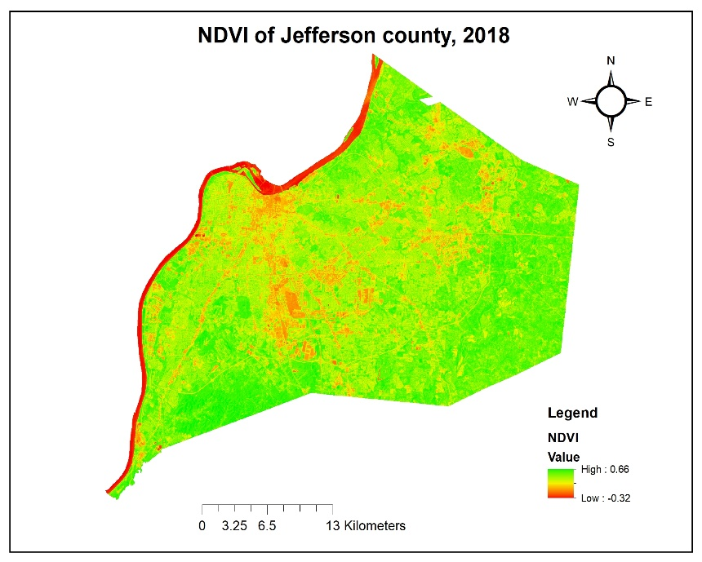
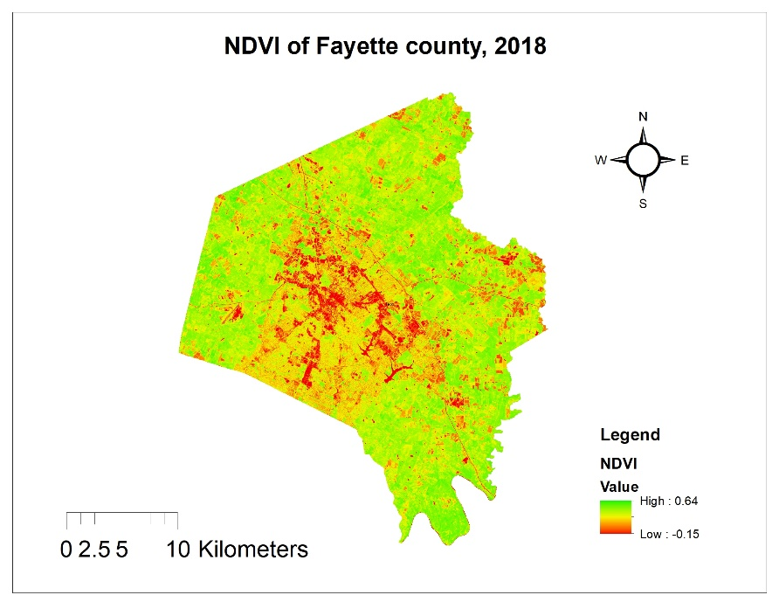
(a)
(b)
Figure 3: NDVI of Jefferson (a) and Fayette (b) county, 2018

Slide 15
Continue..
County | Mean temperature (Celsius) | Mean LST (Celsius) | Mean NDVI | Mean percent ISA
Jefferson | 27.78 | 30.17 | 0.34 | 61.28
Fayette | 27.22 | 29.52 | 0.34 | 60.87
Table 3: Records of mean temperature compared to Landsat measured LST (°C) along with mean NDVI and percent ISA
www.timeanddate.com

Slide 16
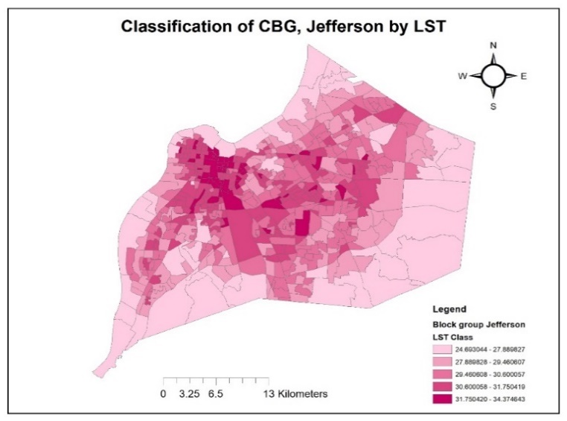
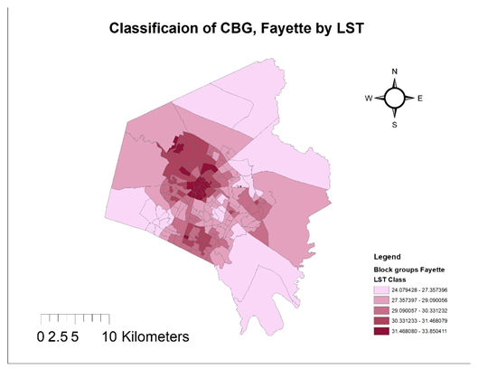
(a)
(b)
Figure 4: Classification of CBG by LST in Jefferson (a) and Fayette (b) counties

Slide 17
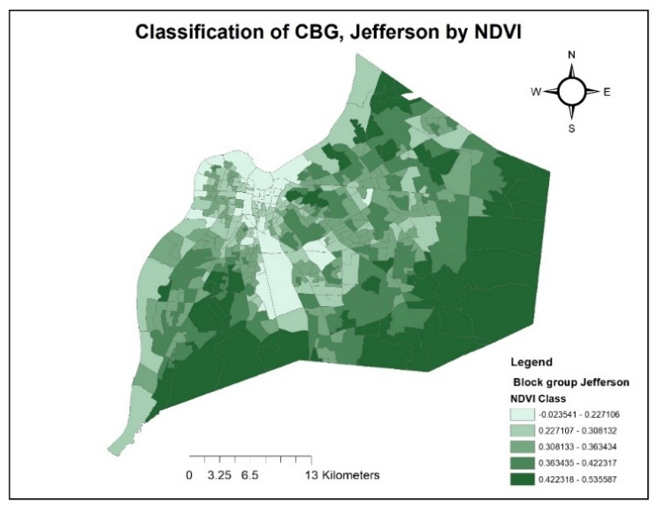
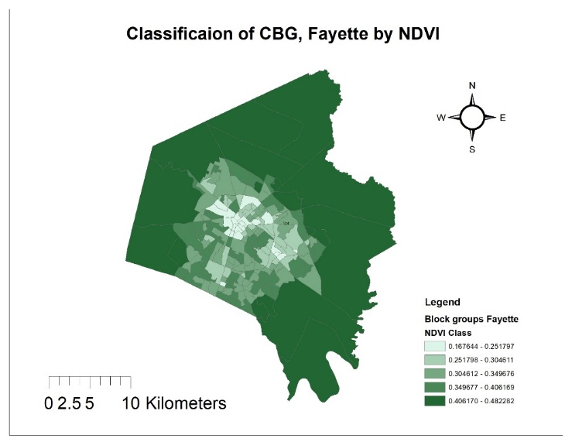
(a)
(b)
Figure 5: Classification of CBG by NDVI in Jefferson (a) and Fayette (b) counties

Slide 18
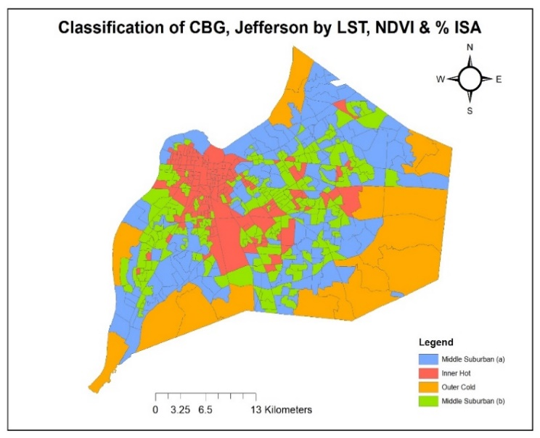
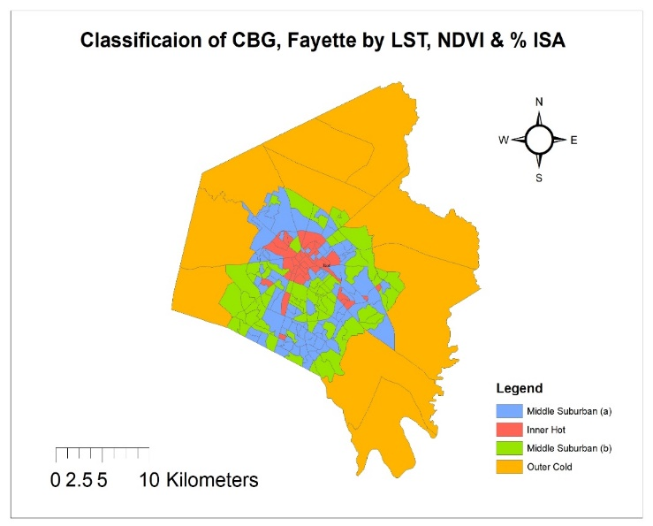
(a)
(b)
Figure 6: Classification of CBG by LST, NDVI & % ISA in Jefferson (a) and Fayette (b)

Slide 19
County | Class ID | LST (°C) |  |  | NDVI |  |  | Percent ISA
 |  | Min | Max | Mean | Min | Max | Mean | Min | Max | Mean
Jefferson | Blue | 24.80 | 30.31 | 28.73 | 0.08 | 0.49 | 0.06 | 0 | 68.97 | 31.38
 | Red | 27.13 | 34.38 | 31.58 | -0.03 | 0.35 | 0.27 | 43.23 | 100 | 91.45
 | Green | 24.69 | 28.49 | 26.84 | 0.24 | 0.54 | 0.43 | 0.13 | 33.80 | 8.55
 | Yellow | 27.03 | 31.51 | 30.37 | 0.22 | 0.41 | 0.35 | 37.5 | 94.02 | 63.53
 | Overall | 24.69 | 34.38 | 30.17 | -0.02 | 0.54 | 0.34 | 0 | 100 | 61.28
Fayette | Blue | 27.78 | 32.34 | 30 | 0.26 | 0.38 | 0.03 | 31.22 | 92.95 | 70.92
 | Red | 29.44 | 33.85 | 31.39 | 0.17 | 0.31 | 0.25 | 43,46 | 100 | 86.79
 | Green | 24.08 | 30.69 | 28.16 | 0.29 | 0.48 | 0.37 | 1.89 | 73.90 | 41.25
 | Yellow | 26.45 | 28.28 | 27.35 | 0.44 | 0.48 | 0.45 | 0.10 | 8.67 | 3.28
 | Overall | 24.08 | 33.85 | 29.52 | 0.17 | 0.48 | 0.34 | 0.11 | 100 | 60.87
Table 4: Summary table showing descriptive statistics of LST, NDVI & percent ISA

Slide 20
Conclusion
Higher mean LST, mean percent ISA and lower minimum NDVI value in Louisville compared to Lexington.
A higher degree of urbanization was found in Louisville than Lexington, metropolitan city of Kentucky.
Lexington and its suburb areas reveals a more systematic pattern of urbanization
In Louisville a more scattered pattern is observed in urbanization process.

Slide 21
Acknowledgement
Dr. Kirk W Pomper
Dr. Buddhi Gyawali
Mr. Jeremy Sandifer
Mr. Ken Bates
Pradip Paudel, Smrity Kandel, Anju Chaudhary, Arjun Chhetri, Anjana Duwal

Slide 22
Thank You
Questions???

