Slide 1
Geospatial Modelling Corn and Soybean in Shelby County, Kentucky, 2011 and 2019
William Christopher Lyons
Graduate Research Assistant
Kentucky State University
College of Agriculture, Community, and the Sciences

Slide 2
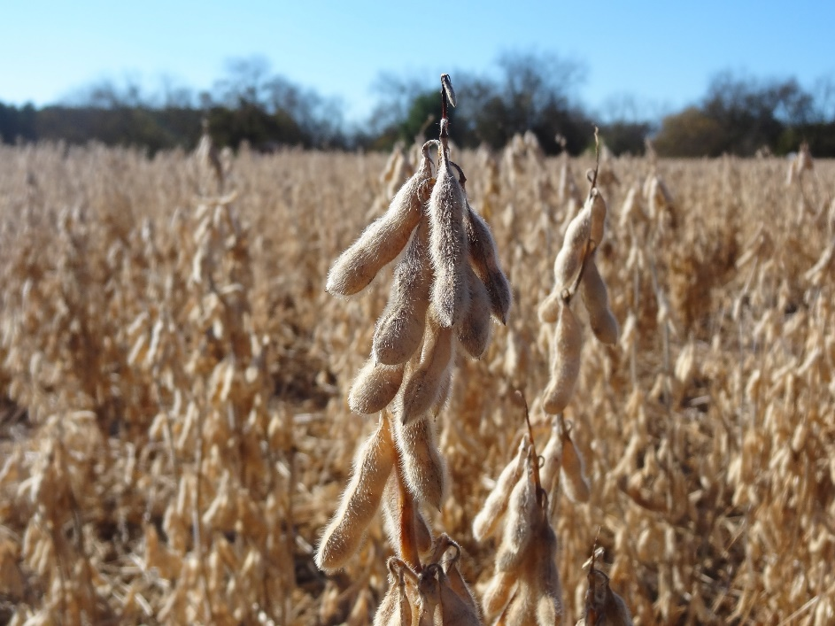
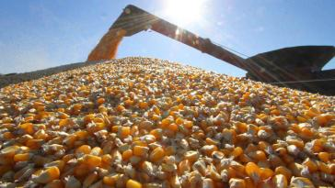
Importance of Corn and Soybean Production
One of the top commodities for Kentucky
Increasing global demand for soy
Ethanol subsidies

Slide 3
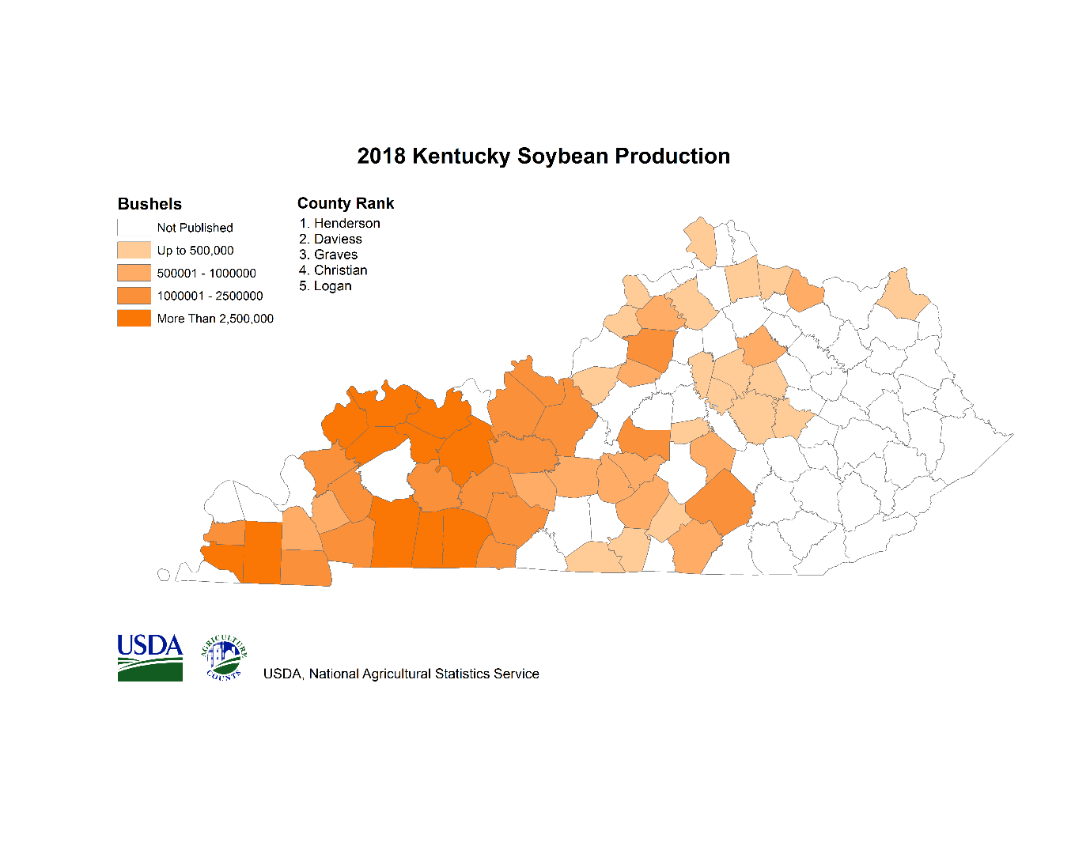
Kentucky Farmland
Corn
2nd in crop receipts (2015)
14th nationally in production (2015)
27,313 jobs (2012)
1,520,000 acres planted (2014)
Per year
70 million bushels fed to livestock
45 million bushels for food and spirits
50 million bushes exported
12 million for ethanol (fuel)
Top counties (2018)
Henderson
Daviess
Christian
Graves
Logan
Kentucky Corn Production-2018
Obtained from USDA- NASS https://www.nass.usda.gov/Statistics_by_State/Kentucky/Publications/County_Estimates/maps/index.php

Slide 4
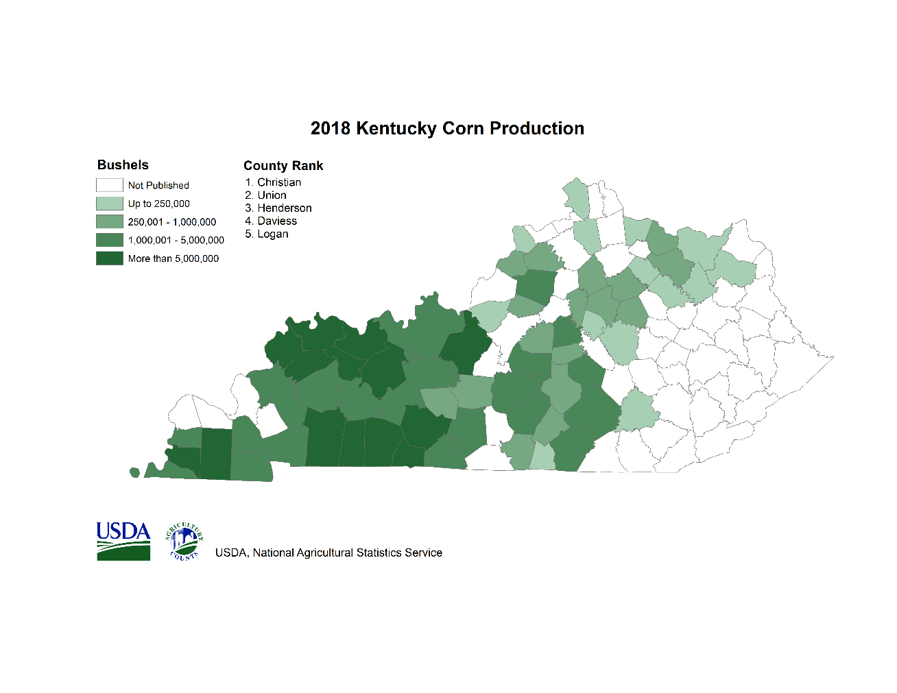
Kentucky Farmland
Soybeans
1st in Kentucky crop receipts
14th nationally in production
1.7 million acres nationally
84,000,000 bushels (2014)
70% domestic livestock (soybean meal)
Top counties (2018)
Christian
Union
Henderson
Daviess
Logan
Kentucky Soybean Production-2018
Obtained from USDA- NASS https://www.nass.usda.gov/Statistics_by_State/Kentucky/Publications/County_Estimates/maps/index.php

Slide 5
Objectives of Study
Evaluate Features and Accessibility of the USDA National Agriculture Statistics Service CropScape web application.
Determine Trends in Corn and Soybean Production
8-year span (2011, 2019)
Integrate data into ArcGIS Pro for producing more reliable crop forecasting models.

Slide 6
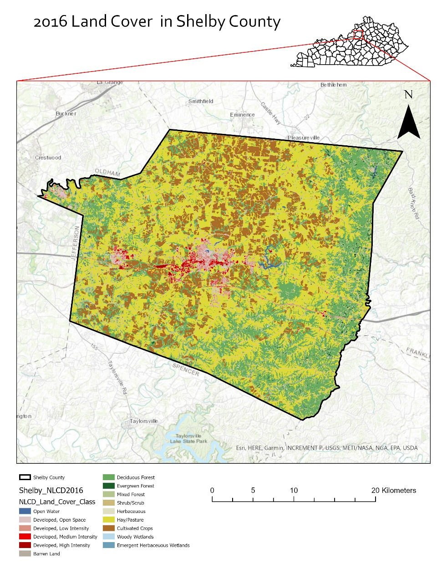
Study Area
Shelby County
Semi-rural county
Land area: 983 sq. km
Interior plateau ecoregion
Average rainfall 42 inches
Urban area grew from 2001 to 2016
16,656 acres urban
28,251 acres of county = crop production

Slide 7
Terrain Attributes
Vital to crop production
Elevation and Slope Statistics:
Maximum Elevation: 369 m
Minimum Elevation: 171 m
Average Elevation: 242.35 m
Average Slope: 3.91 degrees

Slide 8
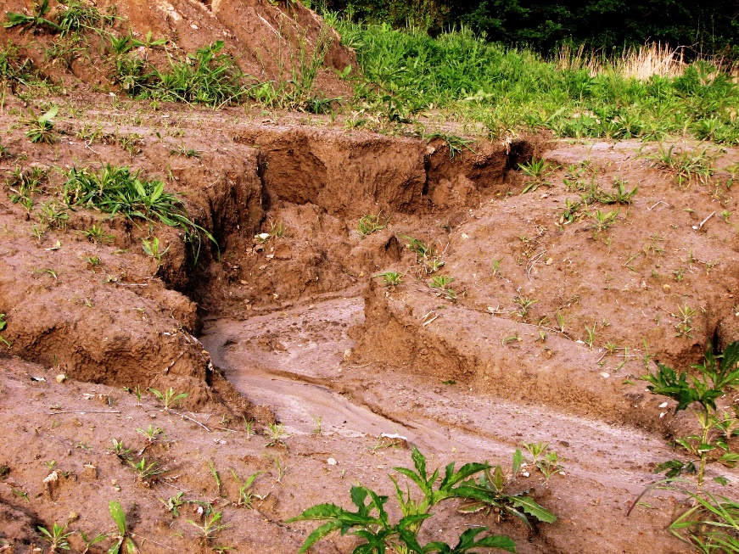
Shelby County Slope
Slope causes issues in agriculture:
Degradation of land
Topsoil erosion
Declining crop yields
Class name | Area(ha) | Area(%)
Little or no slope: 0 - 3 % gradient | 19,609.19 | 19.68
Gentle slopes: 3 - 9 % gradient | 58,477.02 | 58.7
Moderate slopes: 9 - 15 % gradient | 15,097.77 | 15.16
Steep slopes: 15 - 30 % gradient | 6,114.98 | 6.14
Extremely steep slopes: 30 - 60% gradient | 191.36 | 0.19
Excessively steep slopes: > 60% gradient | 188.96 | 0.19

Slide 9
CropScape-National Agriculture Statistics Service
Crop Data Layer (CDL)
Produced from 30 meter satellite imagery
Currently utilizes:
Landsat 8 OLI/TIRS sensor
Disaster Monitoring Constellation (DCM) DEIMOS-1
ESA Sentinel-2 A and B sensors.
Imagery downloaded daily
Objective to get at least one cloud-free day
Every two weeks per growing season
Prior to 2008 satellite data from:
Landsat 4/5/7
IRS-P6 Resourcesat 1 sensor
Han et al. 2012

Slide 10
Crop Data Layer Accuracy
2019 Crop Data Layer
Landsat 8 False Color-June 2019

Slide 11
Crop Data Layer
Crop Data Layer 2011 (All Crops)
Crop Data Layer 2019 (All Crops)

Slide 12
Soybean Harvest Trends
R² = 0.9743 indicate positive correlation in harvested acres from 2007-2017.
Trend indicates an increase in soybean harvest over 10 years.
Data obtained from USDA NASS Agriculture Statistics (2007, 2012, and 2017)
Census Year | Acres Harvested
2017 | 32,300
2012 | 27,124
2007 | 17,893

Slide 13
Corn Harvest Trends
R² = 0.1877 indicate negative correlation in harvested acres from 2007-2017.
Trend indicates a decrease in corn harvest over 10 years.
Data obtained from USDA NASS Agriculture Statistics (2007, 2012, and 2017)
Census Year | Acres Harvested
2017 | 15,200
2012 | 25,877
2007 | 19,839

Slide 14
Corn and Soybean Production 2011
Corn Acres Planted-12,850.6
Soybeans Acres Planted-14,403.8

Slide 15
Corn and Soybean Production 2019
Corn Acres Planted- 22,045.30
Soybean Acres Planted- 27,646.1

Slide 16
Tobacco Harvest
R² = 0.1877 indicate negative correlation in harvested acres from 2007-2017.
Trend indicates a decrease in tobacco harvest over 10 years.
Decrease due to the tobacco buyout program.
Due to buyout, many producers switched to corn/soybean production
Data obtained from USDA NASS Agriculture Statistics (2007, 2012, and 2017)
Census Year | Pounds Harvested
2017 | 1,520
2012 | 3,370
2007 | 2,485

Slide 17
Corn and Soybean Production
Year | Acres Corn Planted | Acres Soybeans Planted
2011 | 12,850.6 | 14,403.8
2012 | 17,957 | 15,296.7
2013 | 16,067.8 | 15,963.5
2014 | 16,460.8 | 20,367.8
2015 | 16,574.4 | 27,478
2016 | 15,180.2 | 25,234
2017 | 19,979.7 | 27,761.7
2018 | 17,515.8 | 28,344.6
2019 | 22,045.3 | 27,646
Mean | 17,181.28889
Median | 16,574.4
Min | 12,850.6
Max | 22,045.3
σ | 2,671.37

Slide 18
Corn Planting Frequency
Number Years Planted | Acreage
One Year | 12,793.3
Two Years | 9,261
Three Years | 8,658.9
Four Years | 10,032
Five Years | 9,718.4
Six Years | 5,694.6
Seven Years | 725.7
Eight Years | 199.7
Nine Years | 88.3
Ten Years | 36.5
Eleven Years | 20.2
Twelve Years | 12

Slide 19
Soybean Planting Frequency
Number of Years Planted | Acreage
One Year | 9,572.3
Two Years | 6,290.2
Three Years | 6,584.4
Four Years | 7,009.7
Five Years | 7,991.8
Six Years | 9,450.7
Seven Years | 6,784.1
Eight Years | 3,028.6
Nine Years | 1,564.5
Ten Years | 772.4
Eleven Years | 303.3
Twelve Years | 18

Slide 20
Kentucky Corn and Soybean Forecast 2020
Corn
Production estimated at 245 million bushels (15% increase from 2018).
Yield estimated at 169 bushels per acre (down 6 bushels from 2019).
Lower yield offset by a 19% increase in acres harvested as grain, estimated at 1.45 million acres.
Soybeans
Production estimated at 245 million bushels (21% decrease from 2018).
Yield estimated at 46 bushels per acre (down 5 bushels from 2019).
Acreage for harvest estimated at 1.69 million acres, down 240,000 acres from 2019
(USDA-NASS Kentucky Field Office, 2020)

Slide 21
Issues and Future Improvements
Use multi-temporal data
Use elevation data to determine field flooding
Access possible solutions to temporal resolution issues
Cloud cover in Landsat Scenes
Use of UAV multispectral camera for higher resolution imagery

Slide 22
Conclusions
USDA NASS CropScape is a valuable, open-source tool to agronomist, agriculture economist, and farmers.
Provides historical data of crop production.
Data can be downloaded and used in GIS platforms to examine change analysis.

Slide 23
References
Kentucky Field Office. (2020, January 10). Kentucky Corn Production Up, Soybean and Tobacco Down (USA, United States Department of Agriculture, National Agriculture Statistic Service). Retrieved October 29, 2020, from https://www.nass.usda.gov/Statistics_by_State/Kentucky/Publications/Current_News_Release/2020/PRJAN20_KY.pdf
Jarvis, A., H.I. Reuter, A. Nelson, E. Guevara. 2008. Hole-filled SRTM for the globe Version 4, available from the CGIAR-CSI SRTM 90m Database: http://srtm.csi.cgiar.org.
Ladoni, M., Kravchenko, A. N., & Robertson, G. P. (2015). Topography Mediates the Influence of Cover Crops on Soil Nitrate Levels in Row Crop Agricultural Systems. PloS one, 10(11), e0143358. https://doi.org/10.1371/journal.pone.0143358
USDA National Agricultural Statistics Service Cropland Data Layer. 2020. Published crop-specific data layer [Online]. Available at https://nassgeodata.gmu.edu/CropScape/ (accessed October 26, 2020). USDA-NASS, Washington, DC.
USDA National Agricultural Statistics Service, 2017 Census of Agriculture. Complete data available at www.nass.usda.gov/AgCensus.
Weiguo Han, Zhengwei Yang, Liping Di, Richard Mueller, CropScape: A Web service based application for exploring and disseminating US conterminous geospatial cropland data products for decision support, Computers and Electronics in Agriculture, Volume 84, 2012, Pages 111-123, ISSN 0168-1699, https://doi.org/10.1016/j.compag.2012.03.005.

Slide 24
Acknowledgements
The presenter would like to thank Dr. Buddhi Gyawali for his assistance with this project and the Kentucky State University College of Agriculture, Community, and the Sciences media and publication team for your efforts.
This research is funded by USDA/AFRI Grant: Enhancing Productivity, Diversification, and Sustainability By Infusing Geospatial Technology In Small And Medium-Sized Farms (Award # 2019-68006-29330, 2019-2022, PI Dr. Buddhi Gyawali)

