Slide 1
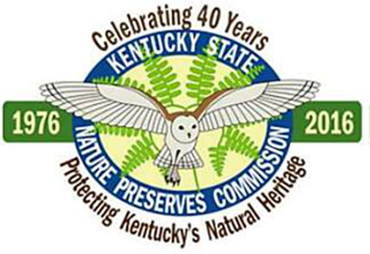
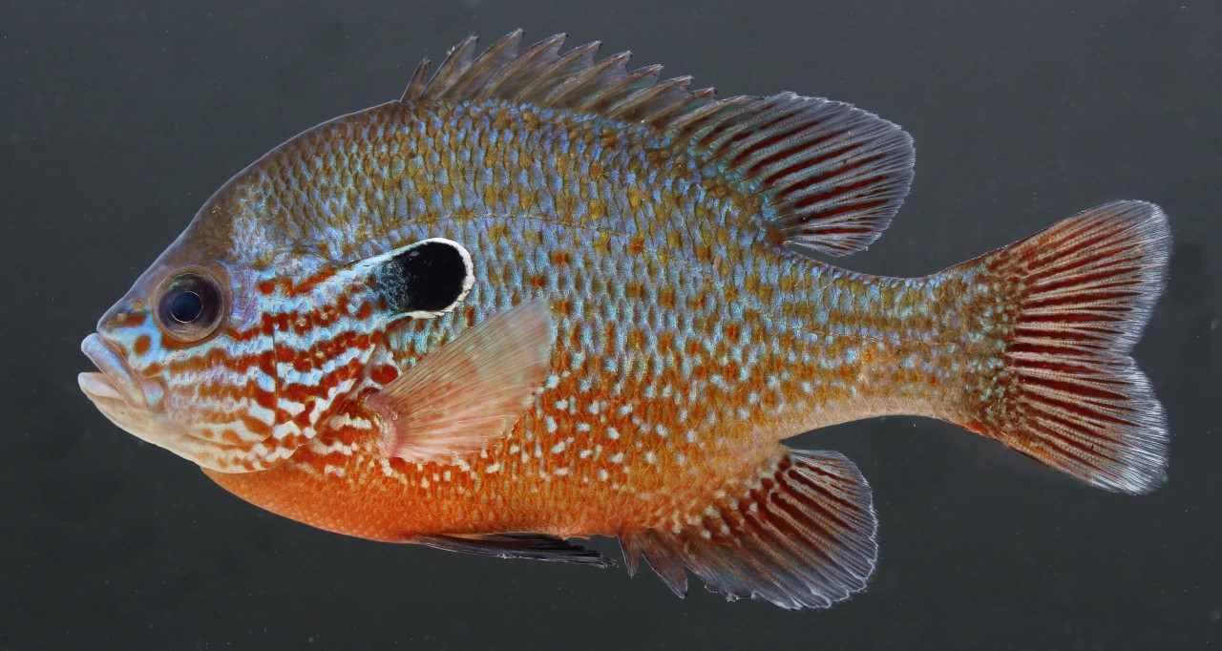
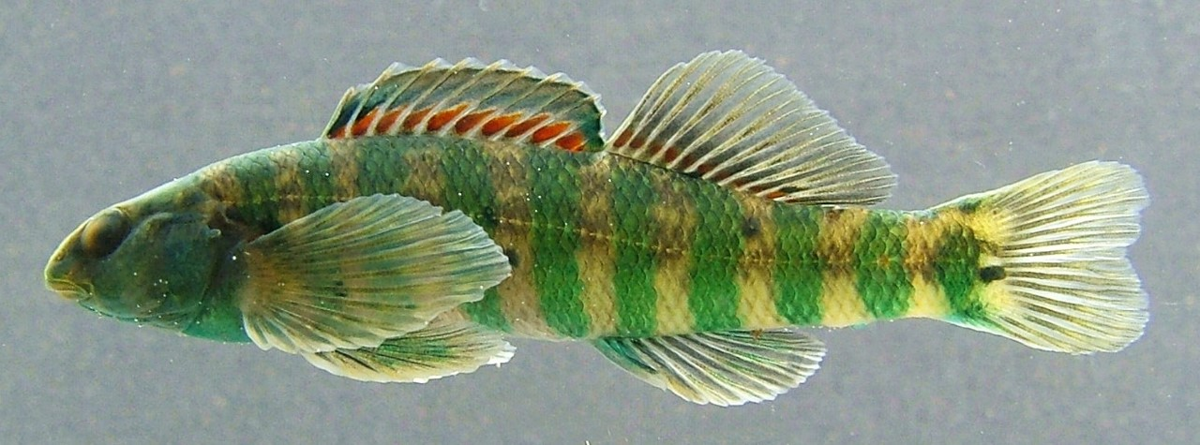
An ecological hotspot for fishes; the Wild River section of the Red River Gorge, Kentucky
Cole W. Ralenkotter, Erika M. Howard, Jon D. Eisenhour, and David J. Eisenhour
Morehead State University
Presented by Cole and Erika
Mottled sculpin, Cottus bairdii
Longear sunfish, Lepomis megalotis
Banded darter,
Etheostoma zonale

Slide 2
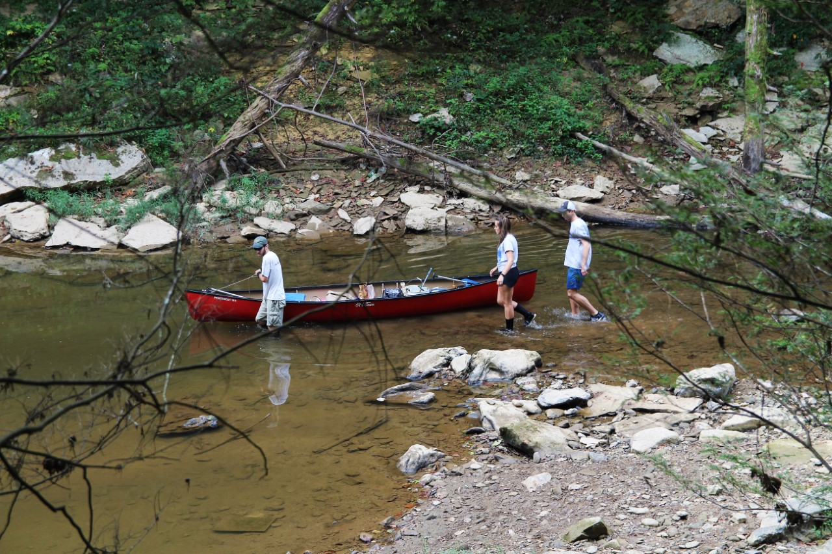
Rationale and Objectives
The purpose of this study was to document the fishes in the wild River section of the Red River and to assess the fish community health of these sites.
Property recently acquired sparked renewed interest in development of the Red River Gorge
Previous surveys late 1960s (Branson, B. A., and D. L. Batch 1974) and late 1990s (Thomas, J. A. 2000)

Slide 3
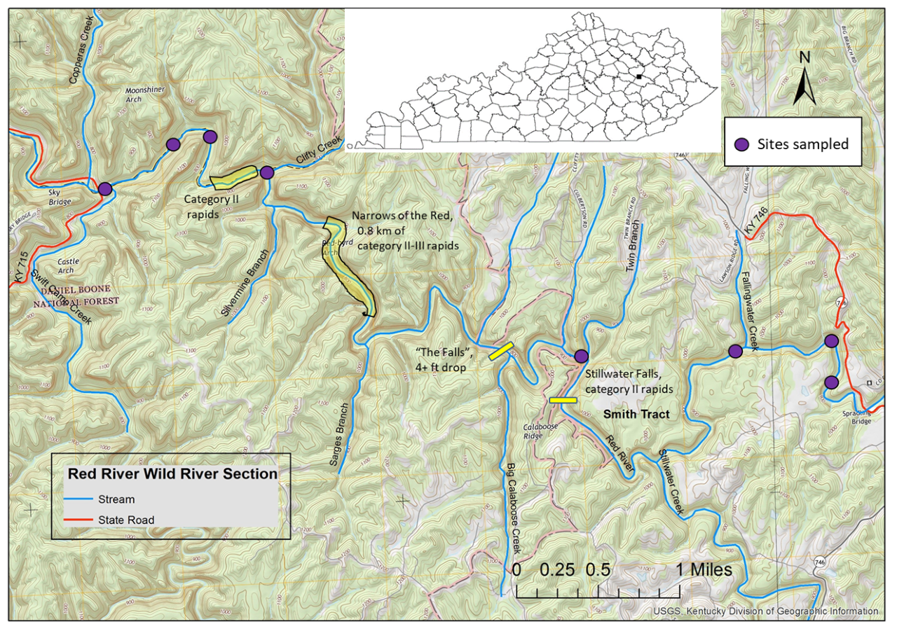
Methods:
8 sites sampled from August -October 2019
Sites roughly 180m in length

Slide 4
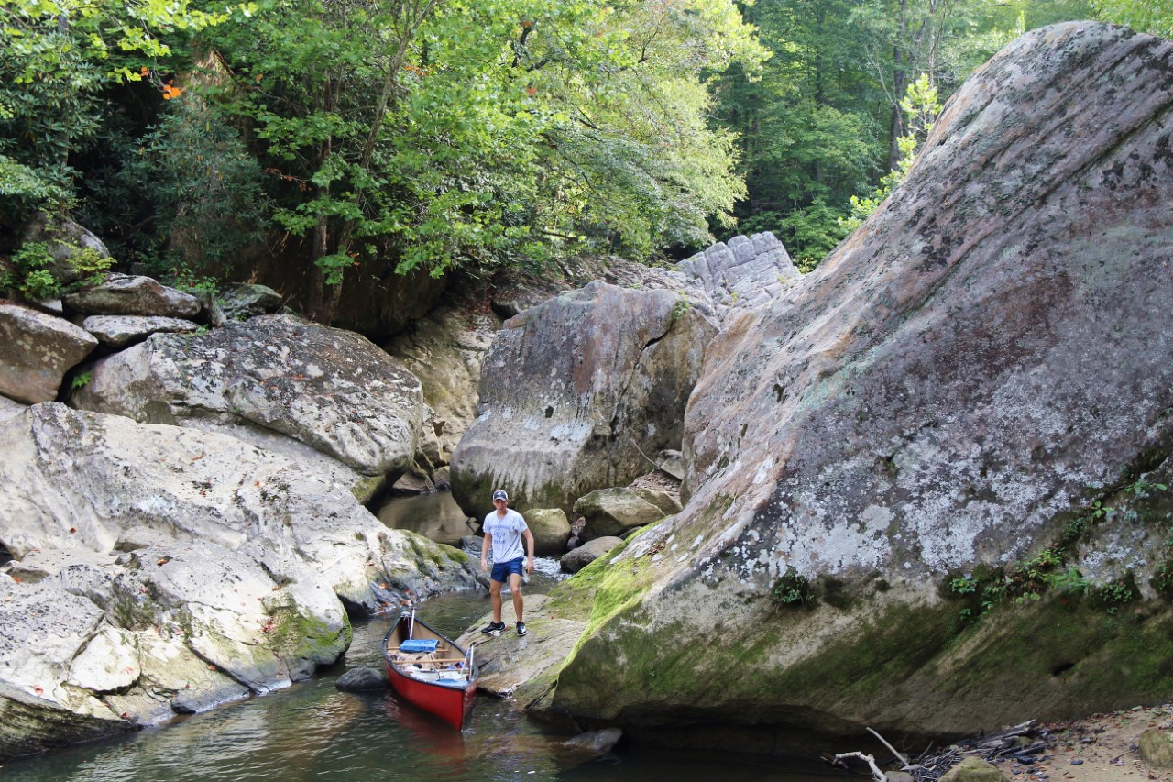

Slide 5
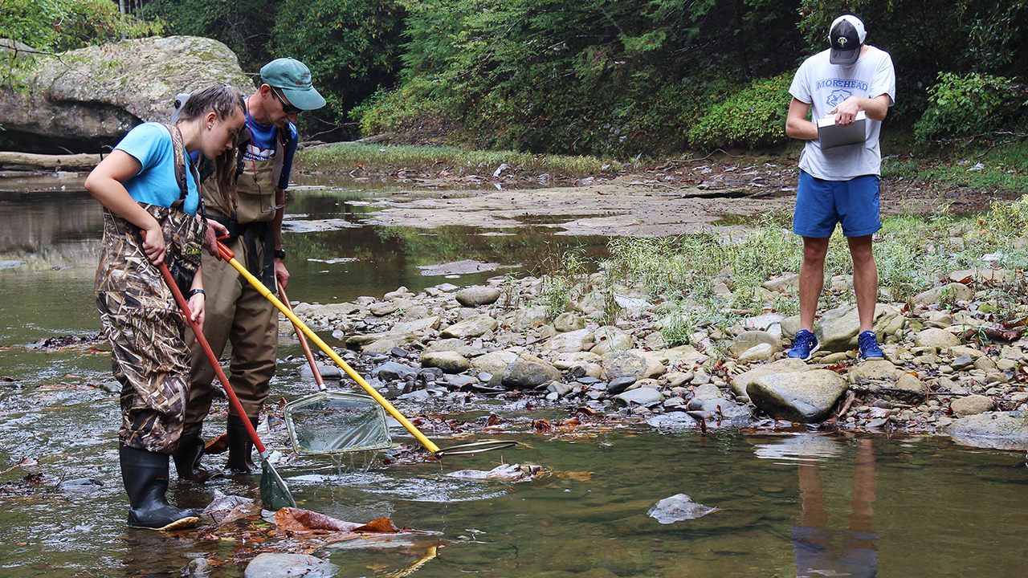
Methods:
Electrofishing

Slide 6
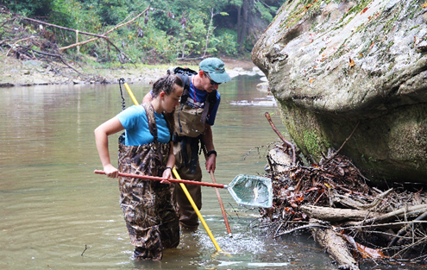
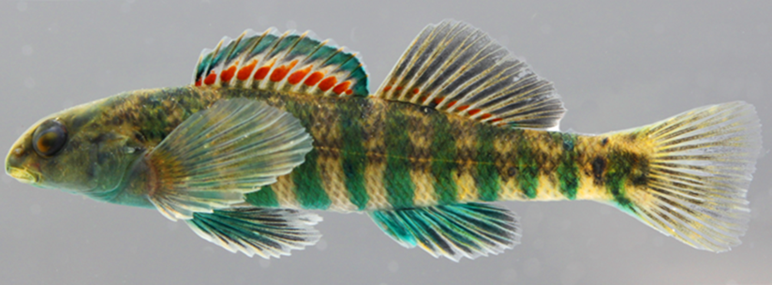
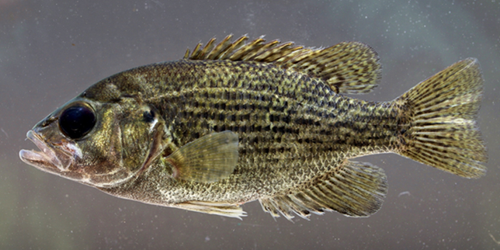
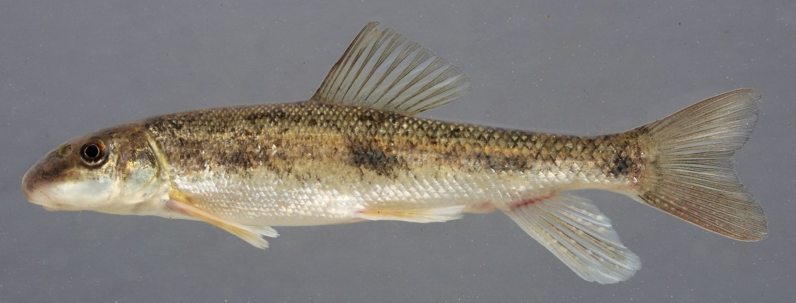
Banded Darter, Etheostoma zonale, an intolerant benthic species common throughout the study area.
Rock Bass, Ambloplites rupestris, a sunfish widespread in the study area.
White Sucker, Catostomus commersonii
Least Brook Lamprey, Lampetra aepyptera

Slide 7
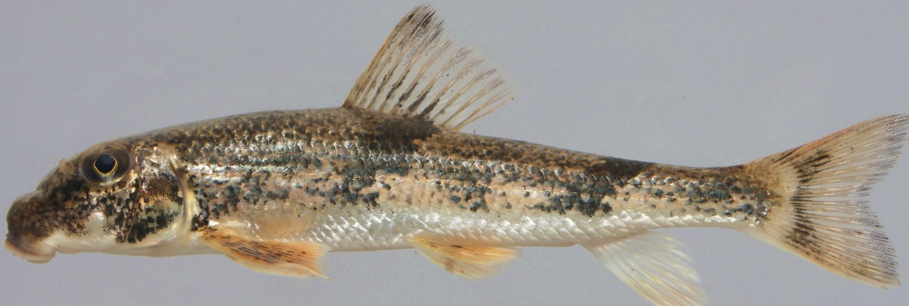
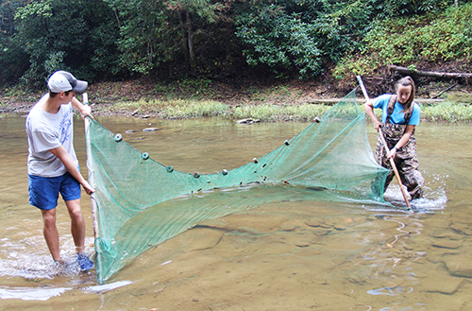
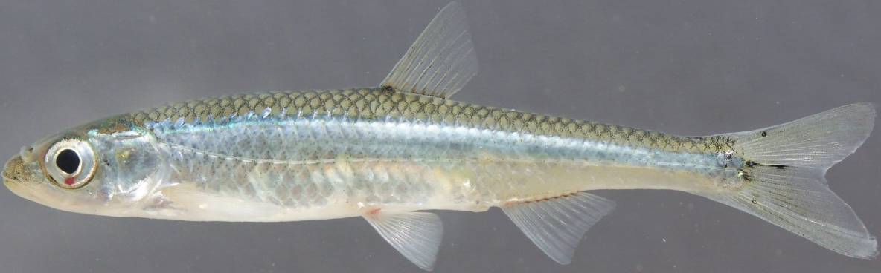
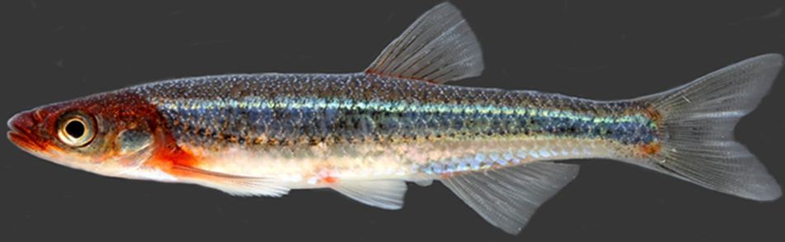
Methods: Seining
Hog sucker, Hypentelium nigricans
Silver shiner, Notropis photogenis
Rosyface shiner, Notropis rubellus, an intolerant, pool-inhabiting minnow, abundant throughout the study area

Slide 8
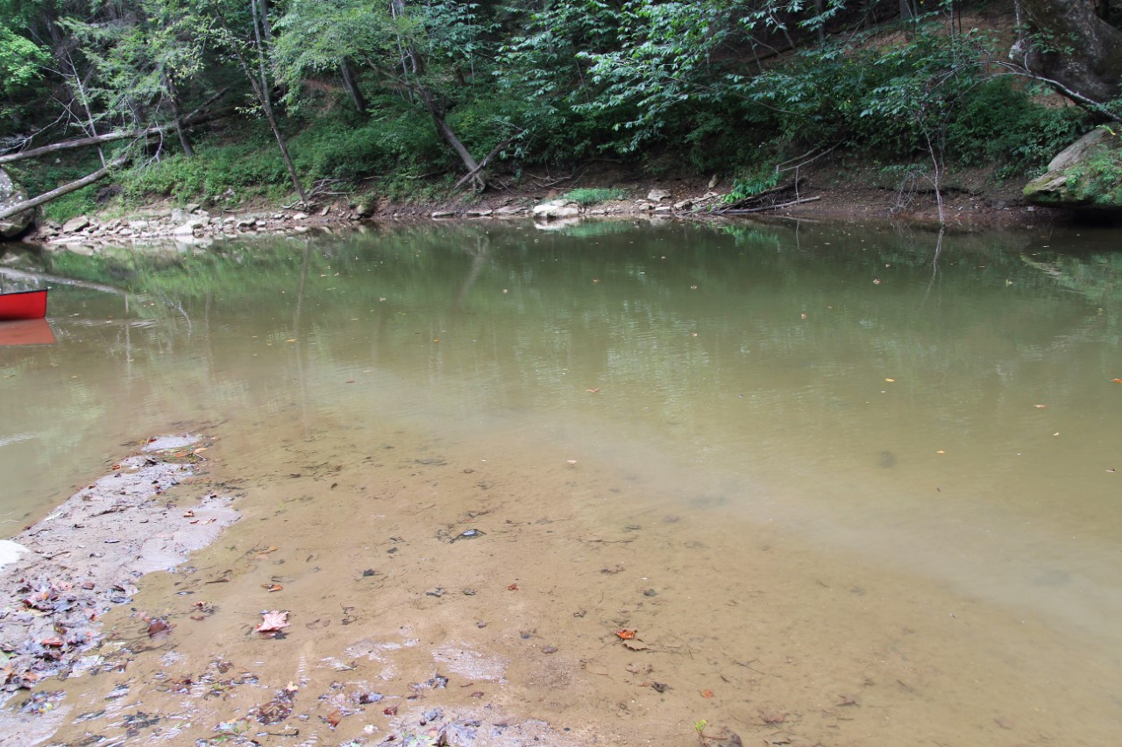
Methods: Visual Surveys
Longnose Gar, Lepisosteus osseus, a newly-documented species confined to the lower portion of the study area.
Canoeing through a deep pool while traveling to a site.

Slide 9
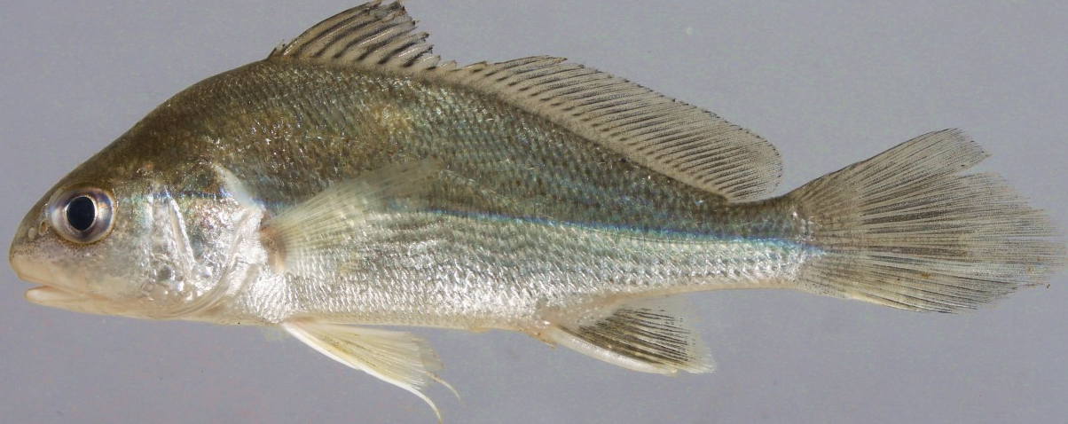
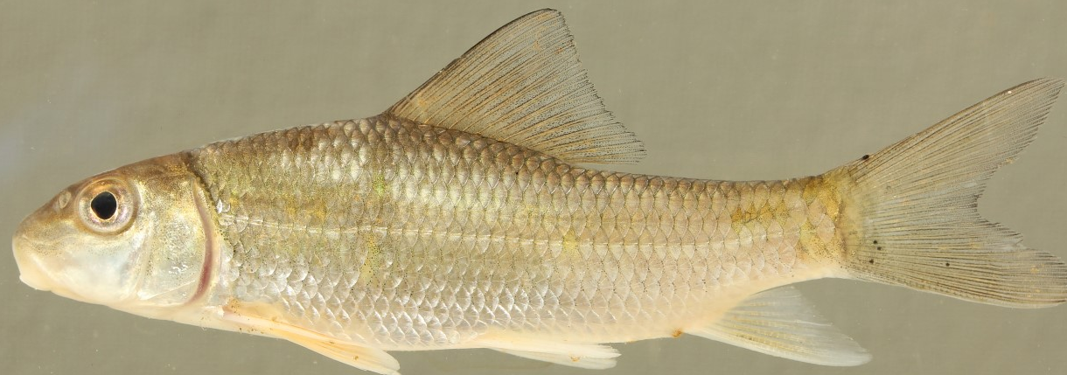
Results
A Species Rich Section: 41 total species, five species newly recorded for this section of the Red River, and one protected species.
White Sucker, Catostomus commersonii
Least Brook Lamprey, Lampetra aepyptera
Freshwater Drum, Aplodinotus grunniens
Longnose Gar, Lepisosteus osseus
Silver Redhorse, Moxostoma anisurum

Slide 10
A Threatened Species
A state threatened species at sites 2 and 3
Northern Brook Lamprey, Ichthyomyzon fossor, a species considered “Threatened” in Kentucky, and documented only in the lower part of the study reach.

Slide 11
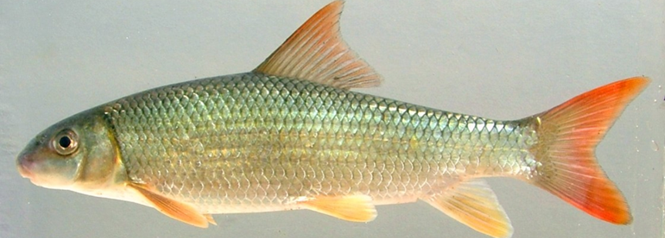
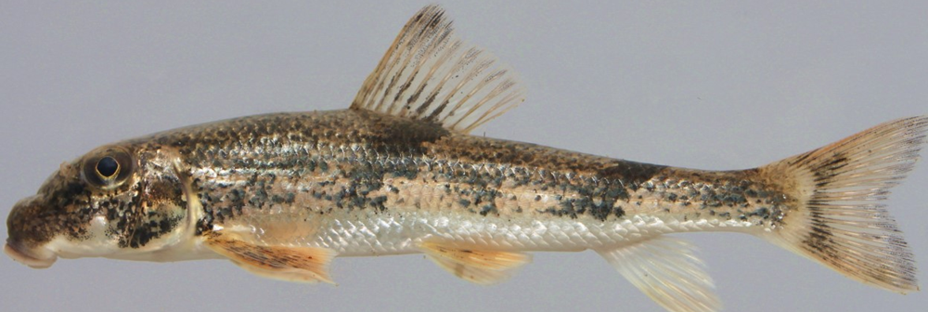
Most dominant fish species
Banded Darter, Etheostoma zonale
Rosyface shiner, Notropis rubellus
Golden Redhorse Moxostoma erythurum
Striped Shiner, Luxilus chrysocephalus
Silver shiner, Notropis photogenis
Hog sucker, Hypentelium nigricans

Slide 12
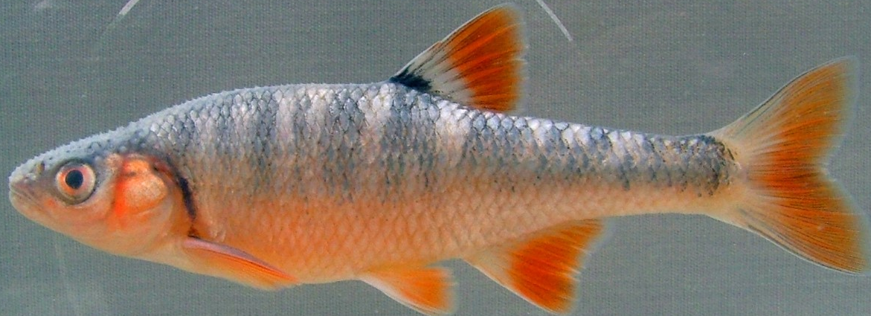
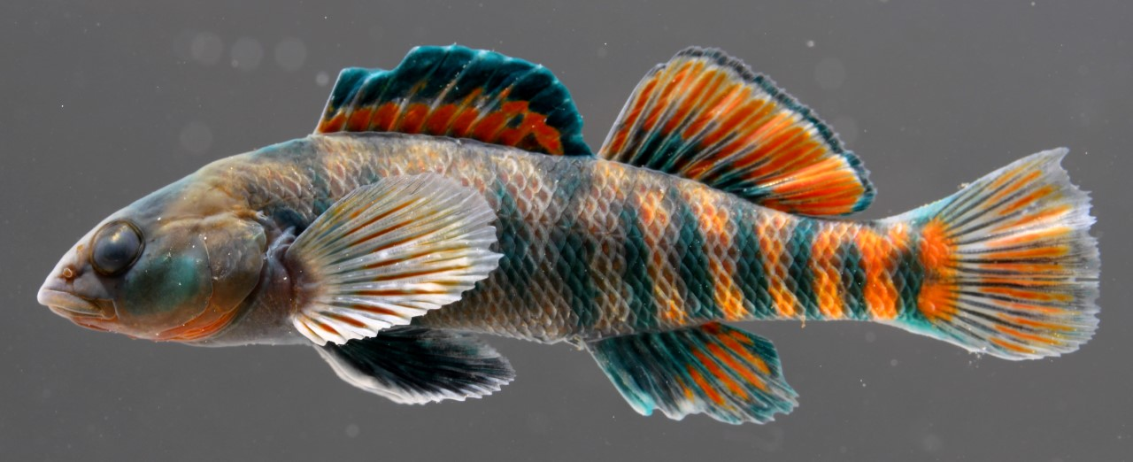
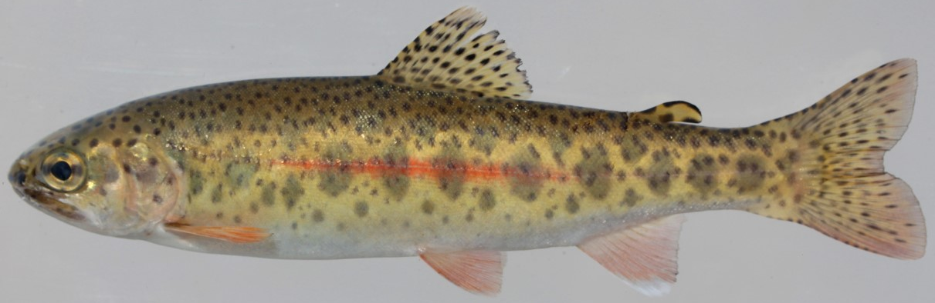
Results
Six species previously reported through this reach were not observed.
Scarlet Shiner, Lythrurus fasciolaris
Rainbow Trout, Oncorhynchus mykiss
Rainbow Darter, Etheostoma caeruleum

Slide 13
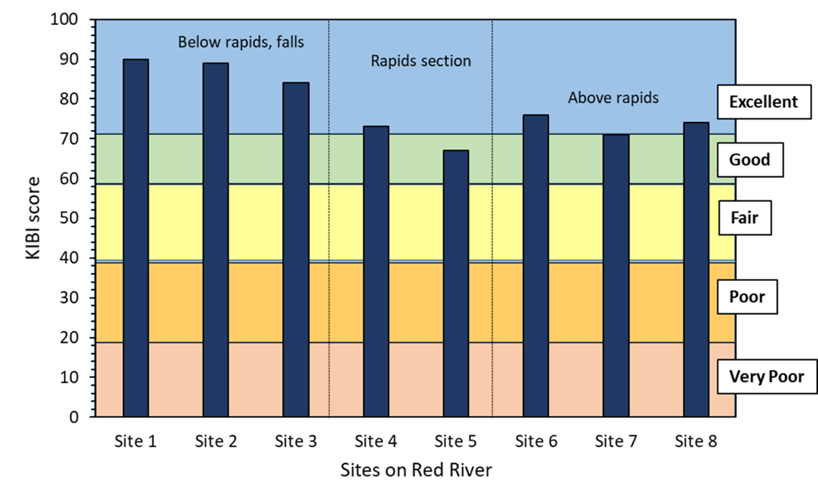
Results

Slide 14
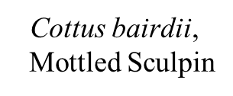
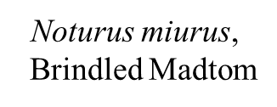
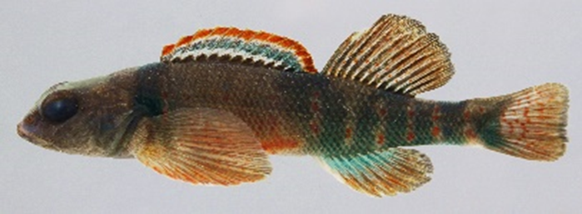
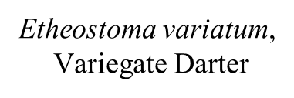
Results

Slide 15
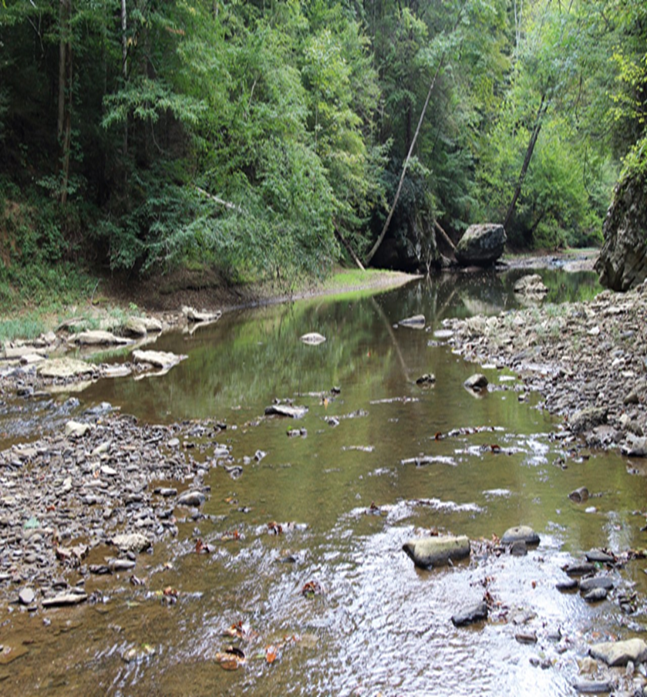
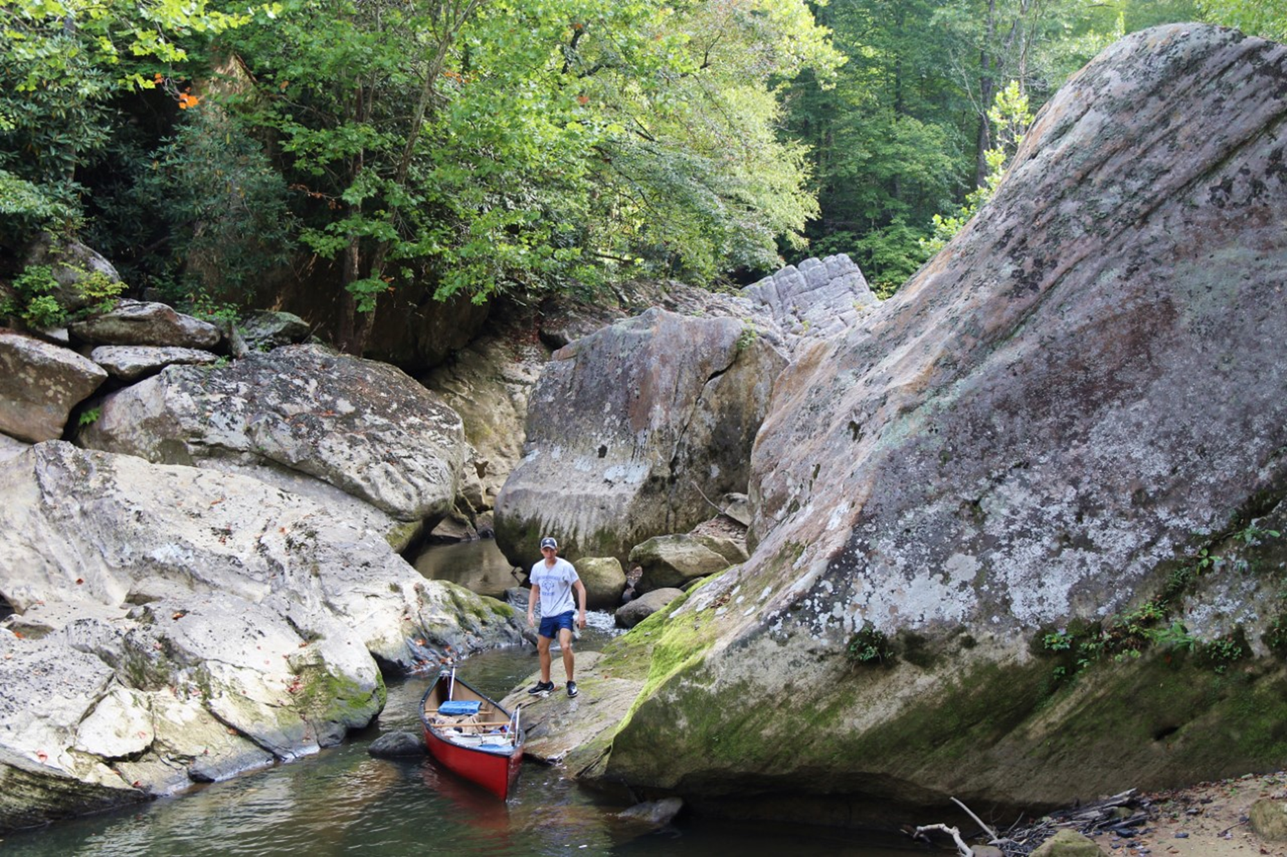
Discussion
Faunal break at the rapids

Slide 16
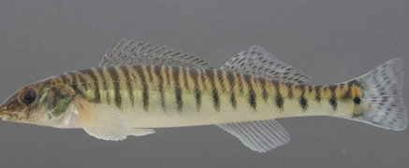
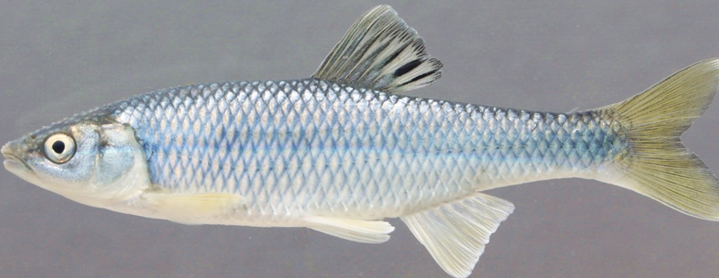
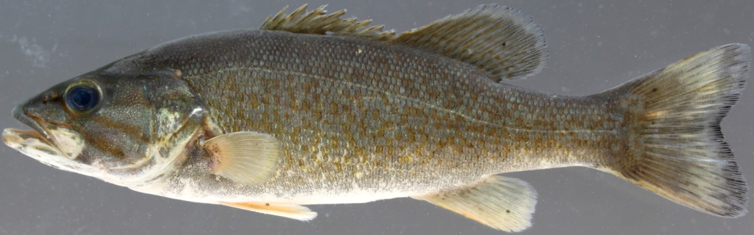
Summary
Extremely high KIBI numbers
Good baseline data for renewed interest and development of the Red River
These surveys help preserve habitats like these, to ensure they remain high quality and biodiversity.
5 species newly recorded in the Wild River section
Found one threatened species (Northern Brook Lamprey)

Slide 17
Acknowledgements
Special thanks to:
David Smith and Austin Spradlin for assistance in field work.
Mike Compton (Kentucky Nature Preserves, KNP), Cliff Hull (KNP), and Allen Helton (private landowner) for providing access to sites or help with funding and study design.
Fishes were collected under permits provided by the IACUC of Morehead State University, KDFWR, and United States Forest Service.

Slide 18
References
Branson, B. A., and D. L. Batch 1974. Fishes of the Red River drainage, eastern Kentucky. The University of Kentucky Press, Lexington.
Compton, M. C., G. J. Pond, and J. F. Brumley. 2003. Development and application of the Kentucky Index of Biotic Integrity (KIBI). Kentucky Department for Environmental Protection, Division of Water, Frankfort.
Kentucky Division of Water (KDOW). 2010. Standard operating procedure collection method for fish in wadeable streams. Kentucky Natural Resources and Environmental Protection Cabinet, Division of Water, Frankfort.
Kentucky Nature Preserves (KNP). 2019. Endangered, threatened, and special concern plant, animals, and natural communities of Kentucky. Office of Kentucky Nature Preserves, Frankfort.
Thomas, J. A. 2000. The fish fauna of the Red River system (Kentucky River basin) in eastern Kentucky: with a biotic assessment of water quality. Unpubl. M.S. Thesis, Eastern Kentucky University, Richmond.

