Slide 1
Mechanism of action of Riluzole
By
Blair Nethery
and Bio 446 class
Mohammad Abou El-Ezz, Cameron Brown, Tom Calderaro, Cameron Evans, Trey Grant, Rachel Hazelett, Cassity High, Dara Buendia Castillo, Tessa Ilagan, Jack Klier, Nicole Marguerite, Felicia Marino, Shelby McCubbin, Nicholas Meredith, Pooja Naidugari, William Russell, Noah Sommers, and Robin L. Cooper
Fall 2020

Slide 2
Introduction
Amyotrophic lateral sclerosis (ALS) is a neuromuscular disease that is characterized by motor neuron degeneration
Riluzole is used to decrease the calcium influx into the postsynaptic cell in some studies.
Riluzole is the only FDA approved treatment but there is little known about it.
Notes:
ALS is causesd by glutaminergic excitotoxicity in which there is too much glutamate in the synaptic cleft, which causes an increased influx of calcium into the post synaptic cell. Calcium then activates enzymes which can have toxic effects
The exact cause of glutaminergic excitotoxicity is not known
Variation in the progression of the disease
It is proposed that Riluzole works on NMDA receptors to decrease calcium influx into the post synaptic cell, but its exact mechanisms are not clear
Riluzole only increases life span by up to 6 months

Slide 3
Predictions
NMJs:
We hypothesize that Riluzole blocks the presynaptic sodium channels causing a smaller action potential and causing less glutamate to be released by the presynaptic cell. Resulting in smaller EJPs.
Sensory neurons:
We hypothesize that Riluzole blocks the sodium channels and decreases sensory nerve activity.
Notes:
Inhibit sodium channels to decrease AP, which decreases the amount of calcium channels activated, which releases less neurotransmitter

Slide 4
Crayfish: use glutamate
Humans: use ACh

Slide 5
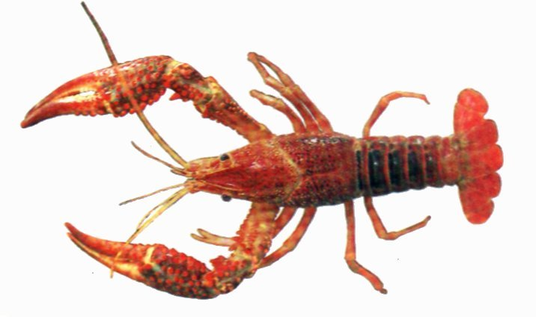
Graded potentials:
more neurotransmitter released causes a larger EPP (also named EJP or EPSP)

Slide 6
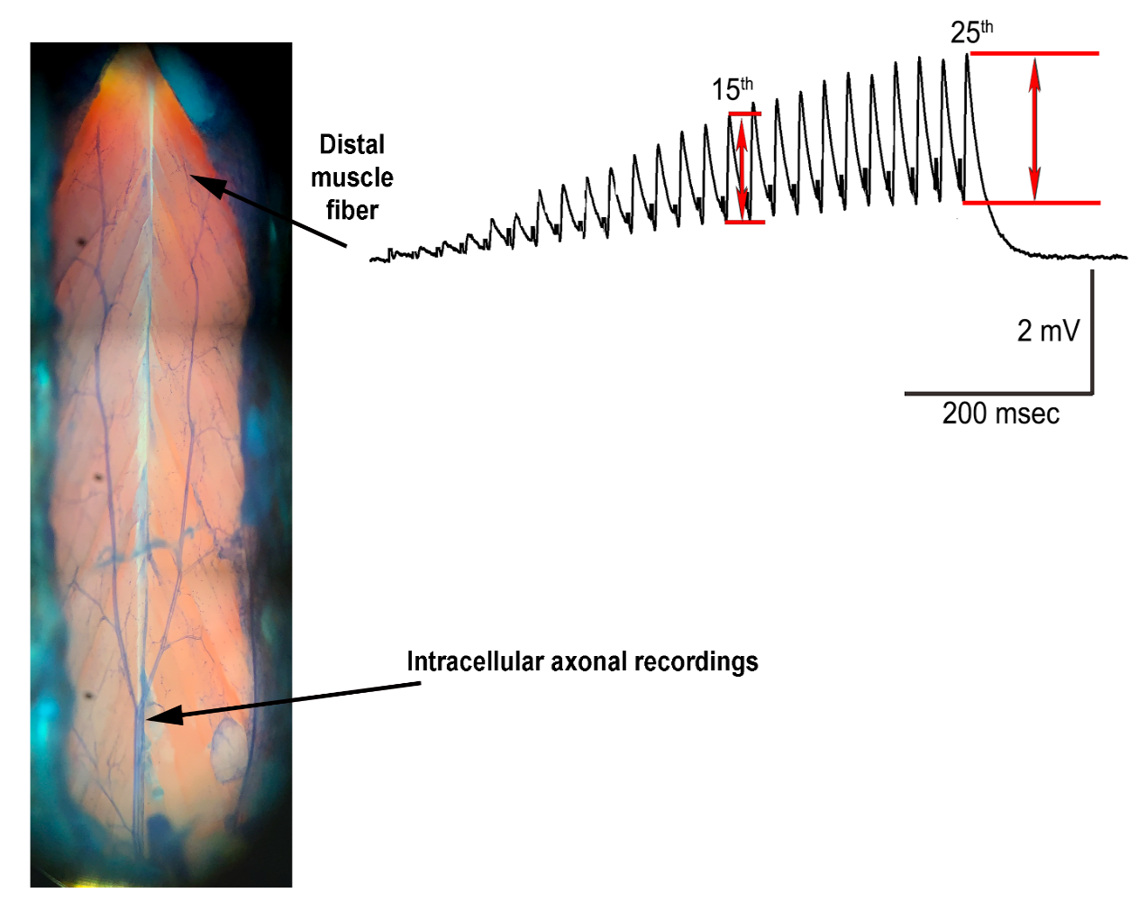
Methods
Crayfish preparations with 1mM Riluzole
These preps have glutaminergic synapses at the NMJ
Measure 25th EJP
Notes:
Using crayfish and drosophila NMJ because they have glutaminergic synapses
- Measure the 25th EPSP for crayfish and measure the amplitude of the EPSP in fly prep

Slide 7
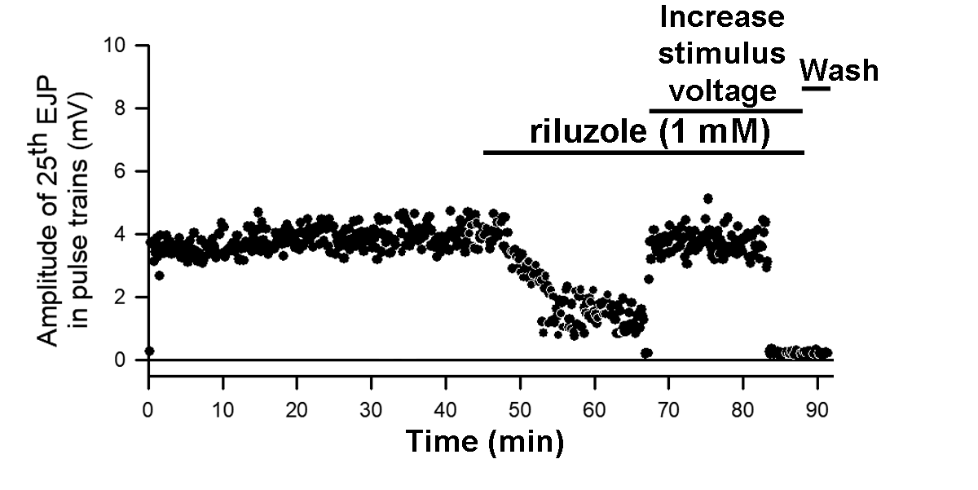
Results- with 1 mM Riluzole
Six out of six preparations showing failure in evoking a response with
exposure to riluzole (1 mM) (N=6, p<0.05, non-parametric Sign-test).
Notes:
In the future we also want to test the axon of crayfish to determine how it affects the EJP and to help us confirm if it is acting upon the voltage gated sodium channels

Slide 8
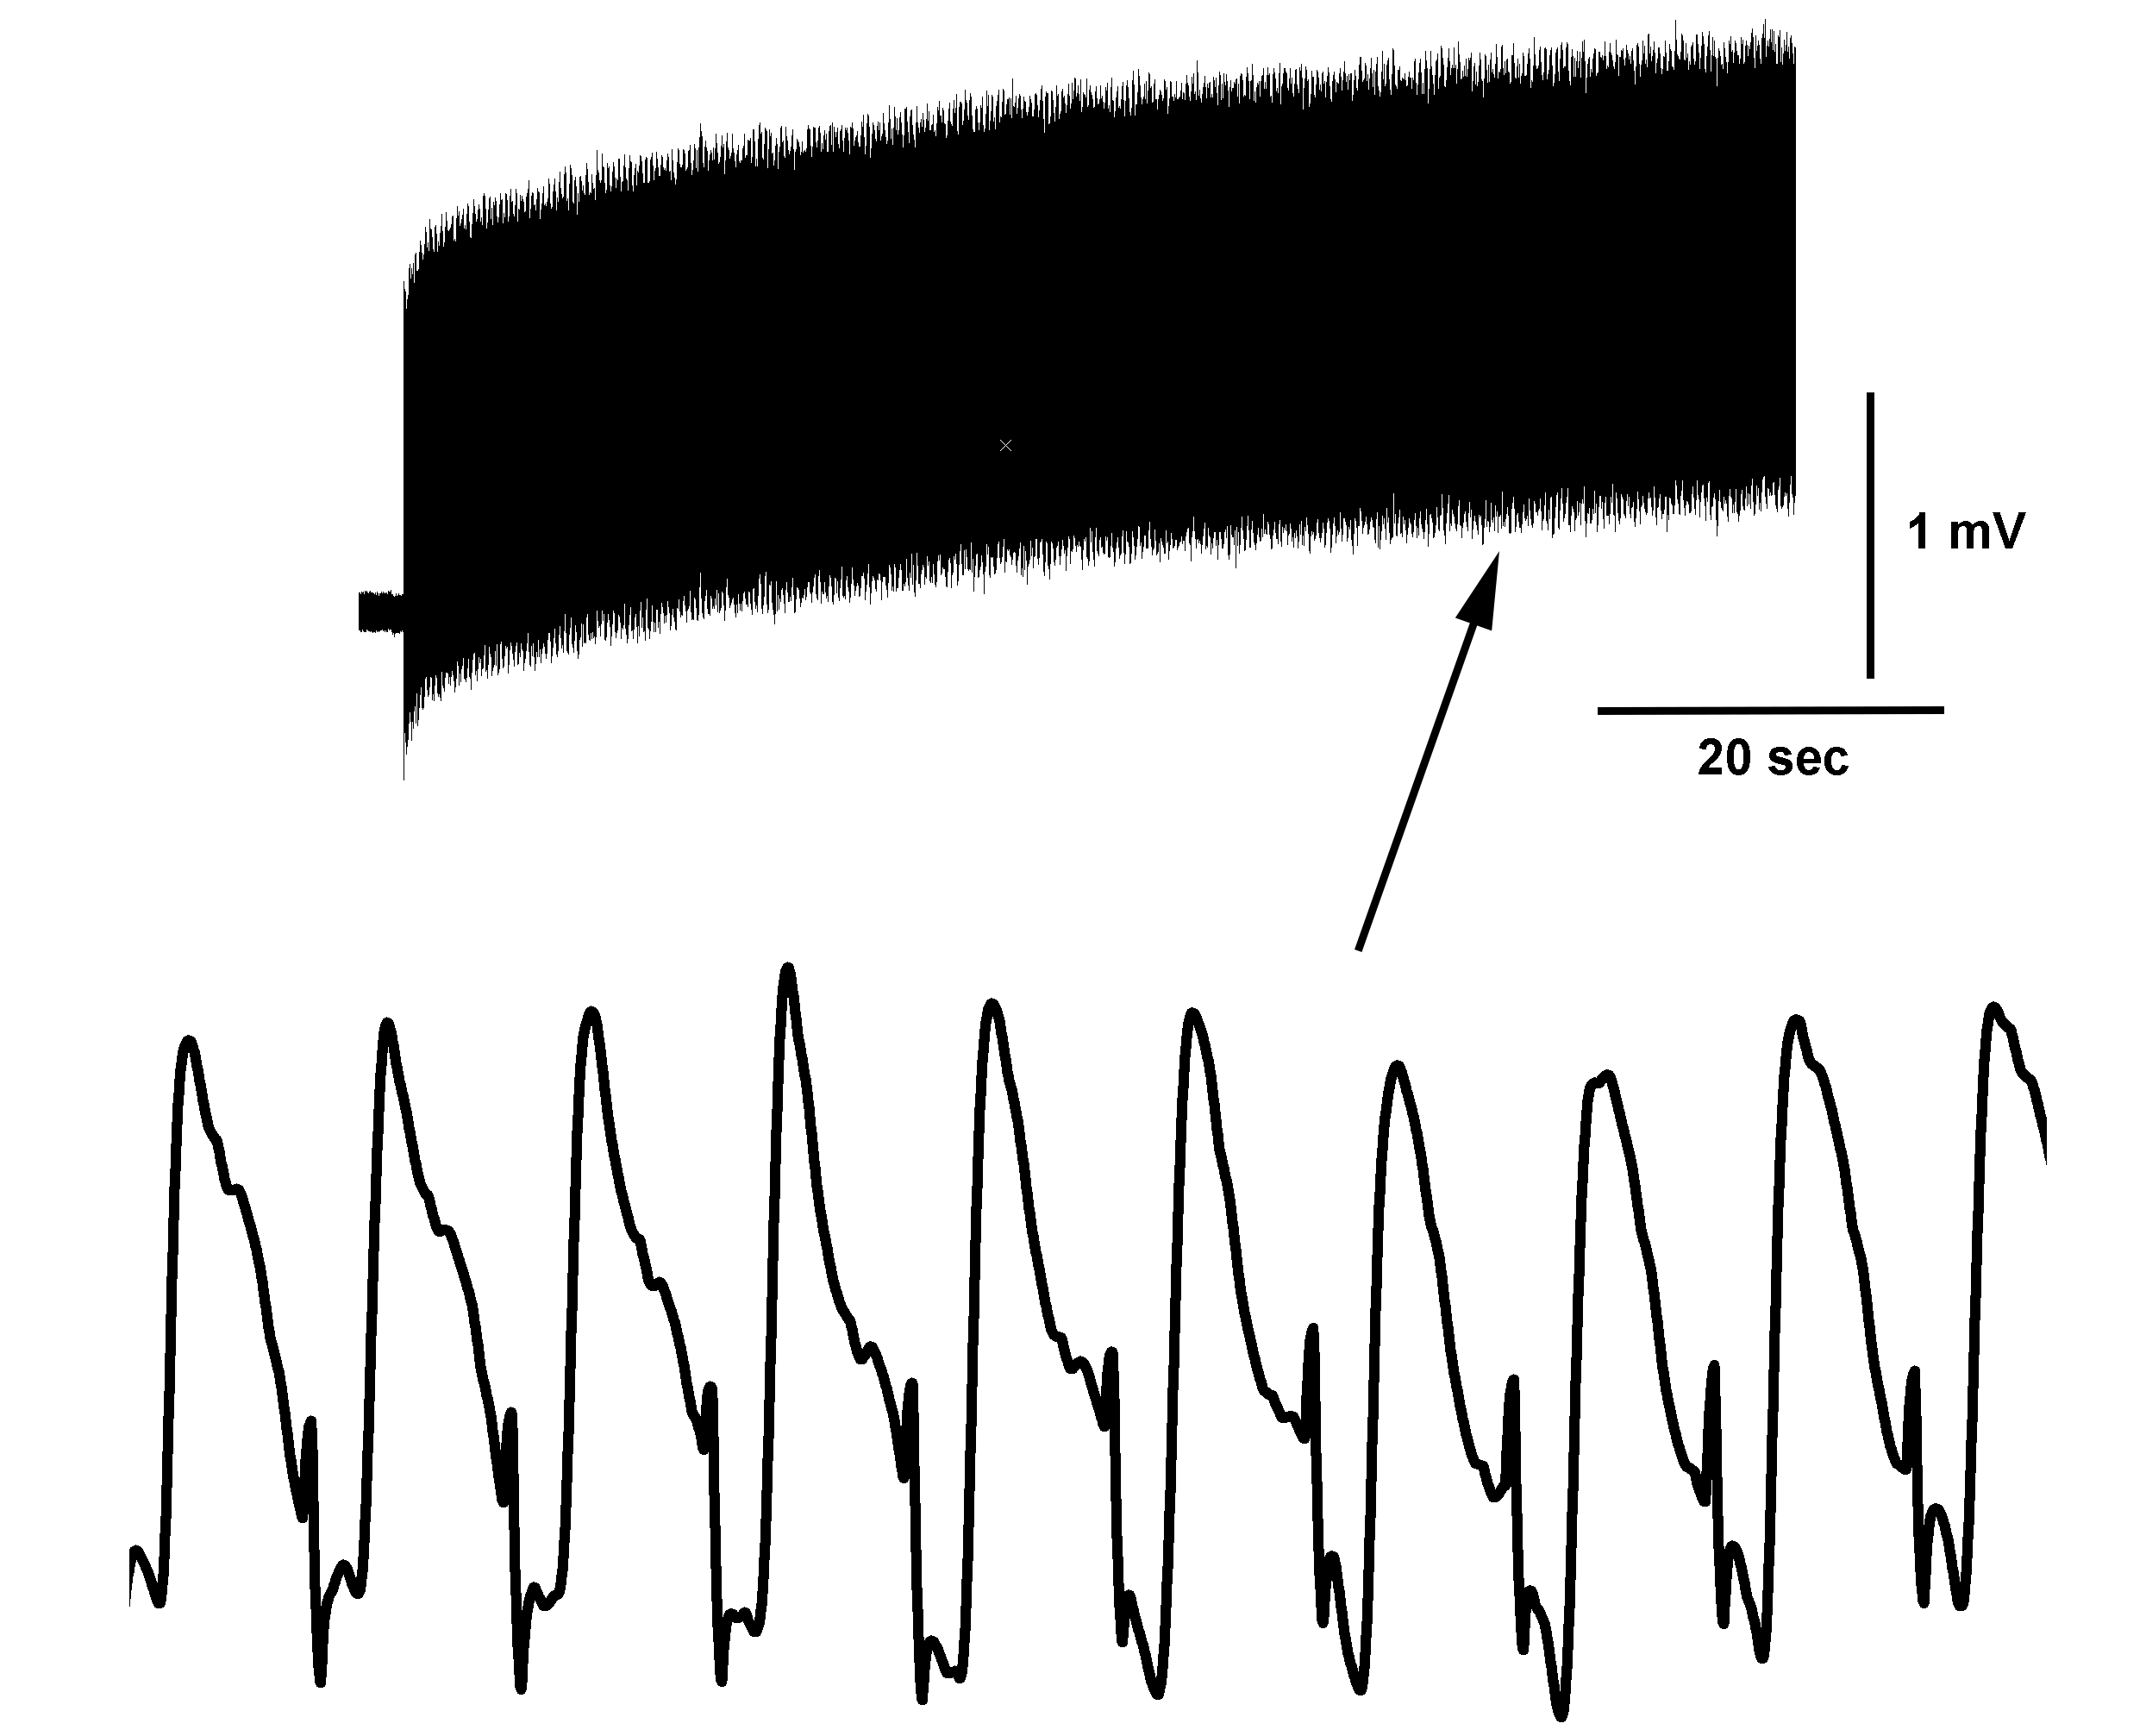
Six out of six preparations showing failure in evoking a response with
exposure to riluzole (1 mM) (N=6, p<0.05, non-parametric Sign-test).
Notes:
The second paradigm consisted of continuous stimulation of 20Hz or higher frequency, up to 60 Hz, to facilitate the evoked responses to detect them. The continuous stimulation occurred for 1 minute to obtain a plateau in the amplitude of the EJPs (Crider and Cooper, 2000) (Figure 2).

Slide 9
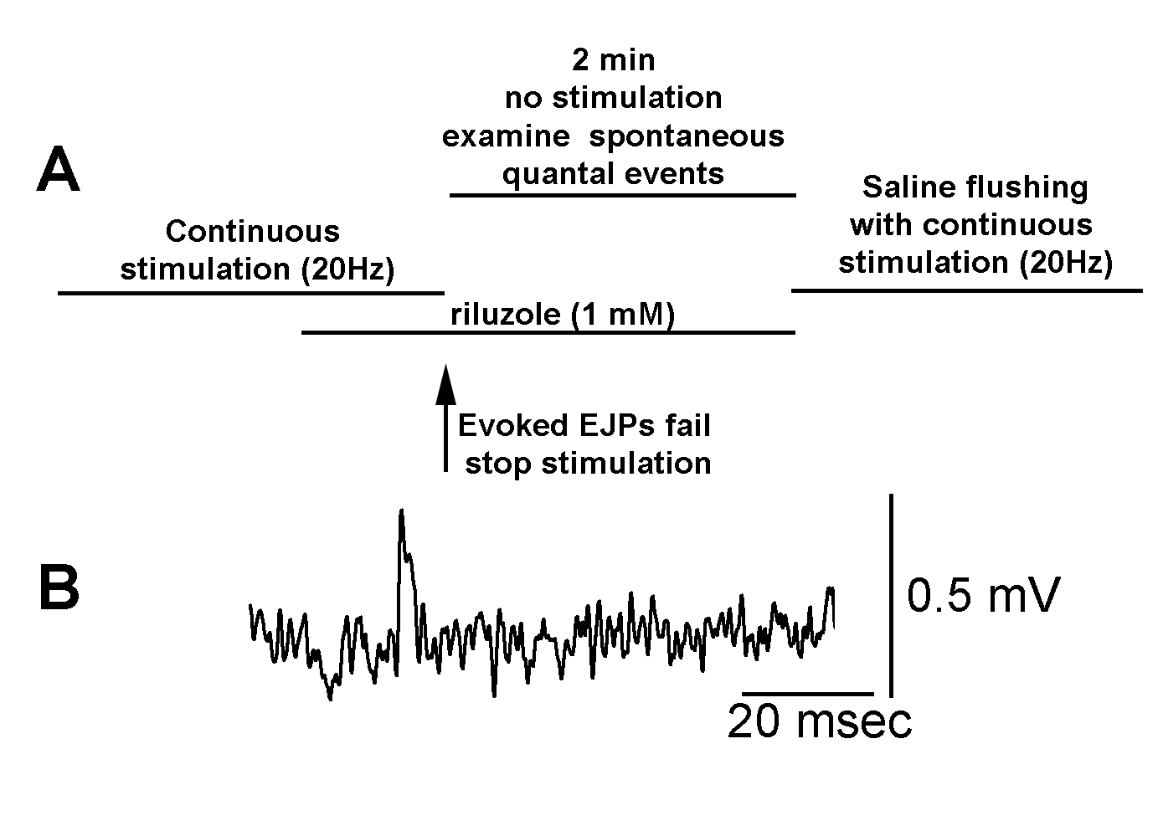
While exposure to riluzole when evoked responses failed spontaneous quantal events continued to occur. Thus, riluzole does not block the postsynaptic glutamate receptors on the opener muscle.

Slide 11
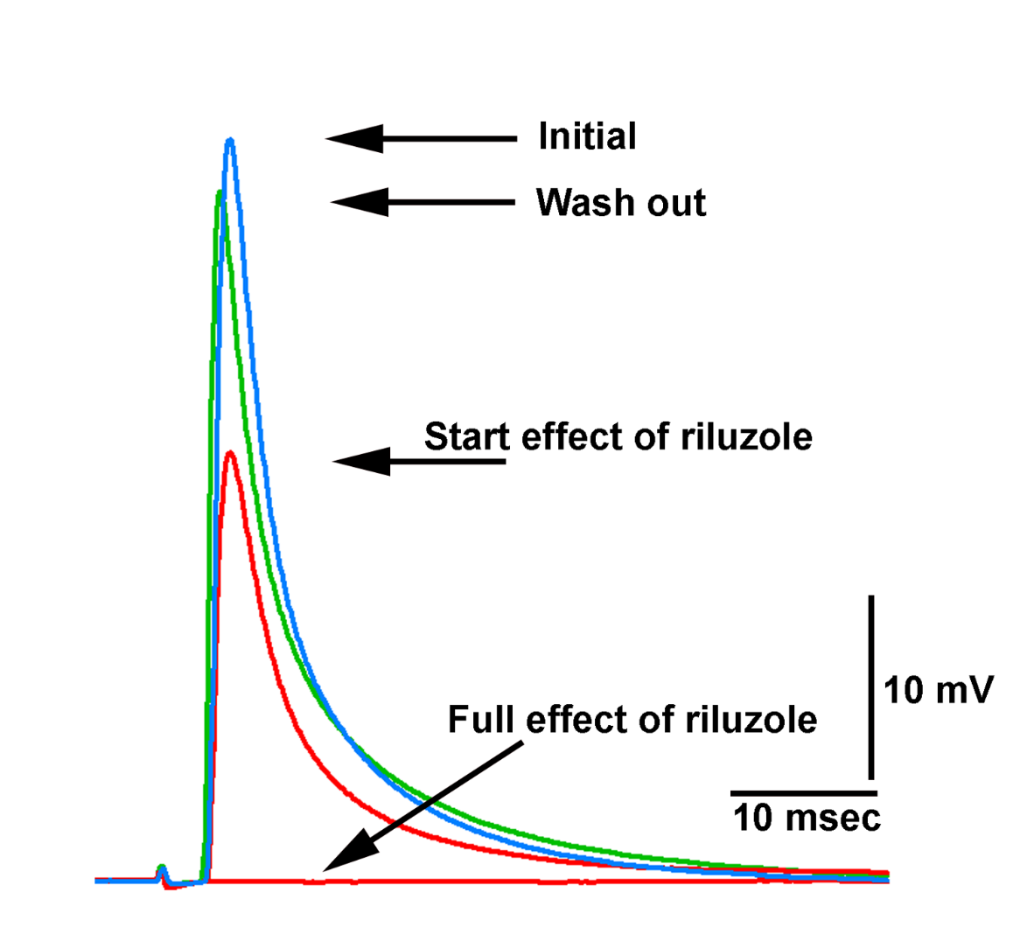
Representative traces of action potentials from the excitatory motor neuron to the opener muscle in saline and during incubation in riluzole while the amplitude is depressed and recovered upon extensive wash out of the riluzole. (N=6, p<0.05, non-parametric Sign-test).

Slide 12
Blue crab : Proprioceptors in the leg
Used sensory neurons in the crab
Bend at joint to stretch the sensory neuron
Expect the same results as motor neurons
However, we found that the sensory nerves were not responsive to Riluzole

Slide 13
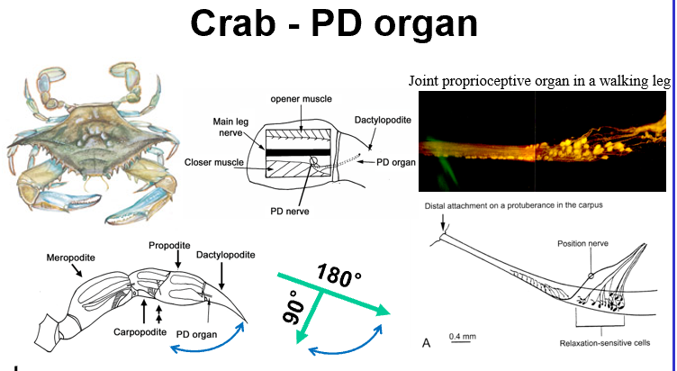

Slide 14
Repeat 3 times
Repeat 3 times
Move joint and hold for 10 seconds
Add Riluzole
Incubate
90 minutes
Move joint and hold for 10 seconds

Slide 15
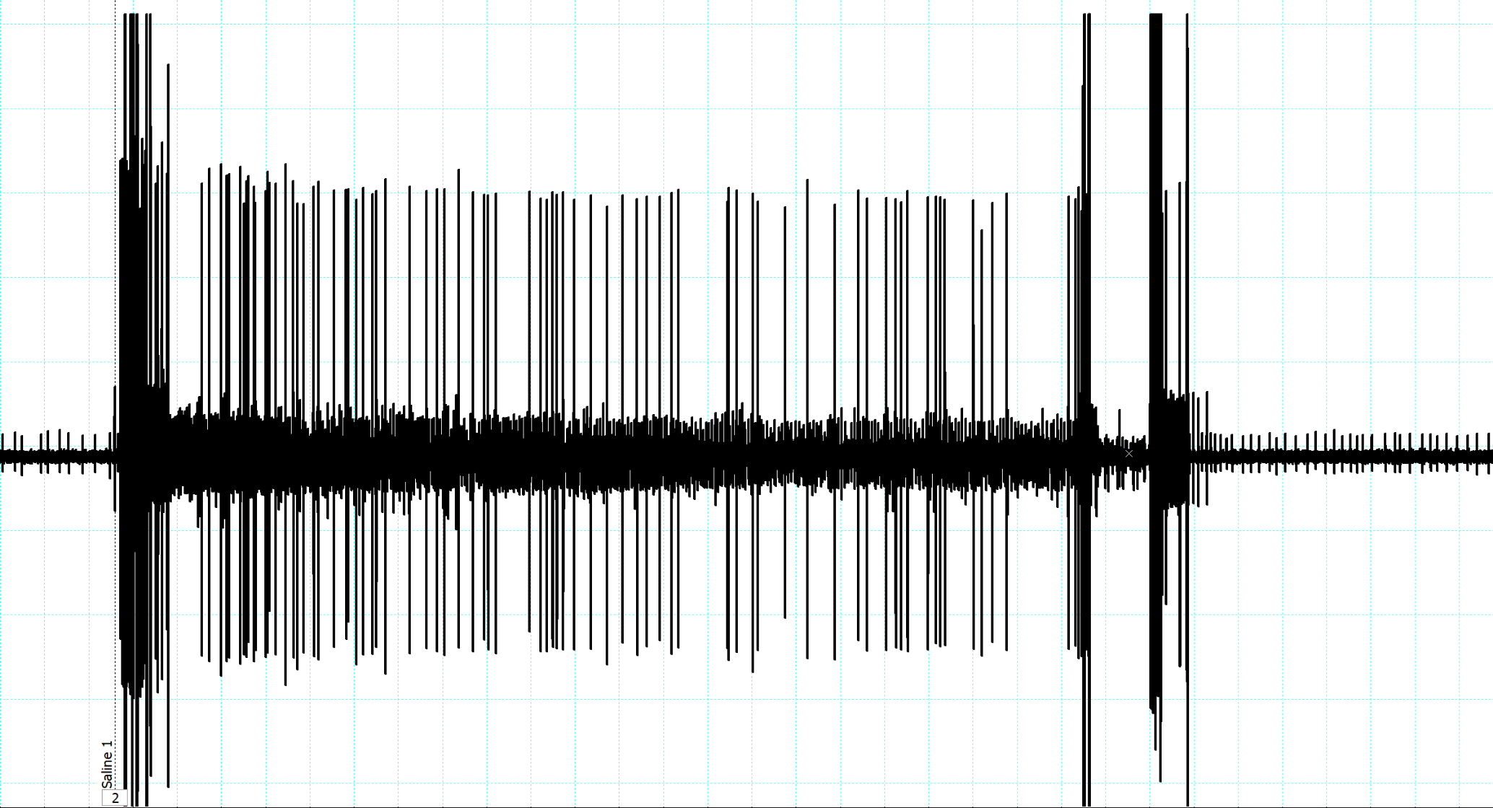

Slide 16
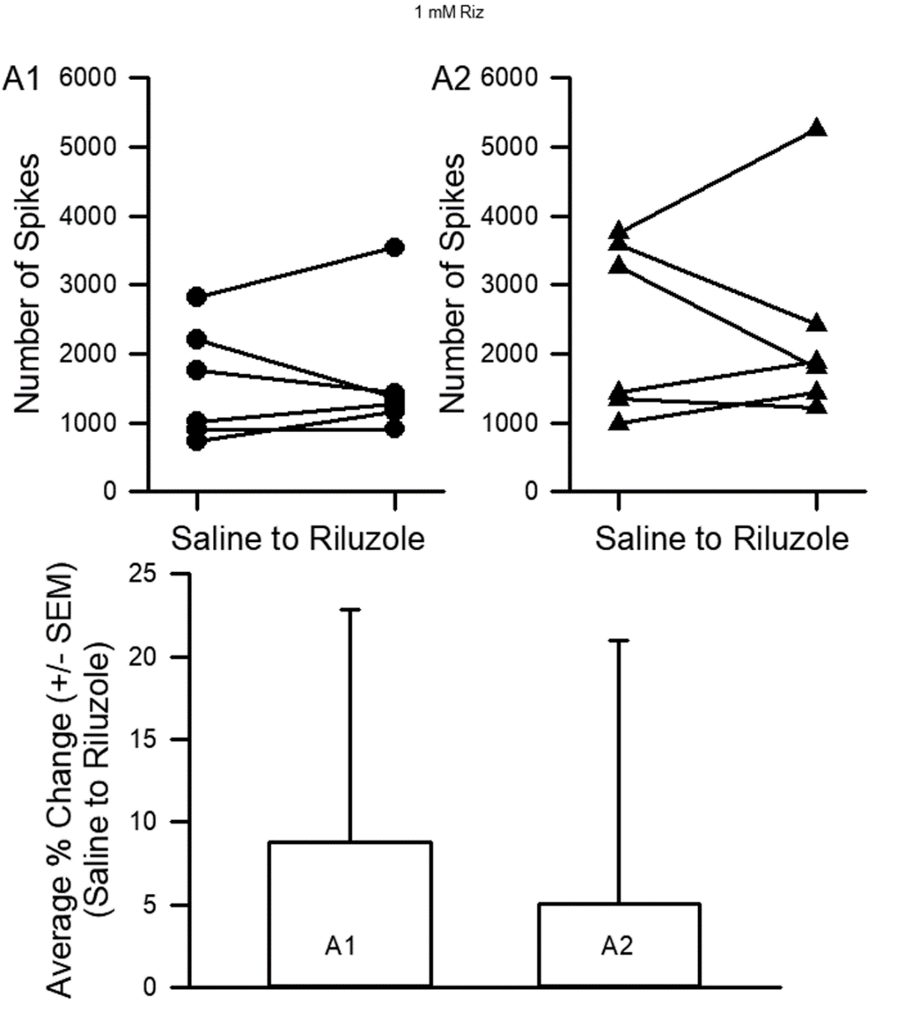
No significant difference due to the effect of riluzole (1mM).

Slide 17
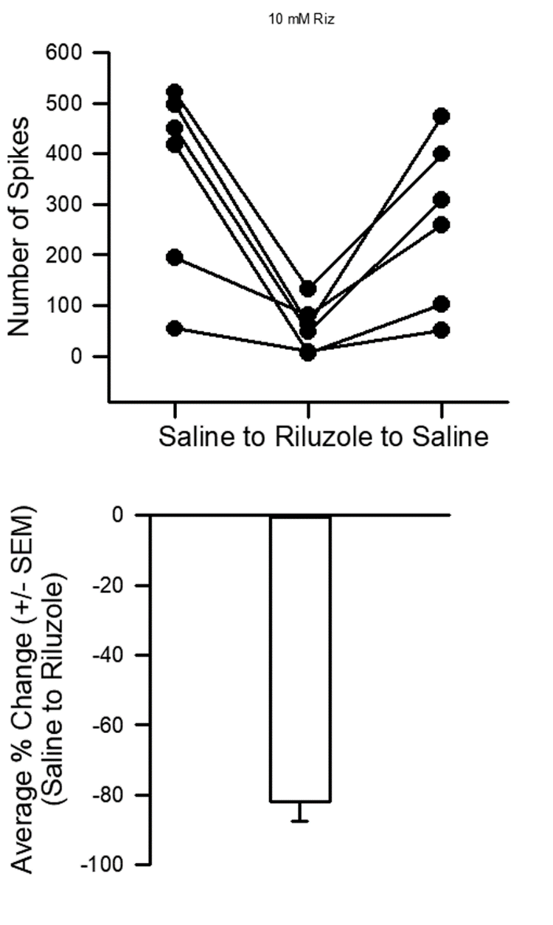
Six out of six preparations drastically reduced in activity due to exposure of 10 minutes in riluzole at 10mM. (N=6, p<0.05, non-parametric Sign-test).

Slide 18
Summary
At the crayfish NMJ evoked EJPs are depressed but spontaneous quantal events are still present. Thus, the glutamate receptors are not blocked.
Action potentials are depressed in motor neuron which blocks evoked EJPs .
Sensory neuron activity of the crab leg is blocked at high concentrations (10 mM) in a few minuets . Likely also blocking action potential production.
Implications in humans: Sensory perception and cognitive abilities may be altered by the actions of Riluzole.

