Slide 1


Characterization of Mercury Resistant Bacteria from the Kentucky River
Brianna Rhoton and William Staddon
Department of Biological Sciences, Eastern Kentucky University, Richmond KY 40475
Notes:
Hello and welcome to my presentation. My name is Brianna Rhoton, and I am a 3rd year undergraduate student working under Dr. William Staddon in his research lab. Our research will discuss characterization of mercury resistant bacteria that have been isolated from the Kentucky River.

Slide 2
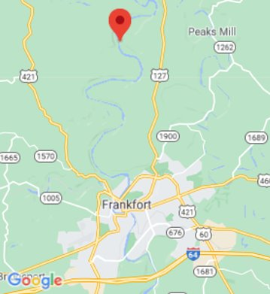
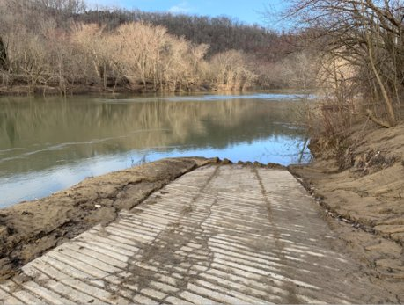
Kentucky River
Steel Branch Boat Ramp
89 km upstream
Notes:
Specifically, our isolates were retrieved from the Steel Branch Boat Ramp on the Kentucky River. This location is approximately 89 km upstream.

Slide 3
Objectives
Isolate mercury resistant bacteria
Identify bacteria by DNA sequencing
PCR of mercury resistance genes
Notes:
We had 3 objectives when conducting our research. First, we aimed to isolate the mercury resistant bacteria. Then, we identified the bacteria via DNA sequencing. And finally, we ran PCR reactions for mercury resistant genes.

Slide 4
Objectives
Isolate mercury resistant bacteria
Identify bacteria by DNA sequencing
PCR of mercury resistance genes
Notes:
To begin, I will discuss our first objective- isolating the mercury resistant bacteria.

Slide 5
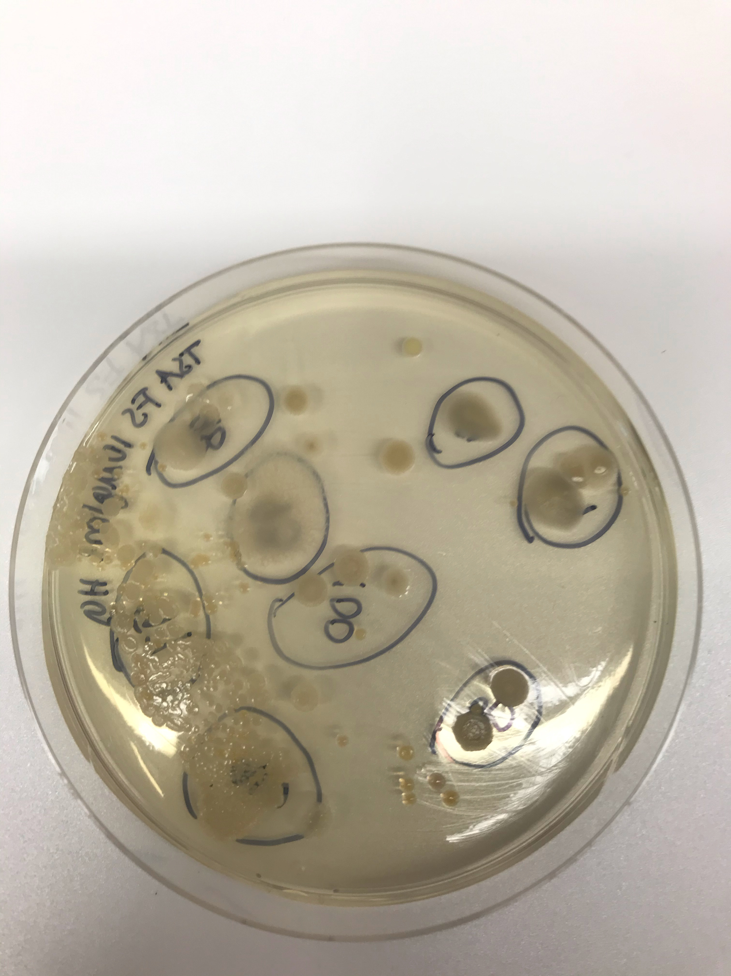
Initial Isolation
Tryptic soy agar with 10 ug/mL of Hg²⁺
Incubate 24 – 48 hours @ 37ºC
~100 isolates selected based on different appearances
Notes:
To start the isolation process, bacteria samples were streaked on TSA with a concentration of 10ug/mL of mercury ions. The dishes were incubated for approximately 24-48 hours at 37 degrees Celsius. Once there was growth on the plates, approximately 100 isolates were selected based on different appearances. We believe that colonies that have a different appearance on the plates may prove to be different species of bacteria.

Slide 6
Mercury Levels at the Steel Branch Site
Kentucky Division of Water
[Hg²⁺] in isolation media
Mercury Concentration (ng/L)
2010
2012
2014
2016
2018
2020
Year
Notes:
This chart shows the average mercury levels that have been measured in the Kentucky River over the past 10 years. The concentration of mercury in our media is significantly higher than the levels typically found in the Kentucky River.

Slide 7
TSA Component
Hg ²⁺
Bacteria
Notes:
It is possible that there was variation in the availability of mercury able to bind to the bacteria.

Slide 8
TSA Component
Hg ²⁺
Bacteria
Notes:
The mercury ion may have bound to some of the TSA components during the making of the plates. This would have caused the effective concentration of mercury available to the bacterial isolates to be lower that 10ug/mL.

Slide 9
Objectives
Isolate mercury resistant bacteria
Identify bacteria by DNA sequencing
PCR of mercury resistance genes
Notes:
The next objective to discuss is our process and results of identifying bacteria via DNA sequencing.

Slide 10
Sequencing
16s rRNA gene
Other
Notes:
100 DNA isolates were sent off to a lab to be sequenced. These sequencing results were then put through BLAST software to obtain the classifications of each isolate. As shown by the chart, most of our samples were members of the Bacillus genus. Additionally, there were four isolates in the Pseudomonas genus, one in the Aerococcus genus, and one in the Citrobacter genus. These are grouped together in the ”other” category of the chart.

Slide 11
Objectives
Isolate mercury resistant bacteria
Identify bacteria by DNA sequencing
PCR of mercury resistance genes
Notes:
The final objective to discuss are the results of PCR reactions for mercury resistant genes.

Slide 12
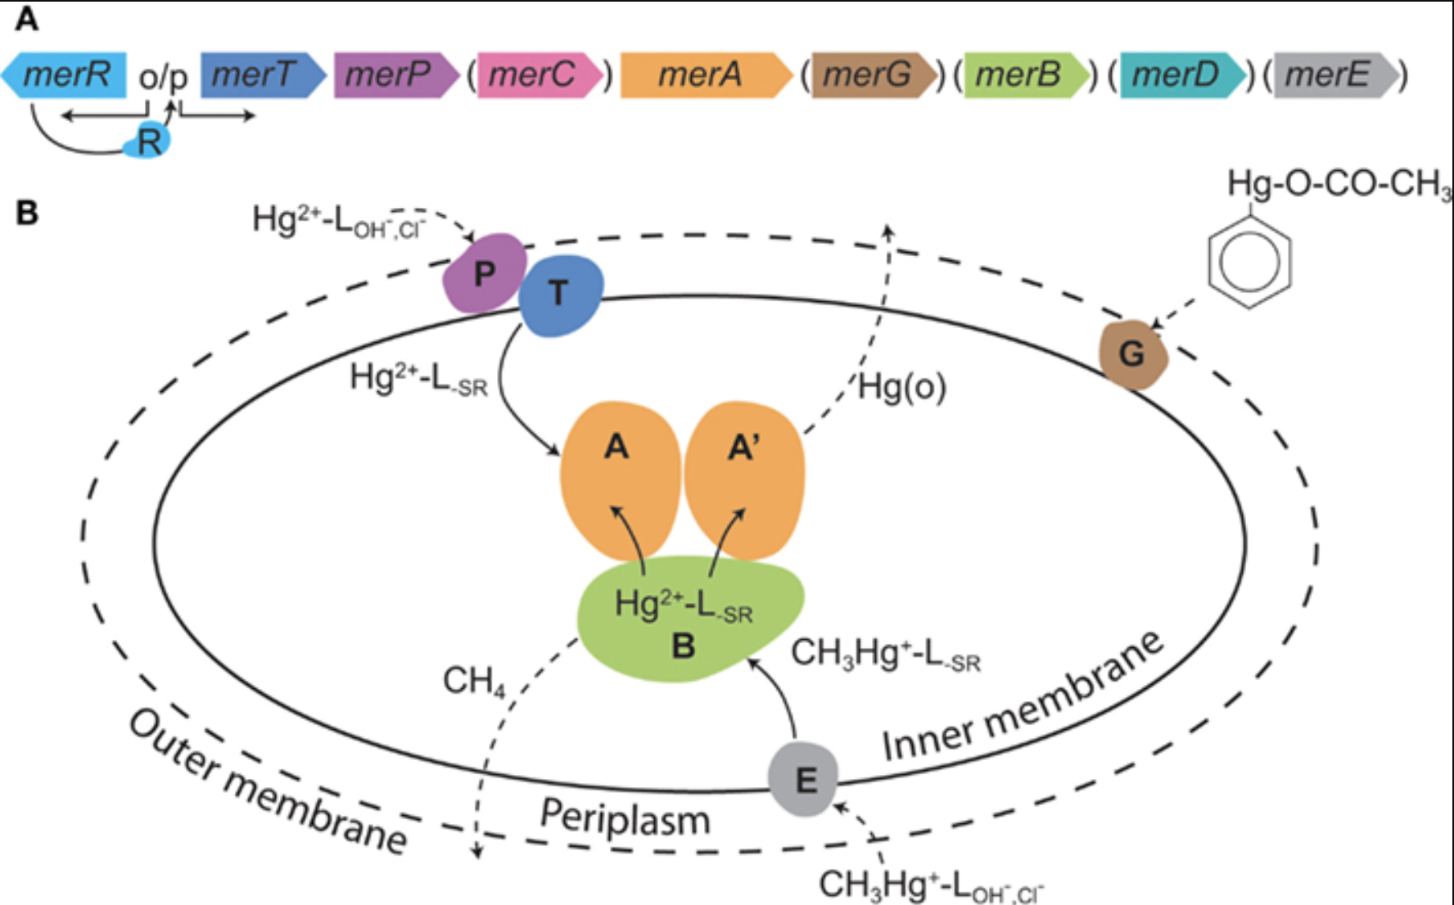
Mercury Resistance Genes
mer operon
Boyd, E. S., & Barkay, T. (2012). The mercury resistance operon: from an origin in a geothermal environment to an efficient detoxification machine. Frontiers in Microbiology, 3, 349. https://doi-org.libproxy.eku.edu/10.3389/fmicb.2012.00349
Notes:
The mer operon contains genes proven to be correlated with mercury resistance in bacteria. Specifically, in our research, we looked at 4 mer operon genes: merA, merB, merD, and merR.

Slide 13
Mercury Resistance Genes
mer operon
merR – Regulatory gene
merD – Regulatory gene
Boyd, E. S., & Barkay, T. (2012). The mercury resistance operon: from an origin in a geothermal environment to an efficient detoxification machine. Frontiers in Microbiology, 3, 349. https://doi-org.libproxy.eku.edu/10.3389/fmicb.2012.00349
Notes:
MerR and merD genes are involved in the regulation of the operon.

Slide 14
Mercury Resistance Genes
mer operon
merR – Regulatory gene
merD – Regulatory gene
merB
merA
Hg
Hg ²⁺
Hg ⁰
Alkylmercury
lyase
Mercury
reductase
Organic Matter
Elemental mercury
Vapor
Organic Matter
Boyd, E. S., & Barkay, T. (2012). The mercury resistance operon: from an origin in a geothermal environment to an efficient detoxification machine. Frontiers in Microbiology, 3, 349. https://doi-org.libproxy.eku.edu/10.3389/fmicb.2012.00349
Notes:
The pathway of mercury resistance in the mer operon begins with mercury covalently bound to organic matter in bacteria. The merB gene then codes for the enzyme alkylmercury lyase. This enzyme breaks the covalent bond, separating the joined molecules into mercury ions and independent organic matter. The merA gene then codes for the enzyme mercury reductase which converts the mercury ion into its elemental state. The elemental mercury created from this pathway is then released from the bacteria in the form of a vapor.

Slide 15
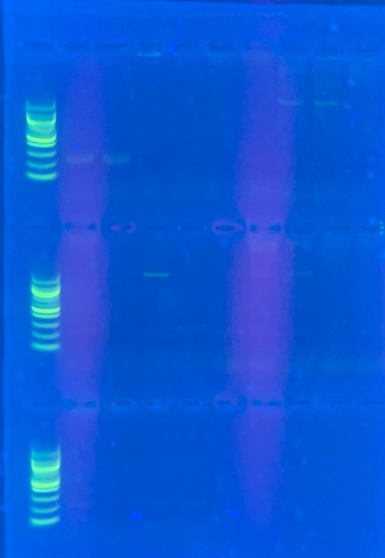
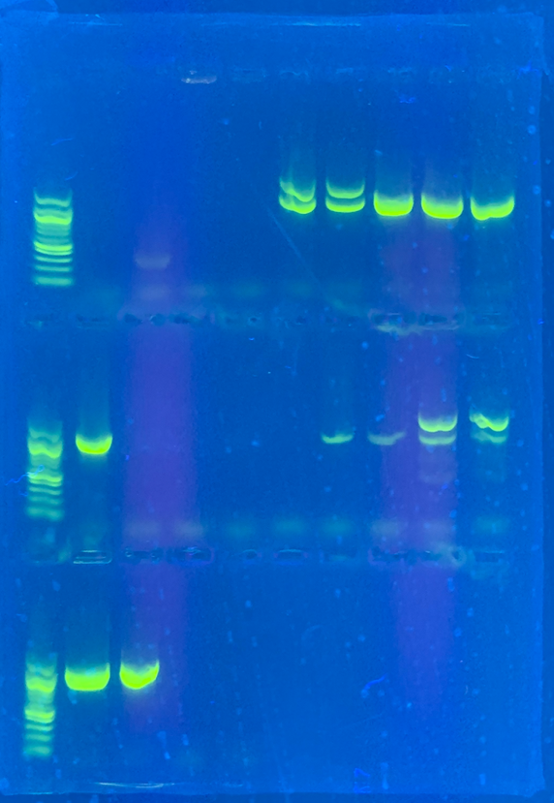
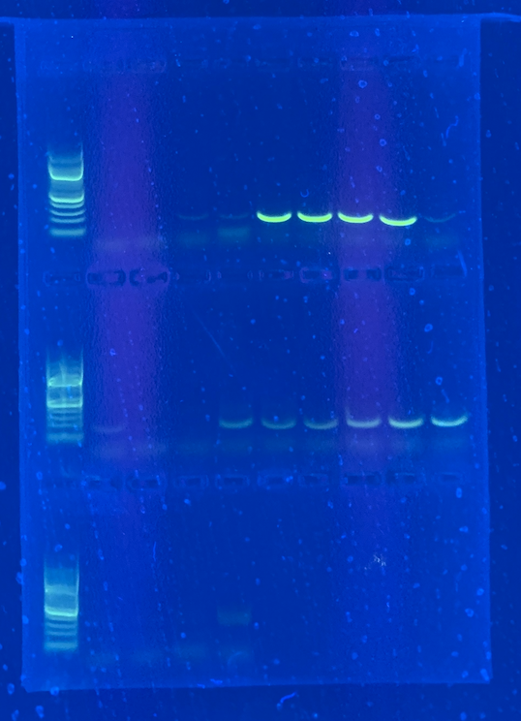
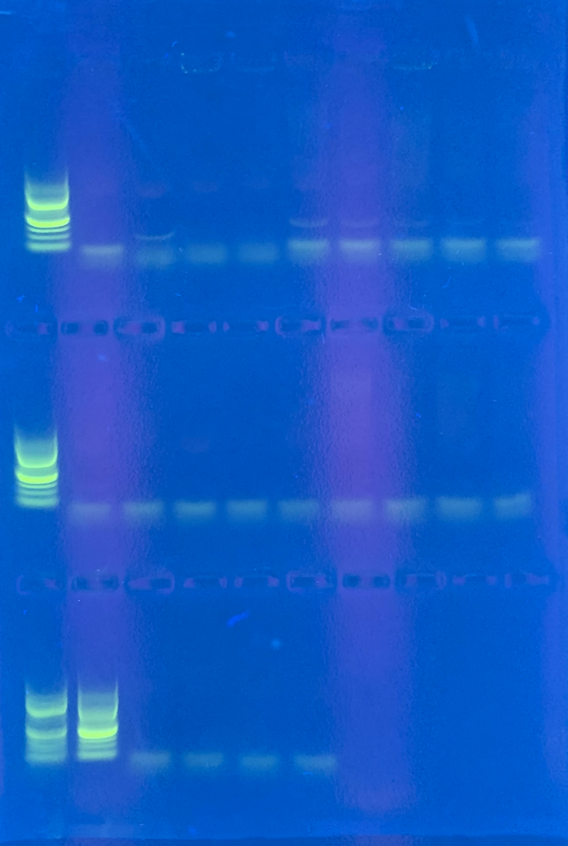
PCR of pooled samples
merD
merR
Faint bands
Notes:
To run PCR reactions for the mer operon genes, the isolates were pooled into groups of 10. This decision was made to economize on materials until we had a better understanding of what was being done and to also see if the genes were really there.

Slide 16
PCR of pooled samples
Notes:
The gel electrophoresis results of the merB gene contained no bands. This indicates that our PCR conditions must be adjusted prior to looking at individual bacteria.

Slide 17
PCR of pooled samples
Notes:
Gel results for the merA gene showed a lot of strong bands, indicating that we had good PCR conditions for the reaction.

Slide 18
PCR of pooled samples
merD
Notes:
Similarly, gel results for the merD gene also had some good bands indicating correct PCR conditions. In the merA and merD gels, the samples either had bothof these genes or neither. Additionally, some of the samples were resistant to mercury but did not show any indication of containing the mer operon.

Slide 19
PCR of pooled samples
merD
merR
Faint bands
Notes:
Finally, gel results for merR gene presented some faint bands. However, the bands are not strong enough to fully accept the results. Therefore, PCR conditions may need adjusted to show more prominent bands for this gene.

Slide 20
Summary
Predominantly Bacillus genus
Indication of mer operon in several bacteria
Notes:
In summary, our results indicate that most of the isolates belong to the Bacillus genus. Additionally, there was an indication of the presence of the mer operon and corresponding genes in several of our bacterial isolates. This concludes my presentation on the characterization of mercury resistant bacteria from the Kentucky river. Thank you for your time and I look forward to discussing this research with you further in the Q&A session.

