Slide 1
Genome improvement of
Magnaporthe oryzae strains
Guy11 and U233
2020 KAS Annual Meeting
By Chloe DeGiorgio and Diksha Satish
University of Kentucky and Western Kentucky University

Slide 2
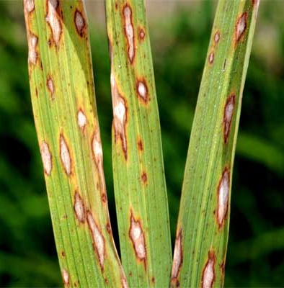
Background
Magnaporthe oryzae is a pathogenic fungus
Subterminal regions are unstable portions of the genome
High-quality, chromosome-level genome assemblies are necessary
Current genomes were derived from MinION sequencing and are broken into multiple contigs
Source: https://agfax.com/2018/09/28/rice-blast-the-most-devastating-rice-disease-in-the-world/
Notes:
Magnaporthe oryzae is a pathogenic fungus
Subterminal regions are unstable portions of the genome
A quality that may be utilized for quick adaptation and/or accelerated evolution of the speceis
, high-quality, chromosome-level assemblies can provide information on internal and subterminal genome structure which will help us understand the underlying causes of the subterminal instability. However, repeats in the genome cause complications for assembly programs.
Current genomes were derived from MinION sequencing and are broken into multiple contigs

Slide 3
Goals
Refine MinION genomes and connect contigs to create chromosome-level assemblies for future studies
Original number of Guy11 contigs: 33
Original number of U233 contigs: 49
Examine subtelomeric regions
Overrepresented genes
Chromosome-end organization

Slide 4
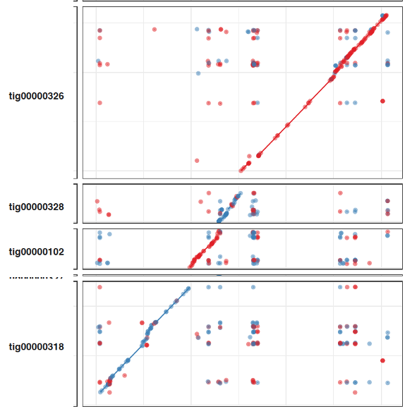
Methods
MUMplot graphs
Contig arrangement, translocations, mis-assemblies
Minimap2 and IGV
Raw read coverage and mis-assemblies
BLAST searches with raw read data for supporting evidence
MUMplot graph of Guy11 contigs and Chromosome 6 of LpKY97-1A
Notes:
To gain insight on how the genomes may be arranged, the MinION contigs were aligned to chromosome-level assemblies using the software MUMplot [1]. The graphs were visualized and then examined to find potential connections, translocations, and mis-assemblies. Raw reads that were used to assemble the contigs were mapped against the contigs and viewed in IGV. MinION raw reads were then analyzed using BLAST searches to support the evidence provided by the MUMplots.
We used MUMplot graphs to find potential contig connections by looking at the contig alignments on the reference chromosomes. We also found potential connections by looking for raw reads that had a large number of bases soft-clipped at their ends.

Slide 5
Connecting contigs
MUMplot graph of Guy11 contigs and Chromosome 6 of LpKY97-1A
IGV view of raw reads. Raw reads with many bases soft-clipped at the end of the contig were BLASTed for connections.
Notes:
We used MUMplot graphs to find potential contig connections by looking at the contig alignments on the reference chromosomes. We also found potential connections by looking for raw reads that had a large number of bases soft-clipped at their ends.

Slide 6
Results
 | Original # contigs | Final # contigs | Connections | Assembly errors | Translocations
Guy11 | 33 | 23 | 7 | 10 | None confirmed
U233 | 49 | 43 | 5 | 11 | 7
Notes:
Before the improvement process, Guy11 had 33 contigs. After finding 7 connections and 10 assembly errors, the final genome now has 23 contigs. We also searched for translocations in Guy11 but found none.

Slide 7
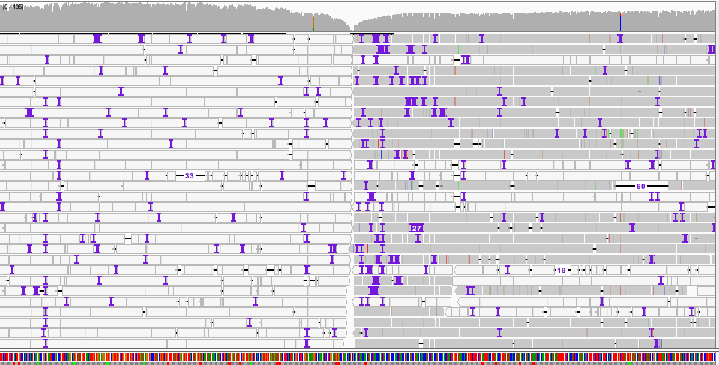
Mis-assemblies
False duplications revealed through poor raw read coverage in IGV
Improper placement of sequences on contigs
Escherichia coli contamination
Mis-assemblies were resolved through the use of raw read data
IGV display of raw reads against a MinION contig. Primary reads are colored gray, and secondary and supplementary alignments are white. Clean breaks in the raw read alignment were indicative of a potential mis-assembly. The sequence to the left of the break is E. coli contamination.
Notes:
Misassemblies were identified by examining raw read coverage in IGV. A location on the contig where all read reads were clipped off at the same position indicated a potential misassembly. Another indication of a misassemby was a region of the contig where the majority of the coverage was from secondary alignments. Mis-assemblies were resolved by extracting raw reads in the region with long, soft-clipped ends and using them as queries in a BLAST search against the genome to identify any matches on other contigs. The desired criteria for the reads were a length of at least 10 kb and soft clipping of at least 1000 bp, as this increases the likelihood of reads extending through repeats that caused the mis-assembly.
E coli

Slide 8
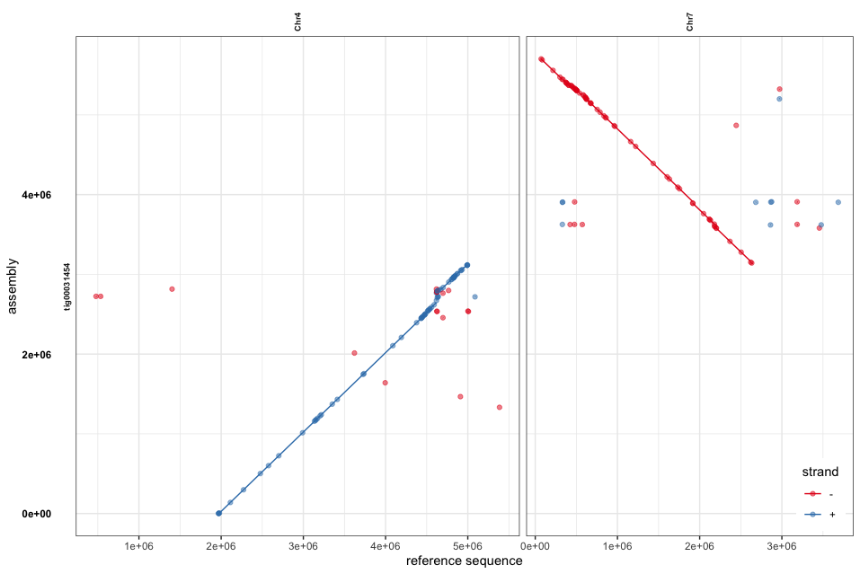
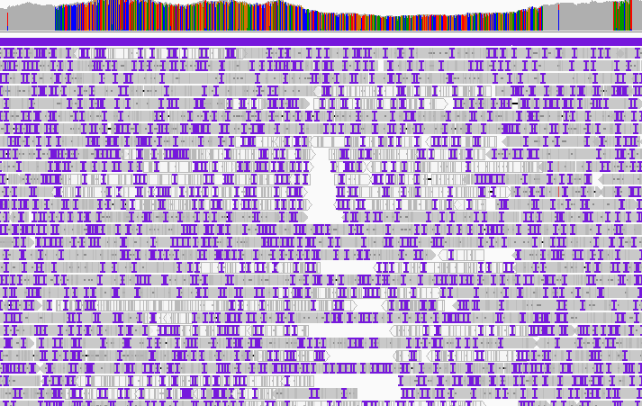
Translocations
Translocations identified in the U233 genome assembly
Breakpoint region used to find retrotransposons associated
Magnaporthe grisea non-LTR MGL retrotransposon was the most common
Translocation of contig 31454 between chromosomes 4 and 7: Colorful read coverage indicated repeats

Slide 9
Telomeres and subterminal regions
Telomeric contigs identified in MinION assemblies and raw read data
Guy11 terminal regions were compared with those of its progeny strain, 70-15 (Rehmeyer et al., 2006)
BLAST searches of the Telomere-Linked Helicase gene (TLH gene), transposons, and rDNA
Ten out of fourteen telomeres were found in both Guy11 and 70-15
Source: Rehmeyer et al. (2006). Terminal organization of chromosome ends of Magnaporthe oryzae strain 70-15.
Notes:
Contigs containing telomeres were identified so that telomeric and subterminal regions of the genomes could be analyzed without needing a complete genome assembly. Eleven of the Guy11 telomeres were captured in the MinION genome and the remaining three were found by examining raw read sequences. The Guy11 subterminal regions were compared to those of its progeny strain 70-15 using the characteristics of 70-15 reported in a paper by Rehmeyer et al. (2006) [4]. (Figure 2). Ten of the Guy11 telomeres shared the same unique features (e.g., repeat patterns, rDNA, the TLH gene) as the 70-15 telomeres, which demonstrates the similarity between the two strains. Previous Southern blots comparing telomeres of Guy11 and 70-15 showed that the strains have three unique telomeres. More research can be done to investigate the whether the fourteenth telomere is also common between Guy11 and 70-15 or another divergence.

Slide 10
Conclusion
Guy11: 33 original contigs, 23 final contigs
U233: 49 original contigs, 43 final contigs
Manually pulling sequence data from IGV was tedious
Internal TLH gene on Guy11 tig00000324
E. coli contamination
Retrotransposons identified at the translocation breakpoints
Potential insertion of a contig unique to the U233 genome
Notes:
The main goal of our project was to improve two M. oryzae genomes by connecting contigs and resolving misassemblies.
We found our strategy for improvement to be tedious and time consuming and hope to refine it so that genomes can be improved in a timelier fashion.
During the process, we uncovered interesting information about the genomes that we studied...
While examining the subterminal regions of Guy11, we found a telomere-linked helicase gene at an internal region of a Guy11 contigs. Further inverstigation can be done to see if this is an internalization event or a misassembly in this region of the contig.
E coli contamination was found in a Guy11 contig, and the contamination sequence was BLASTed against the rest of the contigs to search for any additional contamination. We found that the Guy11 assembly had a total of 7 contigs with E. coli contamination.

Slide 11
Future investigation
Events surrounding the structural divergences of the strains studied
Causes of translocations
Examine genes overrepresented in subterminal regions
Reference-based assembly using refined MinION genomes and Illumina reads
Notes:
These genomes can be studied for structural divergences between strains, such as translocations, and the causes of these events. The subterminal regions can also be studied for overrepresented genes that may be involved in the instability of the region. Finally, these refined genomes can be used for reference-based assembly of other genomes.

Slide 12
References
Cathryn Rehmeyer, Weixi Li, Motoaki Kusaba, Yun-Sik Kim, Doug Brown, Chuck Staben, Ralph Dean, Mark Farman. Organization of chromosome ends in the rice blast fungus, Magnaporthe oryzae. Nucleic Acids Research. 2006;34(17):4586-4701. doi:10.1093/nar/gkl588

