Slide 1
TEMPERATURE DEPENDENCE ON THE PASSIVE EFFECTS OF K+ ON MEMBRANE POTENTIAL OF SKELETAL MUSCLE
By
Janki R. Naidugari

Slide 2
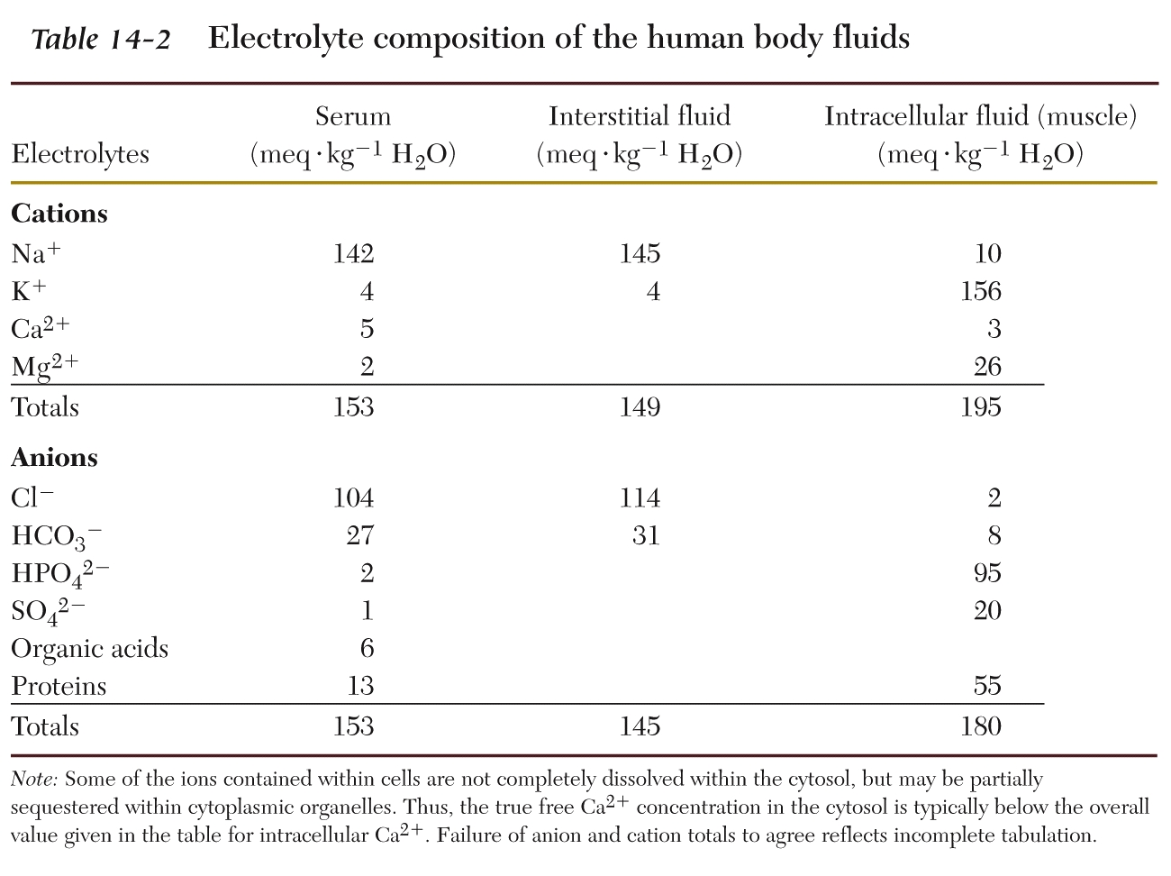
Notes:
Slide 1: The resting membrane potential in cells are actually made up of many different ions. (explain the different ions on the far-left column). In the right most columns, you will see both the intracellular and extracellular concentrations of these ions that researchers have found in the past

Slide 3
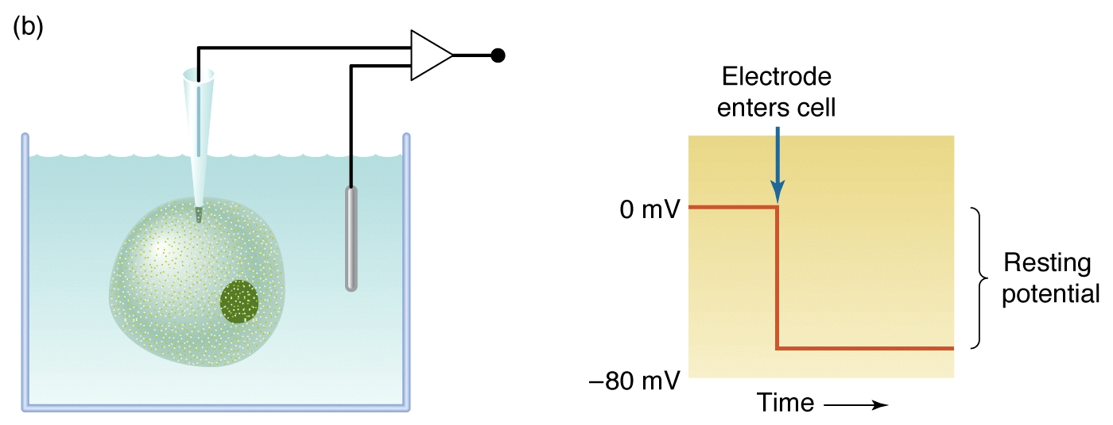
Notes:
Slide 3: This is a quick diagram of the experiment we performed in the lab. Here you have the reference electrode that is placed in the saline bath as a control and here you have the recording electrode that will be placed directly into the cell. On the right side, we will notice that after a few seconds of inserting the electrode, 0 mV drops to about -80 mV. Not every cell will drop to this level, this will depend on the cell. This value of -80mV will be our resting membrane potential.

Slide 4
Nernst equation: 1864 – 1941. Walther Nernst
Notes:
This brings us to the Nernst equation. E= resting membrane potential (for the purposes of this experiment). (Explain all the other variables).

Slide 5
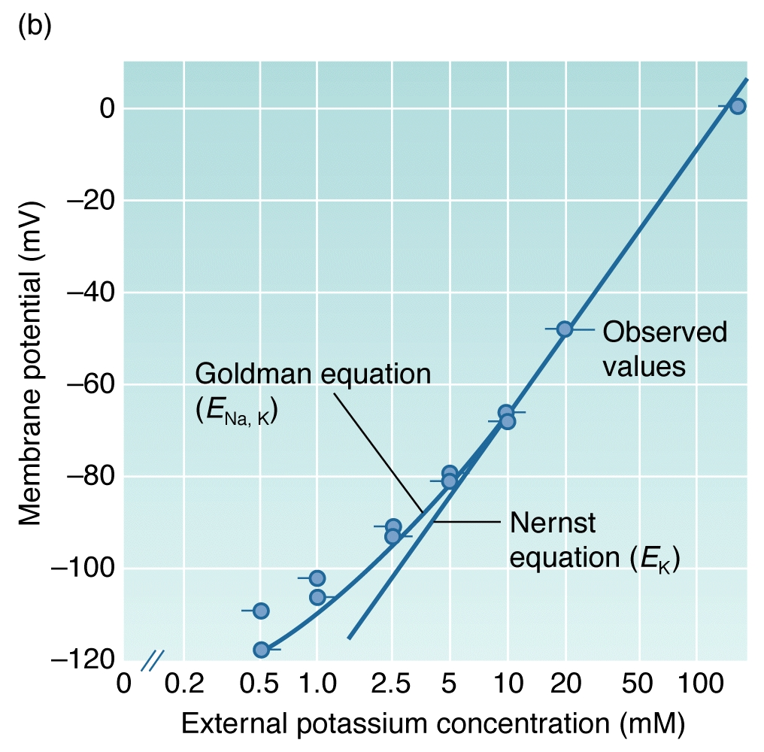
Notes:
Here is the Nernst equation visually represented by this graph. (Explain the x and y axes). We can see the expected vs. observed values. The observed values are a little different than the expected values, especially at the lower concentrations. The GHK equation takes this difference into account.

Slide 6
Here is a generalized G-H-K equation for Na⁺, K⁺, and Cl⁻ ions:
$${Em}_{K, Na, Cl}=\frac{RT}{F}\ln{\frac{P_{{Na}^{+}}{\left[{Na}^{+}\right]}_{out}+P_{K^{+}}{\left[K^{+}\right]}_{out}+PCl[Cl]in}{P_{{Na}^{+}}{\left[{Na}^{+}\right]}_{in}+P_{K^{+}}{\left[K^{+}\right]}_{in}+PCl[Cl]out}}$$
Notes:
Here is the GHK equation. This equation is used to determine the RP of the cell in regard to multiple ions. In fact, it is an extension of the Nernst equation. There are a few differences between the GHK and Nernst equation. First, in the GHK equation, the permeability of different ions is actually taken into account. Second, the GHK equation also takes into account the Na+ and Cl- ions.

Slide 7
There are values estimated for neurons (Atwood 1982) which we could use as well for comparison in muscle fibers.
[Na]_{i} = 17.4 mM (for neurons, Atwood 1982)
[K]_{i} = 265 mM (for neurons, Atwood 1982)
[Cl]_{i} = 12.7 (for neurons, Atwood 1982)
pK = 1 (for neurons, Atwood 1982)
pCl = 0.1 (for neurons, Atwood 1982)
pNa = 0.001 (for neurons, Atwood 1982)
Notes:
Here are the different concentrations that researchers have derived in the past. These values are the intracellular concentration values for Na+, K, and Cl. We also see the permeability of these ions as well. These values are actually assumptions made from neurons because researchers have only been able to find these values on a more consistent level in neurons than muscle fibers. These values will be assumed for muscle fibers as well in our experiment. The extracellular concentrations will depend on the saline that we will be using, so that is in our control.

Slide 8
For crayfish muscle:
“Procambarus and Astacus [K]_{i} appears to be 171 and 167 mM, respectively.” (Katz, G.M., Reuben, J.P., MacBerman, Dunham, P.B. 1972. Potassium Redistribution and Water Movement in Crayfish Muscle Fibers. Journal of Comparative Physiology 80: 267–283). We are using the values for Procambarus.
[K]_{i} = 171 mM (determined for crayfish muscle)
[K]_{o} = 5.3 mM (Saline)
[Na]_{i} = 17.4 mM (assume for muscle)
[Na]_{o} = 205 mM (Saline)
[Cl]_{i} = 12.7 mM (assume for muscle)
[Cl]_{o} = 232.15 mM (assume from saline; 205 mM NaCl; 5.3 mM KCl; 13.5 mM
CaCl₂2H₂O; 2.45 mM MgCl₂ 6H₂O)
pK = 1 (assume for muscle)
pNa = 0.001 (assume for muscle)
pCl = 0.01 (assume for muscle)
Notes:
However, there is one exception. This study cited here was able to determine the intracellular concentrations of K+ in crayfish muscle. The other values are still assumed from neurons.

Slide 9
Here is a generalized G-H-K equation for Na⁺, K⁺, and Cl⁻ ions:
$${Em}_{K, Na, Cl}=\frac{RT}{F}\ln{\frac{P_{{Na}^{+}}{\left[{Na}^{+}\right]}_{out}+P_{K^{+}}{\left[K^{+}\right]}_{out}+PCl[Cl]in}{P_{{Na}^{+}}{\left[{Na}^{+}\right]}_{in}+P_{K^{+}}{\left[K^{+}\right]}_{in}+PCl[Cl]out}}$$
Online https://www.physiologyweb.com/calculators/ghk_equation_calculator.html
(note: values of temperature are in K which is 273.15 + the # in centigrade)
Notes:
Looking at the GHK equation again, there is one variable that is not examined a lot, and this variable is temperature. Temperature plays a large role in this equation because, for example, crayfish can move from warmer to colder places over the year. Us humans will also have fluctuating temperatures throughout the day. Therefore, if T is always fluctuating, it will definitely affect the GHK equation. In this link below, we can manually put in different values for the temperature, and it will show us how the resting membrane potential is affected.

Slide 10
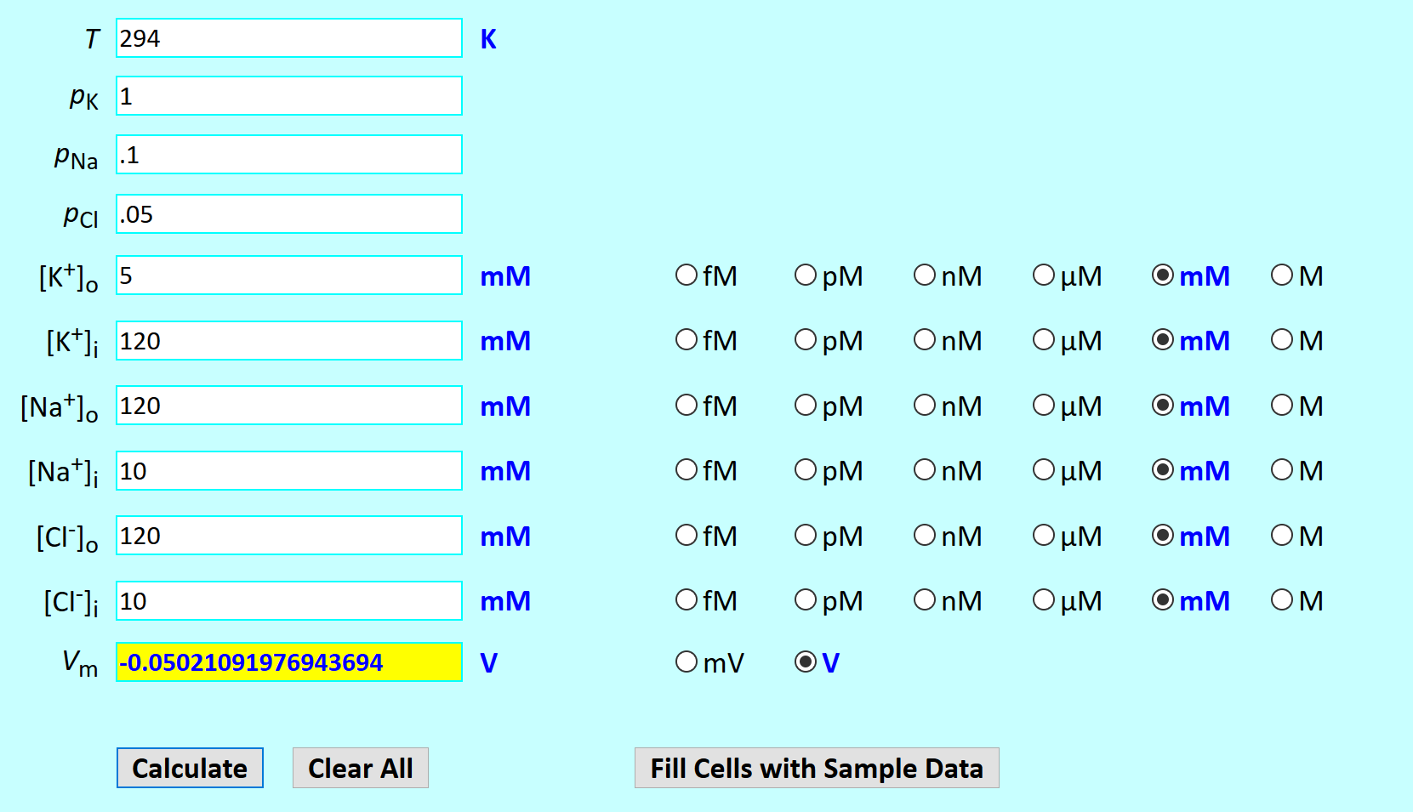
Temp 21C
Notes:
Slide 21: Here, we are plugging in 294 K for the T, and we end up with -50.2 mV.

Slide 11
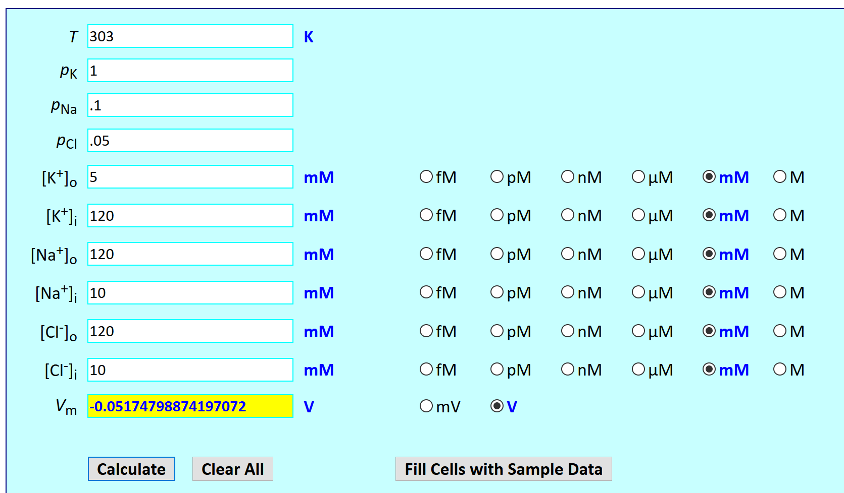
Temp 30 C
More negative Vm than for 21C
Notes:
Slide 22: If we increase the T from 294 K to 303 K, we end up with -51.74 mV. So, this value is decreasing. Therefore, if the T is increasing, the resting membrane potential is actually decreasing, displaying an inverse relationship.

Slide 12
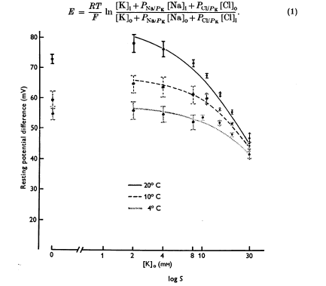
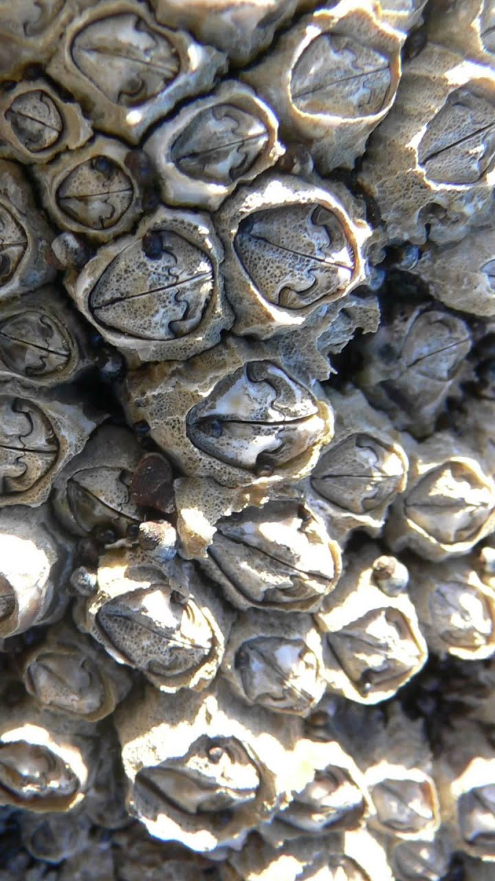
Barnacle muscle
Notes:
The relationship between the RP and temperature has been examined in past studies, but very few studies also vary the levels of Ko in their experiments. The study shown here, performed in barnacle muscles, is one example where this is done. (Explain x and y axes). Y axis is negative again (decreasing as you go up). They changed the temperature and determined that as the T increased, the resting membrane potential decreased, as seen before in the online simulation. However, there is also another relationship to look at. As they increased the Ko concentration, the resting membrane potential increased as well. This suggests a direct relationship between these two variables.

Slide 13
Methods
Crayfish abdominal preparations were made that were bathed in standard crayfish saline (made with 205 NaCl; 5.3KCl; 13.5 CaCl₂; 2H₂O; 2.45 MgCl₂; 6H₂O; 5 HEPES and adjusted to pH 7.4 (in mM)).
A glass intracellular pipette was then filled with 3M KCl with a syringe. After the silver wire was placed into the pipette, the electrode resistance was measured (anywhere between 20-60 MΩ was ideal). The extracellular voltage was then set to 0, and the microelectrode tip was placed into the longitudinal muscles. The microelectrode was then removed and placed into another muscle fiber so that multiple recordings could be obtained. The data was collected via LabChart Software.
The first set of data collection occurred under 21 ° Celsius. The saline bath was exchanged multiple times, starting with 5.3 mM K⁺ , then 10 mM, 20 mM, 30 mM, 40 mM, and 50 mM K+ concentrations before being returned to 5.3 mM K⁺ . This was repeated for 10 ° Celsius, 5 ° Celsius, and finally 30 ° Celsius.

Slide 14
[K⁺]_{out} (mM) | Electrode resistance | Membrane potential (mV) | Bathing temperature
5.3 |  |  | 21
10 |  |  | 21
20 |  |  | 21
30 |  |  | 21
40 |  |  | 21
50 |  |  | 21
5.3 |  |  | 10
10 |  |  | 10
20 |  |  | 10
30 |  |  | 10
40 |  |  | 10
50 |  |  | 10
5.3 |  |  | 5
10 |  |  | 5
20 |  |  | 5
30 |  |  | 5
40 |  |  | 5
50 |  |  | 5
5.3 |  |  | 30
10 |  |  | 30
20 |  |  | 30
30 |  |  | 30
40 |  |  | 30
50 |  |  | 30
RT (~21ºC)
10ºC
5ºC
30ºC.
A period of 5 minutes
5.3 mM K⁺
10 mM
20 mM
30 mM
40 mM
50 mM K+
Notes:
This is the table we used to collect our data in our lab. (Explain the different columns). The Ko repeat in chunks for distinct T values. The electrode resistance is not something we change but something that we just regulate throughout the experiment to ensure everything is going correctly. The main data collection is happening in the middle column.

Slide 15
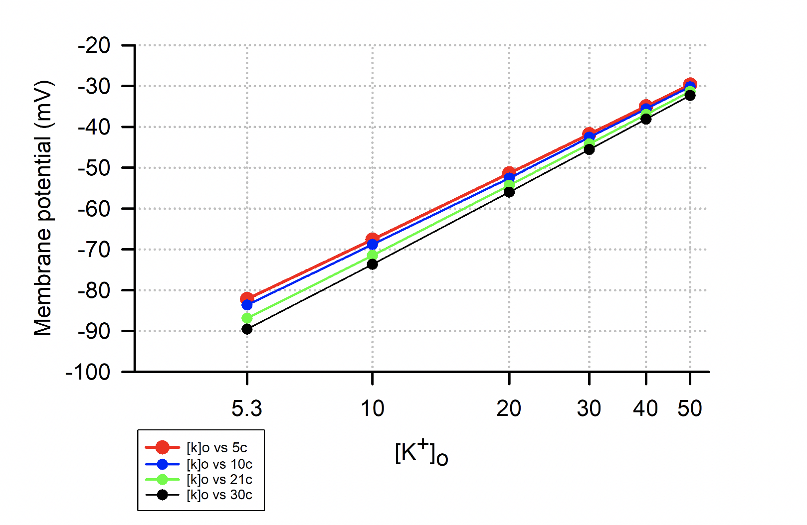
Sample Data Obtained from One Student
Notes:
This is an example of a sample data set that was obtained from one student in our class based on the online simulation. We can see the same relationships that I mentioned earlier: as the extracellular concentration of K+ increases on the x axis, the resting membrane potential is increasing, or depolarizing. We also see that as the temperature increases, the resting membrane potential decreases. (Explain this using one specific T) This further reiterates what the online simulation showed us as well as what the study with the barnacle muscles showed us.

Slide 16
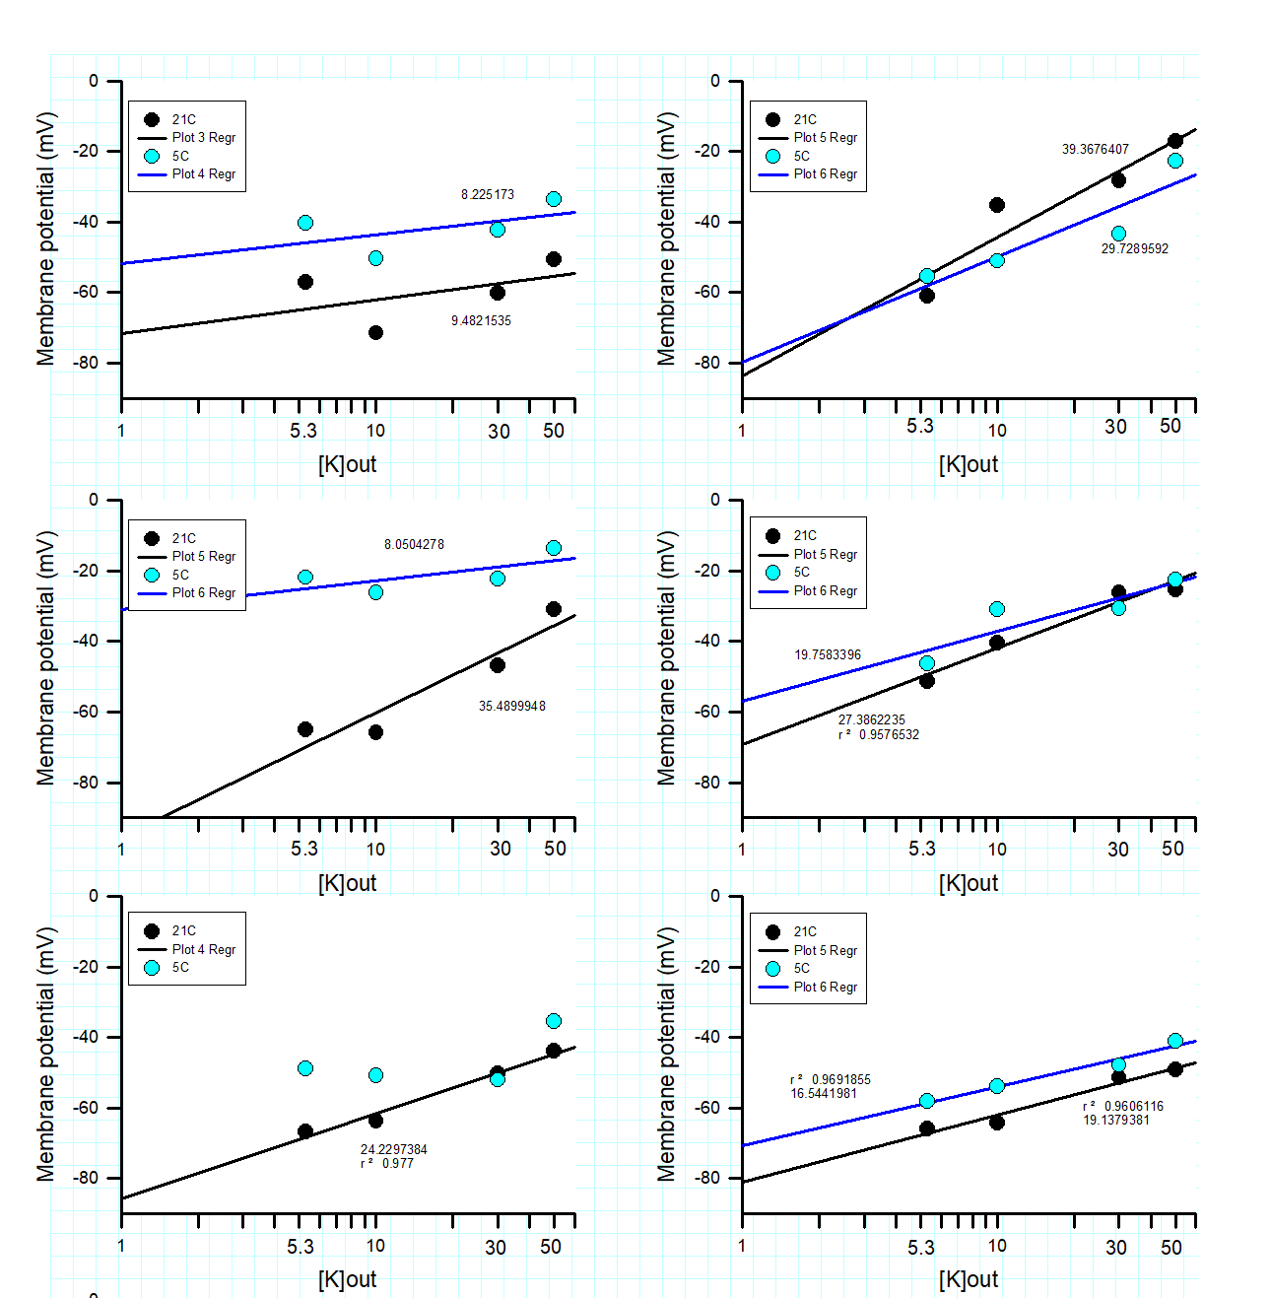
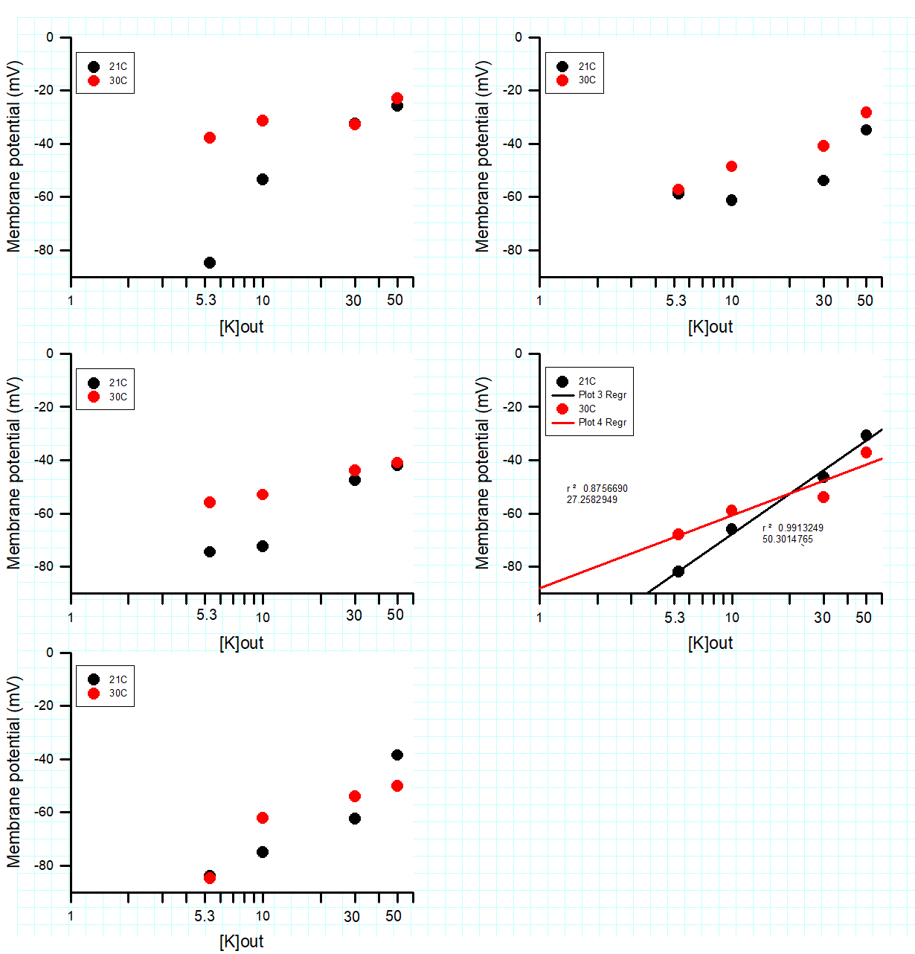
Class Data Obtained
Notes:
These are all graphs that were obtained from the class data. The graphs on the left-hand side show us a comparison between resting membrane potential values obtained at 21 degrees Celsius and 5 degrees Celsius, while the graphs on the right-hand side show us a comparison between resting membrane potential values obtained at 21 degrees Celsius and 30 degrees Celsius. Almost all of the lines on the left side have a generally positive slope. This means that as the extracellular concentration of K+ is increasing, so is the resting membrane potential, which is a relationship we have already established. This same relationship is also seen with the graphs on the right where we compare data points at 21 degrees Celsius with those at 30 degrees Celsius. Additionally, some of the graphs on the left side show that as temperature increases, the resting membrane potential decreases. However, this relationship is not as prominent with the graphs on the right side. We are continuing this data collection in a research lab with tight controls of T and an average of 3 values at each T for each preparation. It was hard to control all of the different setups that were used for this experiment as some electrodes broke and the T may have been varied at times and therefore not constant.

Slide 17
Improvements and Outcomes
Improvements: practice lab periods solely for recording resting membrane potentials and changing saline baths, using thermometers at every station
Outcomes: appreciations for the resting membrane potential and how temperature can affect it, heterothermic animals adapting to environmental changes
Notes:
There are some improvements we could focus on for future labs. For example, we could use one lab period to just record muscle potentials and get familiarized with changing out the saline baths. This would allow for more accurate results in the future. Also, we could have thermometer at each setup in the lab so that we can keep a closer eye on the temperature when the resting membrane potential is being recorded.
Outcomes: As a lab, the students have learned to have a new appreciation for the various values that can contribute to the RP. Also, we now know how T can have large effects on the RP and that heterothermic animals have to adapt to environmental changes. Hopefully, these results can even have some clinical applications in the future.

