Slide 1
The Shape of Arson: Correlating collection Efficiencies of Ignitable Liquid Residues with physical and chemical features of Absorbent Materials
Mackenzie Roark, Jessica N. Carlotti, B.S. Cynthia J. K. Tran, Ph.D., M.S.
Eastern Kentucky University Department of Chemistry.

Slide 2
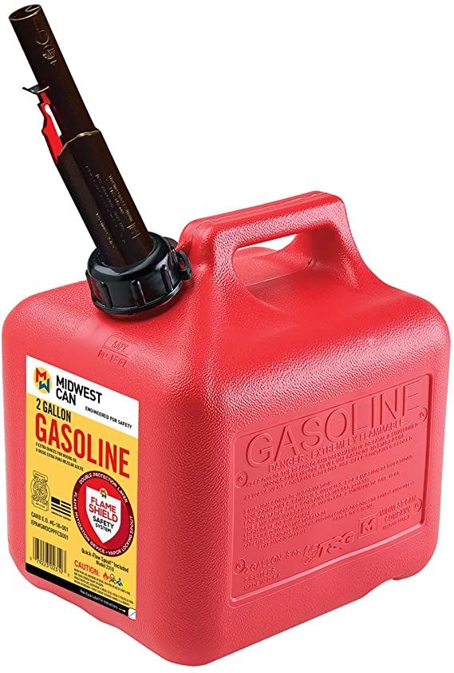
What is arson?
Arson is a crime that entails the intentional setting of a fire with the goal of destruction.
Notes:
There is often an ignitable liquid (IL) present that increases the amount of destruction or the rate of combustion.
These ignitable liquid residues need to be collected in order to analyze them in a laboratory setting.
We are proposing a different method of collection—a handheld method for higher collection efficiency and to save time.

Slide 3
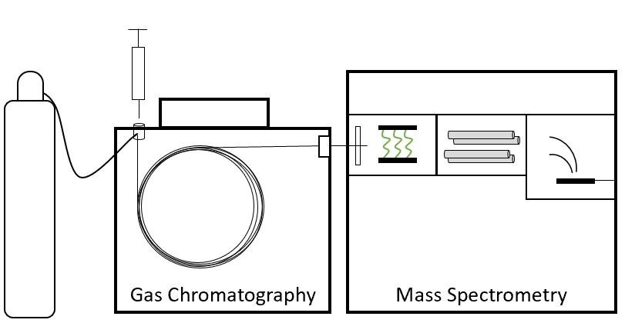
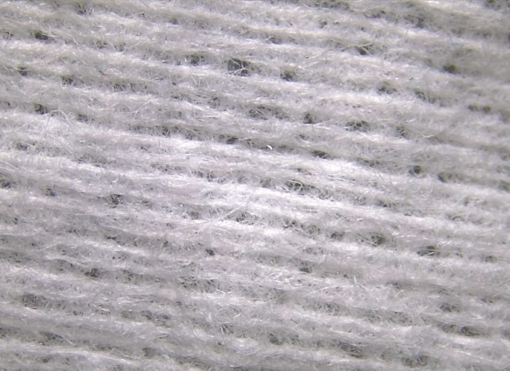
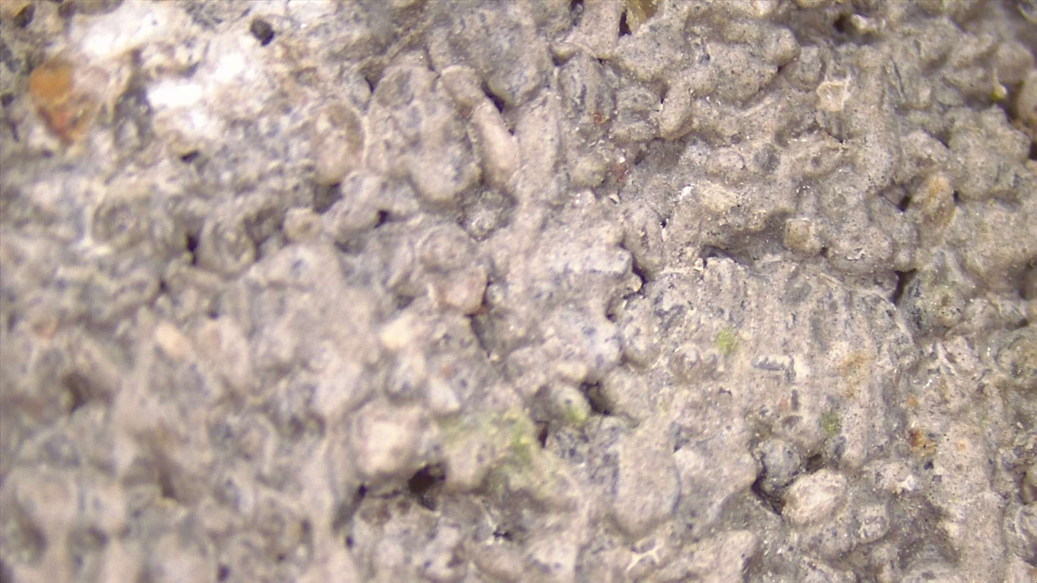
Experimental Overview
String
Paper Clip
Charcoal Strip
Solid Absorbent
Solid Absorbent
Mason Jar
Concrete with IL at the Scene
Notes:
Passive Headspace – Extraction – GC - Data
Standard in field and established through ASTM guidelines
Heat jar at 60° C for 20 hours.
Carbon disulfide is used to extract volatiles from the carbon strip.

Slide 4
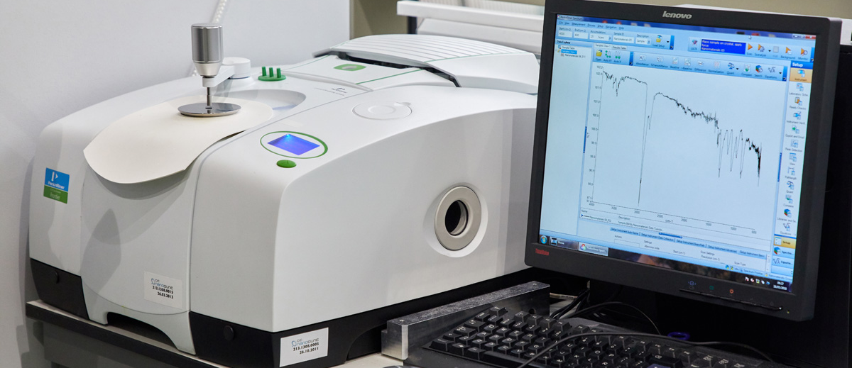
Experimental Overview
.
.

Slide 5
Material List
Material | Composition
Bounty Paper Towels | Paper (Cellulose)
Brawny Paper Towels | Paper (Cellulose)
Viva Paper Towels | Paper (Cellulose)
Professional Scott Shop Towels | Paper (Cellulose)
Cotton Balls | Cotton (Cellulose)
WypAll X80 Cloth, Hydroknit | Pulp Fibers in Polypropylene Base
Fisher Scientific Absorbent Mat | Polypropylene
Anchor Brand Oil only Sorbent Mat | Polypropylene
Wilen Standard Duty Microfiber Cloths | Polyester Blend
Notes:
Adsorbent Materials used – put a list here, perhaps with some pictures?

Slide 6
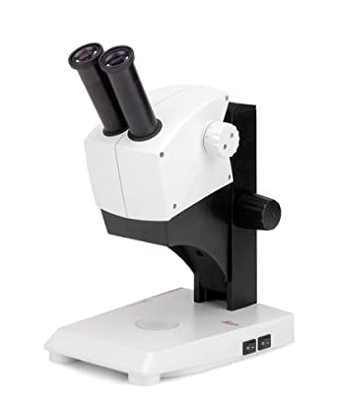
Microscopic Examinations using a Stereomicroscope
The absorbent materials that have been analyzed for this experiment have been analyzed using a stereomicroscope.
The optical path shows 3-D images
Large sections of samples
Quantitative measurements

Slide 7
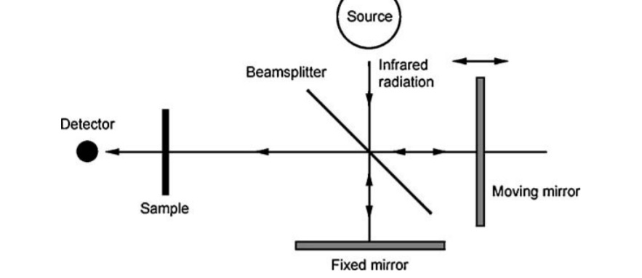
FTIR Analysis
Fourier Transform Infrared Spectroscopy
The library is not all inclusive but gives a general idea.

Slide 8
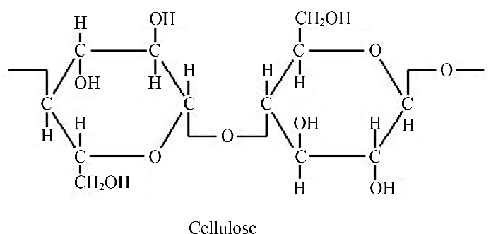
Cellulose Compositions
Many of the materials that were analyzed through this research were determined to be composed primarily of cellulose, according to FTIR analysis.
These materials include:
Bounty Paper Towels
Brawny Paper Towels
Viva Paper Towels
Scott Shop Towels
Cotton Balls

Slide 9
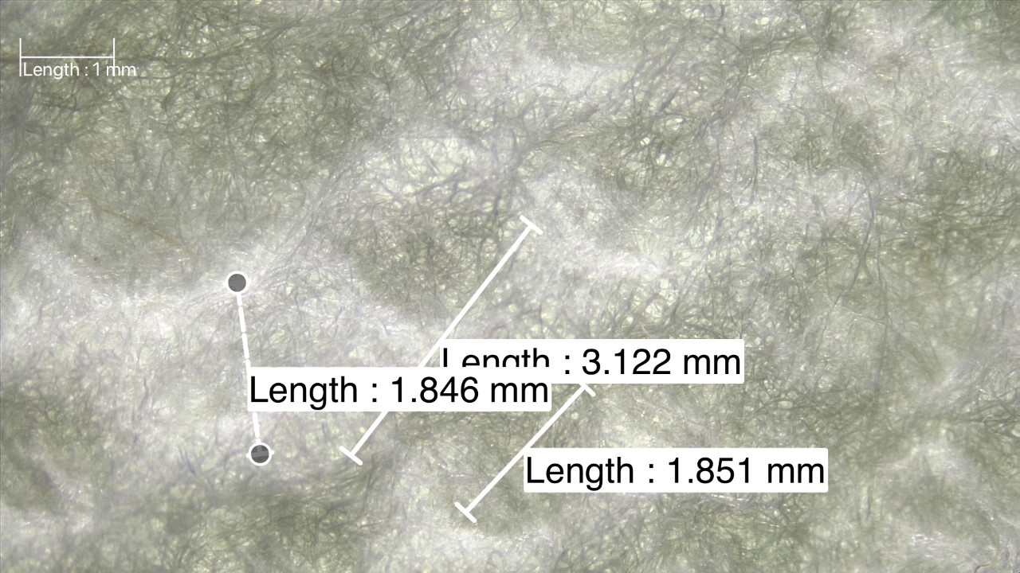
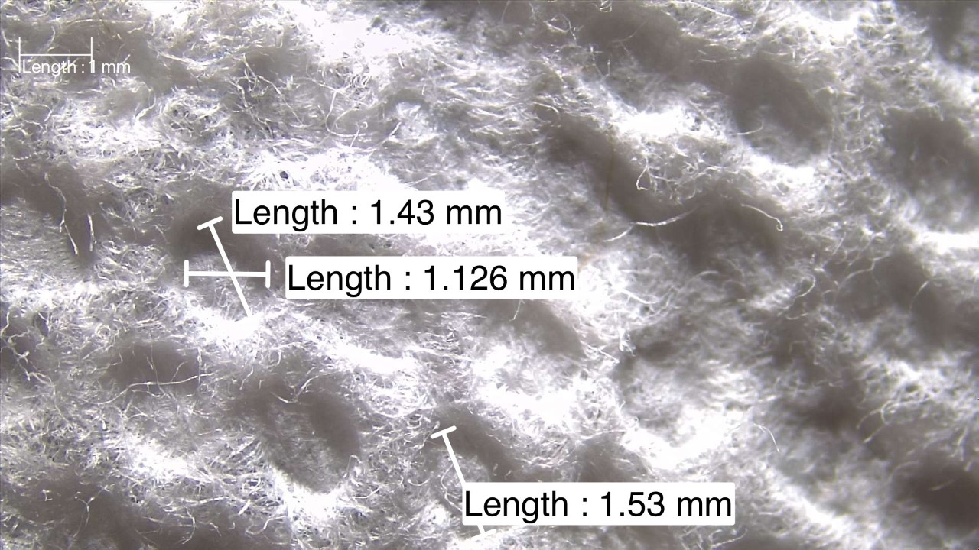
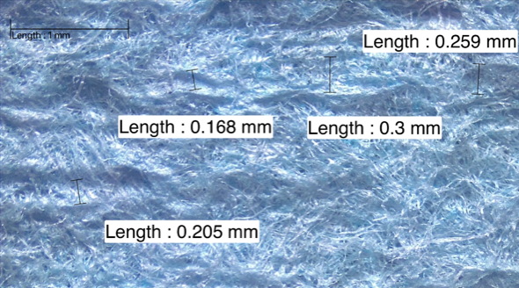
Brawny Paper Towel
Similar chemical composition does not mean similar surface texture or physical features
Bounty Paper Towel
Scott Shop Towel

Slide 10
Microfiber Cloths
FTIR analysis suggested that these cloths were primarily composed of polyester.
Blue Microfiber Cloth
Yellow Microfiber Cloth
Green Microfiber Cloth
Notes:
Be sure to say that the manufacturer indicated these were a polyester blend! The peaks here indicate both the CH stretches for sp2 and sp3 carbons at ~3200 and 2900 (respectively) as well as the carbonyl around 1700.

Slide 11
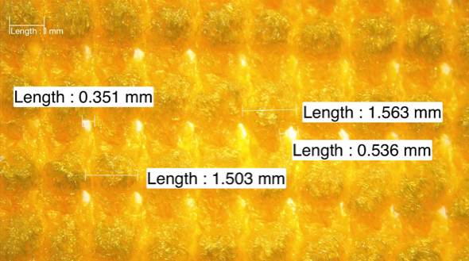
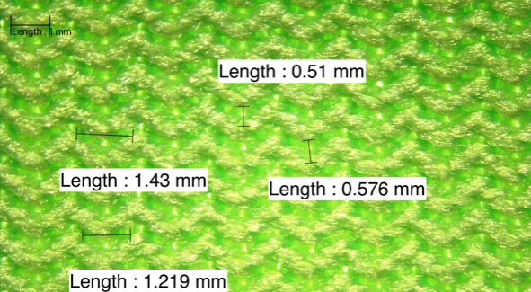
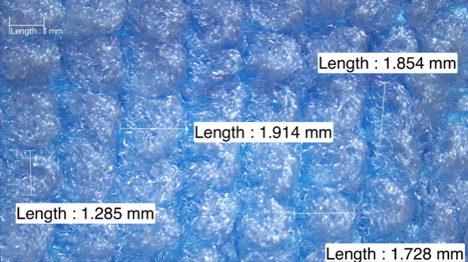
Microfiber cloths (cont.)
Each of these cloths have different physical structures because they are designed for different purposes.
Notes:
Note which cloth is designed for each. Don’t forget to add the scales to this figure!

Slide 12
Synthetic absorbent materials
Other materials that were analyzed using both FTIR and microscope examinations included:
Fisher Scientific Absorbent Mat
Oil Mat
Both library searches indicate polypropylene
Notes:
Lots of peaks just under 3000 wavenumbers indicate sp3 C-H bonds with different environments. This is consistent with the C-H bonds in polypropylene.

Slide 13
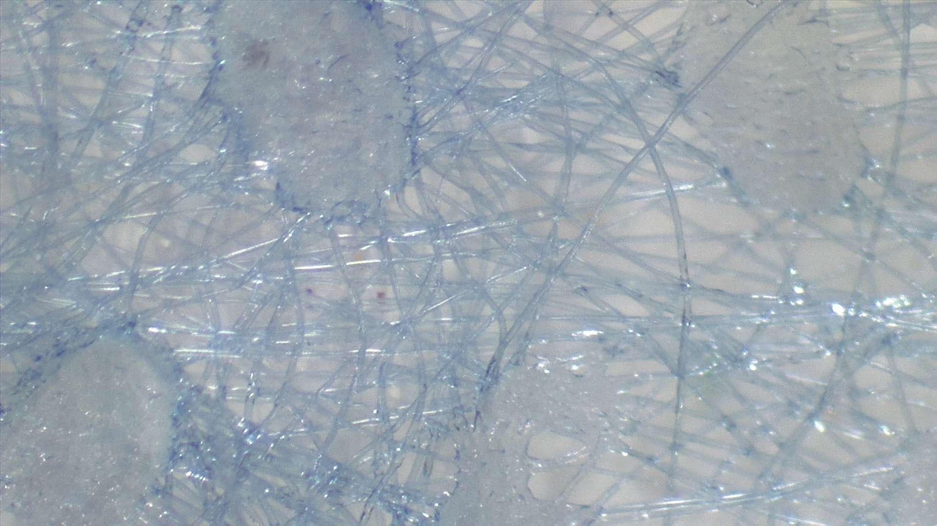
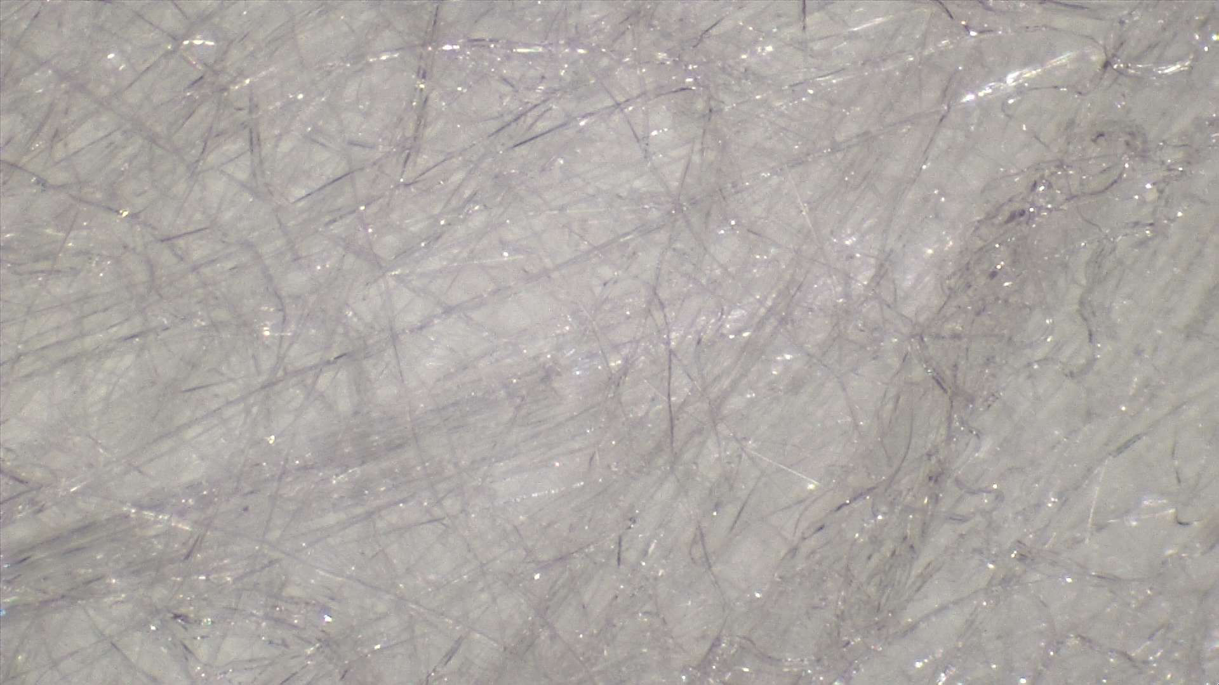
Synthetic Absorbent Materials
Similarities appear both chemically and physically
Notes:
Both manuafactured using a technique that takes one polymer and imbeds it into a layer of another polymer. The nondirectional fibers give overall strength while the polymer film gives flexibility and chemical resistance.

Slide 14
Collection Efficiencies
On nonporous surfaces:
Viva: 99.3%
Bounty: 98.5%
Brawny: Above 90%
WypAll X80: 98.4%
Scott Shop Towels: 96.4%
Cotton Balls: 97.2%
Without Outliers: 98.8%
On porous surfaces, most materials had a collection efficiency of 5-10% using various optimization methods.
Notes:
You mightneed to explain what you mean with the “without outliers” line

Slide 15
Results
For non-porous materials, the materials have had about the same collection efficiencies.
Similar chemical composition does not entail similar physical arrangement.
Overall, no distinct correlation have been shown between the composition and the percent recoveries.

Slide 16
Future Work
Introduce more materials to this experiment.
Use semiporous and porous materials.
Examine individual fibers.

Slide 17
Acknowledgments
Eastern Kentucky University’s College of Science for the funding of this project
EKU Department of Chemistry and the Forensic Science Program for the instrumentations and lab space
Jessica Carlotti and Dr. Cynthia Tran for guiding me and working with me

Slide 18
References
ASTM International. Standard Practice for Separation of Ignitable Liquid Residues from Fire Debris Samples by Passive Headspace Concentration with Activated Charcoal. E1412-19, December 17, 2019.
Burda, K.; Black, M.; Djulamerovic, S.; Darwen, K.; Hollier, K. Field test kits for collection of ignitable liquid residues used by the NSW fire scene investigators. Forensic Sci. Int. 2016, 264, 70-81.
Hall, S.; White, G.; Gautam, L. The development of a novel adsorbent for collection ignitable liquid residues from a fire scene. J Anal Appl Pyrol. 2016, 122, 304 – 314.
Nowlan, M.; Stuart, A. W.; Basara, G. J.; and Sandercock, M. L. Use of a Solid Absorbent and an Accelerant Detection Canine for the Detection of Ignitable Liquids Burned in a Structure Fire. J Forensic Sci. 2007, 52 (3), 643 – 648.
Sandercock, M. L. Fire investigation and ignitable liquid residue analysis – A review: 2001 – 2007. Forensic Sci. Int. 2008, 176, 93-110.
Smale, T.; Arthur, I.; and Royds, D. A comparison of techniques for extracting ignitable liquid residue from concrete. Australian J Forensic Sci. 2014, 46 (2), 216-223.
Sosa, J. Oil Dries: A New Absorbent Material for Collection of Ignitable Liquids from Semi-Porous Material. Chemistry, Eastern Kentucky University: Richmond, KY, 2018.

