Slide 1
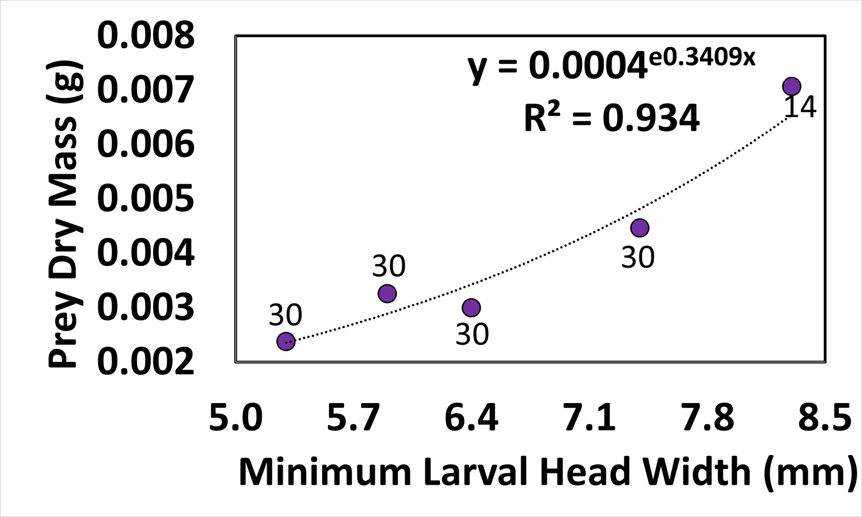
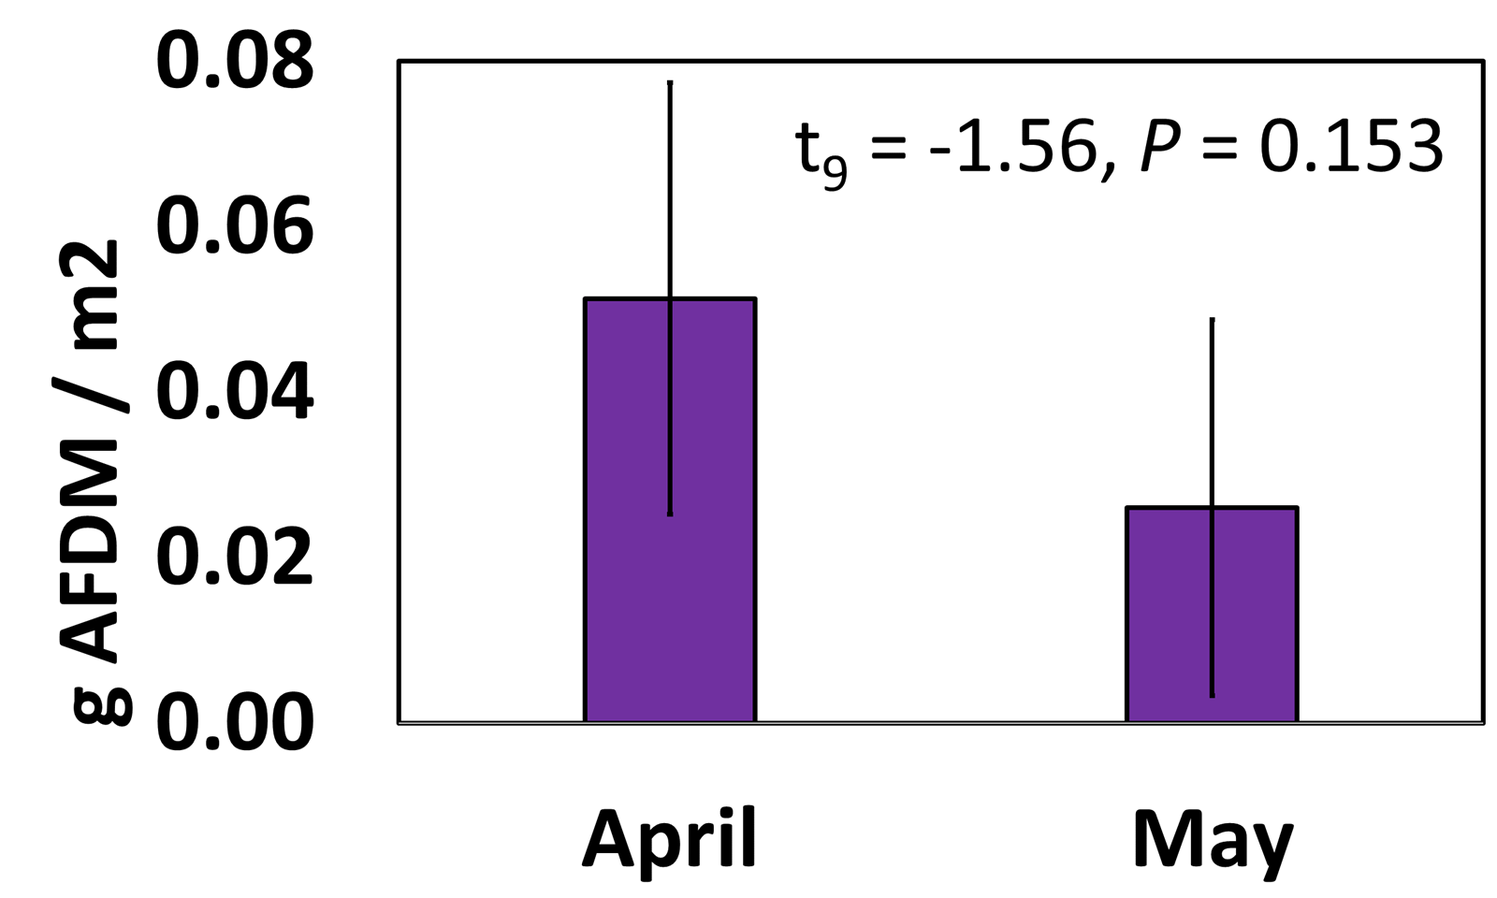
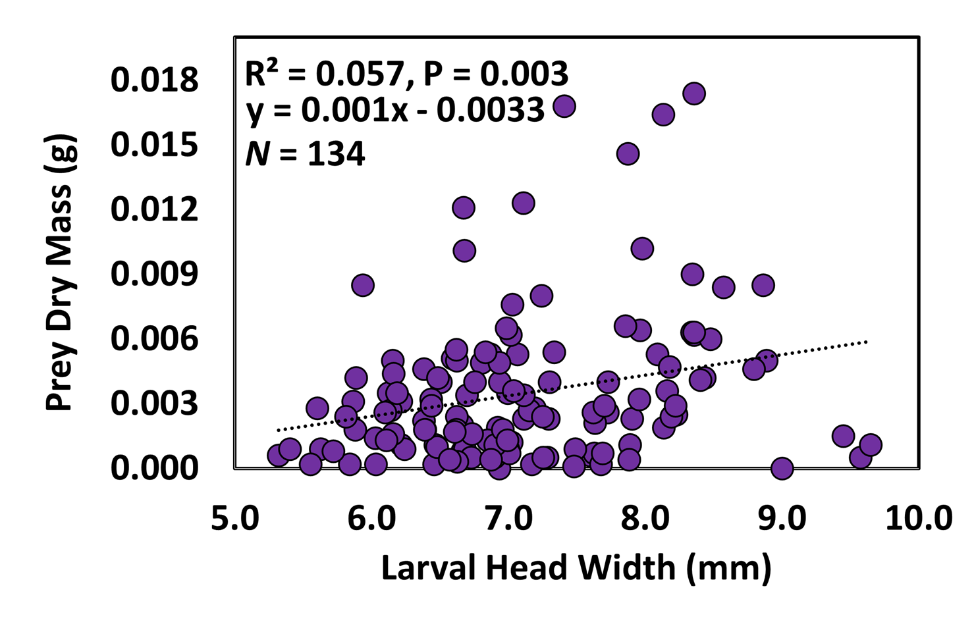
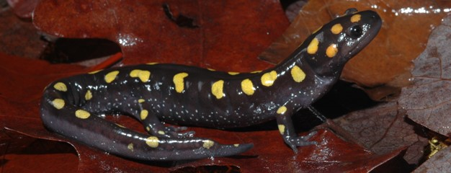
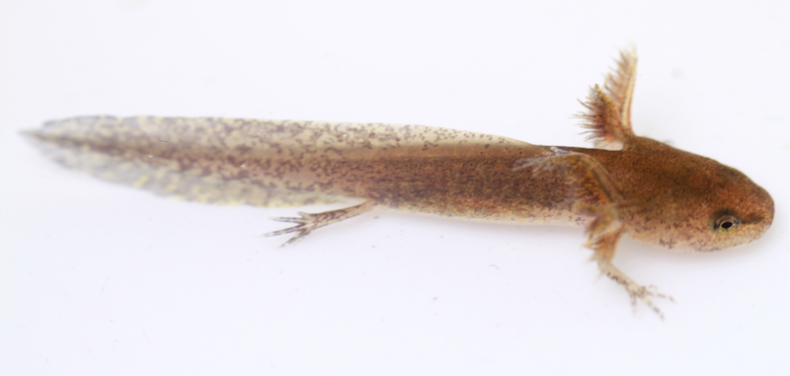
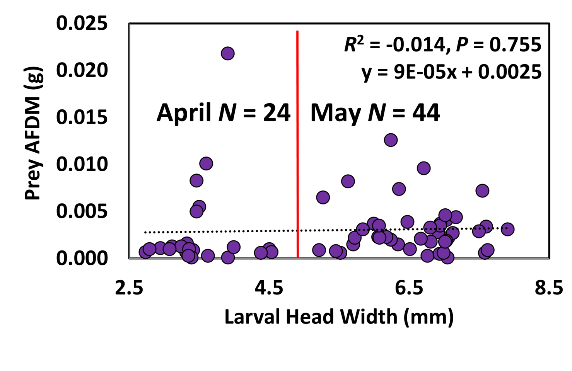
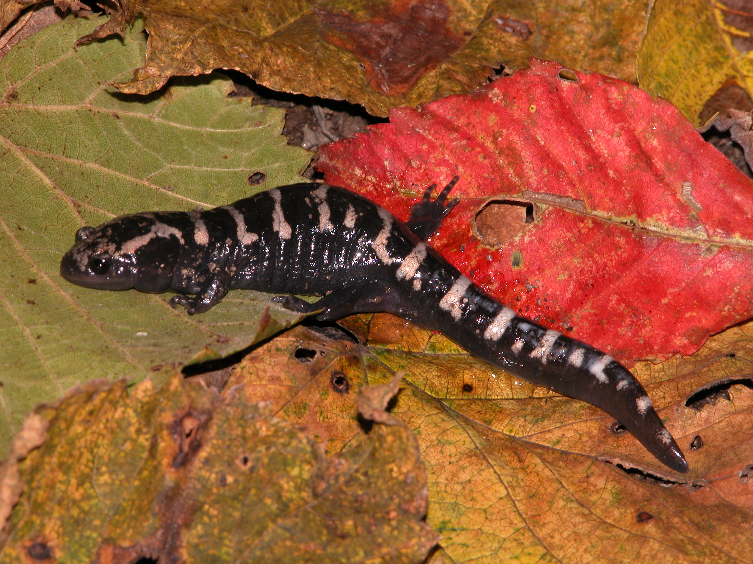
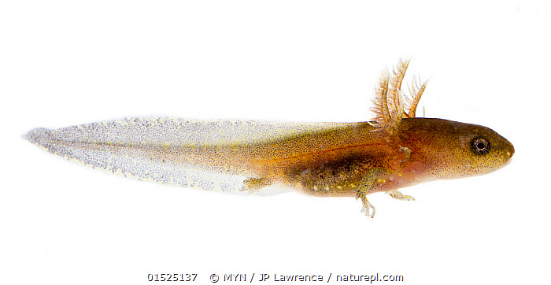
Scaling Relationships between Body Size and
Energy Flow in Apex Predators
Renae M. Steinberger and Cy L. Mott
Department of Biological Sciences, Eastern Kentucky University, Richmond, KY 40475
INTRODUCTION
METHODS
RESULTS
Amphibians are essential to ecosystem function; with ~ 1/3 of species facing extinction¹, it is important to understand functional consequences of population declines.
Despite historical approaches to population ecology that consider all individuals as functionally equivalent², recent studies indicate body size alters ecosystem function, with larger individuals disproportionately more important to energy flow³.
Larval salamanders are dominant predators in fishless ponds that exhibit ontogenetic shifts in size and density, wherein body sizes (and possibly rates of nutrient cycling) increase while population densities decrease.
We therefore sought to assess: a) whether energy flow exhibits linear relationships with body size; and b) whether energy flow by high densities of small larvae is equivalent to that of lower densities of large larvae.
Larval Ambystoma maculatum and A. opacum (Fig. 1) densities estimated using quantitative enclosure sampling, and larval head widths measured using ImageJ
Gut contents of A. maculatum excised, dried, and ashed; difference between dried and ashed contents is ash-free dry mass (AFDM), a common proxy for “energy”⁴
Similar methods employed for A. opacum without ashing (used in previous study). We therefore considered dry prey mass as our proxy for “energy” in this species
Relationships between larval head width and either AFDM or dry prey mass assessed using linear regression in R version 3.5.2.
Average “energy” (AFDM or dry prey mass) used in conjunction with larval density estimates to create estimates of “energy/m²”; differences between small (April) and large (May) larvae compared using a Welch t-test.
Larval head width scaled positively with prey dry mass in A. opacum (Fig. 2, R² = 0.057, P = 0.003), but not with AFDM in A. maculatum (Fig. 2, R² = -0.014, P = 0.755). Prey mass was highly variable among similarly-sized larvae, and we therefore created discrete larval size classes and calculated average prey masses / AFDM by class, which were then fit to linear and exponential models. In A opacum, dry prey mass fit an exponential function better (Fig. 3, R² = 0.93) than a linear function (R² = 0.89). In A. maculatum, AFDM mass did not fit either distribution particularly well (linear R² = 0.42, exponential R² = 0.44).
When AFDM of A. maculatum was corrected for in situ larval densities (16/m² and 9/m² in April and May, respectively), April estimates of AFDM/m² were double those in May, but the observed differences were not significant (Fig. 5, t₉ = -1.56, P = 0.153).
Fig. 3: Average prey dry mass in A. opacum in relation to average larval head width across five larval size classes
Fig. 4: Density- corrected estimates of AFDM for larval A. maculatum in April and May
DISCUSSION
While further statistical analyses are pending, preliminary data for A. opacum suggest larger larvae perform disproportionately more energy transfer, thus supporting previous studies³. This result from larval size classes was evident despite variation among similarly-size larvae that obscured the pattern when assessed at the level of individual larvae.
In contrast, larval A. maculatum did not exhibit similar relationships, which could be the result of several factors, including smaller sample sizes or influences of predation risk or hydroperiod, that influence dietary choices in this later-hatching species.
Density-corrected estimates of energy transfer suggest larval energy flow remains relatively constant throughout ontogeny despite seasonal changes in invertebrate abundance. If larval salamanders consistently transfer similar amounts of energy regardless of density or season, overwintering salamander species may play key roles in energy flow during months without additional incoming sources of energy (e.g., leaf fall, aquatic plant growth, amphibian and invertebrate egg deposits, etc.).
ACKNOWLEDGEMENTS / LITERATURE CITED
We thank S. Albert, E. Croteau, C. Haas, A. Halbrook, M. Steffen, J. Uzzardo, and B. Willey for their assistance in field data collection and K. Regester for providing data on pond localities and larval salamander species compositions. All components performed in accordance witth Southern Illinois University animal care guidelines (SIUC IACUC 05-036 and 05-037) and Illinois Scientific Collecting Permit A08.4048. Permissions granted by the U.S. Forest Service and Illinois Department of Natural Resources, with funding was provided by a Delyte and Dorothy Morris Fellowship awarded to CLM.
1 Stuart paper 2004; 2 Bolnick paper 2011; 3 Norkko paper 2013; 4 Regester paper 2005
Fig. 1: Focal species Ambystoma maculatum (Spotted Salamander, top) and A. opacum (Marbled Salamander, bottom)
Fig. 2: Prey dry mass (A. opacum, top) and AFDM (A. maculatum, bottom) in relation to larval head width. The vertical red line for A. maculatum separates April and May larval samples

