Slide 1
Evaluating Preferences for Fish Disease Treatment Options and Success Rates at KYSU Fish Disease Diagnostic Laboratory
Tifani Watson
Tyler McKay
John Kelso
Dr. Robert Durborow

Slide 2
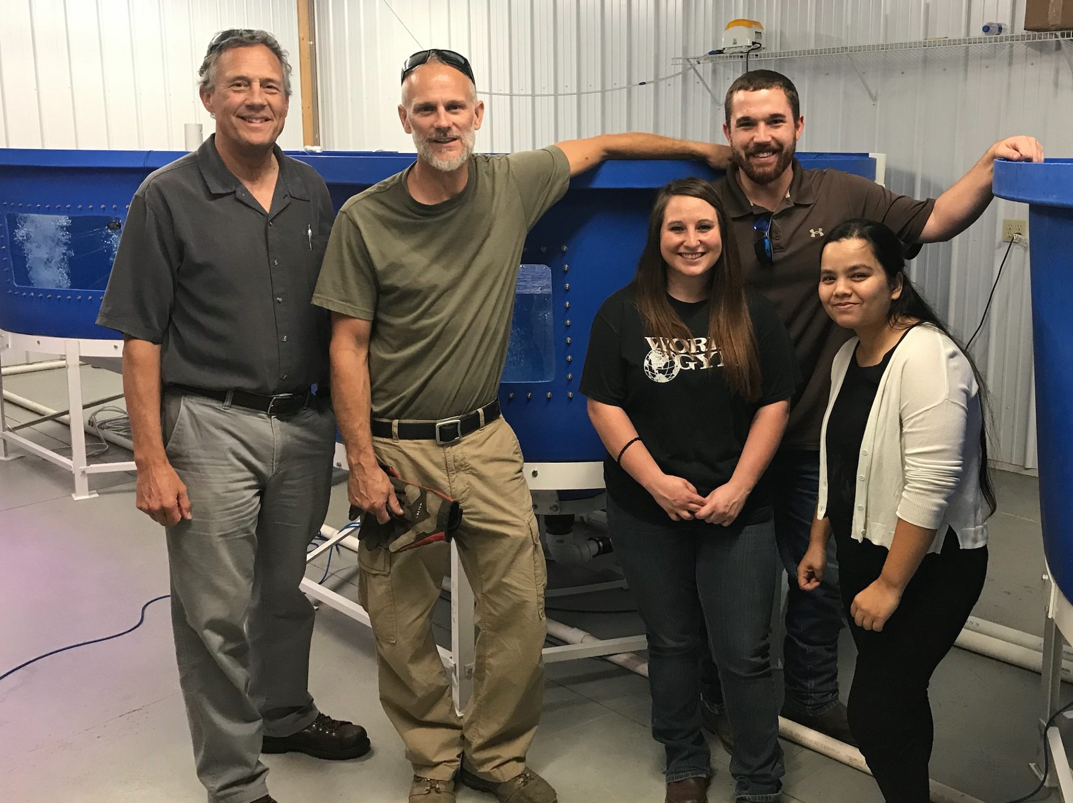
Outline
Introduction
Objectives
Methods
Expected outcomes

Slide 3
Introduction
The Fish Disease Diagnostic Lab at Kentucky State University is part of the Cooperative Extension Program.
Assists fish farmers in raising healthy fish by diagnosing disease outbreaks and recommending treatments.

Slide 4
Study Objectives
Better understand the needs of small-scale fish farmers in Kentucky and surrounding states
Help educate farmers on pathogen clinical signs and treatment options
Evaluate which treatment method is preferred among fish farmers
Analyze treatment success rates

Slide 5
Methods: Obtaining fish used in study
Disease lab researchers may travel to fish farm to collect moribund samples
Fish owners can bring fish samples to the Kentucky State University Fish Disease Diagnostics Lab
If fish farm is not within convenient driving distance, the fish owner may choose to ship the infected fish overnight on ice to the lab.

Slide 6
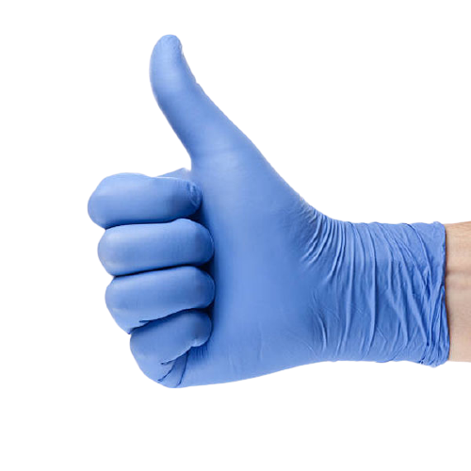
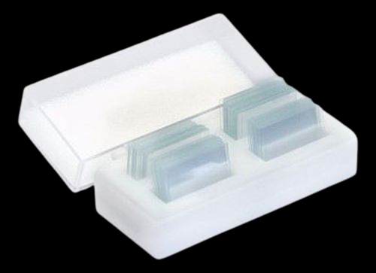
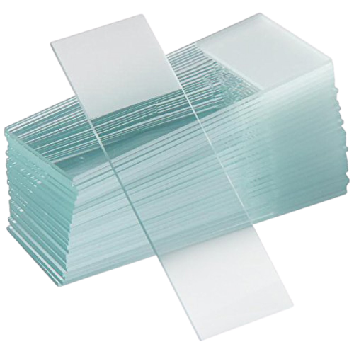
Methods: Pathogen collection external
Fish will be handled with nitrile gloves to preserve pathogens on surface of fish and to protect diagnostician.
External samples (skin, gill, and lesion) will be taken and examined under the microscope for pathogens

Slide 7
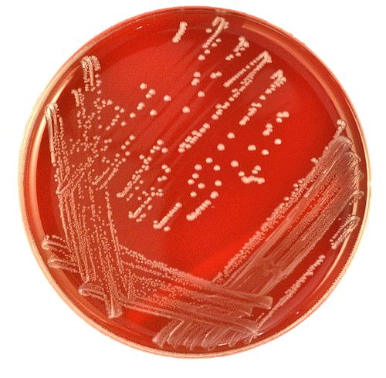
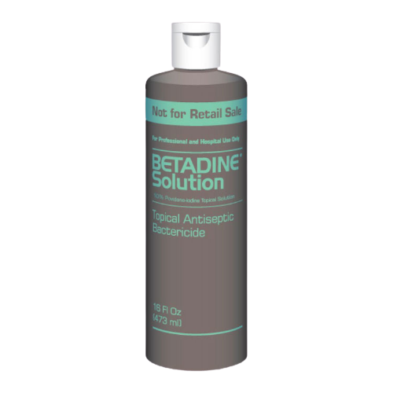
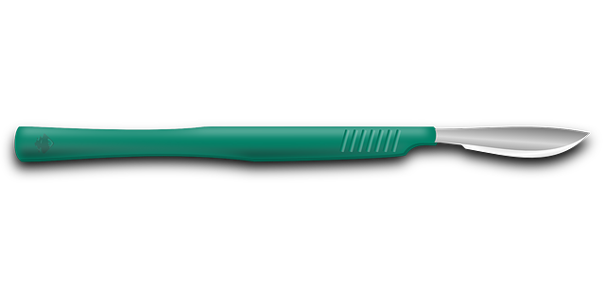
Methods: Pathogen collection internal
Fish are disinfected with povidone iodine (Betadine).
Necropsy is performed to collect internal samples from the kidney, spleen, and brain.
Tissue swabs are plated on Tryptic Soy Agar w/ 5% sheep blood and put in incubator at 28˚C for a minimum of 24 hours.

Slide 8
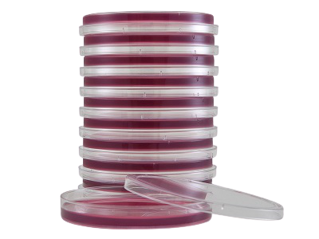
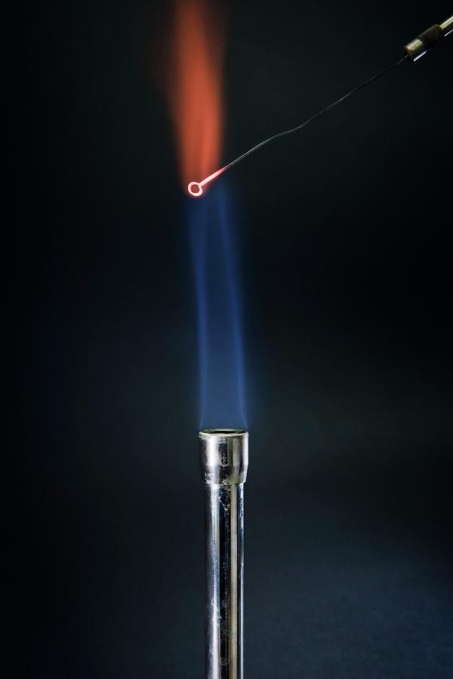
Methods: Bacterial growth
Re-isolate if growth occurs after 24 hours
Plate on MacConkey agar to determine if bacteria is gram-negative or gram-positive

Slide 9
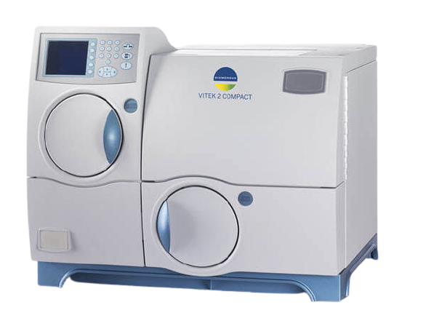
Methods: Pathogen identification
Pure, isolated bacterial colonies from TSA blood agar plate will be diluted in a sterile saline solution to a proper density
Optical density of 0.5-0.65
A sample of diluted bacteria will be taken via a sterile swab and plated on Mueller Hinton agar to test for antibiotic susceptibility.
Remaining saline solution will be inserted into a BioMerieux Vitek®2 machine for identification
Between 4-8 hours

Slide 10
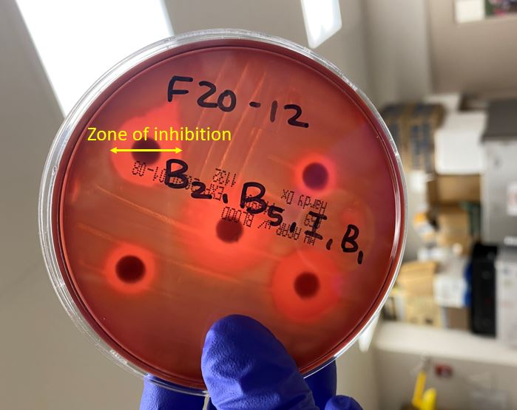
Methods: Antibiotic susceptibility
Antibiotics tested are Aquaflor® (Florfenicol), Terramycin® (Oxytetracycline), Romet®-30 (sulfadimethoxine + ormetoprim), and Novobiocin.
Mueller Hinton plates with antibiotic disks will be incubated for 24 hours to assess which antibiotics are most susceptible or have the largest ring of inhibition.

Slide 11
Methods: Recommending treatments
After final diagnosis has been identified in the lab, a treatment recommendation can be given to the fish owner.
Fish owner will be given recommendation with dosage and duration
Fish owner may choose to treat with medicated feed or use a chemical treatment
Fish owner may have a preference on what kind of treatment he/she prefers (antibiotic vs. chemical).

Slide 12
Methods: Survey
Once the treatment recommendation has been made and the fish owner has made a treatment choice, diagnosticians will continue to follow up.
A short survey will be given to the fish owner to complete
Survey will help determine what kind of treatment the fish owner prefers (antibiotic vs. chemical) and if the treatment was successful.

Slide 13
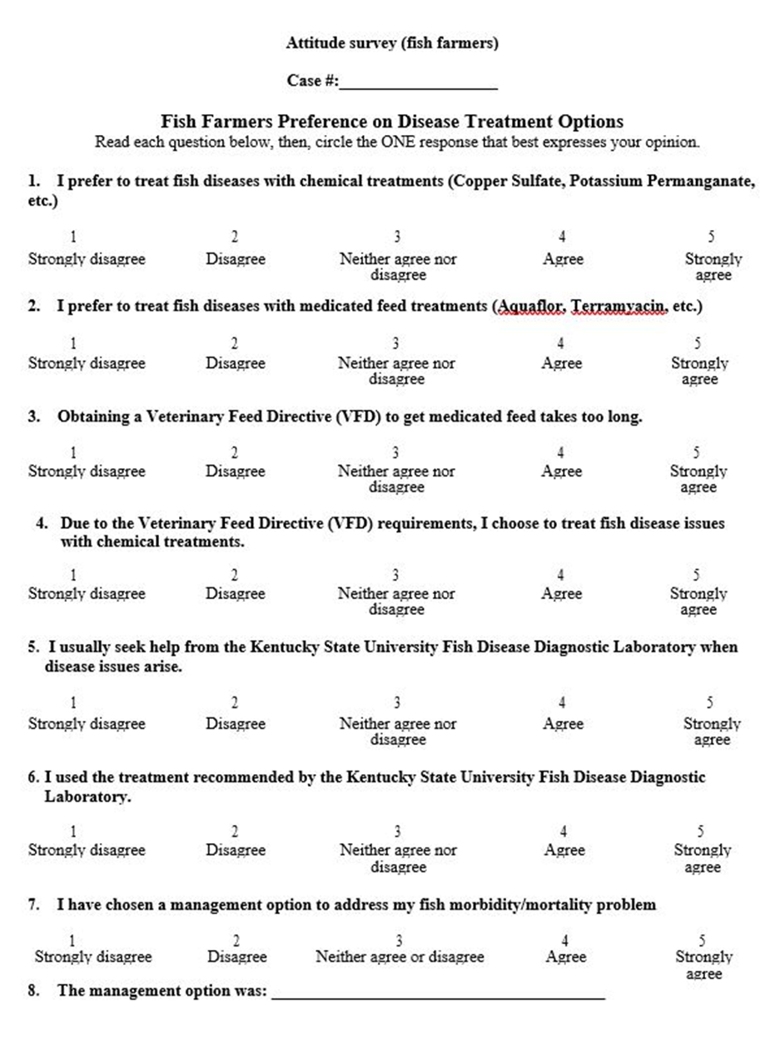
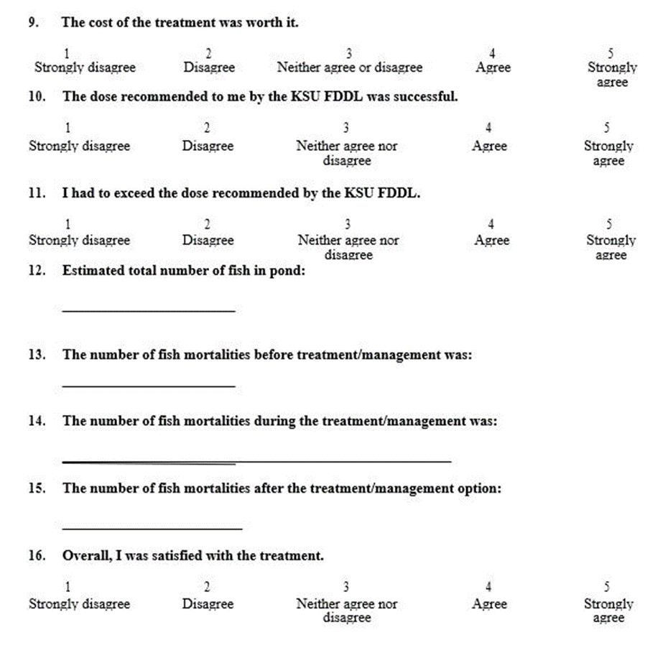
Survey

Slide 14
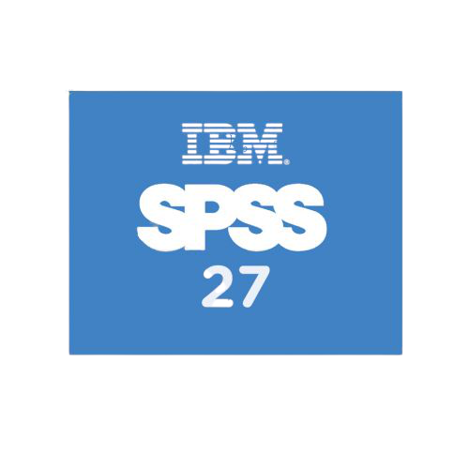
Methods: Analyzing Data
The 16 survey questions will be entered into SPSS statistics along with answers given by the fish owners
Data will then be analyzed to:
Determine preferred treatment method among fish farmers
Determine recommended treatment success rate

Slide 15
Expected Outcomes
Disease outbreaks can impair fish health, which increases mortality and decreases profit.
This study will provide insight on how fish farmers make their treatment decisions when disease outbreaks arise at their aquaculture facility.
It will also help determine the success of the recommended treatment option.

Slide 16
References
Baird, S. F. 1889. The Sea Fisheries of Eastern North America. Government Printing Office, Washington.
Dasgupta, S., K. R. Probst, and S. Wesley. 2011. Hispanic Consumers' Willingness to Purchase Aquaculture Products Directly from Farmers: Results from a Recent Survey. Journal of Extension 49(2):1–9.
Keck, K. C. 2017. The Big "Blue" Nation: Expanding Aquaculture in Kentucky. Kentucky Journal of Equine, Agriculture, and Natural Resources Law 10(1):1–21.
Meyer, F. P. 1991. Aquaculture Disease and Health Management. Journal of Animal Science 69(10):4201–4208.
Romero, J., C. Gloria, and P. Navarrete. 2012. Antibiotics in Aquaculture – Use, Abuse and Alternatives. Health and Environment in Aquaculture.
Stickney, R. R. 1996. Aquaculture in the United States: A Historical Survey. Wiley-Interscience, New York, NY.
Tidwell, J. H. 2012. Aquaculture Production Systems. Wiley-Blackwell, Ames, IA.
Winton, J. R. 2001. Fish Hatchery Management, 2nd edition. American Fisheries Society, Bethesda, MD.

