Slide 1
Difficulty engaging in goal-directed behavior is associated with alcohol-related problems
Shelby A. King, Sarah N. Elder, & Jenni B. Teeters
Department of Psychological Sciences , Western Kentucky University
Notes:
Hello everyone! We will be talking about a recent project done in our lab, Difficulty engaging in goal-directed behavior is associated with alcohol-related problems

Slide 2
Background info
In 2018, 54.9% of college students drank alcohol in the past month
36.9% engaged in heavy episodic drinking
Previous findings suggest that emotion regulation may be associated with alcohol use and related problems (Dvorak et al., 2014; Weiss et al., 2018)
https://www.onlineuniversities.com/blog/2012/04/the-disturbing-state-of-college-drinking-10-telling-facts/
Notes:
According to the 2018 National Survey on Drug Use and Health, 54.9 percent of college students drank alcohol in the past month, and 36.9 percent engaged in heavy episodic drinking.
With over half of college students drinking alcohol, research understanding alcohol-related problems in this population is vital.
Previous research suggests that emotion regulation may be associated with alcohol use and related problems.

Slide 3
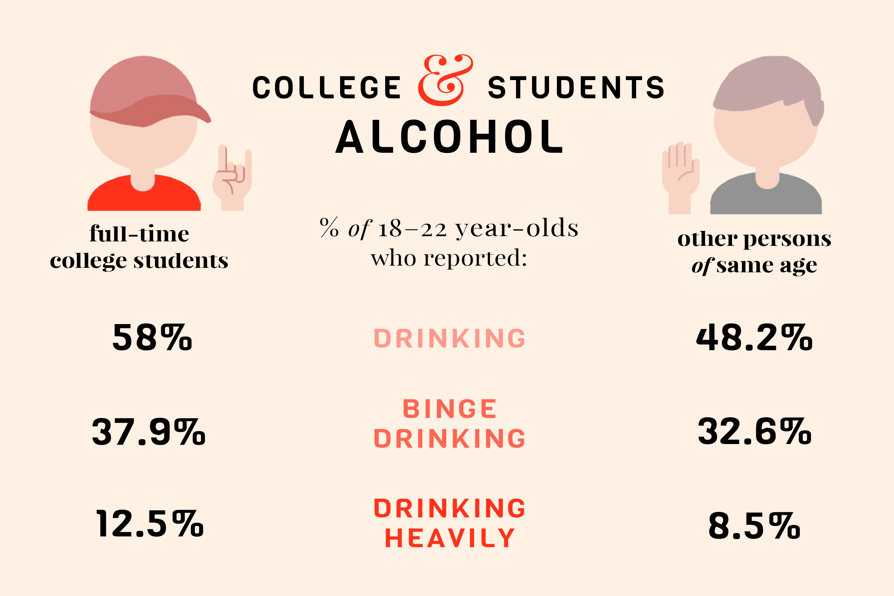
https://www.the-alcoholism-guide.org/college-binge-drinking.html
Notes:
Furthermore, it is especially important to study college populations as they are at an increased risk compared to other same age individuals

Slide 4
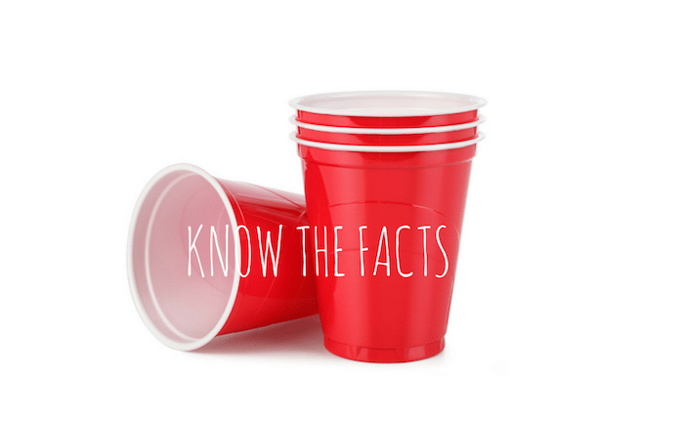
ALCOHOL-RELATED PROBLEMS
Researchers estimate that each year:
1,519 college students die from alcohol-related unintentional injuries, including motor-vehicle crashes
696,000 students are assaulted by another student who has been drinking
97,000 experience alcohol-related sexual assault or date rape
1 in 4 college students report academic difficulties from drinking, such as missing class or getting behind in schoolwork
Hingson et al., 2017; Wechsler et al., 2002

Slide 5
EMOTION DYSREGULATION
A multidimensional construct involving the inability to execute the skills of awareness, understanding, and acceptance of emotions (Gratz, K. L. & Roemer, L., 2004)
https://www.dbttherapy.com/dbt-leading-treatment-emotion-dysregulation/
Notes:
As mentioned, previous research suggests links between alcohol use and emotion dysregulation. But what exactly is emotion dysregulation. It has been defined by many and in multiple contexts, however, for the purpose of this study it is defined as a multidimensional construct involving the inability to execute the skills of awareness, understanding, and acceptance of emotions.
For example, an individual displaying behaviors related to emotion dysregulation may not be able to control their responses to bad news and may inappropriately lash out to those around them. Conversely, an individual with strong emotion regulation skills may appropriately process the bad news information and work towards resolving the issue

Slide 6
CURRENT STUDY
The present study examined the 6 facets of emotion regulation in relation to alcohol-related problems
1. Nonacceptance
2. Goals
3. Impulse
4. Awareness
5. Strategies
6. Clarity
https://magentix.ca/calming-emotional-storm-using-dialectical-behavior-therapy/
Notes:
The present study wanted to expand on previous research by examining facets of emotional regulation difficulties in relation to alcohol-related problems
According to the DERS, which the measurement we use in this particular study to measure emotion dysregulation, emotion dysregulation is comprised of 6 subscales:
1. Nonacceptance of emotional responses (NONACCEPT)
2. Difficulty engaging in Goal-directed behavior (GOALS)
3. Impulse control difficulties (IMPULSE)
4. Lack of emotional awareness (AWARENESS)
5. Limited access to emotion regulation strategies (STRATEGIES)
6. Lack of emotional clarity (CLARITY)

Slide 7
Methods
Participants: 382 college students
Online measures:
Alcohol use frequency
Alcohol-related problems
Emotion regulation difficulties
Notes:
As for methods, we collected data from 382 college students (79% female, 76% Caucasian, mean age = 19.45 years,
They completed online measures that assessed alcohol use frequency, alcohol- related problems, and emotion regulation difficulties. We will go further into each of these measures in subsequent slides

Slide 8
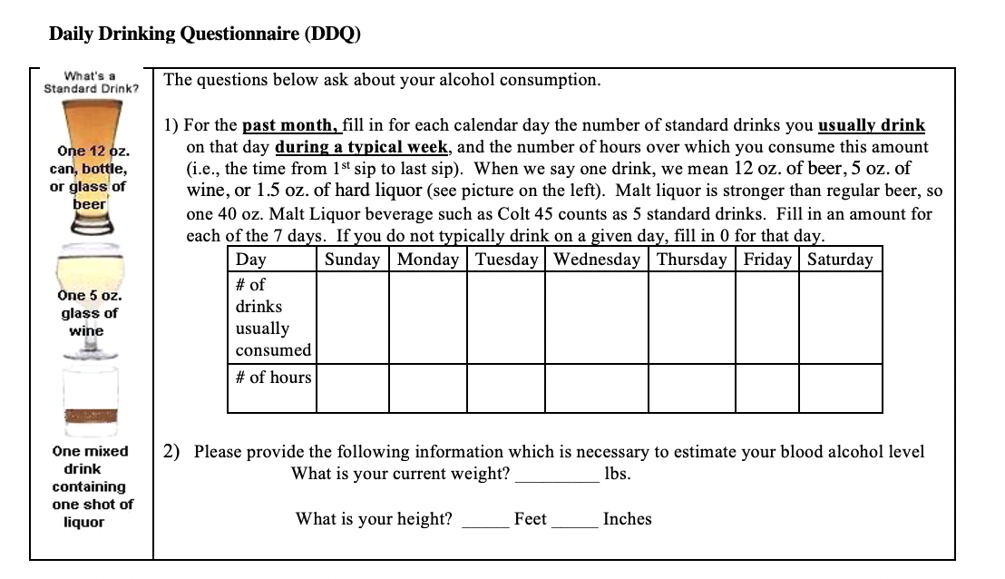
Alcohol USE FREQUENCY
Collins et al., 1985
Notes:
Alcohol use frequency was measured using the Daily Drinking Questionnaire (DDQ). The DDQ assesses information regarding past month typical drinking frequency and quantity.

Slide 9
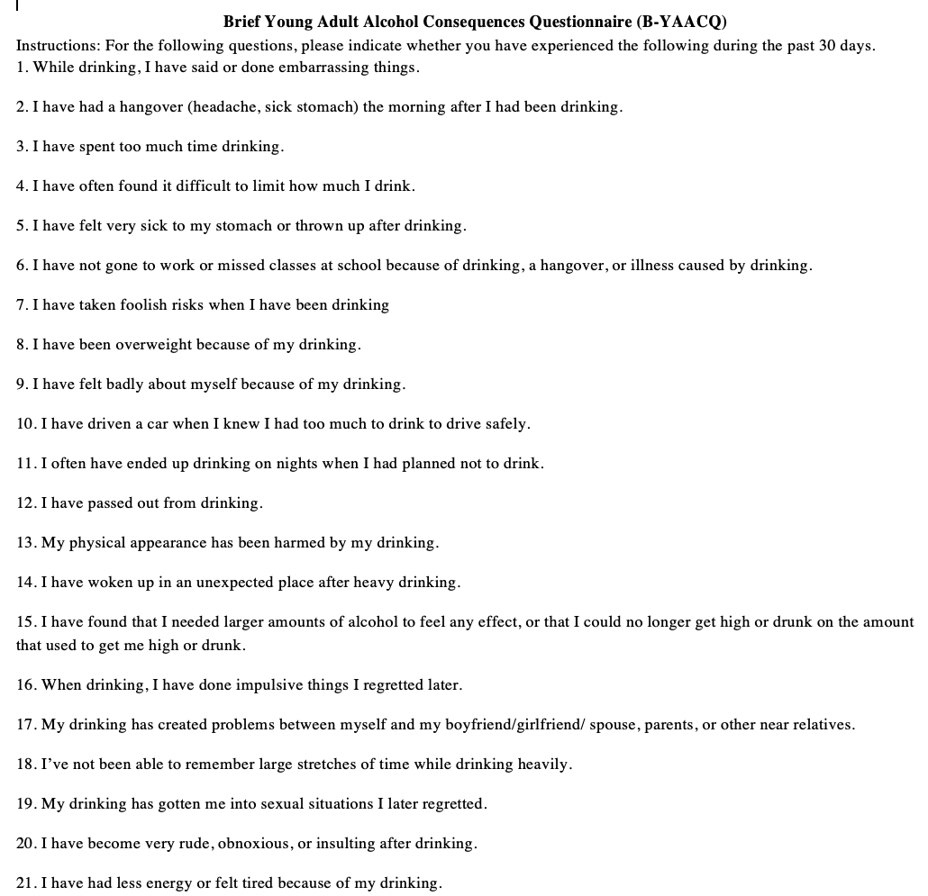
ALCOHOL-RELATED PROBLEMS
Kahler et al., 2005
Notes:
To measure alcohol-related problems we used the Brief Young Adult Alcohol Consequences Questionnaire. The B-YAACQ is a 24-item self-report measure that assesses whether or not participants have experienced items of potential alcohol-related problems.
Participants were asked to indicate whether or not they had experienced each alcohol-related problem by marking yes or no for each item.

Slide 10
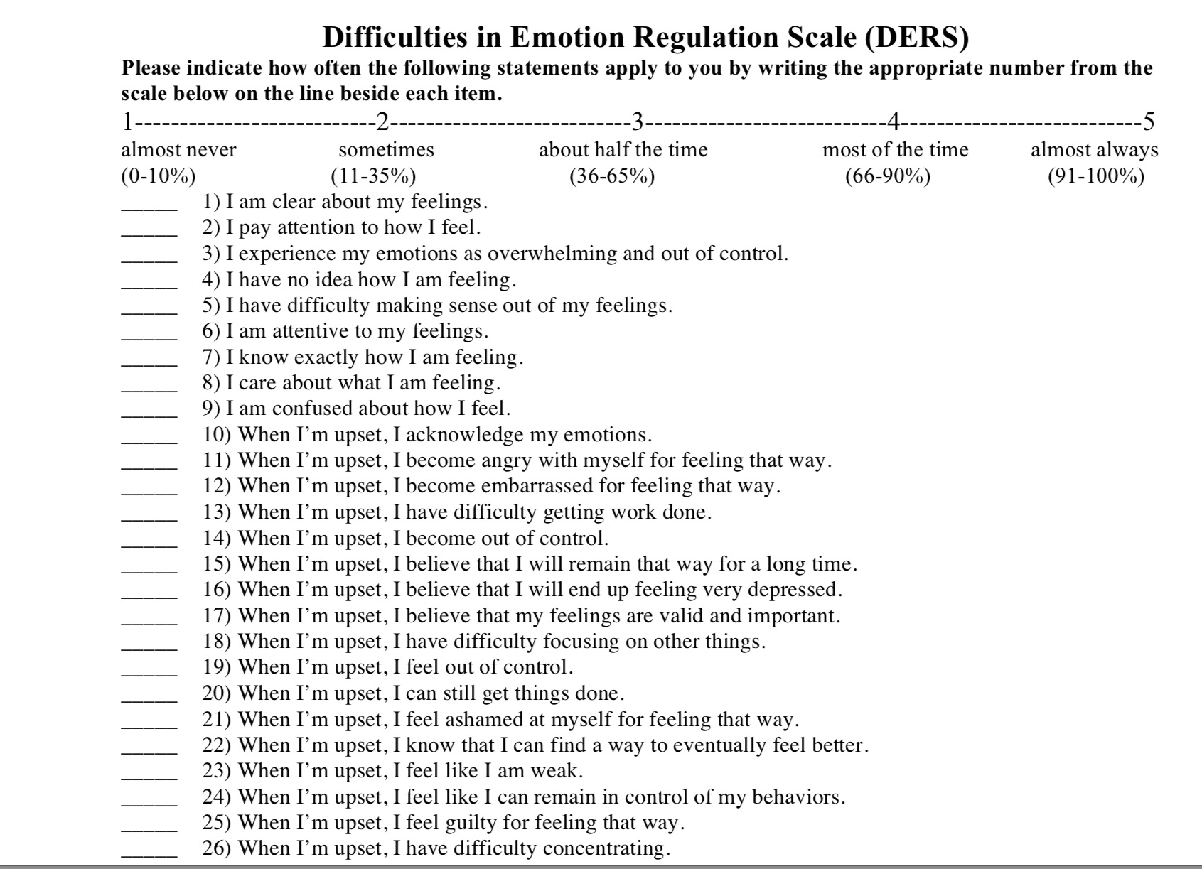
Emotion Regulation difficulties
Gratz, K. L. & Roemer, L., 2004
Notes:
Lastly, we used the Difficulties in Emotion Regulation Scale (DERS) to assess emotion dysregulation. The DERS is a 36-item self-report questionnaire that assesses emotion dysregulation. As stated earlier in the presentation, it was measured using the six subscales: which were nonacceptance, goals, impulse, awareness, strategies, and clarity.

Slide 11
Results
Linear regression model:
Significant effect between DERS subscales, drinking level, and alcohol-related problems (F(6, 343) = 25.73, p < .000, R2=.31)
Difficulty engaging in goal-directed behavior was a significant predictor (t=3.52, p < .000)
Model | B | Std. Error | Standardized Coefficients Beta | t | Sig.
 | -0.376 | 0.905 |  | -0.416 | 0.678
DERS_NONACCEPT | -0.073 | 0.042 | -0.097 | -1.718 | 0.087
DERS_GOALS | 0.175 | 0.050 | 0.190 | 3.515 | 0.000
DERS_AWARENESS | -0.014 | 0.047 | -0.016 | -0.307 | 0.759
DERS_IMPULSE | 0.005 | 0.053 | 0.006 | 0.093 | 0.926
DERS_CLARITY | 0.110 | 0.075 | 0.092 | 1.477 | 0.141
DDQ_WeekTotal | 0.284 | 0.025 | 0.516 | 11.387 | 0.000
a. Dependent Variable: BYAACQ_Total
Notes:
For results, In a linear regression model, a significant effect was found between the six DERS subscales, level of drinking, and alcohol-related problems, which a p value of less than .000
The individual predictors were examined further and indicated that only one subscale, difficulty engaging in goal-directed behavior (t = 3.52, p < .000) was a significant predictor.

Slide 12
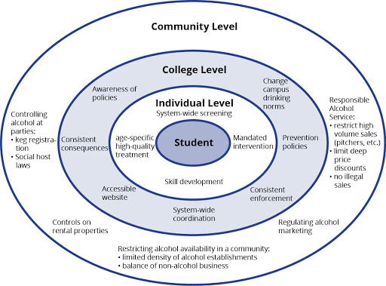
Discussion
Results underscore importance of emotion regulation in the context of alcohol-related problems
Intervention efforts should target goal-directed behavior that may reduce alcohol-related problems
https://projecthelping.org/goal-setting/
http://www.aep.umn.edu/aep-tools/college/
Notes:
These results underscore the importance of emotion regulation, specifically the ability to engage in goal-directed behavior, in the context of understanding alcohol-related problems in a college student population
Intervention and prevention efforts aimed at enhancing goal-directed behavior may reduce alcohol-related problems
Future studies should aim to further understand this link goal-directed behavior and alcohol use

Slide 13
REFERENCES
Collins, R. L., Parks, G. A., & Marlatt, G. A. (1985). Social determinants of alcohol consumption: The
effects of social interaction and model status on the self-administration of alcohol. Journal of
Consulting and Clinical Psychology, 53(2), 189–200. https://doi.org/10.1037/0022-006X.53.2.189
Dvorak, R. D., Sargent, E. M., Kilwein, T. M., Stevenson, B. L., Kuvaas, N. J., & Williams, T. J. (2014).
Alcohol use and alcohol-related consequences: Associations with emotion regulation difficulties. The
American Journal of Drug and Alcohol Abuse, 40(2), 125–130.
https://doi.org/10.3109/00952990.2013.877920
Gratz, K. L., & Roemer, L. (2004). Multidimensional Assessment of Emotion Regulation and
Dysregulation: Development, Factor Structure, and Initial Validation of the Difficulties in Emotion
Regulation Scale. Journal of Psychopathology and Behavioral Assessment, 26(1), 41–54.
https://doi.org/10.1023/B:JOBA.0000007455.08539.94
Hingson, R. W., Zha, W., & Weitzman, E. R. (2009). Magnitude of and Trends in Alcohol-Related Mortality
and Morbidity Among U.S. College Students Ages 18-24, 1998-2005. Journal of Studies on Alcohol
and Drugs, Supplement, s16, 12–20. https://doi.org/10.15288/jsads.2009.s16.12
Kahler, C. W., Strong, D. R., & Read, J. P. (2005). Toward Efficient and Comprehensive Measurement of
the Alcohol Problems Continuum in College Students: The Brief Young Adult Alcohol Consequences
Questionnaire: Alcoholism: Clinical & Experimental Research, 29(7), 1180–1189.
https://doi.org/10.1097/01.ALC.0000171940.95813.A5
Wechsler, H., Lee, J. E., Kuo, M., Seibring, M., Nelson, T. F., & Lee, H. (2002). Trends in College Binge
Drinking During a Period of Increased Prevention Efforts: Findings from 4 Harvard School of Public
Health College Alcohol Study Surveys: 1993–2001. Journal of American College Health, 50(5), 203–
217. https://doi.org/10.1080/07448480209595713
Weiss, N. H., Bold, K. W., Sullivan, T. P., Armeli, S., & Tennen, H. (2017). Testing bidirectional
associations among emotion regulation strategies and substance use: A daily diary study: Emotion
regulation and substance use. Addiction, 112(4), 695–704. https://doi.org/10.1111/add.13698
Email questions to: shelby.king819@topper.wku.edu, sarah.elder713@topper.wku.edu, or jenni.teeters@wku.edu
Notes:
Thank you for listening!

