Slide 1
PRIMARY REASONS FOR NOT ATTENDING FARMERS’ MARKETS. DO MARKET FEATURES AND CONSUMER CHARACTERISTICS MATTER?
Autumn Milliner
Dr. Dominique Gumirakiza
Kentucky Academy of Science — Fall 2020

Slide 2
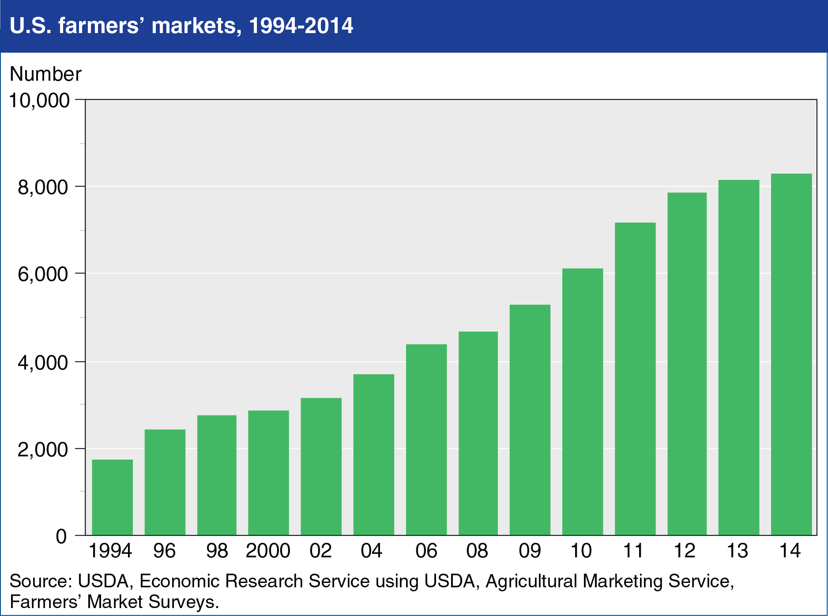
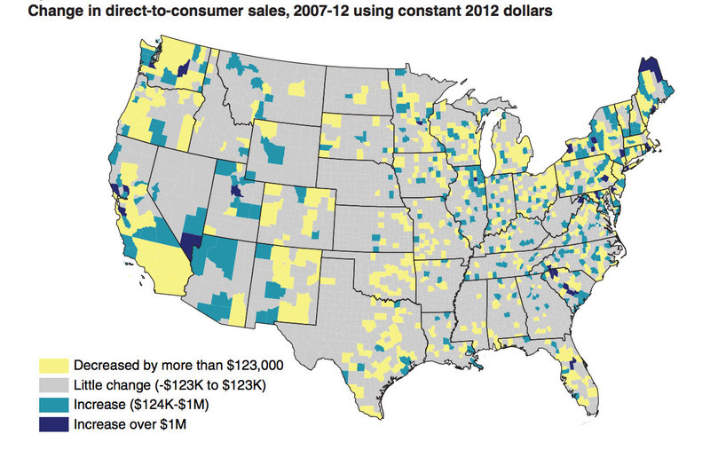
background
The number of farmers’ markets are increasing (USDA, 2018, Gumirakiza, 2016)
Consumer attendance is not rising at the same rate (Eggert & Biasillo, 2018)

Slide 3
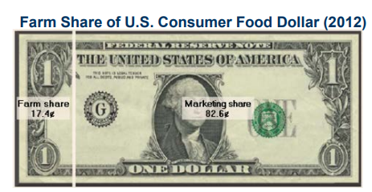
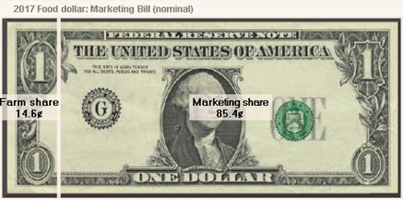
Background
Majority of a consumer dollar goes toward marketing costs
In mainstream supply chains, producers retain 14.6 cents per dollar (Saksena & Canning, 2019)
In “shorter” supply chains, farmers receive 7x that amount (USDA, 2017)
2012
2017

Slide 4
Supporting literature
G. Ritter, L. Walkinshaw, E. Quinn, S. Ickes, D. Johnson, 2018
J. Gumirakiza, 2016
J. Gumirakiza, K. Curtis, R. Bosworth, 2014
8

Slide 5
Research Objectives
Overall purpose: assess the statistical relationship between market attendance and consumer characteristics together, with market features and attributes.
Specific objectives:
Describe the consumer characteristics of individuals who do not attend farmers’ markets.
Analyze the primary reasons for not attending farmers’ markets.

Slide 6
Research Questions
1. What are the consumer characteristics of individuals who do not attend a farmers’ market?
2. What are the primary reasons that individuals choose to not attend a farmers’ market?

Slide 7
Hypotheses
The null hypothesis is that there is no statistical relationship between market attendance and each one of the consumer characteristics together, with market features and attributes.
$H_{0}≡ β_{k}=0 ∀ k=1…K$
The alternative hypothesis is that there is a significant statistical relationship between market attendance and each one of the consumer characteristics together, with market features and attributes.
$H_{1}≡ β_{k}≠0 ∀ k=1…K$

Slide 8
MEthods
2,530 surveys were mailed in January, 2020
Households in South-Central Kentucky
Mailed in a proportional manner
** Ex: if the entire region has 50 households and Warren County had 10% of those, 5 surveys would be sent to Warren County addresses

Slide 9
Methods
Counties: Adair, Cumberland, Grayson, Hardin, Larue, Edmonson, Butler, Warren, Barren, Allen, Monroe, Simpson, Logan, Todd, Green, and Metcalfe

Slide 10
Methods
Types of Questions:
Categorical/discrete question
Rank-order question
Simple binary (yes or no) question
Types of Independent Variables:
Consumer: Age, income, education, gender, and ethnicity
Market attributes: Hours of operation, amenities, events, location/distance, and availability of fresh produce

Slide 11
Theoretical Model
U_{ij} = V_{ij} + $ε$_{ij} $∀ i=1…I and j=1…J$
j represents of choice alternatives
i represents the individual
V*_{ij} = β' X_{ij}+ μ_{ij} $∀ i=1…I and j=1…J$
X_{ij} is a vector of characteristics of the chooser
β is to be estimated
µ_{ij} is the disturbance that accounts for unobserved factors
P_{ij} = P (y_{i} = j) = $\frac{\exp{\text{β}\text{′}\text{k} \text{Xij}\text{)}}}{∑j \text{β}\text{′}\text{k} \text{X}\text{ij}}$
The probability that an individual (i) chooses not to attend a market primarily due to motive (j)

Slide 12
Data analysis
Stata:
Multinomial Logit Model

Slide 13
Results: Descriptive statistics
Variable Name | Description | Mean
Rural | Rural=1, Small sized City=0 | 0.63
Male | Male=1, Female=0 | 0.68
Education | Level of Education; 1=High School, 2=2-year associate’s degree, 3=4-year bachelor’s degree, 4=graduate degree or higher | 2.05
Household | Total number of people in a household | 2.5
Citizenship | Citizen=1, Non-citizen=0 | 1.0
Age Category | Age Category; 1=18-29, 2=30-39, 3=40-49, 4=50-59, 5=60-69, 6=70+ | 3.9
Married | Married=1, Single=0 | .62
Income Category | Income Category; 1=Less than $25,000, 2=$26,000-$50,000, 3=$51,000-$75,000, 4=$76,000-$100,000, 5=$100,000+ | 2.69
Ethnicity | African-American=1, Asian=2, Hispanic=3, Caucasian=4, Other=5 | 4.0
PrimaryShopper | Is primary shopper; Yes=1, No=0 | 0.82
LikelyToSubscribeToCSA | Would join a CSA program; Yes=1, No=0 | 1.97
CSAAwareness | Knows what a CSA is; Yes=1, No=0 | 0.21
63% live in a rural setting
68% are male
62% are married
Average respondent has a 2-year associate’s degree
The third age category (40-49)
2.5 people per household
Second income level ($26,000-$50,000)
82% are their household’s primary shopper
21% knows what a CSA program is

Slide 14
Results: Descriptive Statistics
SatisfactionOverallExp | 1=Extremely Dissatisfied, 2=Dissatisfied, 3=Moderately Satisfied, 4=Satisfied, 5= Extremely Satisfied | 3.59
SatisfactionPrices | 1=Extremely Dissatisfied, 2=Dissatisfied, 3=Moderately Satisfied, 4=Satisfied, 5= Extremely Satisfied | 3.35
SatisfactionProduceQual | 1=Extremely Dissatisfied, 2=Dissatisfied, 3=Moderately Satisfied, 4=Satisfied, 5= Extremely Satisfied | 3.7
SatisfactionHours | 1=Extremely Dissatisfied, 2=Dissatisfied, 3=Moderately Satisfied, 4=Satisfied, 5= Extremely Satisfied | 2.88
SatisfactionSocialInteract | 1=Extremely Dissatisfied, 2=Dissatisfied, 3=Moderately Satisfied, 4=Satisfied, 5= Extremely Satisfied | 3.1

Slide 15
Results: Multinomial logit
Notes:
Coefficients of non-linear models are not explicitly analyzed
Instead, marginal effects are used for analysis
Three habits of attendance: Never Attend, Occasionally Attend, Very Frequently Attend
Relative probabilities of the three habits are 62.3%, 21.3%, and 17.3%, respectively.
Ex: The likelihood of a consumer to choose to Never Attend a farmers market is 62.3%.

Slide 16
Results: Multinomial Logit
Never Attend
y=Pr(Never Attend= 62.3%)
Variable | Marginal Probability
Rural | 0.0391
Household | 0.0209
Citizenship | -0.3089
Male | -0.1386
AgeCategory | -0.0394
Married | -0.0622
Education | -0.0577
IncomeCategory | -0.0004
Ethnicity | -0.2177*
Primary Shopper | 0.2274**
SatisfactionOveralExp | -0.0729
SatisfactionPrices | 0.0425
SatisfactionProduceQual | -0.0860
SatisfactionHours | -0.0820
SatisfactionSocialInteract | 0.0452
CSAAwareness | -0.1265
ActualSpendingFP | -0.0022*
Support Farmers | -0.0486
InterestinUsingApp | -0.0545*
Ethnicity: -0.2177
Primary Shopper:
0.2274
Monthly spending on fresh produce: -0.0022
Interest in using a mobile app to purchase fresh produce: -0.0545
Ex: Primary shoppers, compared to non-primary shoppers, are 22.74% more likely to choose to Never Attend a farmers market.

Slide 17
Results: Multinomial Logit
Male: 0.1631
Primary Shopper: -0.2007
Satisfaction w/ Produce Quality: 0.0993
Satisfaction w/ Social Interaction: -0.1335
Actual Spending: 0.0015
Interest in using a mobile app to purchase fresh produce: 0.0615
Occasionally Attend
y=Pr(Occasionally Attend= 20.3%)
Variable | Marginal Probability
Rural | -0.0467
Household | -0.0199
Citizenship | 0.1129
Male | 0.1631*
AgeCategory | 0.0357
Married | -0.0391
Education | 0.0113
IncomeCategory | 0.0158
Ethnicity | 0.0524
Primary Shopper | -0.2007*
SatisfactionOveralExp | -0.0781
SatisfactionPrices | 0.0211
SatisfactionProduceQual | 0.0993*
SatisfactionHours | 0.0522
SatisfactionSocialInteract | -0.1335*
CSAAwareness | 0.0576
ActualSpendingFP | 0.0015***
Support Farmers | 0.0362
InterestinUsingApp | 0.0615**
Ex: For each additional dollar spent per month on fresh produce, the probability of choosing to occasionally attend a farmers market increases by 0.15%.

Slide 18
Results: Multinomial Logit
Very Frequently Attend
y=Pr(Very Frequently Attend= 17.3%)
Variable | Marginal Probability
Rural | 0.0075
Household | -0.0010
Citizenship | 0.1961
Male | -0.0245
AgeCategory | 0.0037
Married | 0.1014
Education | 0.0463*
IncomeCategory | -0.0153
Ethnicity | 0.1653
Primary Shopper | -0.0266
SatisfactionOveralExp | 0.1510**
SatisfactionPrices | -0.0636
SatisfactionProduceQual | -0.0132
SatisfactionHours | 0.0298
SatisfactionSocialInteract | 0.0583
CSAAwareness | 0.0690
ActualSpendingFP | 0.0007
Support Farmers | 0.0124
InterestinUsingApp | -0.0070
Education: 0.0463
Satisfaction Overall: 0.1510
Ex: For each additional unit of education achieved, the likelihood of a consumer choosing to Very Frequently attend a market increases by 4.63%.

Slide 19
Discussion
Limits:
Only surveyed consumers from sixteen counties
Mail surveys usually have low response rates and administration errors
Mail surveys are also ineffectual for certain groups of adults (disabilities, language barriers, are marginally illiterate (National Public Research, 2017).
Accept all alternative hypothesis – The regressions had statistically significant results.
Results should aid farmers’ market personnel in growing their markets. By directing advertising activities on specific groups of consumers who are not likely to attend, while maintaining the current consumer segments that are likely to attend, markets should thrive and experience growth as the local food movement continues to thrive.

Slide 20
references
U.S. Department of Agriculture. Agriculture Marketing Service. "New Data Reflects the Continued Demand for Farmers Markets." News release, August 4, 2014. Usda.gov. Accessed March 27, 2019. https://www.usda.gov/media/press-releases/2014/08/04/new-data-reflects-continued-demand-farmers-markets.
Eggert, D., & Biasillo, L. (2018, June 26). Why a decrease in participation in farmers markets? Survey aims to find out. Retrieved April 18, 2019, from https://smallfarms.cornell.edu/2018/06/25/why-a-decrease-in-participation-in-farmers-markets-survey-aims-to-find-out/
Gumirakiza, J. D., Curtis, K. R., & Bosworth, R. (2014). Who Attends Farmers’ Markets and Why? Understanding Consumers and their Motivations. International Food and Agribusiness Management Review, 17(2), 65-82. Retrieved April 18, 2019.
Saksena, M., & Canning, P. (2019, March 14). Food Dollar Series. Retrieved April 18, 2019, from https://www.ers.usda.gov/data-products/food-dollar-series/
Leibrock, A. (2014, August 6). Good Growth: Farmers Markets Still on the Rise. Retrieved April 20, 2019, from https://sustainableamerica.org/blog/good-growth-farmers-markets-still-on-the-rise/
Runyon, L. (2015, February 06). Are Farmers Market Sales Peaking? That Might Be Good For Farmers. Retrieved April 20, 2019, from https://www.npr.org/sections/thesalt/2015/02/05/384058943/are-farmer-market-sales-peaking-that-might-be-good-for-farmers
Tropp, D. (2017). Why Local Food Matters: Views from the National [PowerPoint slides]. Retrieved from https://www.ams.usda.gov/sites/default/files/media/Why%20Local%20Food%20Matters.pdf

Slide 21
QUESTIONS?

