Slide 1
An Assessment of Land Use and Land Cover (LULC) Changes in Chitwan, Nepal
Pradip Poudel, Leigh Whittinghill, and Buddhi Gyawali
College of Agriculture, Community and the Sciences,
Kentucky Sate University,
Frankfort, KY 40601

Slide 2
Outline of presentation
Introduction
Objective/Hypothesis
Methodology
Results
Conclusions
Acknowledgement

Slide 3
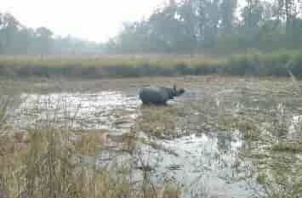
Introduction
Increasing trend of domestic migration in Nepal
The Maoist insurrection was one of the major factors (Bohra-Mishra and Massey, 2011)
Now, people migrate for better facilities, jobs & quality of life
500 % increase in the built-up area in the Bharatpur area in the last 28 years (Rai et al., 2020)
Fig 1: Forest land encroachment by agriculture
Photo credit: Tilak Ram Rimal
Water bodies and cultivated land increased from 1898 to 2017 , while there was a decrease in bare and forest land in Madi, Chitwan (Adhikari et al., 2020)
Bohra-Mishra, P., & Massey, D. S. (2011). Individual decisions to migrate during civil conflict. Demography, 48(2), 401-424.
Rai, R., Yili, Z., Paudel, B., Khanal, N. R., & Acharya, B. K. (2020). Satellite Image-Based Monitoring of Urban Land Use Change and Assessing the Driving Factors in Pokhara and Bharatpur Metropolitan Cities, Gandaki Basin, Nepal. Journal of Resources and Ecology, 11(1), 87-99.
Upreti, B. R., Breu, T., & Ghale, Y. (2017). New challenges in land use in Nepal: Reflections on the booming real-estate sector in Chitwan and Kathmandu Valley. Scottish geographical journal, 133(1), 69-82.

Slide 4
Cont…
Agricultural land was threatened by real estate and commercial land acquisition (Upreti et al., 2017)
Land Use Land Cover (LULC) changes overtime may have affected the sustainable utilization of natural resources available
This research provides insight on LULC type and areas changed between 2009 and 2020 in the Chitwan district, Nepal
Adhikari, B., Pokhrel, P., Pradhan, Y., & Ulak, A. (2020). Decadal Variation in the Land Use and Land Cover Pattern of Madi, Chitwan from 1989 to 2017 with Flood Hazard Mapping. Lowland Technology International, 21(4), 287-295.

Slide 5
Objective/Hypothesis
Objective
To assess the changes in land cover types of Chitwan district between 2009 and 2020
Hypothesis
There were changes in LULC classes from 2009 to 2020 in Chitwan District, Nepal

Slide 6
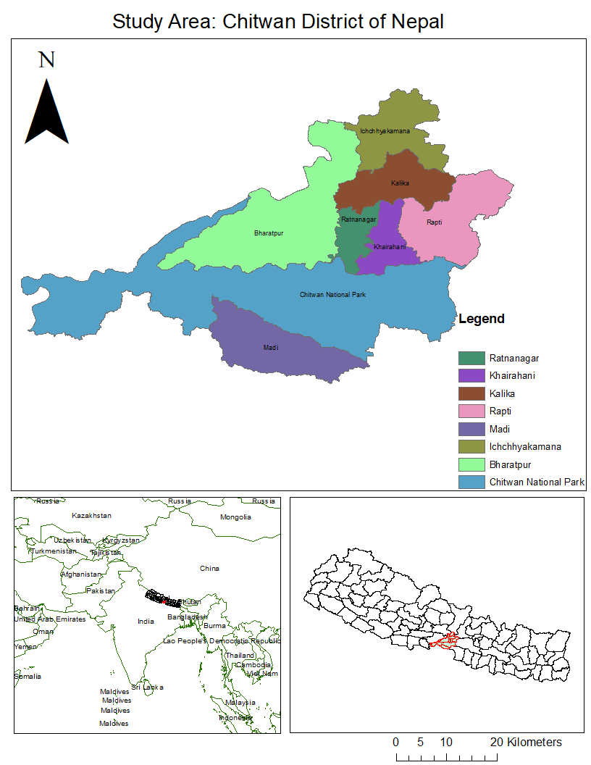
Methodology
Study area: Chitwan, Nepal
A part of Bagmati Province
Sothern Central part of Nepal
Total area of 2237.57 km²
Eastern longitudes
83° 55' 7.5" to 84° 47' 50.71"
Northern latitudes
27° 52' 49.96" to 27° 21' 18.15 "
Elevation range
144 m to 1,947 m from mean sea level
Two major Rivers (Narayani and Rapti) and one National Park
Population: 579,984 (Male- 279,087 and Female-300,897 )(National Census, 2011).
National Population and Housing Census (NPHC). (2011). Government of Nepal, Central Bureau of Statistics, Kathmandu, Nepal.

Slide 7
Data source /Analysis
Raster data downloaded from the United States Geological Survey Earth Explorer (https:// earthexplorer.usgs.gov/)
Shape file of study area from Nepal (NPL) Administrative Boundary Common Operational Database (COD-AB) (https://data.humdata.org/dataset/administrative-bounadries-of-Nepal)
Projection used: WGS_1984
Table 1: Landsat data used information
Data set | Path/Row | Spatial resolution | Acquisition date/year
Landsat 5-TM | 142/41 | 30m x 30m | 12th March 2009
Landsat 8-OLI | 142/41 | 30m x 30m | 26th March 2020

Slide 8
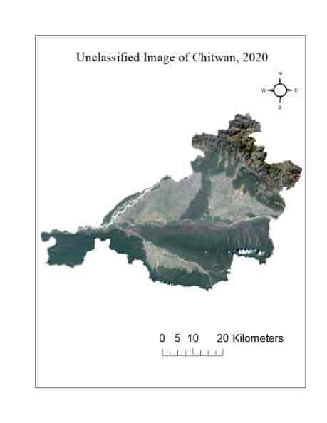
Cont…
Figure 2: Image used for classification, 2009
Figure 3: Image used for classification, 2020

Slide 9
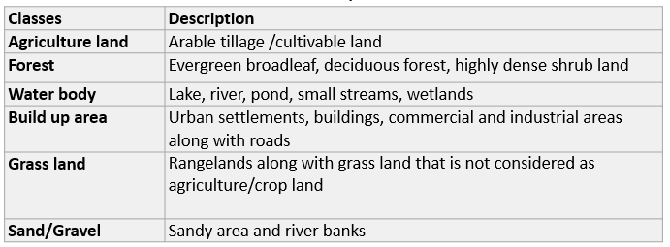
Cont…
Table 2: LULC classes and their description
(Source: Pokhrel, 2018 ; Rai et al, 2020)
Pokhrel, J. (2018). Land Use and Landcover Changes in Chitwan National Park and Adjacent Areas from 1988 to 2017 (Doctoral dissertation, The University of Arizona).
Rai, R., Yili, Z., Paudel, B., Khanal, N. R., & Acharya, B. K. (2020). Satellite Image-Based Monitoring of Urban Land Use Change and Assessing the Driving Factors in Pokhara and Bharatpur Metropolitan Cities, Gandaki Basin, Nepal. Journal of Resources and Ecology, 11(1), 87-99.

Slide 10
Cont…
Images were classified into six classes (Table 2) using maximum likelihood supervised classification in ERDAS IMAGINE version 16.5
Minimum of 50 training samples per class were taken
Multiple signature files per class were created to minimize the error of image classification
Images were filtered through spatial model builder (5X5 low pass) after classification

Slide 11
Cont…
Accuracy assessment was done using high resolution Google Earth images
300 stratified random points created with minimum 10 points per class
LULC data of ninety eight wards and seven municipal levels were extracted using zonal statistics in Arc Map Version 10.7.1
Pairwise t-test (alpha level=0.05) was done in R Version 1.2.5001 (The R Project for Statistical Computing, Vienna, Austria) to compare the land cover from 2009 to 2020 at the ward level after normalizing for ward area.
$$t=\frac{{\overline{x}}_{d}}{{s_{d}}/{\sqrt{n_{d}}}}$$
Where, ${\overline{x}}_{d}$ is the mean of differences, $s_{d}$ is the standard deviation of differences, and $n_{d}$ is the number of paired observation

Slide 12
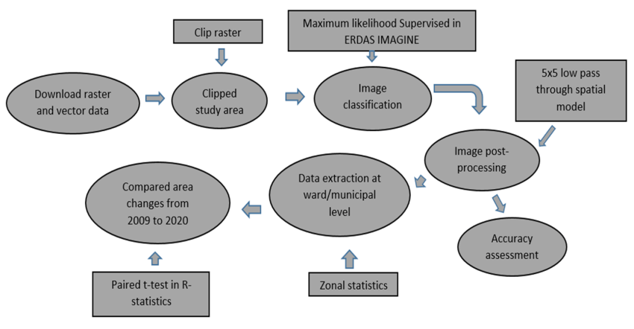
Cont…
Figure 4: Analysis workflow

Slide 13
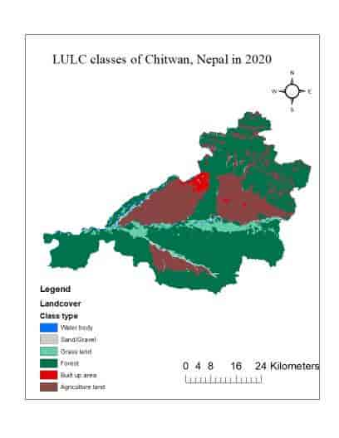
Results
Figure 5: Classified map of Chitwan, 2009
Figure 5: Classified map of Chitwan, 2020

Slide 14
Cont…
Table 3: The Accuracy of image classification

Slide 15
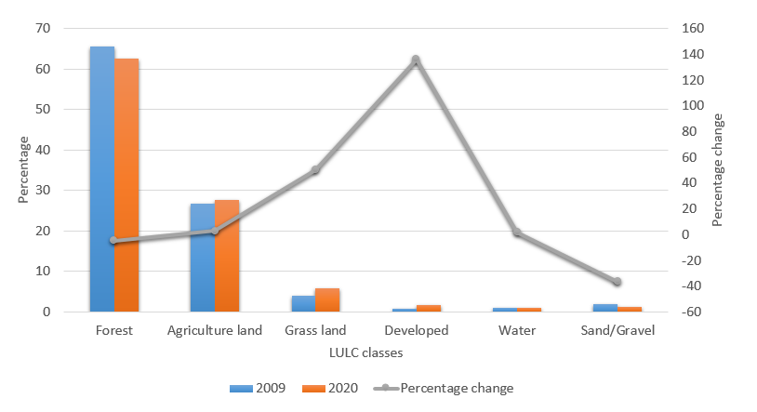
Cont…
Figure 6: LULC % in 2009 and 2020 and change over time in Chitwan, Nepal

Slide 16
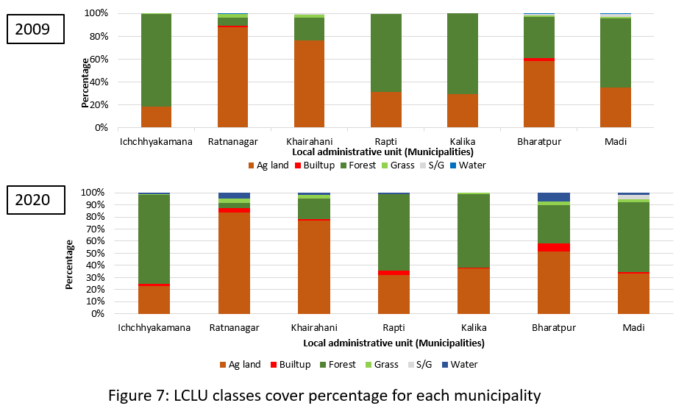

Slide 17
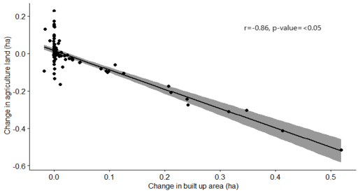
Cont…
Table 4: LULC changes per Ha of total land ( ward level )
Figure 8: The correlation between change in agriculture land and built up area

Slide 18
Discussion and Conclusions
There was significant increase in built up area (136%). Meanwhile, significant decrease (4.49 %) in forest area was found
This could increase the urban heat island and the area affected
Recent study found an increase in higher land surface temperature area in the Chitwan district (Smriti, 2020)
Further, results show a strongly negative correlation between change in agriculture lands and built up area in Chitwan
Policy makers should make policy and plan for sustainable development based on current land use and land cover patterns
This study suggest the immediate need for policy change and better city planning for sustainable city development and utilization of natural resources
Smriti K. (2020, Sep 25-28). Assessment of Urban Heat Island (UHI) in Relation to Normalized Difference Vegetation Index (NDVI): A Case Study of Chitwan, Nepal [Conference presentation]. NAPA biennial conference(virtual)

Slide 19
References
Adhikari, B., Pokhrel, P., Pradhan, Y., & Ulak, A. (2020). Decadal Variation in the Land Use and Land Cover Pattern of Madi, Chitwan from 1989 to 2017 with Flood Hazard Mapping. Lowland Technology International, 21(4), 287-295.
Bohra-Mishra, P., & Massey, D. S. (2011). Individual decisions to migrate during civil conflict. Demography, 48(2), 401-424.
National Population and Housing Census (NPHC). (2011). Government of Nepal, Central Bureau of Statistics, Kathmandu, Nepal
Pokhrel, J. (2018). Land Use and Landcover Changes in Chitwan National Park and Adjacent Areas from 1988 to 2017 (Doctoral dissertation, The University of Arizona).
Rai, R., Yili, Z., Paudel, B., Khanal, N. R., & Acharya, B. K. (2020). Satellite Image-Based Monitoring of Urban Land Use Change and Assessing the Driving Factors in Pokhara and Bharatpur Metropolitan Cities, Gandaki Basin, Nepal. Journal of Resources and Ecology, 11(1), 87-99.
Smriti K. (2020, Sep 25-28). Assessment of Urban Heat Island (UHI) in Relation to Normalized Difference Vegetation Index (NDVI): A Case Study of Chitwan, Nepal [Conference presentation]. NAPA biennial conference(virtual)
Upreti, B. R., Breu, T., & Ghale, Y. (2017). New challenges in land use in Nepal: Reflections on the booming real-estate sector in Chitwan and Kathmandu Valley. Scottish geographical journal, 133(1), 69-82.

Slide 20
Acknowledgement
Mr. Jeremy Sandifer Mr. Ken Bates for their guidance and technical support
College of Agriculture, Community and the Sciences

Slide 21
Thank you!

