Slide 1
Assessing Autism Spectrum Disorder During a Pandemic: Percent Agreement of the ADOS-2 Across Mediums
Nicholas Hoffmann, Tyler McQueen, & Gabriel Gomez

Slide 2
Overview of Presentation
Significance of the problem
Research Question
Meta-analytic method
Results
Summary & Implications

Slide 3
Significance of the problem
The ADOS-2 requires careful observation of behavior and manipulation of items
Does tele-assessment maintain fidelity of care?
Definition of Terms:
ADOS-2: Autism Diagnostic Observation Schedule: 2nd edition
ASD: Autism Spectrum Disorder
Tele-assessment: A health assessment carried out remotely using audiovisual telecommunications between doctor and patient.
Percent Agreement (PA): A measure of agreement between raters.
Typical in-person ADOS-2 Kit

Slide 4
2. Research Question
Is assessment of Autism Spectrum Disorder via tele-assessment equivalent to assessments done live in face-to-face settings?

Slide 5
3. Meta-analytic Method
Meta-analyses combine similar studies to form a more powerful conclusion
Form research question
Literature search
Compute effect sizes based on data gathered
Meta-analytical calculations

Slide 6
3. Meta-analytic Method
Literature search
Key terms:
ADOS, autism diagnostic observation schedule, ADOS-2, ASD, autism, autism spectrum disorder, telehealth, assessment, remote assessment, tele-assessment, tele*, assess*, item comparison, agreement, percent agreement, accuracy, reliability, interrater reliability, kappa statistic, Cohen’s kappa, & kappa.
Databases:
APA PsycInfo, APA PsycArticles, CINAHL Complete, CINAHL with Full Text, Medline, and Academic Search Complete.
Number of studies that met inclusion criteria: 5

Slide 7
Results
Tele-assessment delivered ADOS-2
Lower than average PA compared to ADOS-2 Initial study
Compared to in person replication of ADOS-2 Initial study, higher average PA

Slide 8
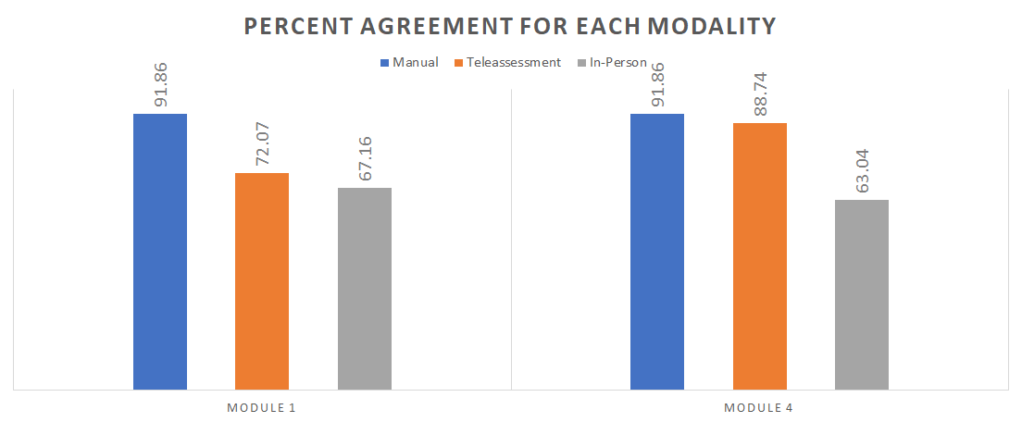

Slide 9
5. Summary and Implications
Tele-assessment: NO reductive effect on PA
Higher PA on Module 4 items when using teleassessment compared to replication.
Implications:
Higher rate of agreeance over tele-assessment vs in person replication
ADOS-2 via tele-assessment PA is acceptable and on par with en vivo administration.
Percent agreement for the ADOS-2 in clinical training programs will not be affected merely by use of teleassessment methods.
Significance:
Given the current pandemic and the forceful shift to tele-assessment, this meta analysis has indicated that the ADOS-2 can be administered via tele-assessment, without the medium having a reductive effect on percent agreement when compared to in-person administration.

