Slide 1
Ethnic Identity & Well-being
Tajana Graves

Slide 2
Contents
Significance of the problem
Research question
Meta- analysis method
Results
-overall
-moderator variables
Summary and Implications

Slide 3
Significance of the question
Identity formation has been considered a crucial element in psychological well being
strong ethnic identity helps individuals recognize positive virtues ,lessens negative societal views
Well being is comprised of 8 elements

Slide 4
Research Question
How strongly are ethnic identity and well being related?
Notes:
Consider talking about:
Diener: tripartite model of subjective well-being
Six-factor Model of Psychological Well-being
Corey Keyes: flourishing
Seligman: positive psychology
UK Office for National Statistics (ONS) definition
Nagel: Experience itself as a good
Mixed emotions help wellbeing

Slide 5
Previous Findings
These findings are specific to people of color in North America
R=.17

Slide 6
Meta analysis method
Meta analysis is the process of combining similar studies to form a more powerful conclusion
1.form research question
2.literature search
3. Computing effect sizes
4. meta analysis calculations

Slide 7
Meta analysis method
Literature search
Key terms : ethnic identity and well being
Databases: PsychInfo, Google Scholar, SAGE Journal
Nuber of studies that met the inclusion criteria : 25

Slide 8
Meta analysis method
Compute effect sizes
I used correlation r ( Cohen’s d)
This was reported in data tables

Slide 9
Meta analysis method
Meta analysis calculations
Compute weighted average effect size
Weighted based on sample size
- larger studies count towards the average

Slide 10
Results
r=.19
According to Cohens’ guidelines, this is a moderate, positive relationship
Ethnic identity is not a strong indicator of well being .
Notes:
Consider talking about:
Diener: tripartite model of subjective well-being
Six-factor Model of Psychological Well-being
Corey Keyes: flourishing
Seligman: positive psychology
UK Office for National Statistics (ONS) definition
Nagel: Experience itself as a good
Mixed emotions help wellbeing

Slide 11
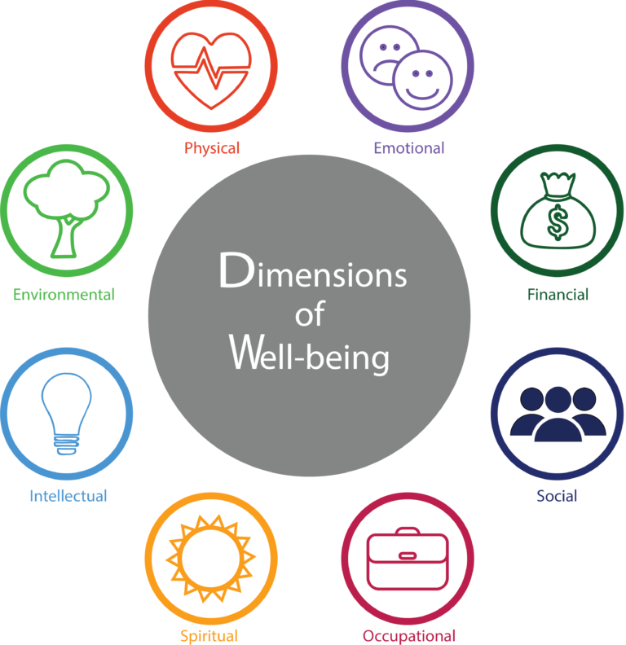
Results

Slide 12
Summary and Implications
Helpful towards psychotherapy
Interventions
It can take a lot of the guessing out for therapists in treatment
Therapists can match interventions with the client's strengths
situations and behaviors that can shed light on situations
Can help therapists better understand clients

Slide 13
Thank you .

