Slide 1
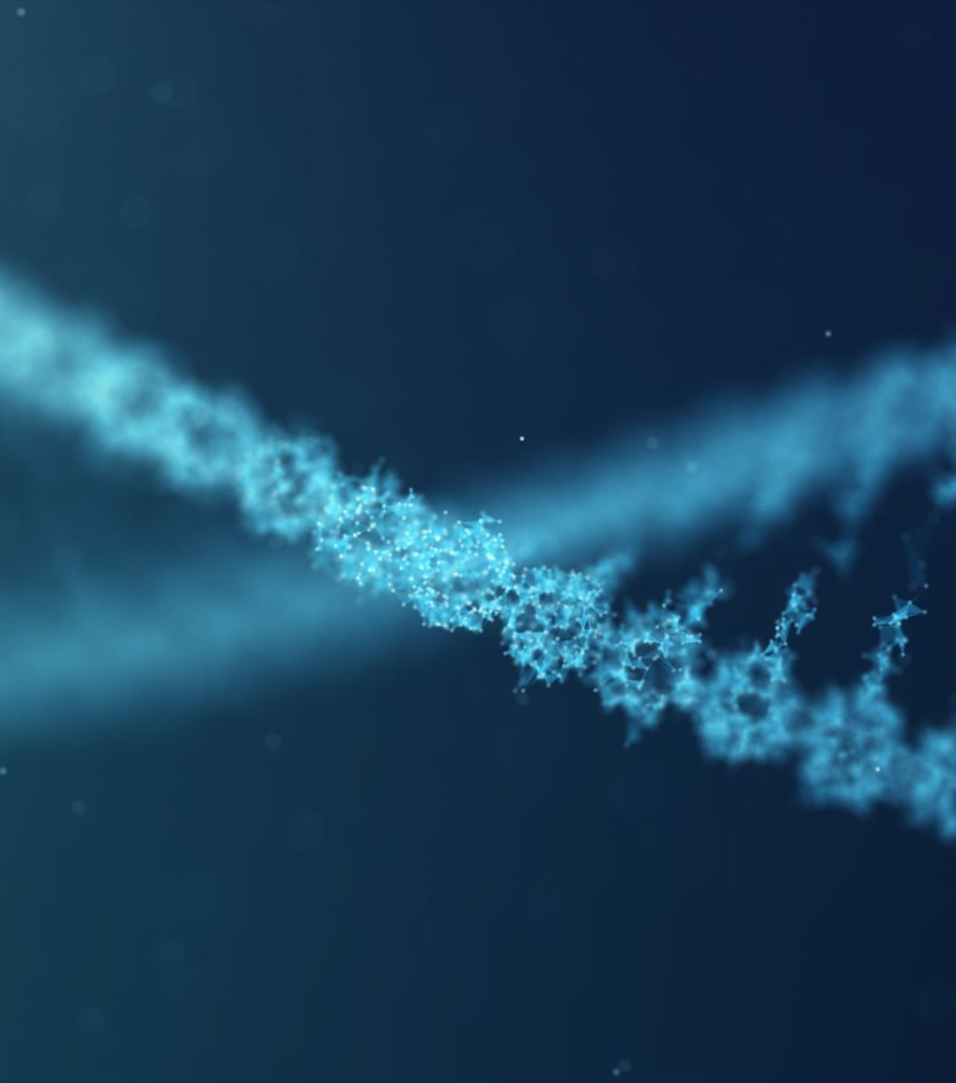

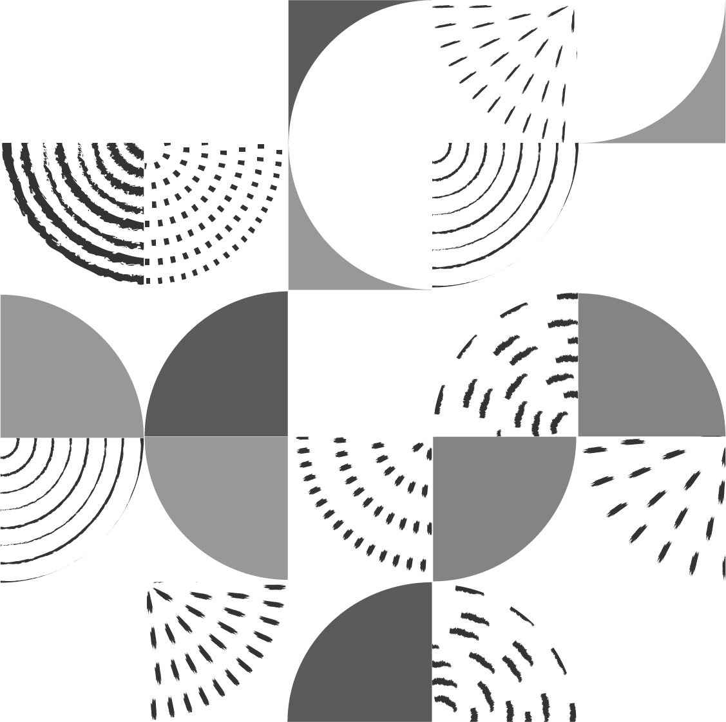
Are telomeres required?
Genetically engineering a eukaryote with circular chromosomes
Nadia Richardson, Dr. Melissa Mefford
Department of Biology and Chemistry, Morehead State University in Morehead, Kentucky.

Slide 2
Introduction
Prokaryotic Chromosomes
Eukaryotic Chromosomes
Circular chromosomes
Lack of telomeres and telomerase
Linear chromosomes
Telomeres and telomerase
Eukaryotic chromosomes likely evolved from prokaryotic chromosomes.

Slide 3
Telomeres and Telomerase
Telomeres are regions of repetitive DNA at the ends of linear eukaryotic chromosomes.
  Cannot be fully copied by the DNA replication machinery.
Telomerase is an enzyme that helps with end-replication problem that telomeres have in eukaryotes.
  Without telomerase activity, telomere lengths decrease and may be a leading cause of aging
  While up-regulation of telomerase activity is implicated in >85% of cancers.

Slide 4
Are telomeres required?
Are telomeres required in eukaryotic chromosome, and why did they evolve?
  If a eukaryotic chromosome gets circularized, it will remove the telomeres of the chromosome. I am attempting to circularize chromosome XVI in Saccharomyces cerevisiae by integrating DNA cassettes and selecting for recombination to address this very broad question.

Slide 5

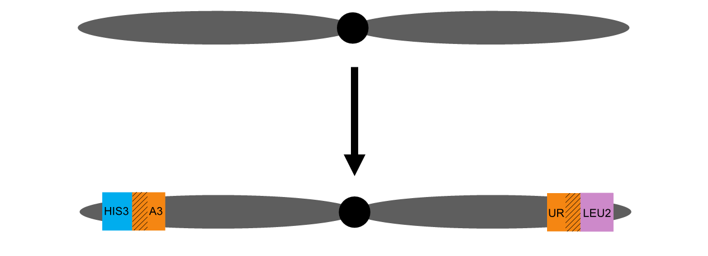
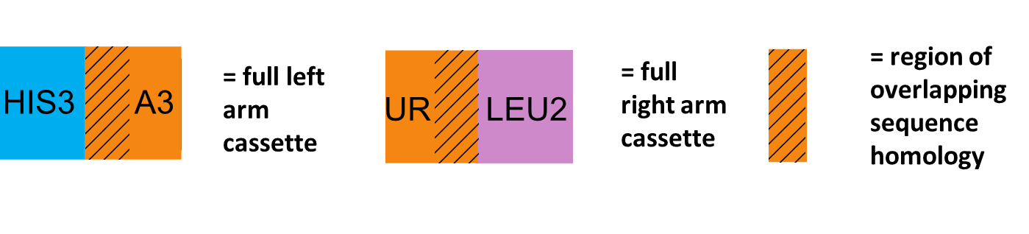
Overview of Experimental Approach
Insert cassettes into left and right arms of Ch. XVI

Slide 6
DNA recombination between homologous regions of URA3 genes will generate circular chromosomes
Select by growth on –URA

Slide 7
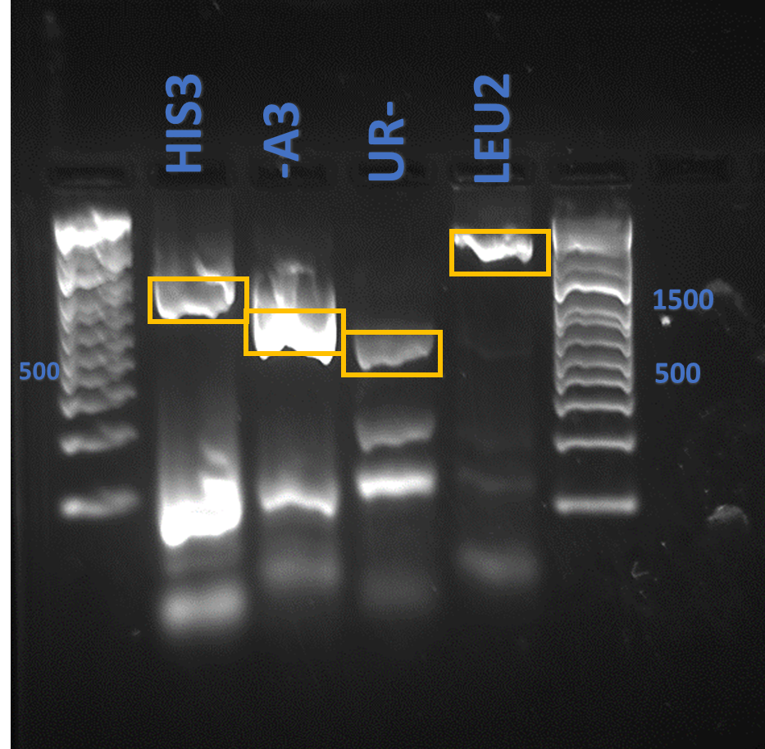
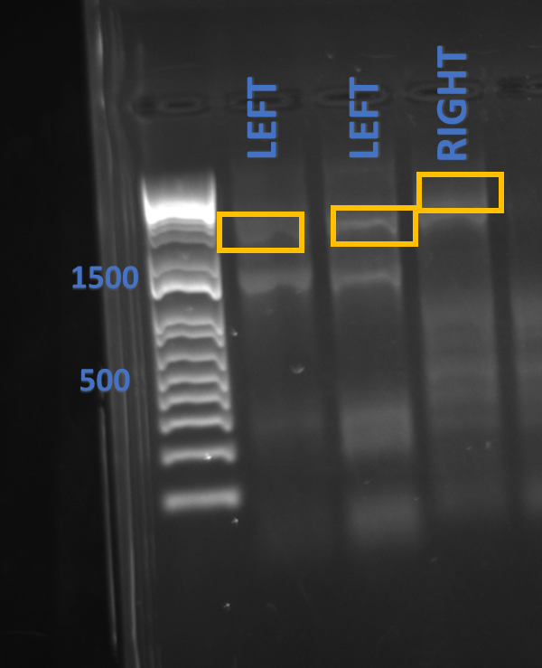
Amplifying Left and Right Arm DNA Cassettes for Ch. XVI by PCR
PCR products of individual components of the right and left arm.
PCR products of DNA cassettes.

Slide 8
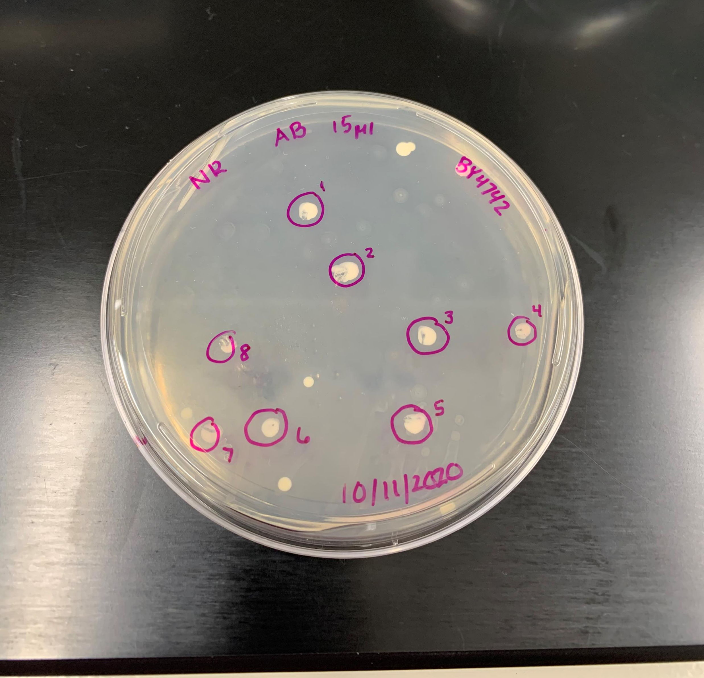
Transforming DNA Cassettes into Ch. XVI in S. cerevisiae
Colonies potentially have the left arm cassette integrated.
Transformation results of integration of the Left arm DNA cassettes into Ch. XVI.

Slide 9
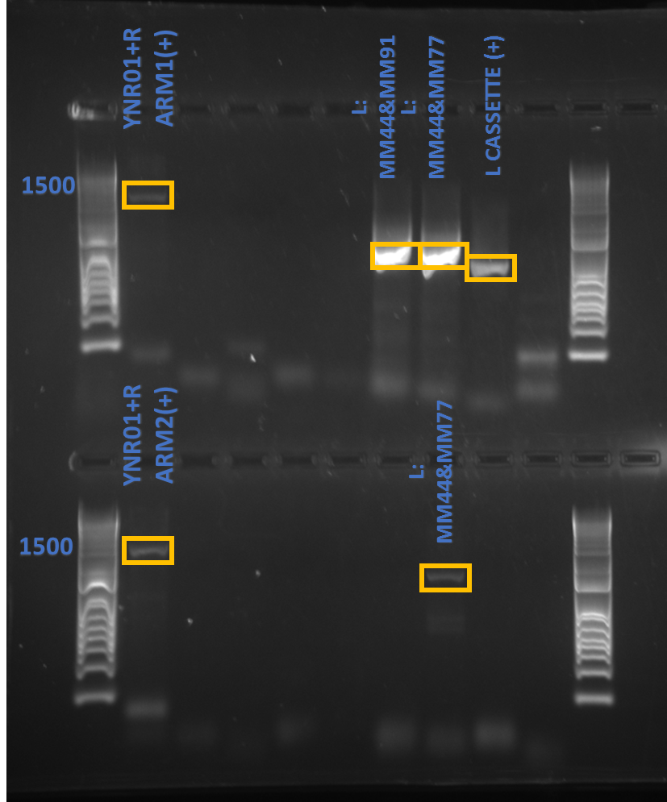
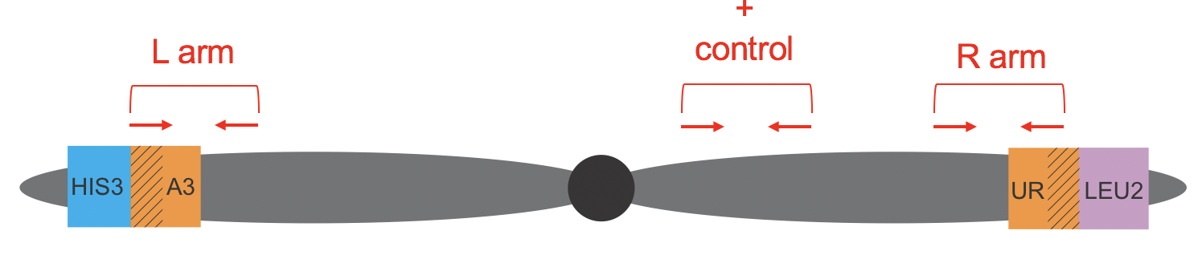
Confirming Integration of DNA Cassettes into Ch. XVI
Confirmation of the integrated DNA cassettes in the left arm of Ch. XVI.
Testing for integration of DNA Cassettes in a linear chromosome.

Slide 10
Discussion and Conclusion
Thus far, I have successfully integrated and confirmed the left arm cassette in several candidates of S. cerevisiae.
I am working on being able to transform in the right arm cassette for Ch. XVI
  I have modified a yeast CRISPR plasmid (pCAS) to contain gRNA sequences complementary to the overlapping regions of the URA3 genes in the left and right arm cassettes. Expression of this plasmid in yeast will assist in making a double strand breaks in the cassettes and should increase the efficiency recombination that results in circularization
  Flip the cassettes upside down and then transform them into Ch. XVI
    Alternate design of cassettes to attempt to increase integration efficiency to select for recombination

Slide 11
Acknowledgements:
This work was supported by a KBRIN IDeA award to Dr. Melissa Mefford (NIGMS grant 8P20GM103436-14) and start-up funds from Morehead State University.
Mefford Lab at MSU
  Dr. Melissa Mefford
  Brianna Haynes
  Ethan Chandler

