Slide 1
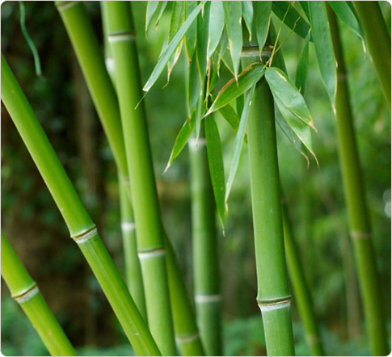
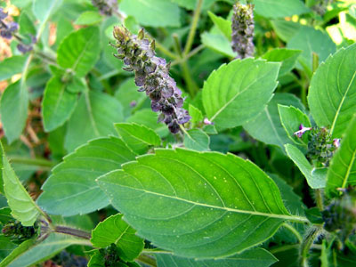
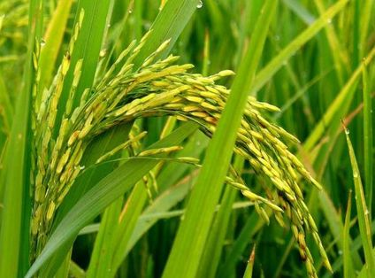
Bamboo, Basil and Rice
Transgenic plants as non-human models to explore molecular bases of cancer and other inflammatory diseases
Chandra Emani

Slide 2
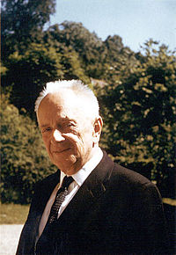
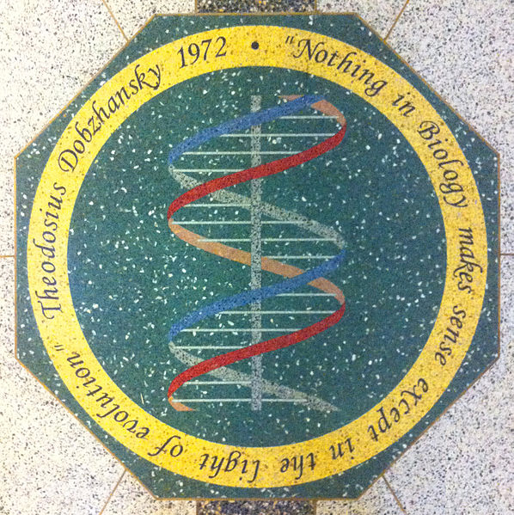
Premise of my talk

Slide 3
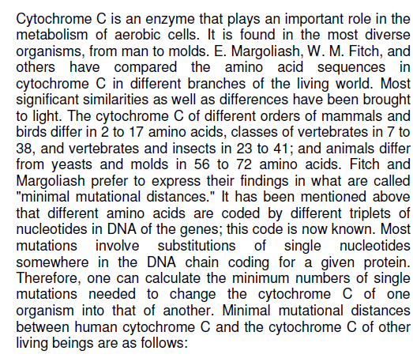
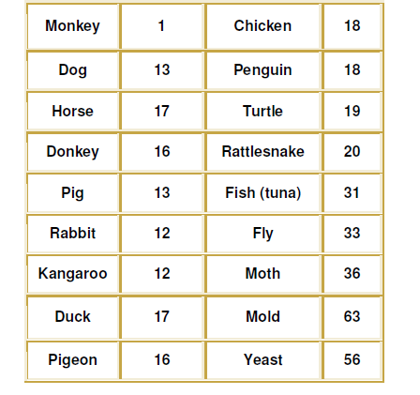

Slide 4
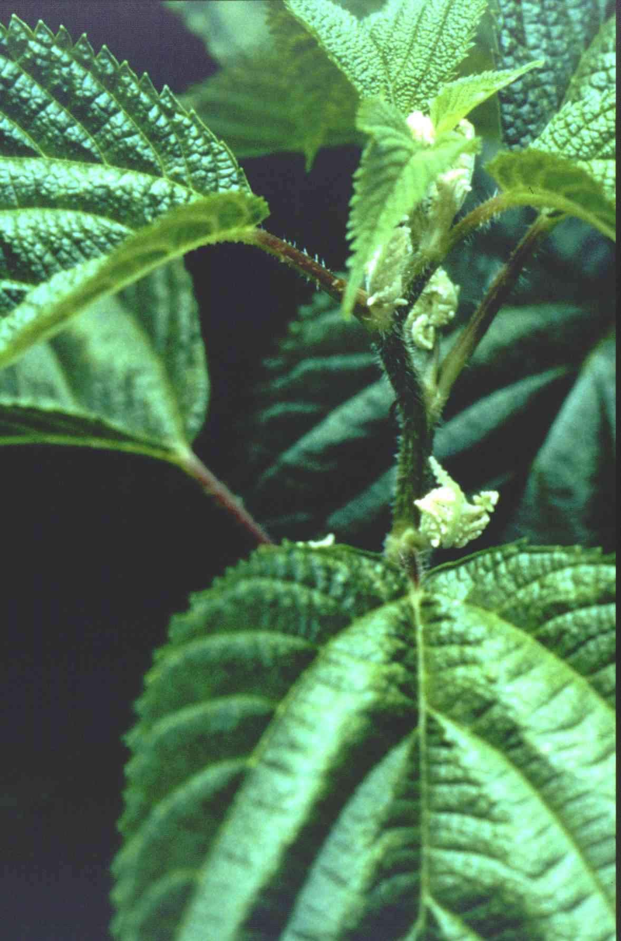
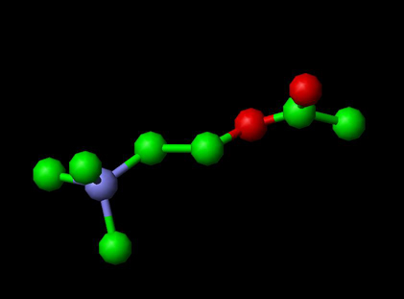
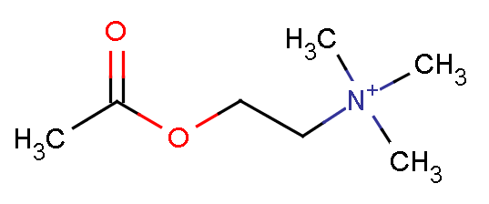
What are we going to learn today?
Is there more to acetylcholine than its neurotransmitter abilities ?
What is acetylcholine doing in places outside of brain and IN PLANTS?
Can PLANTS be non-human models to answer questions related to the molecular bases of diseases involving inflammation such as cancer?

Slide 5
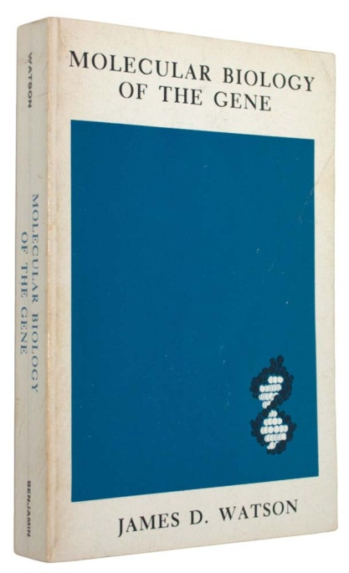
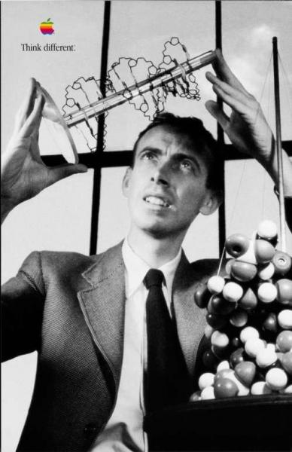
What is a Gene ?
A discrete chromosomal region which
is responsible for a specific cellular product
consists of a linear collection of potentially mutable units (mutable sites)
each of which can exist in several alternative forms
and between which crossing over can occur

Slide 6
What is Transgenesis?
(Also known as Genetic Engineering)
The process of transgenesis involves introducing desirable genes (transgenes) into crops and ensuring their stable expression in the resulting offspring.
The process of transgenesis relies on stable integration, desired level of expression, and predictable inheritance of the introduced transgenes.

Slide 7
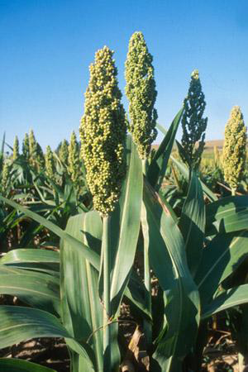
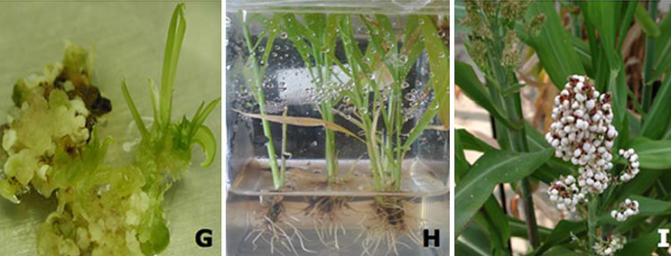
Transgenic sorghum with cellulase from Acidothermus cellulyticus
Fermentable sugars for biofuels

Slide 8
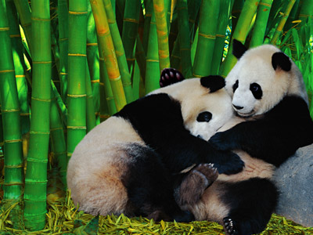
Why not bamboo?
Bamboo is an important multipurpose plant grown worldwide as a versatile raw product for ornamental, building, food and medicinal uses
More recently, it is being established as a potential bio-energy feedstock for its ability to sequester atmospheric carbon-dioxide to help fight climate change

Slide 9
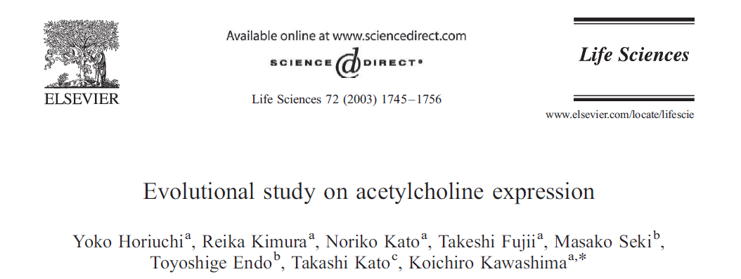
When I googled bamboo….

Slide 10
Non-neuronal acetylcholine !
The presence of non-neuronal acetylcholine in plants and animals has been implicated in the regulation of cell differentiation, phyotochrome-mediated processes, cytoskeletal organization, immune function, and ion transport (Wessler et al, 2001)
Clinical significance of the non-neuronal acetylcholine’s role is in pathogenesis of diseases such as acute and chronic inflammation, local and systemic infection, dementia, atherosclerosis and cancer

Slide 11
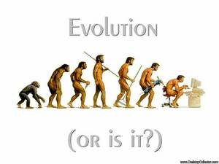
Will tracing the molecular evolution of the acetylcholine pathway uncover its transition from a non-neuronal role to a neuronal role?

Slide 12
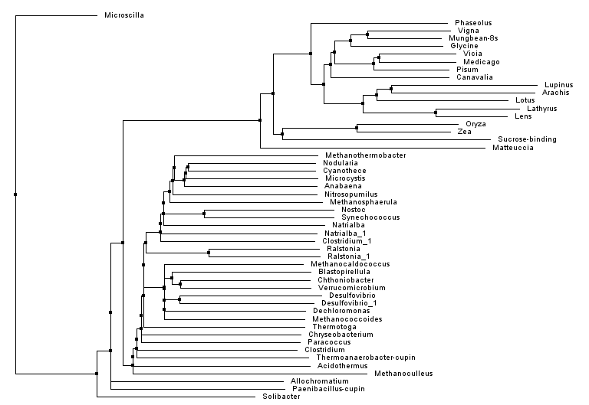
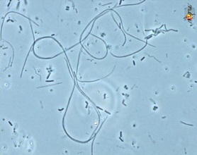
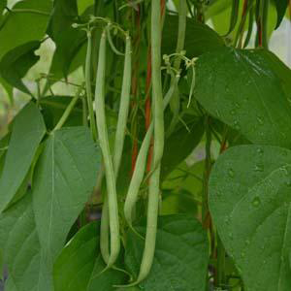
I was no stranger to bioinformatics….
Phaseolin Evolution – related to cupin domains

Slide 13
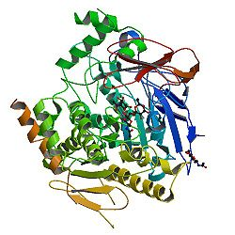
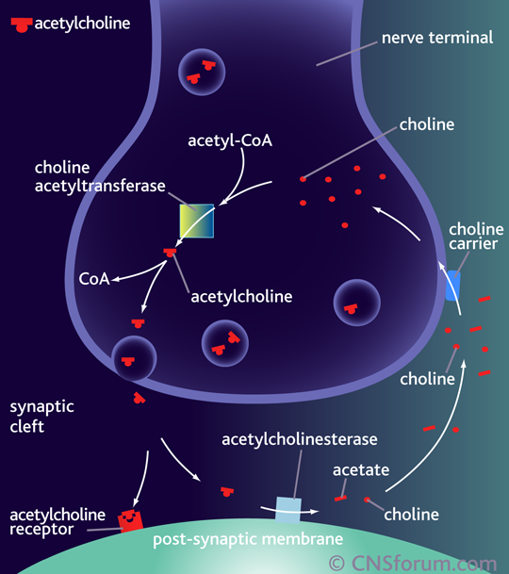
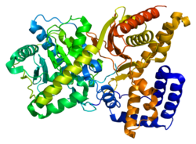
My reference sequences –
ChAT and AChE!
Choline acetyltransferase (ChAT) is the enzyme that synthesizes acetylcholine from acetylCoA and choline
Acetylcholine esterase (AChE) hydrolyzes acetylcholine

Slide 14
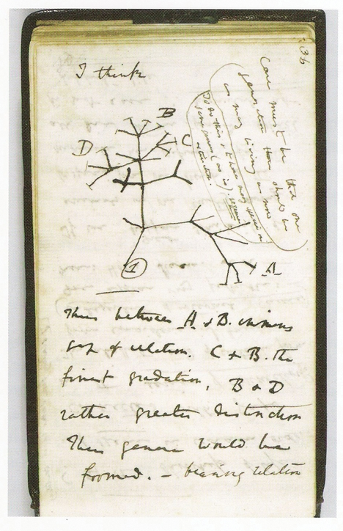
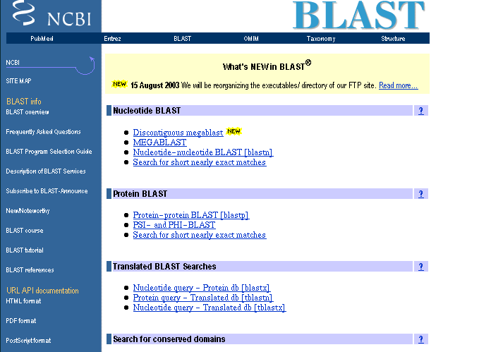
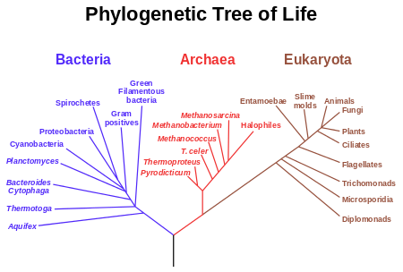
BLAST the ChAT!

Slide 15
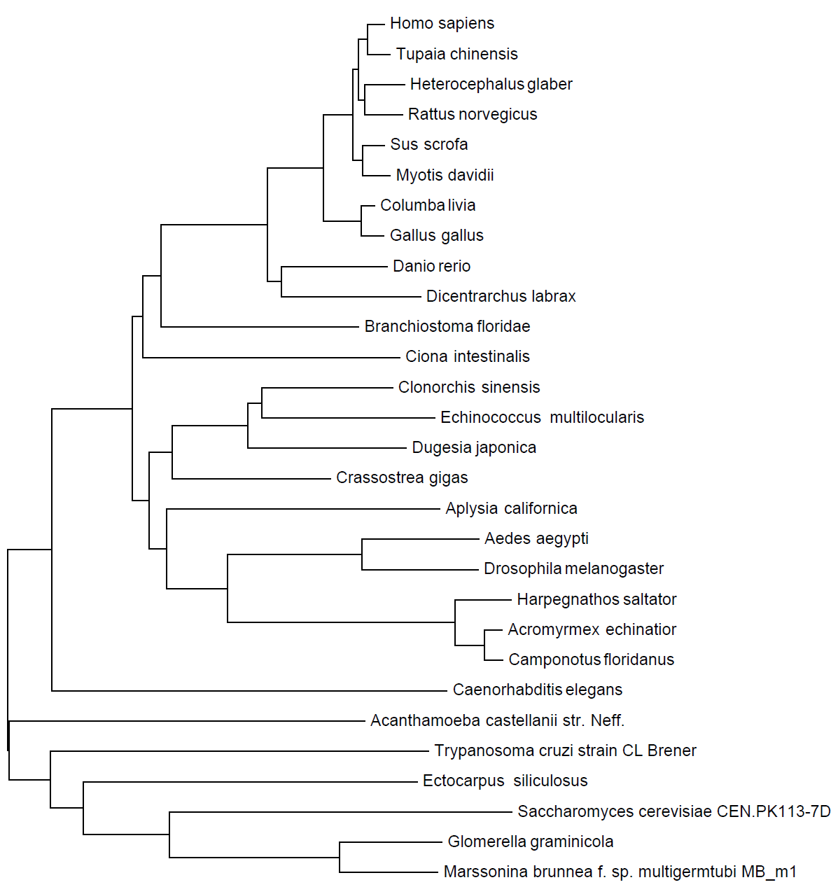
Acetylcholine pathway evolution….
Phylogenetic tree for the choline acetyltransferase
(ChAT)

Slide 16
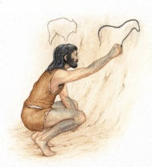
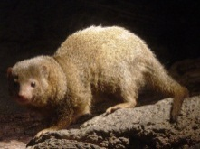
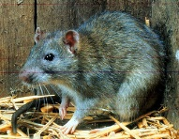
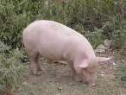
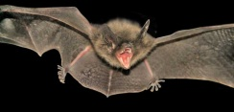
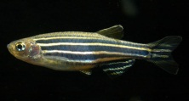
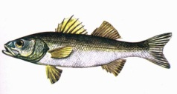
ChAT tree….

Slide 17
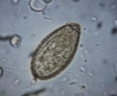
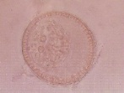
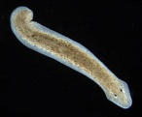
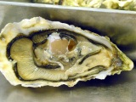
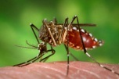
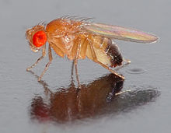
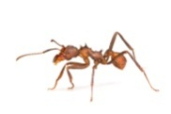
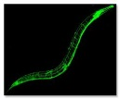
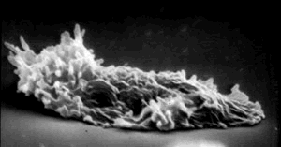
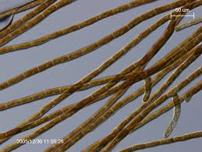
ChAT tree….

Slide 18
ChAT tree….
Ectocarpus siliculosus is Brown Algae!
Then I did a search in TAIR and other plant genome databases…….

Slide 19
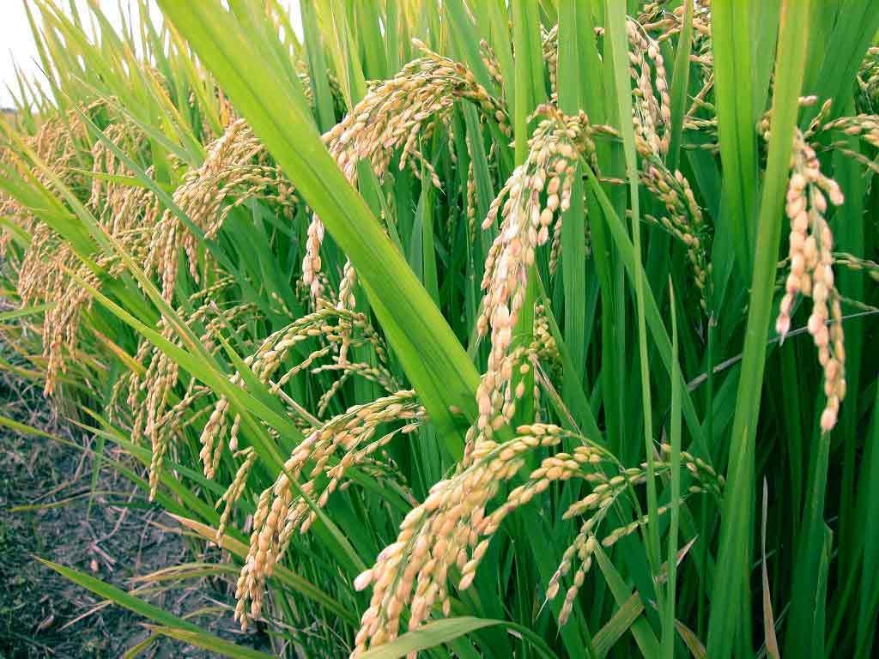
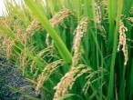
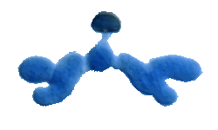
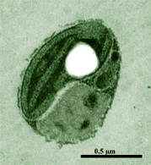
Refining the ChAT tree….
>Oryza sativa
MAPGLMSADAKGVFNAQAVEAKSAAKDDGGANEGLGGGKTFEGQSKLPHLPIPKLEDTCQRYLSSLLPLQ
SPEQHAVTQRIVDDFLQNQGPTLQKQLQEYASTRASYIEEFWDESYLQASDSVVLNLNPFFILEDDPTPT
RGNQLMRTANLILASLAFIHDLRTGVLEPDNVRGTPLDMYQYTRLFATSRIPTANGCRMEVEPESRHIVV
MRRGQIYWFEALDEEHRPLLTERAMLGNLQAIVRDADKIQIDDVAKGSVGILTTEKRPIWSMYREHLRED
SHNRKCLEVVDTALFVVCMDDSEPADAAELSNNMLCGTYKLQRGIQAGTCTNRWYDKLQIIVCANGAAGI
NFEHTGVDGHTVLRYAADVYTELIMRFAKSINSATKSLFKAKTSPYAKGAGKKANGSFSEADAQKAQDVN
QATAPKKLEWNLTKKLTDGIKYGETRLSDLICQNECQVLEFDRYGKNFITRHRFSPDAYVQMAFQAAYYT
LYGRCETTYEPAMTKAFLHGRTEAIRTVQPHSARFVETYMSDAKTDAKLDALKKACEGHAKLSKACATGQ
GHDRHLYALHNLWKKMQAERSDDQPAPKIFTDAGYAKLNHTVVSTSNCGNPALRMFGFGPVVPDGFGIGY
IIKDDGITVCASSKHLQTKRFLDTLEAYLLDTQRMIIETYKAANVRSQSTYIDHAGVECDVRTGLPIGSK
NNGYSLDYDQVPAQHFGQSGYSFFGDEKAAAKKDEQHKEDSAQSRRRSRLASVGKTILYDDY

Slide 20
The ancestor….picoplankton green alga
Ostreococcus belongs to the Prasinophyceae, an early-diverging class within the green plant lineage, and is reported as a globally abundant, single-celled alga thriving in the upper (illuminated) water column of the oceans. The most striking feature of O. lucimarinus and related species is their minimal cellular organization: a naked, nearly 1-micron cell, lacking flagella, with a single chloroplast and mitochondrion. Three different ecotypes or potential species have been defined, based on their adaptation to light intensity. Comparative analysis of Ostreococcus sp will help to understand niche differentiation in unicellular eukaryotes and evolution of genome size in eukaryotes.

Slide 21
Bamboo and Rice!
There is a well characterized ChAT sequence in rice
We are now in the process of isolating the cDNA clones of ChAT and AChE in bamboo as….
The top portion of bamboo shoot has acetylcholine content of 2.9 mmol/g, about 80 times of that found in rat brain (Kawashima et al, 2007).

Slide 22
Transgenic Bamboo ( and Rice)
Developing a bamboo genetic transformation system to alter the expression of the choline acetyltransferase (ChAT) and acetylcholine esterase (AChE) genes, and analyzing the transgenic plants for altered acetylcholine content.
TRANSGENIC BAMBOO CAN THUS BE A MODEL SYSTEM TO UNCOVER THE MOLECULAR BASIS OF NON-NEURONAL ACETYLCHOLINE
TRANSGENIC BAMBOO CAN ALSO BE A NON-HUMAN MODEL to illuminate the involvement of the non-neuronal acetylcholine system in pathogenesis of diseases involving inflammation, local and systemic infection and tumorigenesis, where modification of cell structure and function plays a key role

Slide 23
If successful…..
Rice will once again prove to be a model research plant, this time as a non-human model for examining molecular therapeutics
Bamboo will be a new addition as a non-human plant model
Basil will enhance its status from being a phytopharmaceutical to an experimental non-human model for examining the molecular basis of cancer treatment

Slide 24
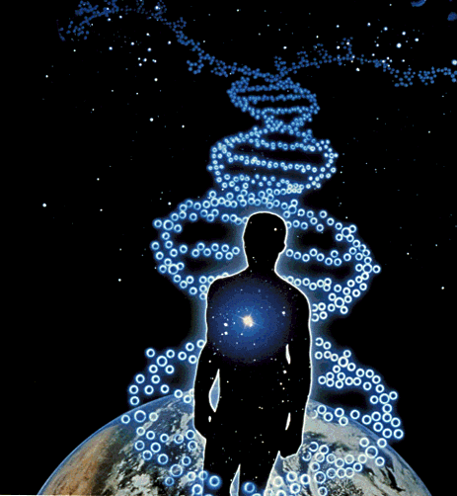
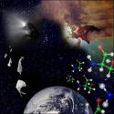
“It is not the fruits of scientific research that elevate man and enrich his nature, but the urge to understand.”
-Albert Einstein
I CONTINUE TO UNDERSTAND LIFE!

