Slide 1
Developing Tools and Strategies for
Using of Disordered Published
Data in Chemistry
Andrew Smith, Vinayak Bhat, Dr. Qianxiang Ai, Dr. Chad Risko
Undergraduate Student
Department of Chemistry &
Center for Applied Energy Research
University Of Kentucky

Slide 2
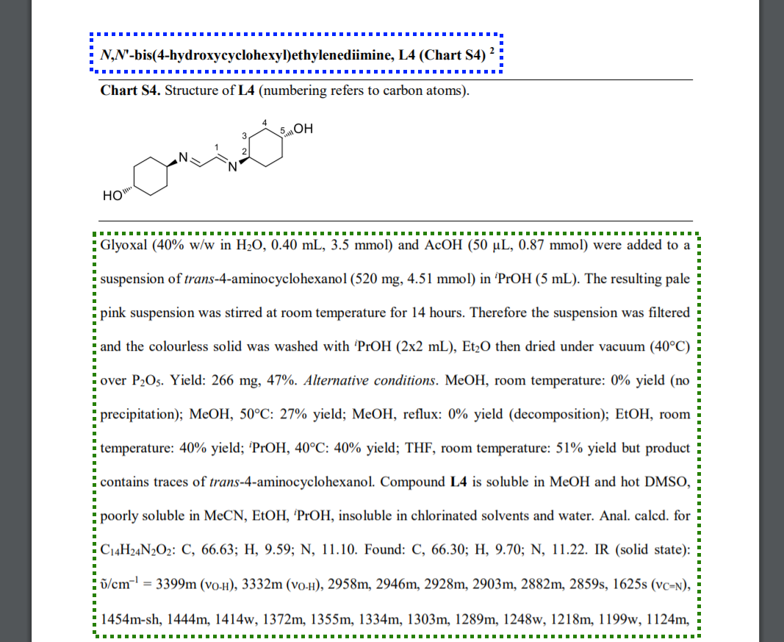
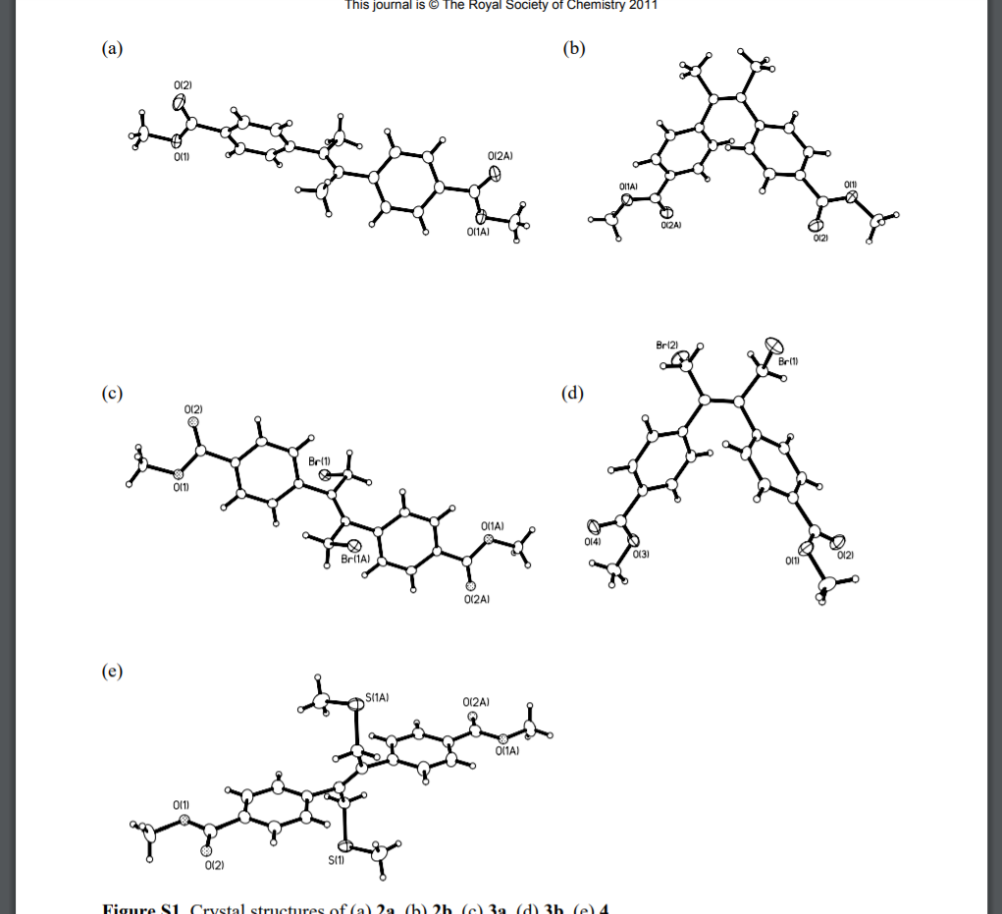
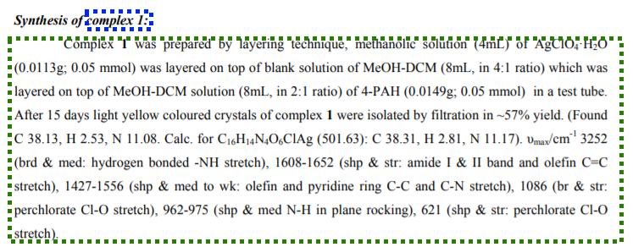
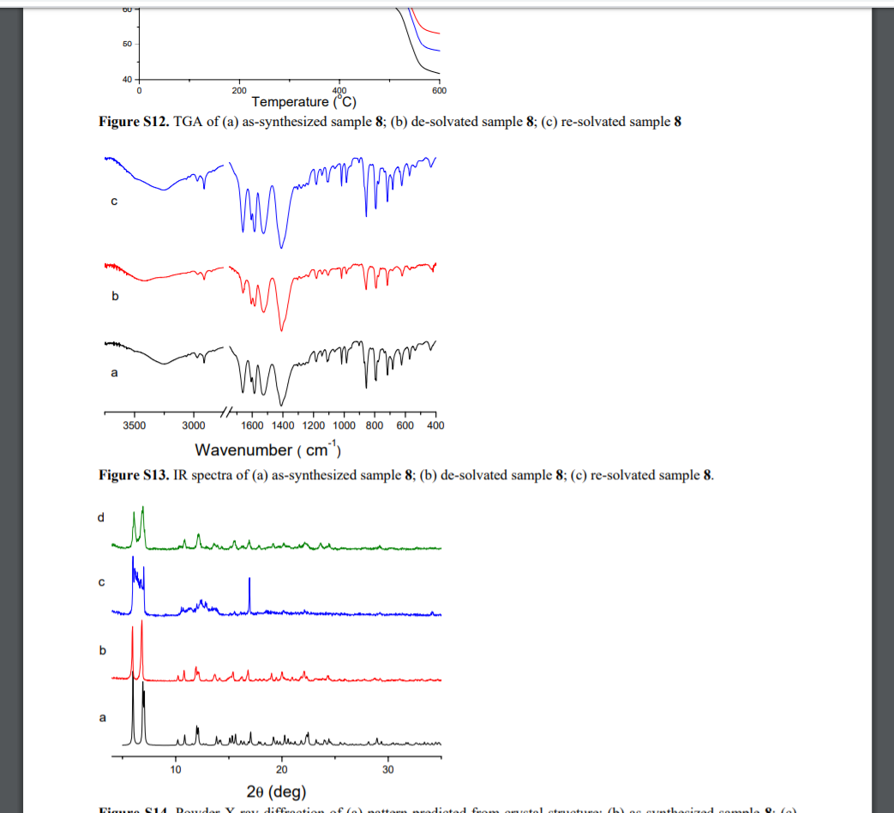
The problem with data
A huge amount of scientific data is published every year, approximately 3 million articles.
But most of this data is not readily usable. If the data was more easily used that would open the door to a lot of scientific applications in machine learning. For projects such as predicting process or synthesis.
2
1
3
1
1) Biancalana, Lorenzo, et al. “Ruthenium p-Cymene Complexes with α-Diimine Ligands as Catalytic Precursors for the Transfer Hydrogenation of Ethyl Levulinate to γ-Valerolactone.” New Journal of Chemistry, vol. 42, no. 21, 19 Sept. 2018, pp. 17574–17586., doi:10.1039/c8nj03569e.
3) Santra, Ramkinkar, et al. “Weak Ag⋯Ag and Ag⋯π Interactions in Templating Regioselective Single and Double [2+2] Reactions of N,N′-Bis(3-(4-Pyridyl)Acryloyl)–Hydrazine: Synthesis of an Unprecedented Tricyclohexadecane Ring System.” Chemical Communications, vol. 47, no. 38, 22 Aug. 2011, p. 10740., doi:10.1039/c1cc13994k.
2) Li, Yu, and Datong Song. “Syntheses, Structures and Luminescent Properties of Decorated Lanthanide Metal-Organic Frameworks of (E)-4,4′-(Ethene-1,2-Diyl)Dibenzoic Acids.” CrystEngComm, vol. 13, no. 6, 8 Dec. 2010, pp. 1821–1830., doi:10.1039/c0ce00750a.

Slide 3
Recrystallization case study
Recrystallization is a method of purifying a sample. This is generally done by dissolving an impure sample in solvent which it is soluble in at high temperatures but not soluble at low temperatures. The goal being that the sample will recrystallize at the lower temperature while impurities will not.
What solvent should be used for a given sample is not usually theoretically known but rather determined from trial and error.
The goal of this project was to collect data on recrystallization solvent to make synthesis easier and to develop scraping techniques for scientific literature.

Slide 4
Theoretical end data structure
Specific synthesis property (eg recrystallization solvent)
DOI for related paper
Synthesis information
One to one
One to many
Specific synthesis property (eg recrystallization solvent)
Chemical Name
One to many
DOI for related paper
Synthesis information
Specific synthesis property (eg recrystallization solvent)
DOI for related paper
Synthesis information

Slide 5
Theoretical Work Flow
Paper Identifier List
Identify synthesis information
Full Synthesis information
Access SI from publisher
Get compound of interests
Parse to smaller synthesis properties
Compound of interest name
Synthesis properties

Slide 6
Practical implications
Access SI from publisher
Publishers often are uncooperative about accessing full text so the supporting information which is free to access was used.
A python program was implemented to resolve article DOI to a publisher page from which a BeautifulSoup based scraper actually identifies the correct supporting information file and copies the bit string for that file.

Slide 7
Practical implications
Get compound of interests
Once the paper has between retrieved the compound of interest is identified based on if available the Cambridge Crystal Structure database entry for that compound.
If not available this is done by comparing the similarity between the compounds in the SI and a list of compounds which are synonyms with compounds appearing in the title.

Slide 8
Practical implications
Identify synthesis information
From here the paper is broken down into layout objects which are the closest thing to a paragraph in a PDF.
Each of these layout object is scored for likely hood of being the desired paragraph. High scoring paragraphs are feed through the IBM reactions for chemistry api. Objects with at least one synthesis action are then returned.

Slide 9
Preliminary Testing
Access this information is incredibly time consuming which is the motivation for this project. Many papers have extremely long SI section cluttered with a dump of information. In fact it is common for these to exceed 30 pages.
Furthermore, any attempt to reduce this would necessarily introduce bias into the algorithm’s performance evaluation.
For this reason testing has only been preformed on a few very small test sets (n<10)
On these small sets the program had 97% accuracy identifying synthesis information and 60% accuracy identifying the paper’s focus compound.
A key part of future work will be more robust testing and increase compound identification accuracy.

Slide 10
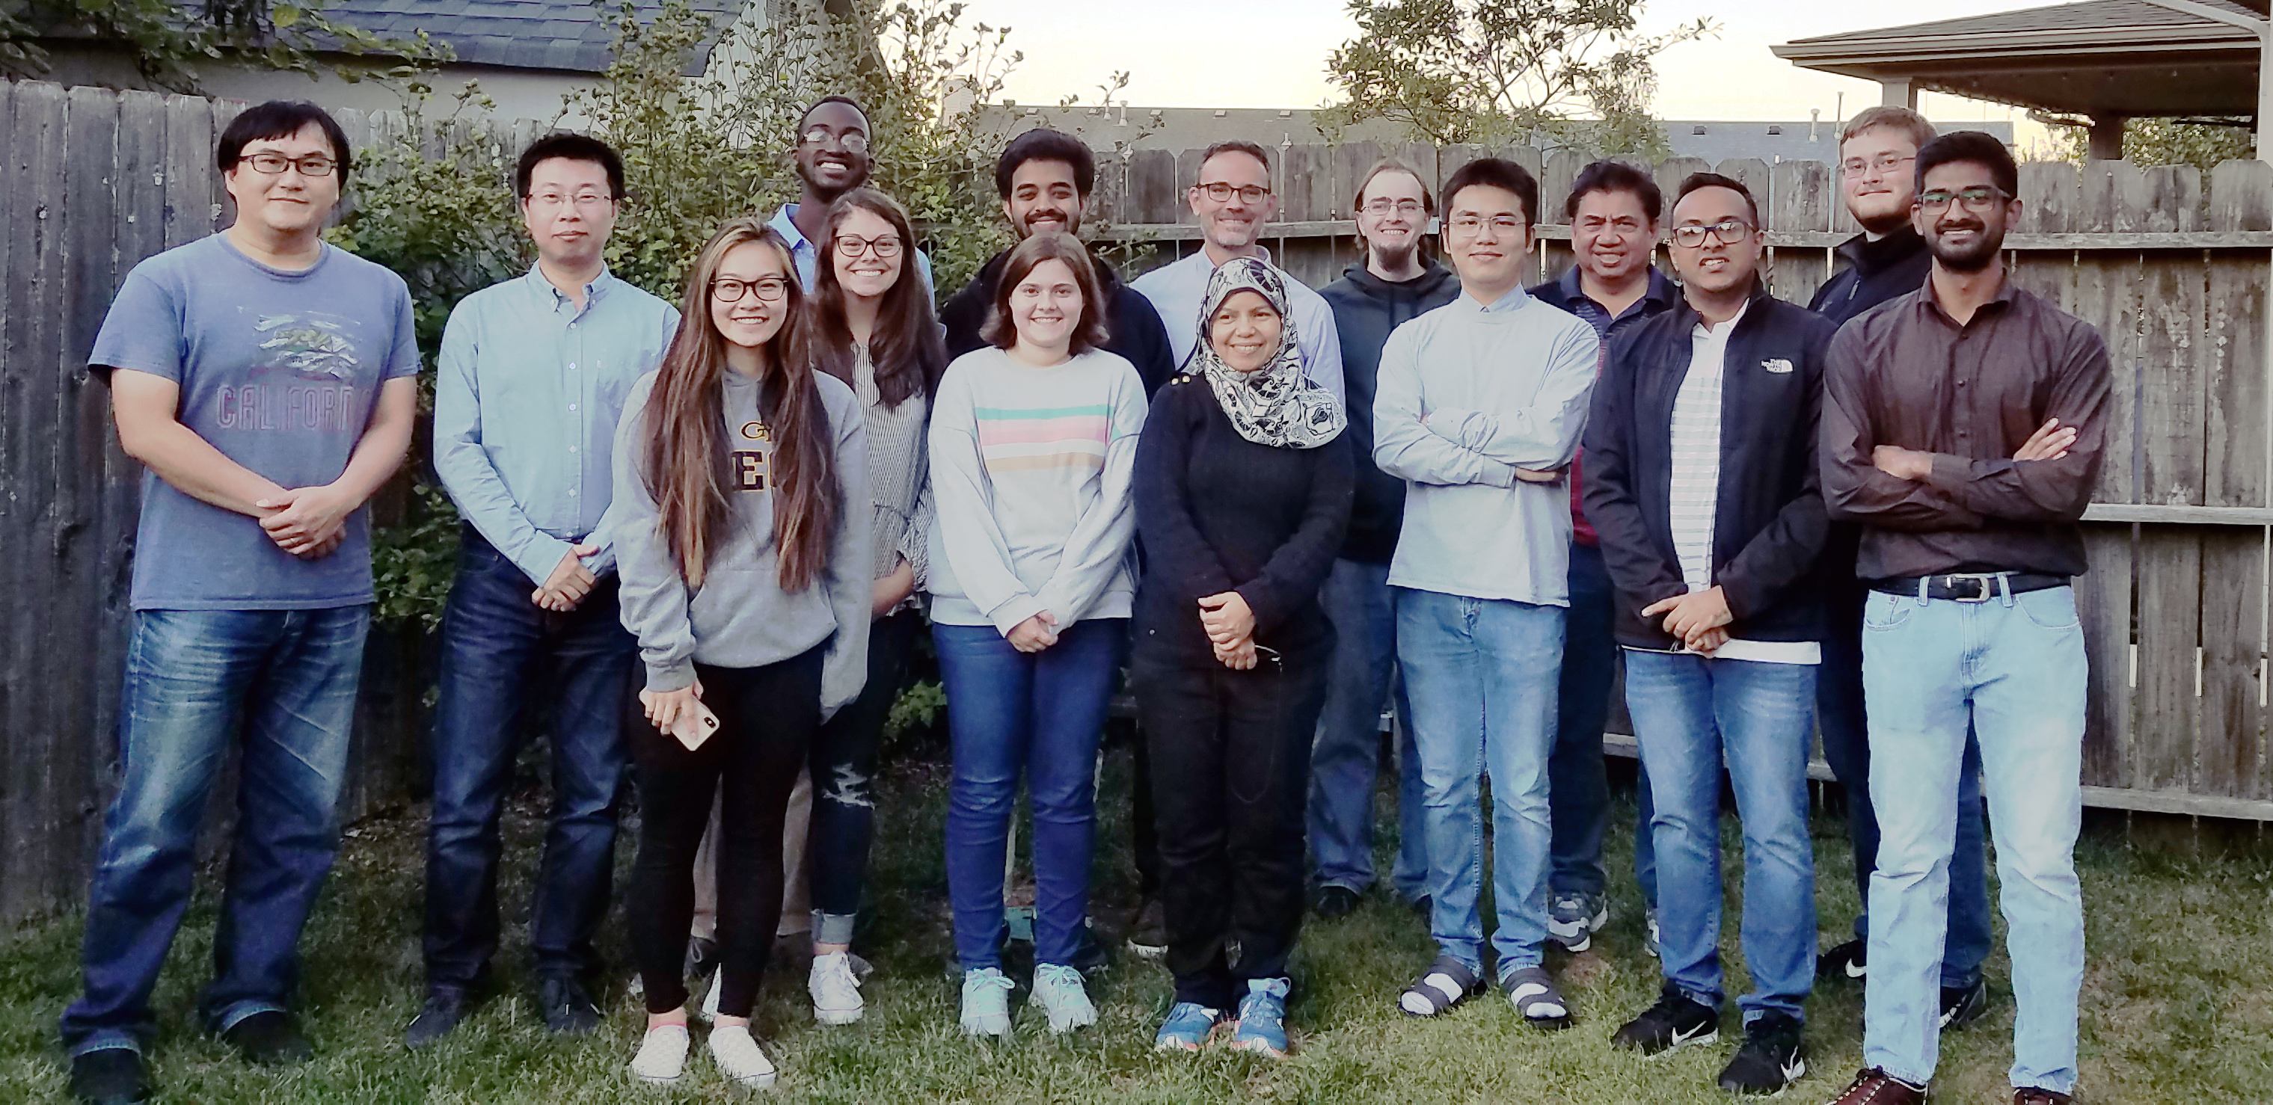
Affiliations and thanks
I would like to thank everyone in Dr. Risko’s group at CAER at UK.
I would also like to thank Dr. Jerzy Jaromczyk for helping me to get involved in this work.

