Slide 1



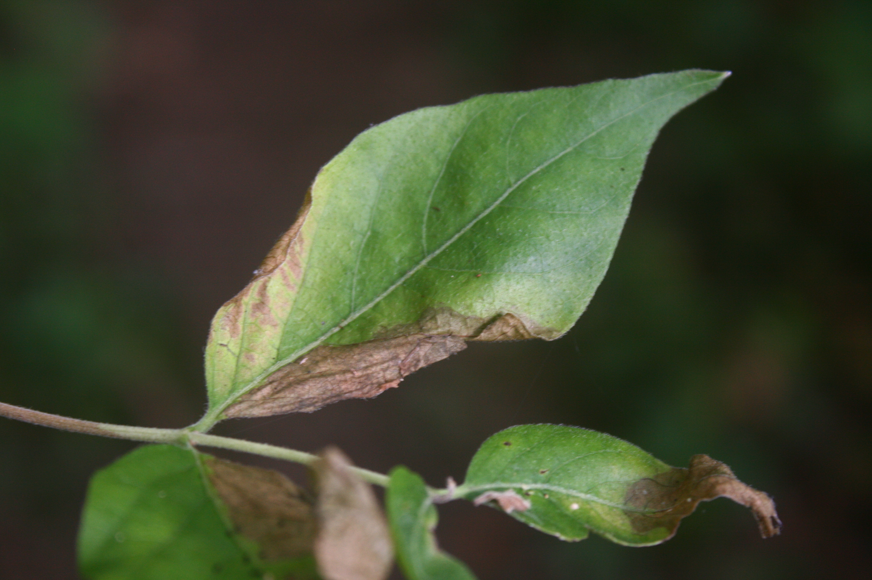

Determination of Honeysuckle Leaf Blight Effects on the Growth of Amur Honeysuckle in the Field
Caitlyn Helton, Dr. Richard Boyce
Introduction
Lonicera maackii (Amur honeysuckle) is a non-native honeysuckle species that has invaded many eastern North American forests. There are many widespread consequences of this widespread invasion, at both the community and ecosystem levels (McNeish and McEwan 2016). Boyce et al. (2014) found that the occurrence of the native leaf pathogen honeysuckle leaf blight (Insolibasidium deformans), which causes leaf death, was associated with declines seen in some honeysuckle stands in the region, and Boyce et al. (2020) found that infection reduced seedling growth. Thus, determining the extent to which this fungus affects Amur honeysuckle in the field is important for determining its potential control. Previous unpublished work by this lab has shown that infection is more likely in “long” shoots, which grow rapidly into areas of high light and may be less well-defended than “short” shoots. In this study, we looked at forest understory shrubs of various sizes to determine how much of the leaves are affected by honeysuckle leaf blight.
Results
Smaller shrubs are more affected by blight than smaller shrubs (Fig. 1). Bigger trees have a smaller fraction of long shoot leaf mass compared to smaller shrubs (Figs. 2-3).
Blight targets specifically long shoots. A median of 12.4% of long shoots were affected by blight, whereas only 0.3% of short shoots were affected (Fig 4).
Short shoots have higher values of SLA with greater variability (Fig. 5).
Short shoots have higher mean leaf densities with greater variability (Fig. 6)
Allometric equations for Amur honeysuckle shrub components (Table 1). Results are similar to those reported by Luken (1988) for forest understory shrubs in northern Kentucky, with the following slopes—stem mass: 2.33; twig mass: 1.69; leaf mass: 1.82 (intercepts differ because diameters were measured at different heights above the ground).
Figure 1. Fraction of blighted leaf mass vs. diameter (R² = 0.30, P = 0.0102)
Figure 4. Box plot of leaf mass fraction of blighted shoots (Mann-Whitney test V = 0, P < 0.0001).
Methods
Shrubs were sampled at NKU Research & Education Field Station in Melbourne, KY., and were then selected based on size and presence of leaf blight infection. Stump diameters were taken in the field before sampling. Shrubs were broken down into sections, and shoots were sorted into long and short shoots. Long shoots were defined as having >5 cm internodal distance, as well as a light shoot green color. Leaves were stripped from the shoots and were sorted into blighted and unblighted leaves. Leaf areas were measured, and # individual leaves were counted. Dead material was discarded. Shrub components were oven-dried at 70°C and then weighed. The following components were regressed against base diameters after being log-transformed: 1) Woody stems—mass, 2) shoot twigs—mass and length, 3) leaves--mass, area, and number. Fraction of the mass of leaves blighted, specific leaf area (SLA; area/mass), and leaf densities (#/cm) were compared between long and short shoots.
Appearance of leaf
blight
(photo by J. Nienaber)
Figure 2. Long shoot leaf mass fraction vs. diameter (R² = 0.23, P = 0.0415)
Figure 5. Box plot of specific leaf area (t = 2.530, P = 0.022).
Discussion
• Smaller shrubs have a higher proportion of blighted leaves
• This is because they have a higher proportion of long shoots, which are more susceptible to blight
•Thus, reduced growth and/or mortality is likely to be higher in small shrubs
•Next steps:
1) Look at the population structure of forest understory stands to see if the smaller size classes are reduced relative to earlier studies (e.g., Luken 1988).
2) See if similar results are found in open-grown stands
Figure 3. Short and long shoot leaf mass vs. diameter (short: slope = 1.94, R² = 0.86, P < 0.001; long: slope = 1.15, R² = 0.75, P < 0.0001)
Figure 6. Box plot of leaf densities (Mann-Whitney test V = 171, P < 0.0001).
References
Boyce, R. L., S. N. Brossart, L. A. Bryant, L. A. Fehrenbach, R. Hetzer, J. E.
Holt, B. Parr, Z. Poynter, C. Schumacher, S. N. Stonebraker, M. D. Thatcher, and M. Vater. 2014. The beginning of the end? Extensive dieback of an open-grown Amur honeysuckle stand in northern Kentucky, USA. Biol Invasions 16:2017–2023.
Boyce, R. L., S. M. Castellano, A. N. Marroquin, O. M. Uwolloh, S. E. Farrar, and K. P. Wolfe. 2020. Honeysuckle leaf blight reduces the growth of infected Amur honeysuckle (Lonicera maackii, Caprifoliaceae) seedlings in a greenhouse experiment. J Torrey Bot Soc 147:1–8.
Luken, J. O. 1988. Population structure and biomass allocation of the naturalized shrub Lonicera maackii (Rupr.) Maxim. in forest and open habitats. Am Midl Nat 119:258–267.
McNeish, R. E., and R. W. McEwan. 2016. A review on the invasion ecology of Amur honeysuckle (Lonicera maackii, Caprifoliaceae) a case study of ecological impacts at multiple scales. J Torrey Bot Soc 143:367–385.
Equation | R² | P
ln(stem mass (g)) = 3.4278 + 2.749*ln(base d (cm)) | 0.91 | <0.0001
ln(twig length (cm)) = 6.9809 + 1.0871*ln(base d (cm)) | 0.53 | 0.0002
ln(twig mass(g)) = 2.0922 + 1.67*ln(base d (cm) | 0.80 | 0.0001
ln(leaf mass (g)) = 2.6328 + 1.9410*ln(base d (cm)) | 0.87 | <0.0001
ln(leaf area (cm²)) = 8.4406 + 1.7351*ln(base d (cm)) | 0.83 | < 0.0001
ln(leaf no.) = 6.5837 + 1.3323*ln(base d (cm)) | 0.72 | < 0.0001
Acknowledgements
We thank Seth Boyce and Sarah Helton for help with field work. We also thank NKU REFS for providing the facilities for the field work. This study was funded by NKU UR STEM.
Table 1. Allometric equations shrub components as a function of base diameter.
Notes:
Hello! My name is Caitlyn Helton, an undergraduate research student and Chemistry major at Northern Kentucky University. I worked with Dr. Richard L Boyce, a professor in the Department of Biological Sciences at NKU.

Slide 2
Determination of Honeysuckle Leaf Blight Effects on the Growth of Amur Honeysuckle in the Field
Caitlyn Helton, Dr. Richard Boyce
Introduction
Lonicera maackii (Amur honeysuckle) is a non-native honeysuckle species that has invaded many eastern North American forests. There are many widespread consequences of this widespread invasion, at both the community and ecosystem levels (McNeish and McEwan 2016). Boyce et al. (2014) found that the occurrence of the native leaf pathogen honeysuckle leaf blight (Insolibasidium deformans), which causes leaf death, was associated with declines seen in some honeysuckle stands in the region, and Boyce et al. (2020) found that infection reduced seedling growth. Thus, determining the extent to which this fungus affects Amur honeysuckle in the field is important for determining its potential control. Previous unpublished work by this lab has shown that infection is more likely in “long” shoots, which grow rapidly into areas of high light and may be less well-defended than “short” shoots. In this study, we looked at forest understory shrubs of various sizes to determine how much of the leaves are affected by honeysuckle leaf blight.
Notes:
McNeish, R. E., and R. W. McEwan. 2016. A review on the invasion ecology of Amur honeysuckle (Lonicera maackii, Caprifoliaceae) a case study of ecological impacts at multiple scales. J Torrey Bot Soc 143:367–385.
Amur honeysuckle is a highly invasive ornamental plant that has carved a path throughout much of eastern North America, harming a variety of native plants and wildlife as well as disrupting ecosystems. However, a native honeysuckle pathogen known as honeysuckle leaf blight has begun to target Amur, leading to leaf death and impacting seedling growth. It’s important to understand just how this pathogen affects Amur to help understand how we could potentially curb its spread. In the past, this lab has determined that leaf blight targets “long” shoots more often than “short” shoots, as long shoots tend to pop up to reach areas of high light quickly, and may be less well-defended than short shoots. In this study, we sampled several forest shrubs of differing sizes and makeups to determine the extent of impact of honeysuckle leaf blight.
Boyce, R. L., S. N. Brossart, L. A. Bryant, L. A. Fehrenbach, R. Hetzer, J. E. Holt, B. Parr, Z. Poynter, C. Schumacher, S. N. Stonebraker, M. D. Thatcher, and M. Vater. 2014. The beginning of the end? Extensive dieback of an open-grown Amur honeysuckle stand in northern Kentucky, USA. Biol Invasions 16:2017–2023.
Boyce, R. L., S. M. Castellano, A. N. Marroquin, O. M. Uwolloh, S. E. Farrar, and K. P. Wolfe. 2020. Honeysuckle leaf blight reduces the growth of infected Amur honeysuckle (Lonicera maackii, Caprifoliaceae) seedlings in a greenhouse experiment. J Torrey Bot Soc 147:1–8.

Slide 3
Determination of Honeysuckle Leaf Blight Effects on the Growth of Amur Honeysuckle in the Field
Caitlyn Helton, Dr. Richard Boyce
Methods
Shrubs were sampled at NKU Research & Education Field Station in Melbourne, KY., and were then selected based on size and presence of leaf blight infection. Stump diameters were taken in the field before sampling. Shrubs were broken down into sections, and shoots were sorted into long and short shoots. Long shoots were defined as having >5 cm internodal distance, as well as a light shoot green color. Leaves were stripped from the shoots and were sorted into blighted and unblighted leaves. Leaf areas were measured, and # individual leaves were counted. Dead material was discarded. Shrub components were oven-dried at 70°C and then weighed. The following components were regressed against base diameters after being log-transformed: 1) Woody stems—mass, 2) shoot twigs—mass and length, 3) leaves--mass, area, and number. Fraction of the mass of leaves blighted, specific leaf area (SLA; area/mass), and leaf densities (#/cm) were compared between long and short shoots.
Appearance of leaf
blight
(photo by J. Nienaber)
Notes:
We sampled our shrubs at the NKU Research and Education Field Station in Melbourne, KY. We selected each shrub based on its apparent size and whether or not leaf blight was present. Before each shrub was destructively sampled, we took measurements of its stump diameter. Each shrub was then taken back to the station and shoots were sorted into long and short, where long shoots were defined as having an internodal distance of more than five centimeters and a light green shoot color. Leaves were stripped and sorted into blighted and unblighted leaves, and their numbers and areas were recorded. We discarded dead material, then dried each shrub component and took masses. We then ran a variety of regressions comparing the listed measurements to determine the relationship between each.

Slide 4
Determination of Honeysuckle Leaf Blight Effects on the Growth of Amur Honeysuckle in the Field
Caitlyn Helton, Dr. Richard Boyce
Results
Smaller shrubs are more affected by blight than smaller shrubs (Fig. 1). Bigger trees have a smaller fraction of long shoot leaf mass compared to smaller shrubs (Figs. 2-3).
Figure 1. Fraction of blighted leaf mass vs. diameter (R² = 0.30, P = 0.0102)
Figure 3. Short and long shoot leaf mass vs. diameter (short: slope = 1.94, R² = 0.86, P < 0.001; long: slope = 1.15, R² = 0.75, P < 0.0001)
Figure 2. Long shoot leaf mass fraction vs. diameter (R² = 0.23, P = 0.0415)
Notes:
As seen in Fig. 1, smaller shrubs have a higher fraction of blighted leaves than larger shrubs. Bigger shrubs, as seen in Figures 2 and 3, have a smaller fraction of long shoot mass.

Slide 5
Determination of Honeysuckle Leaf Blight Effects on the Growth of Amur Honeysuckle in the Field
Caitlyn Helton, Dr. Richard Boyce
Results
Blight targets specifically long shoots. A median of 12.4% of long shoots were affected by blight, whereas only 0.3% of short shoots were affected (Fig 4).
Short shoots have higher values of SLA with greater variability (Fig. 5).
Short shoots have higher mean leaf densities with greater variability (Fig. 6).
Figure 4. Box plot of leaf mass fraction of blighted shoots (Mann-Whitney test V = 0, P < 0.0001).
Figure 5. Box plot of specific leaf area (t = 2.530, P = 0.022).
Figure 6. Box plot of leaf densities (Mann-Whitney test V = 171, P < 0.0001).
Notes:
As demonstrated in Figure 4, blight seems to target long shoots, affecting about 12.4% of long shoots versus only .3% of short shoots. Short shoots were also shown to have more variation in specific leaf areas but with overall higher values as seen in Figure 5. They also have higher average leaf densities, again showing wide variability in figure 6.

Slide 6
Determination of Honeysuckle Leaf Blight Effects on the Growth of Amur Honeysuckle in the Field
Caitlyn Helton, Dr. Richard Boyce
Equation | R² | P
ln(stem mass (g)) = 3.4278 + 2.749*ln(base d (cm)) | 0.91 | <0.0001
ln(twig length (cm)) = 6.9809 + 1.0871*ln(base d (cm)) | 0.53 | 0.0002
ln(twig mass(g)) = 2.0922 + 1.67*ln(base d (cm) | 0.80 | 0.0001
ln(leaf mass (g)) = 2.6328 + 1.9410*ln(base d (cm)) | 0.87 | <0.0001
ln(leaf area (cm²)) = 8.4406 + 1.7351*ln(base d (cm)) | 0.83 | < 0.0001
ln(leaf no.) = 6.5837 + 1.3323*ln(base d (cm)) | 0.72 | < 0.0001
Table 1. Allometric equations shrub components as a function of base diameter.
Results
Allometric equations for Amur honeysuckle shrub components (Table 1). Results are similar to those reported by Luken (1988) for forest understory shrubs in northern Kentucky, with the following slopes—stem mass: 2.33; twig mass: 1.69; leaf mass: 1.82 (intercepts differ because diameters were measured at different heights above the ground).
Notes:
These are the allometric equations we used to analyze our data, as well as the associated R2 and P-values. Our results were markedly similar to those reported by the Luken lab in 1988.

Slide 7
Determination of Honeysuckle Leaf Blight Effects on the Growth of Amur Honeysuckle in the Field
Caitlyn Helton, Dr. Richard Boyce
Discussion
• Smaller shrubs have a higher proportion of blighted leaves
• This is because they have a higher proportion of long shoots, which are more susceptible to blight
•Thus, reduced growth and/or mortality is likely to be higher in small shrubs
•Next steps:
1) Look at the population structure of forest understory stands to see if the smaller size classes are reduced relative to earlier studies (e.g., Luken 1988).
2) See if similar results are found in open-grown stands
Notes:
Luken, J. O. 1988. Population structure and biomass allocation of the naturalized shrub Lonicera maackii (Rupr.) Maxim. in forest and open habitats. Am Midl Nat 119:258–267.
Our major takeaway from this study was that smaller shrubs have a higher proportion of blighted leaves because of their higher proportion of blight-susceptible long shoots. Because of this, blight-related reduction in growth and even shrub death are more common in smaller shrubs. In the future, we hope to survey the population of forest Amur honeysuckle shrubs and see if this population has declined since the publishing of earlier studies on Amur, such as Luken’s research. We would also like to look into populations of open-grown honeysuckle.

Slide 8
Determination of Honeysuckle Leaf Blight Effects on the Growth of Amur Honeysuckle in the Field
Caitlyn Helton, Dr. Richard Boyce
Acknowledgments
We thank Seth Boyce and Sarah Helton for help with field work. We also thank NKU REFS for providing the facilities for the field work. This study was funded by NKU UR STEM.
Notes:
We would like to thank Seth Boyce and Sarah Helton for their help in our field work! We are also incredibly grateful to NKU REFS for their facilities and to NKU’s UR-STEM for funding this study.

Slide 9
Determination of Honeysuckle Leaf Blight Effects on the Growth of Amur Honeysuckle in the Field
Caitlyn Helton, Dr. Richard Boyce
References
Boyce, R. L., S. N. Brossart, L. A. Bryant, L. A. Fehrenbach, R. Hetzer, J. E.
  Holt, B. Parr, Z. Poynter, C. Schumacher, S. N. Stonebraker, M. D. Thatcher, and M. Vater. 2014. The beginning of the end? Extensive dieback of an open-grown Amur honeysuckle stand in northern Kentucky, USA. Biol Invasions 16:2017–2023.
Boyce, R. L., S. M. Castellano, A. N. Marroquin, O. M. Uwolloh, S. E. Farrar,
  and K. P. Wolfe. 2020. Honeysuckle leaf blight reduces the growth of infected Amur honeysuckle (Lonicera maackii, Caprifoliaceae) seedlings in a greenhouse experiment. J Torrey Bot Soc 147:1–8.
  Luken, J. O. 1988. Population structure and biomass allocation of the naturalized shrub Lonicera maackii (Rupr.) Maxim. in forest and open habitats. Am Midl Nat 119:258–267.
  McNeish, R. E., and R. W. McEwan. 2016. A review on the invasion ecology of Amur honeysuckle (Lonicera maackii, Caprifoliaceae) a case study of ecological impacts at multiple scales. J Torrey Bot Soc 143:367–385.

