Slide 1
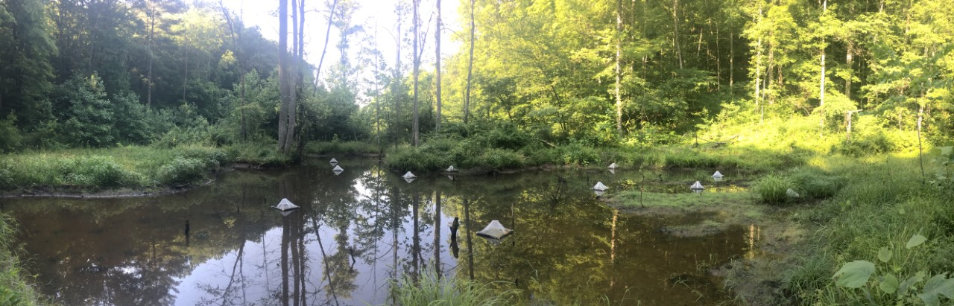
Preliminary insect emergence data from two headwater valleys in eastern Kentucky
Emily Jones
Notes:
Hello and thank you for coming. This presentation will cover preliminary insect emergence data collected over the summer for my thesis, comparing insect emergence from two headwater valleys in eastern Kentucky.

Slide 2
What is insect emergence?
Notes:
Insect emergence is an important event in the life cycle of aquatic insects, as demonstrated by this diagram. In stages 1-3 we can see an individual growing and developing, and finally at stage 4, emerge as a flying adult into the terrestrial environment. Here- the individual can reproduce and pass genetic information on to the next generation. After this is completed, the life cycle is over and the individual dies.

Slide 3
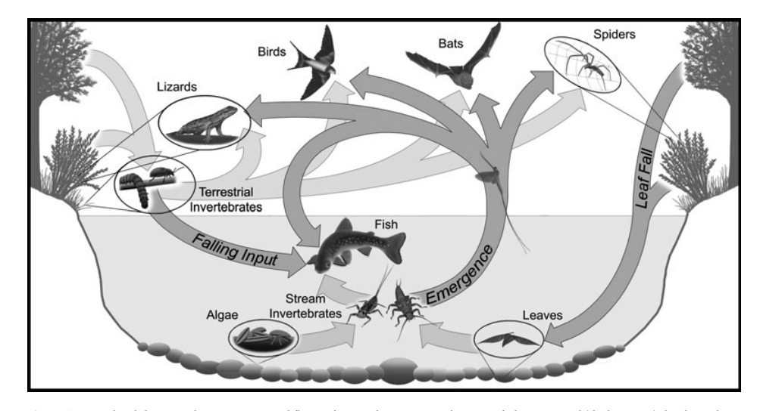
Why is insect emergence important?
Baxter et al. 2012
Notes:
Here, we can see how the emergence of aquatic insects impact the terrestrial food web. At the bottom of this figure, we can see the base of the aquatic food web- algae and detritus that falls into the water column. This is consumed by aquatic insects for energy and nutrients. The insects are then in turn predated on by fish. This is pretty much a closed loop until emergence occurs. Then, all the nutrients and energy stored in the insects becomes available to organism such as bats and birds. This is an important subsidy for the terrestrial system.

Slide 4
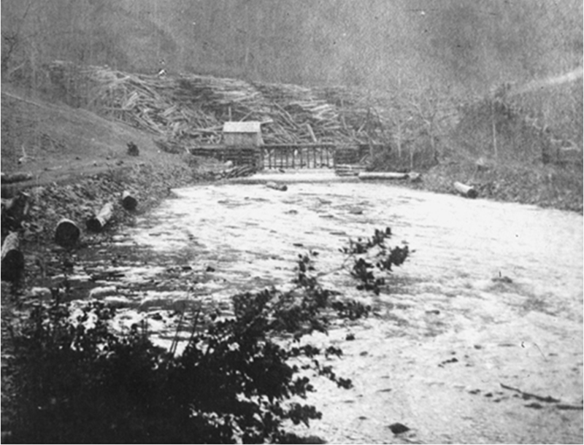
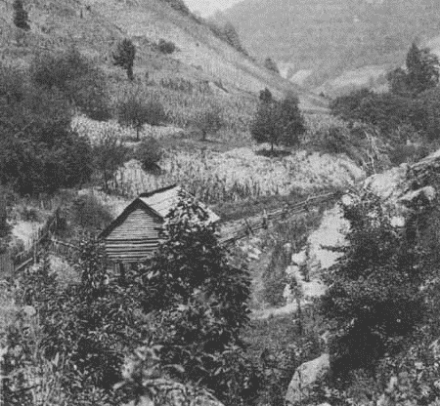
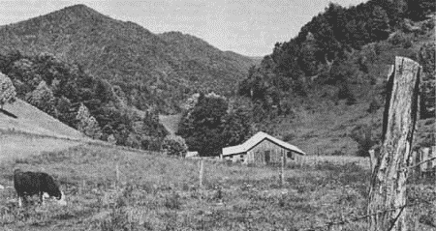
How humans altered the landscape
Notes:
I want to take a quick detour and talk about how humans alter aquatic landscapes- specifically in the eastern United States. Logging and farming practices from the early 20th century left scars on the landscape, including channelized headwaters, and legacy sediments on the valley floors. These images show some of those effects. On the top let, we can see the results of using dynamite to straighten river channels to transport logs and the other two images depict hillsides bare of trees and being used for agriculture.

Slide 5
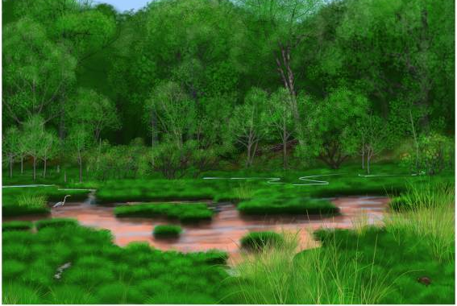
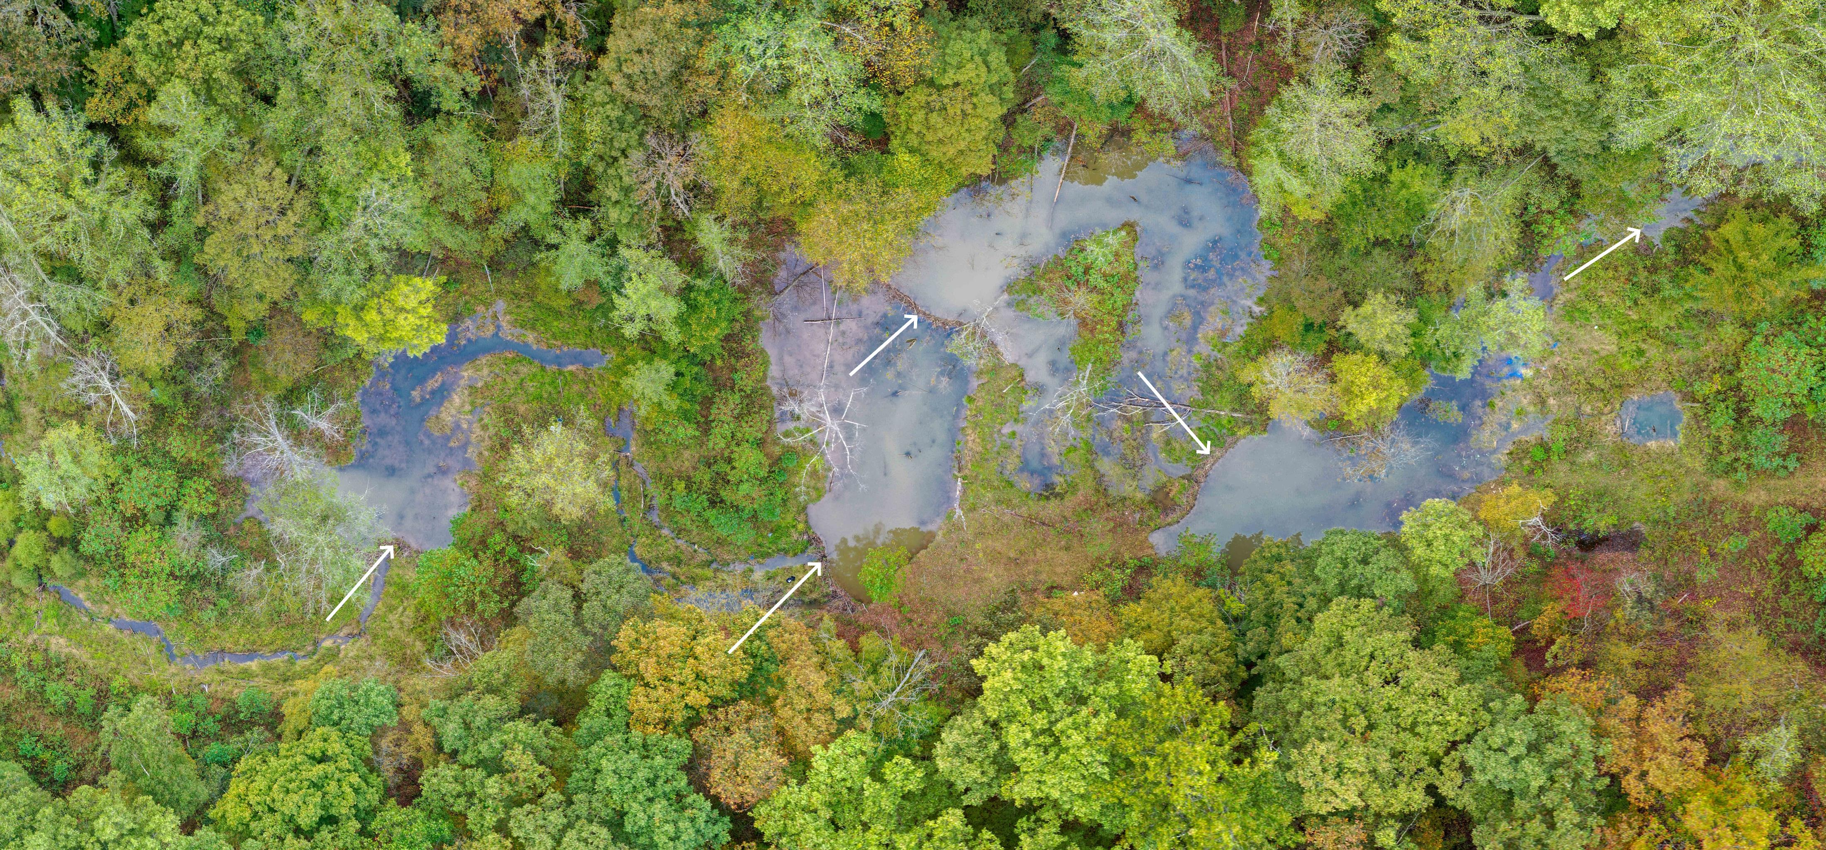
How humans altered the landscape
Notes:
Pre colonial Appalachia looked much different. On the left, we have an artist depiction of what one of these Appalachian valleys would have looked like and on the right, we can see a valley that has been restored to hydrologic functioning pre-colonial times. Both of the images represent valleys where channels have high connectivity to both the ground water and flood plain. The channel itself is meandering across the valley floor and beaver are present.
My study will compare the two types of altered landscapes- a unrestored, channelized system, and the restored system you see pictured on the right.

Slide 6
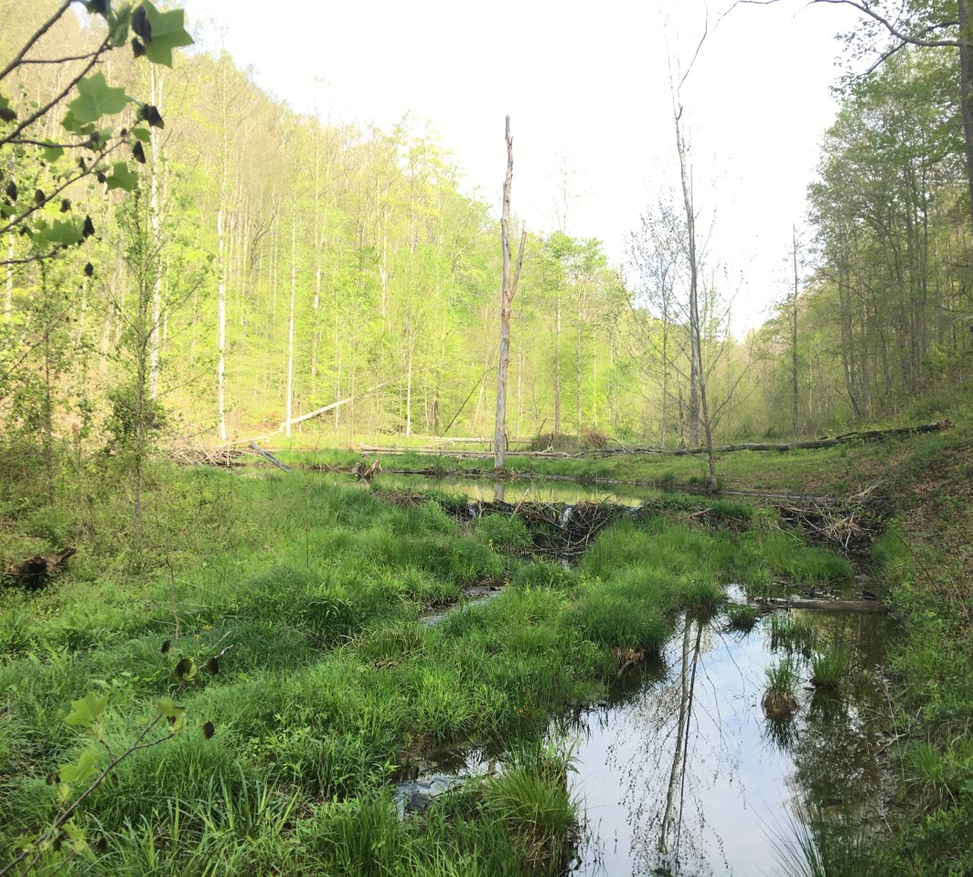
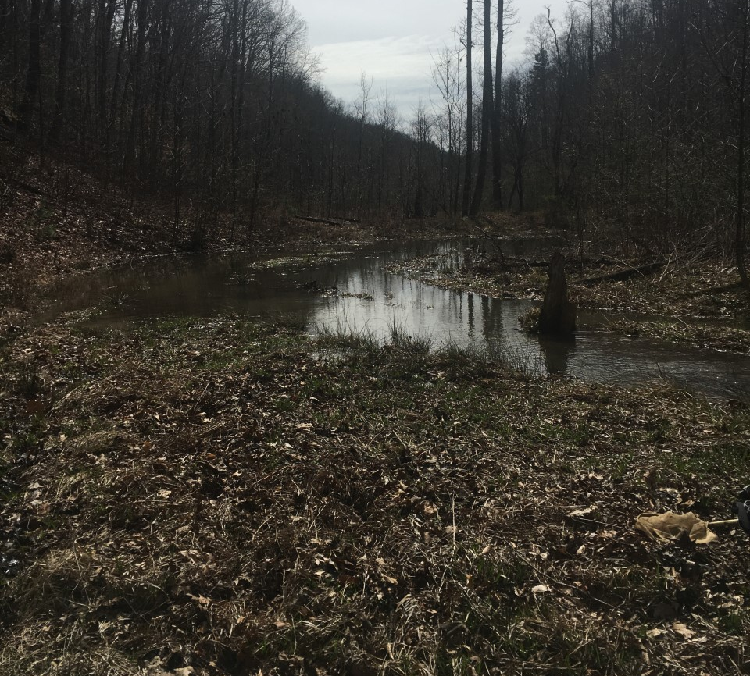
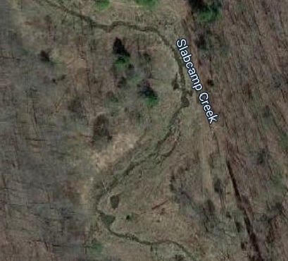
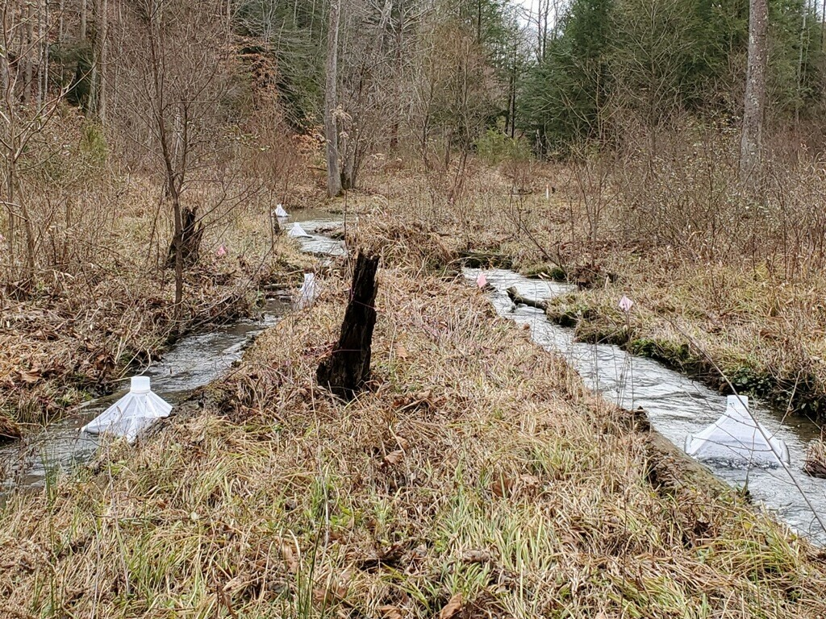
Restored Valley
Beaver ponds
Low banks
Lots of CWD
Connected to groundwater
Notes:
The restored valley can be characterized by beaver ponds. As of March 2020, 7 beaver ponds were present. Beaver pond number 2 is pictured on the top left. The channel has low banks, meaning when it floods the energy is dissipated across the valley floor rather than forced quickly downstream. There are lots of coarse woody debris in the stream and we know through different experiments the system is highly connected with the ground water.

Slide 7
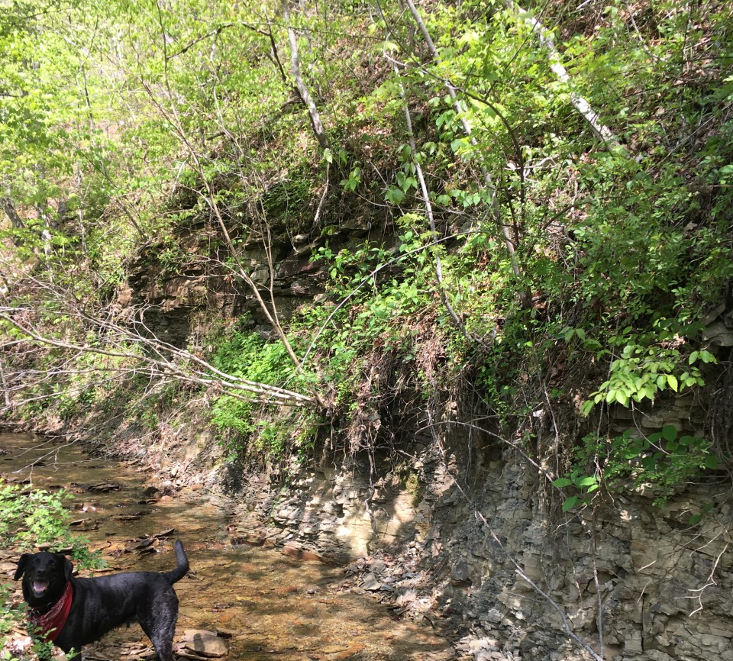
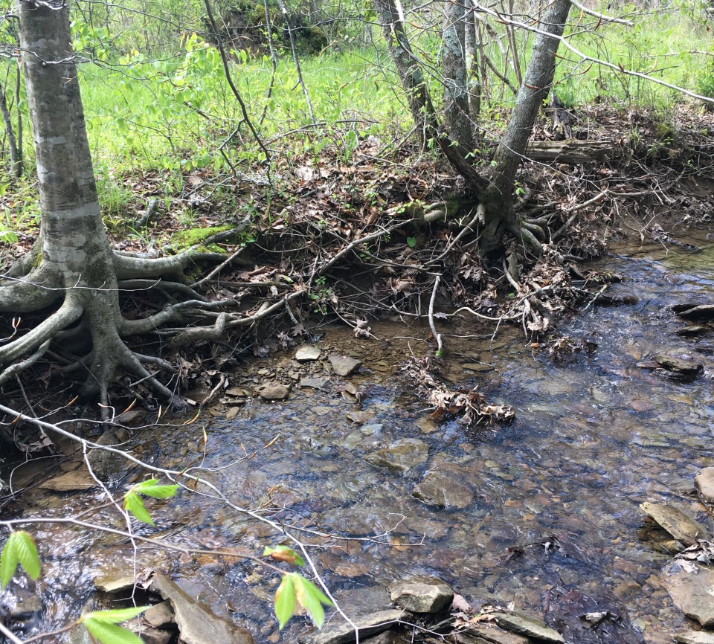
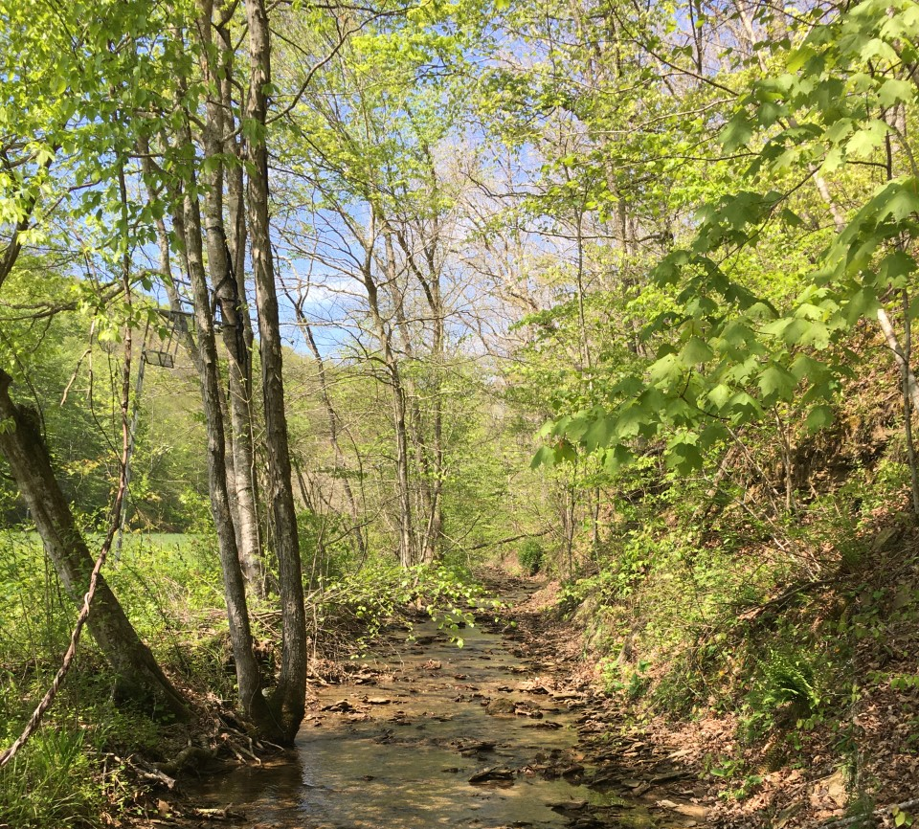
Unrestored Valley
Straight channel
Dries after May
No CWD/detritus
High erosion
Incised banks
Edge of valley
Notes:
The unrestored valley can be characterized as having a very straight channel, which you can see in the photograph on the bottom right. The other three images were taken in May and the following month the stream was completely dry. As of September, there still has been no water in it. Despite being surrounded by trees, there is little to no coarse woody debris or detritus in the channel. As I say that, I would like to point out this, which is a leaf pack. These are formed by detritus getting stuck on exposed roots or rocks as it moves downstream. These packs are often flushed out after any rain event. As you can see in the same image, there is a lot of erosion that occurs, causing these exposed roots. The other photos demonstrate how incised the banks are and that the stream is located on the edge of the valley.

Slide 8
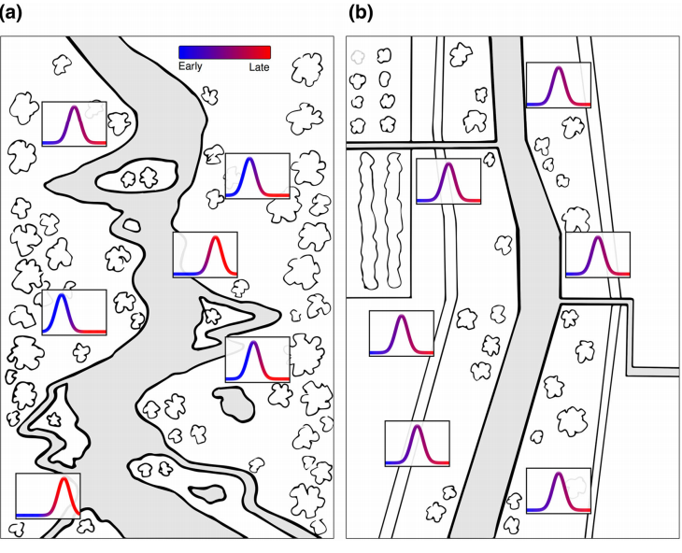
Expected insect emergence response to the landscape
Schindler and Smits 2017
Notes:
I expected a response in insect emergence to the alteration of the landscape. In this image, we have two hypothetical headwaters. On the left, we have a valley representative of my restored system. The meandering stream is mulit-branched and there are flood plain depressions dotting the landscape. On the right, we have a valley representative of my unrestored system. The stream has been channelized and homogenized.
From the valley on the left, I expect consistent emergence throughout the year. These are represented by the curves. The further left, or more blue, the earlier in the year an event occurs. The further right, or more red, the later in the year. This is important because the insects would be providing subsidies year-round to the terrestrial environment.
From the valley on the right, I expect a homogenized response, with maybe only one or two large emergence events occurring throughout the year.

Slide 9
Study design
1-week sampling periods
Emergence traps placed over dominant habitats at each location
Insects identified to morphospecies, counted, and measured for biomass

Slide 10
Emergent insect abundance per day by valley

Slide 11
Biomass (mg) per day by valley

Slide 12
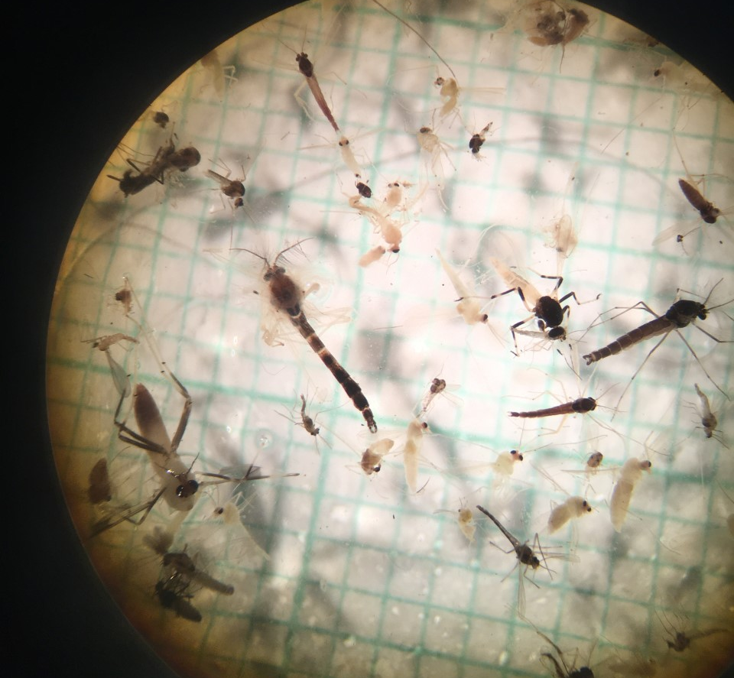
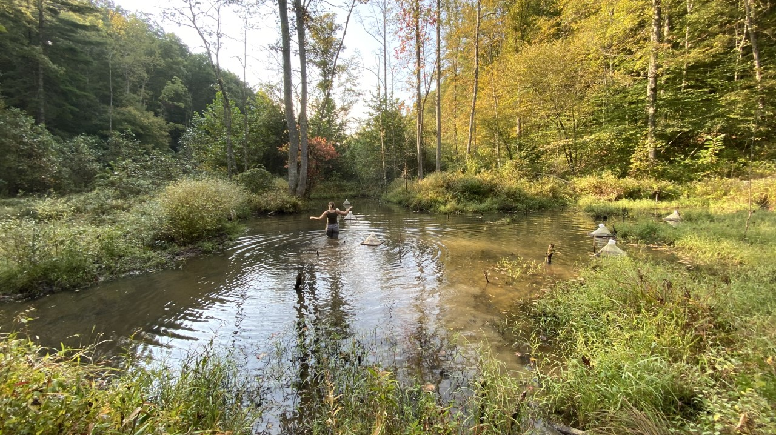
Summary
Higher abundance of emerging insects during all months at restored valley
Higher biomass during all months except May from restored valley
Beaver ponds were the most important for magnitude in June-August
Jones Branch dried after May, leaving no time for aquatic insect emergence during summer months.

Slide 13
Abundance per day by location

Slide 14
Biomass (mg) per day by location

Slide 15
Abundance per day by habitat

Slide 16
Biomass (mg) per day by habitat

Slide 17
Acknowledgments
University of Louisville Stream Institute
US EPA Region 4
NKY Fly Fishers
Eastern Kentucky University Biology Department
Many graduate and undergraduate students of EKU

