Slide 1
Floating raceway nursery proof of concept for production of phase I fingerling largemouth bass (Micropterus salmoides)
By:
Dawson Armstrong
Ken Semmens
John Kelso
Aquaculture Research Center
Frankfort, KY

Slide 2
Intensive Production of Largemouth Bass
Drain brood pond to remove all fish.
Stock brooders and place spawning mats.
Fish spawn on mat.
Harvest mats with eggs.
Incubate eggs in the hatchery.
Fry hatch into sac fry.
Fertilize nursery ponds.
Yolk sac consumed and fry swim up.
Stock swim-up fry into prepared pond.
After 30 days, harvest Phase I fingerlings.
Feed train fingerlings in the hatchery.
Stock feed trained fingerlings into ponds (Phase II).
Grow fish to stocker size the end of the year.
Grow out stockers to market size.

Slide 3
Issues with producing LMB In indoor systems or nursery ponds
INDOOR SYSTEMS
Costly
First live food is very difficult to culture indoors
Space is limited
NURSERY PONDS
Number of fish stocked in the pond can be limited
Can only stock same age spawns together or cannibalism will occur
Recovery of fish is an issue (filamentous algae, hot weather, etc.)
Damaging/killing the fish during harvest is an issue
Labor intensive

Slide 4
What is a Raceway?
Also known as a flow-through system, a raceway is a unit that has three enclosed walls and uses continuously running water for production of aquatic organisms.
Advantages of raceways include:
Space per unit
Higher stocking density
Ease of feeding
Ease of harvesting
Improved water quality
Multiple size groups can easily be separated
Predator protection

Slide 5
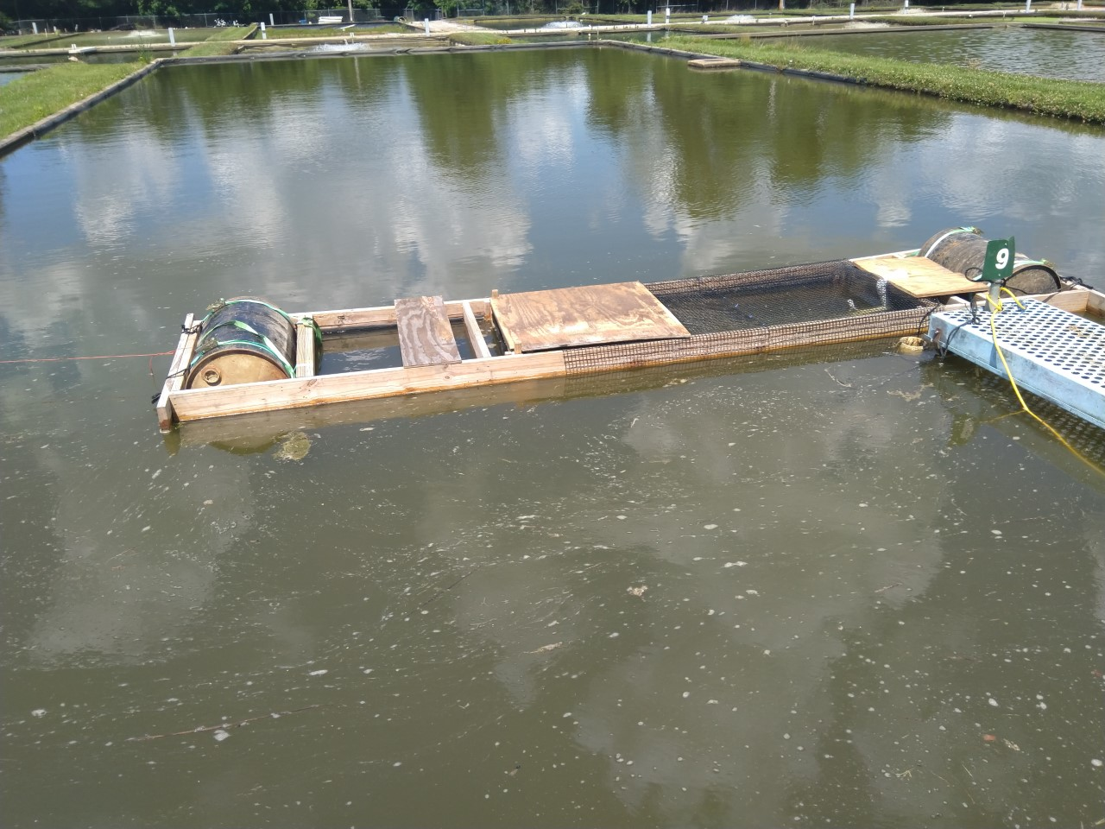
Floating Raceway Nursery design
Total length: 16 ft
Inside length holding fish: 8 ft
Inside width: 3 ft
Side walls are Permalon plastic sheets
Suspend raceway from floating frame
Hard bottom, with vertical sides
Floatation at each end of raceway
Keyway for screen removal
1/3 hp electric pump to push water and aerate
Mesh cover predator protection and escapement
Fine mesh screen in keyway on one end and a plywood sheet end wall
Estimated cost of materials is $500

Slide 6
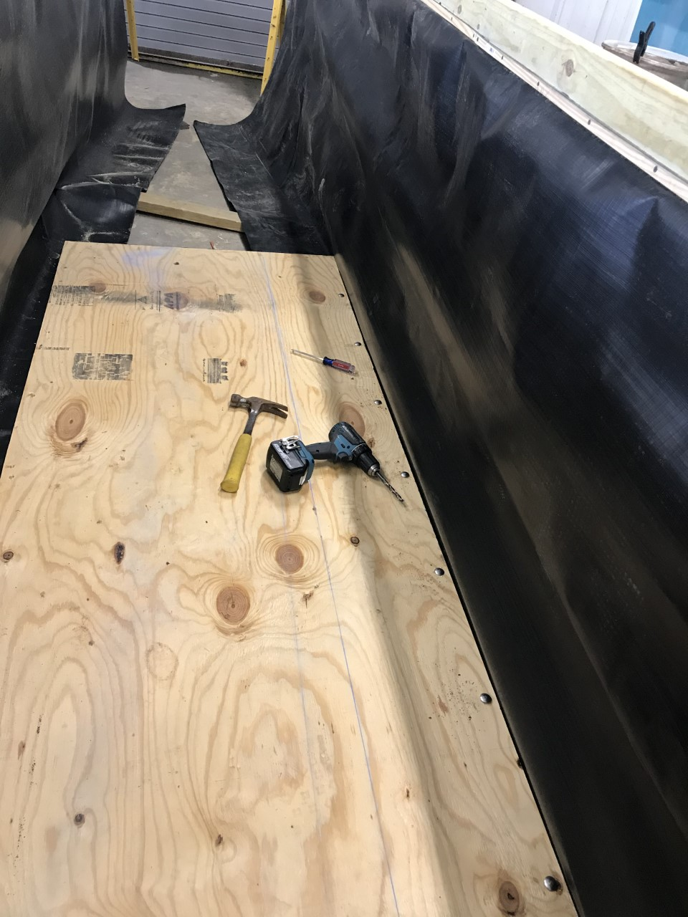
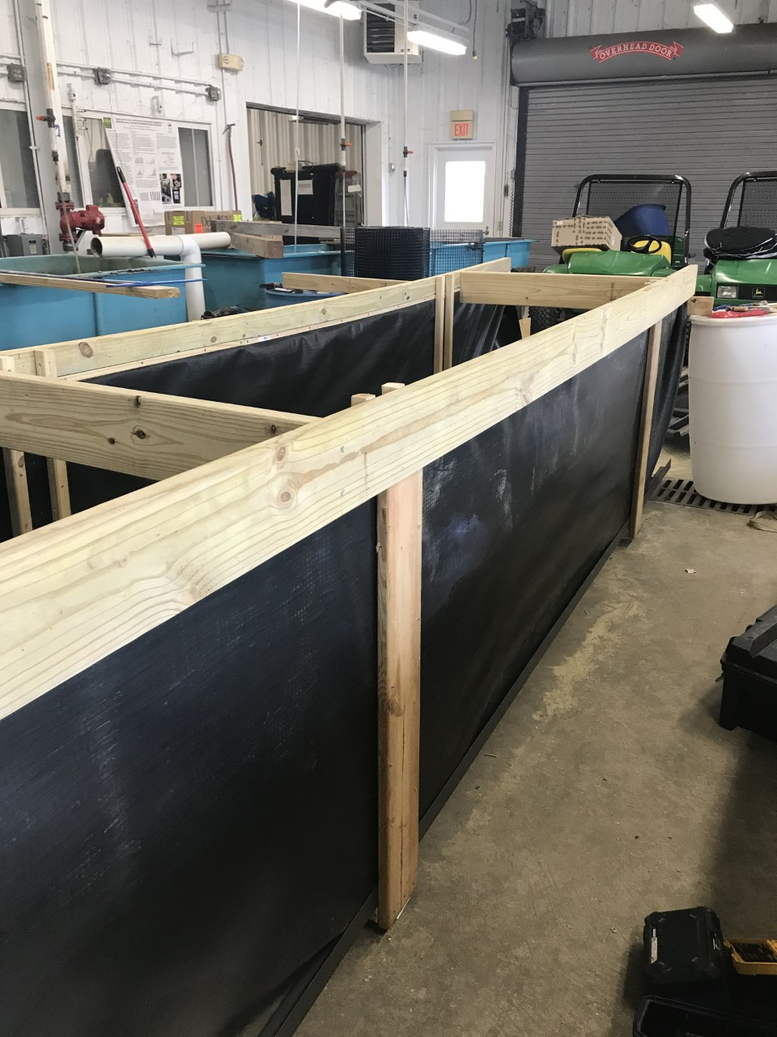
Construction

Slide 7
Phase I Largemouth Bass production at Kentucky State University
In this experiment there were two treatments:
3 nursery ponds as a control
3 ponds with floating raceway nursery treatment
All 6 ponds received the same fertilization program.
Fill brood pond; stock brooders.
Brood stock spawn; collect mats with eggs.
Prepare nursery ponds.
Eggs hatch and become swim up fry.
Stock 6,000 swim up fry in each pond and raceway.
Water from the pond pumped over plywood end wall of each raceway at 15 gpm.
Fish in both treatments feed on zooplankton and other natural foods.
Fingerlings are harvested after 27 days.
Move fingerlings taken to the hatchery for feed training.

Slide 8
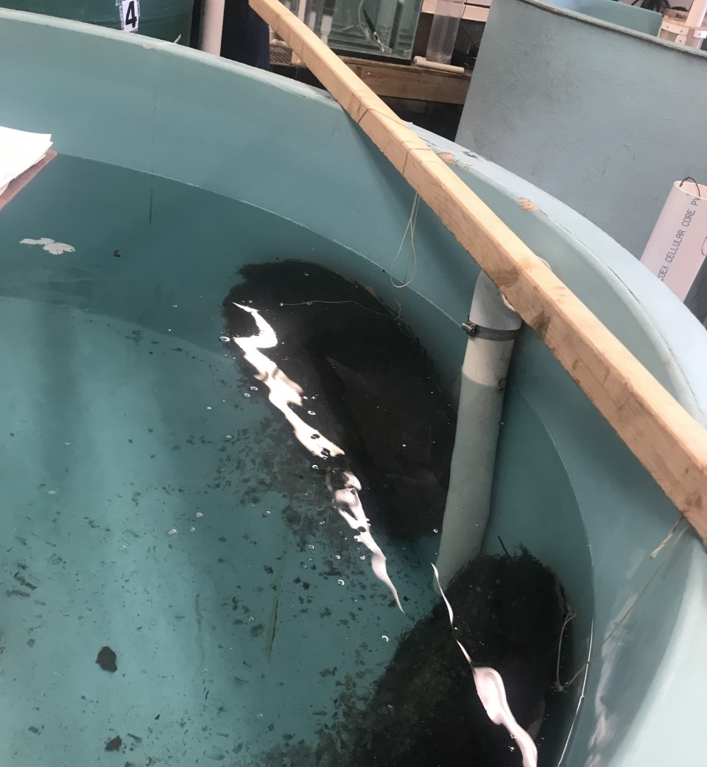
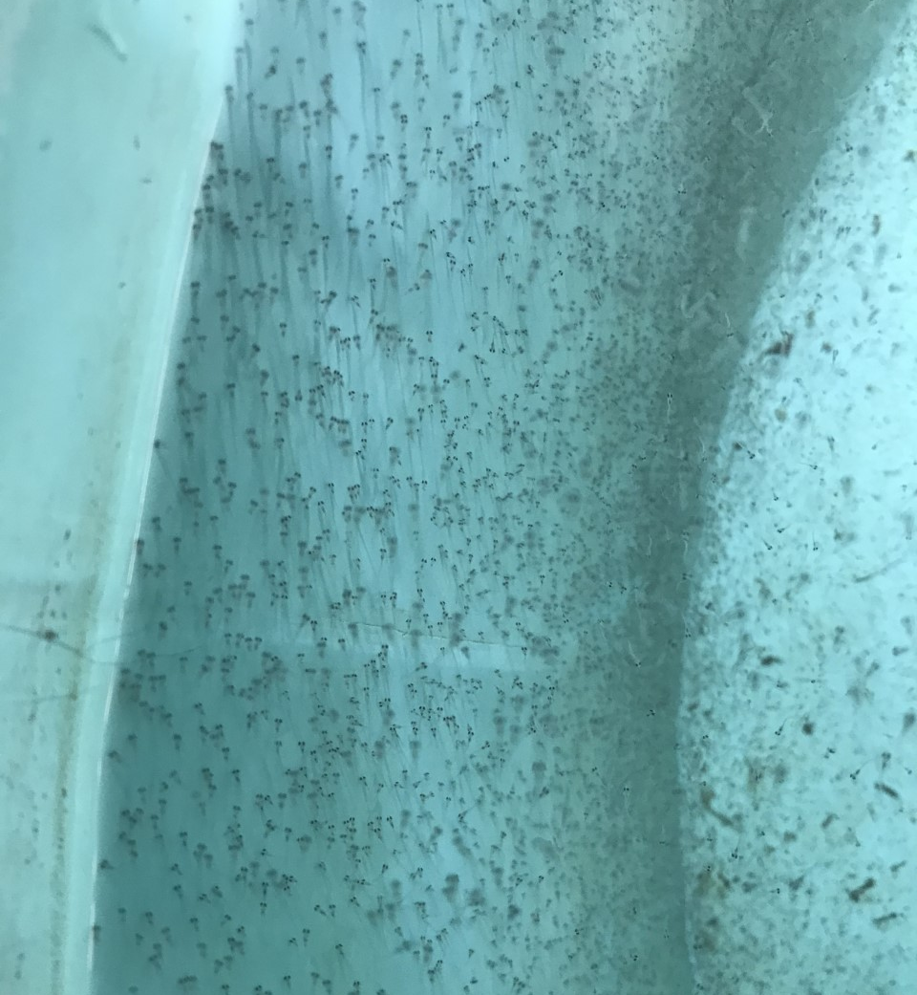

Slide 9
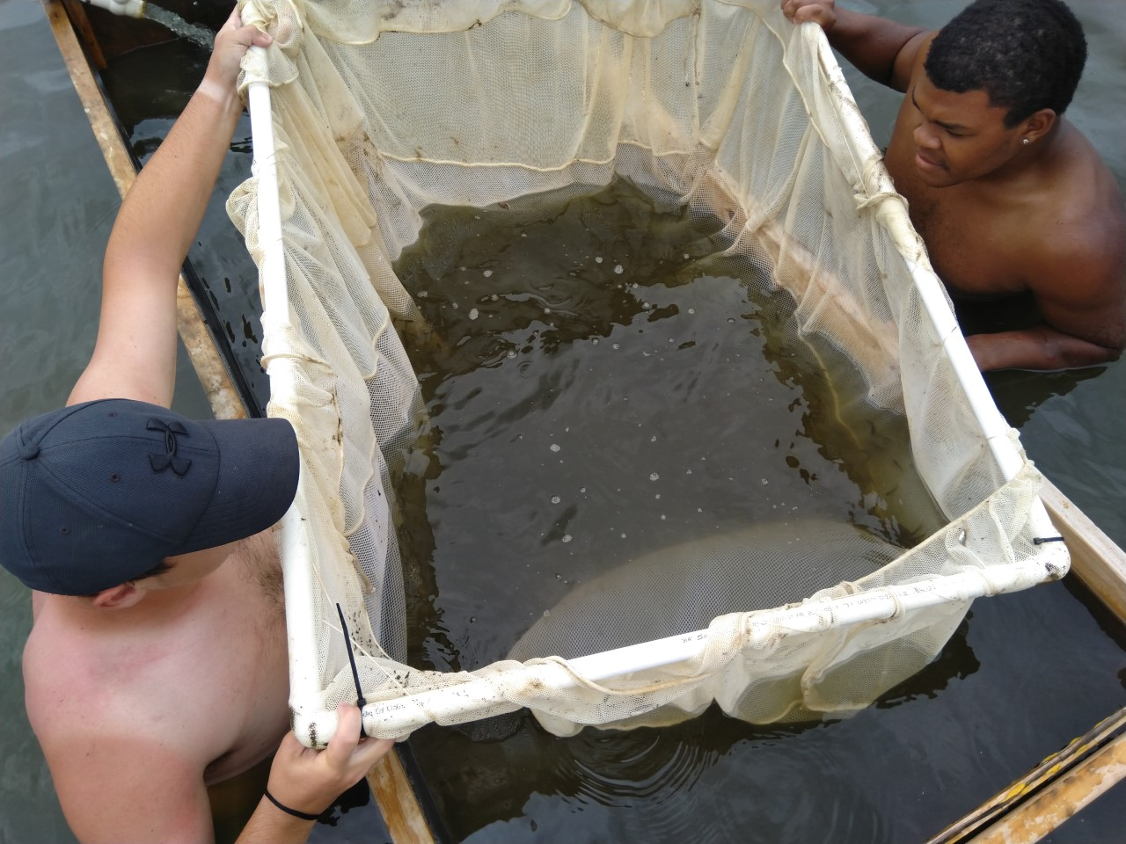
Results: Recovery of LMB
 | Recovery of LMB
Pond | 98%
Raceway | 41%
Outside Raceway | 48%
Raceway sum | 89%
Escapement and survival are issues to address
Recovery of fish inside the raceways was much more efficient than recovery of fish in nursery ponds
Harvesting 3 nursery ponds took us 3.5 hours
Harvesting the three raceways and the escapees took 2 hours

Slide 10
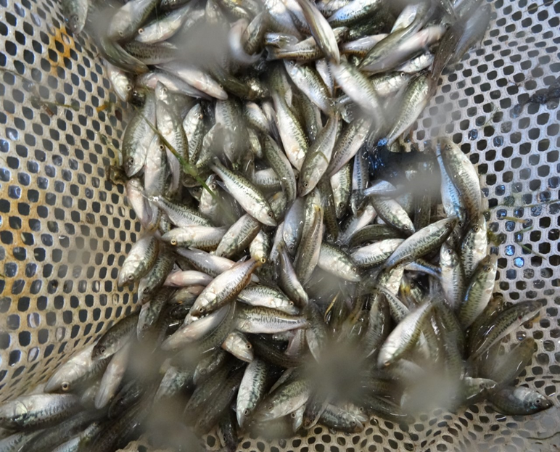
Results: Growth of LMB
 | Weight (g) | Length (mm)
Pond | 1.34g | 41.93mm
Raceway | 0.77g | 34.29mm
Outside Raceway | 1.70g | 45.62mm
A T-test was ran on growth of LMB. Comparing the weight between the raceways and ponds, the p-value was 0.423
Comparing the length of LMB between the raceways and ponds, the p-value was 0.241
Statistically, growth between the raceways and ponds was not significant.

Slide 11
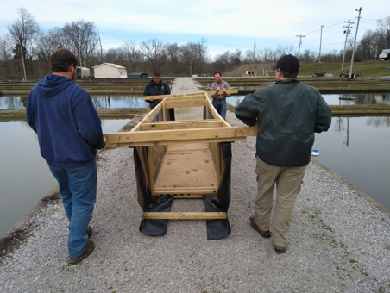
Advantages of Floating nursery production
Modest cost
Utilize existing ponds
Management and harvest labor efficient
Easily separate multiple size groups
Abundant natural feed available to fry
Protection of fry from predators
Multiple raceways can be placed in ponds, so space is not limited

Slide 12
Addressing issues
Escapement of Raceways
Secure screens more carefully with cross braces on bottom.
Consider using smaller mesh for screens.
Growth/food availability
Increase flow (gpm) through raceway to deliver more food.
Use a belt feeder to introduce small amounts of feed in the third week.
Other things to investigate:
Don’t harvest LMB. Grade and feed train them in the raceway.
Multiple raceways in a single pond
Can unmanaged recreational ponds support this practice?
Fish Density inside the raceway
Zooplankton form and abundance

Slide 13
Conclusion
First attempt of floating nursery production of phase I Largemouth Bass was encouraging.
Suspended design and materials were viable.
Verified modest cost.
Significant numbers of fry survived and grew in the floating nursery.
Growth in ponds was greater than growth in floating raceway nursery.
Escapement was an issue in floating raceway.
Harvesting the LMB took far less time and was gentle on the fish.

Slide 14
Acknowledgement
This material is based upon work that is supported by the National Institute of Food and Agriculture, U.S. Department of Agriculture, Capacity Building Grant 2017-38821-26436.
Any opinions, findings, conclusions, or recommendations expressed in this publication are those of the author(s) and do not necessarily reflect the view of the U.S. Department of Agriculture.

Slide 15
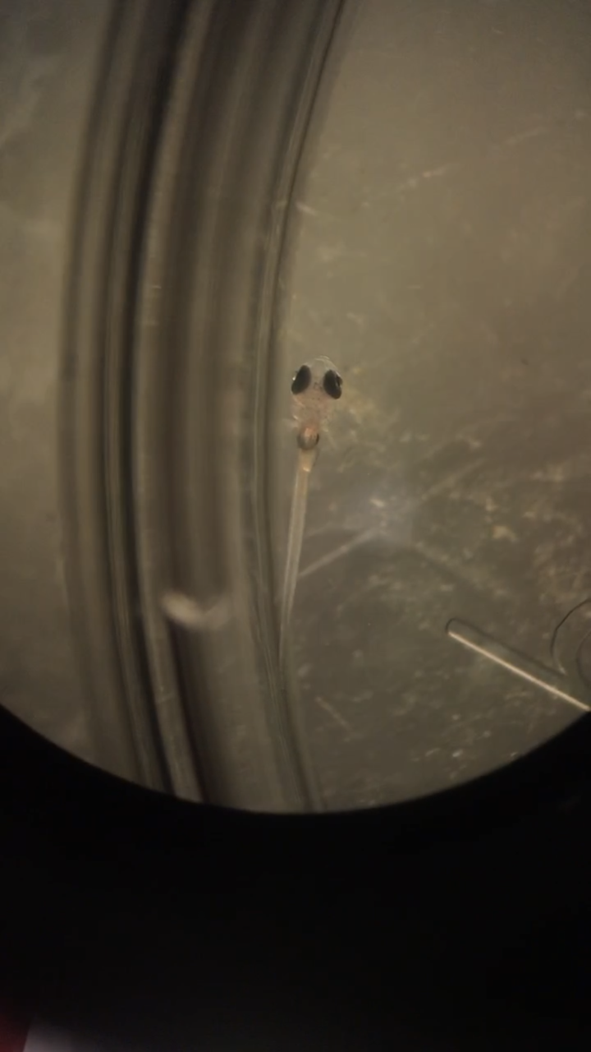
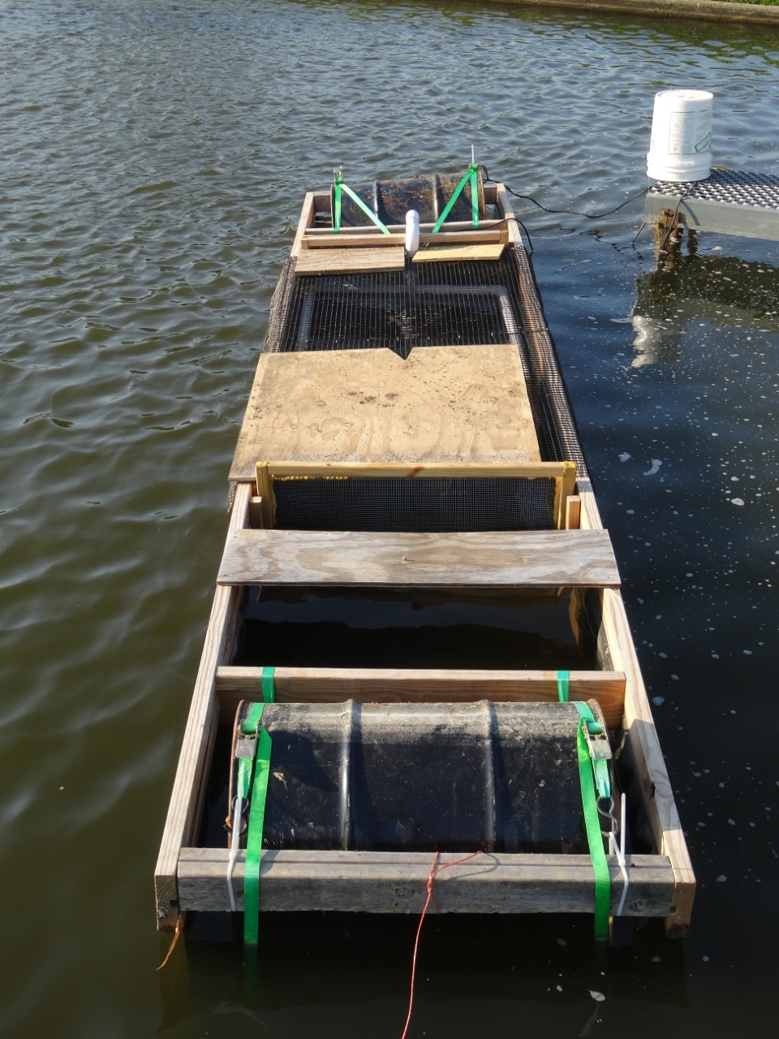
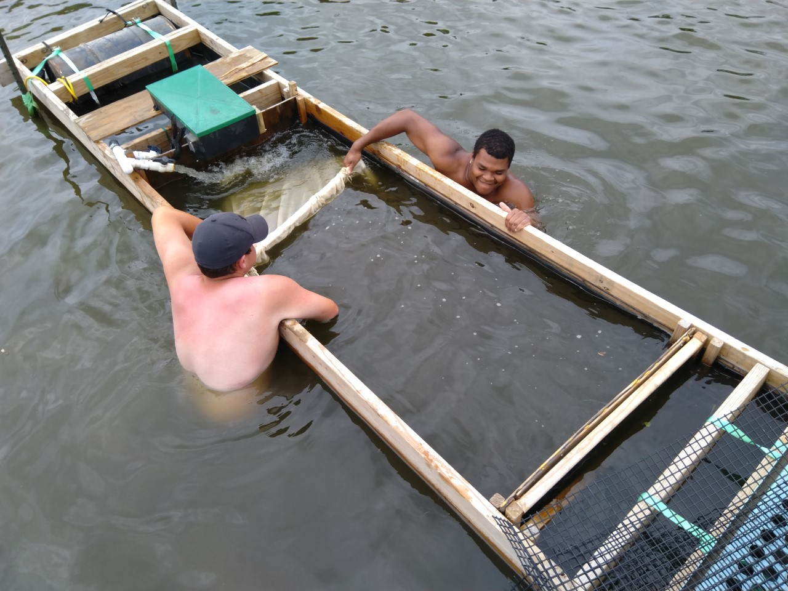
Questions?
If you would like a copy of the assembly video for this Floating Raceway Nursery, email me:
Dawson.Armstrong@kysu.edu

