Slide 1
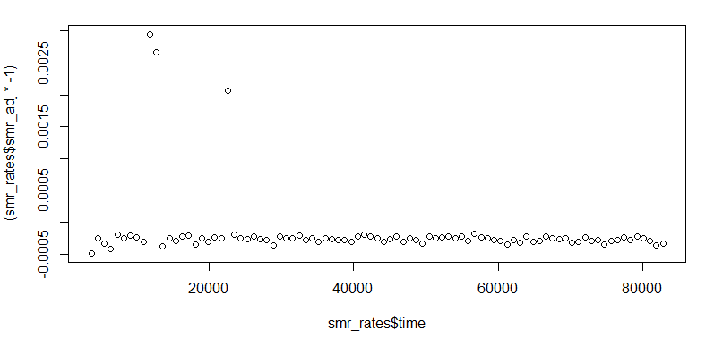
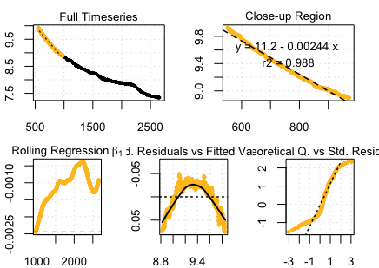
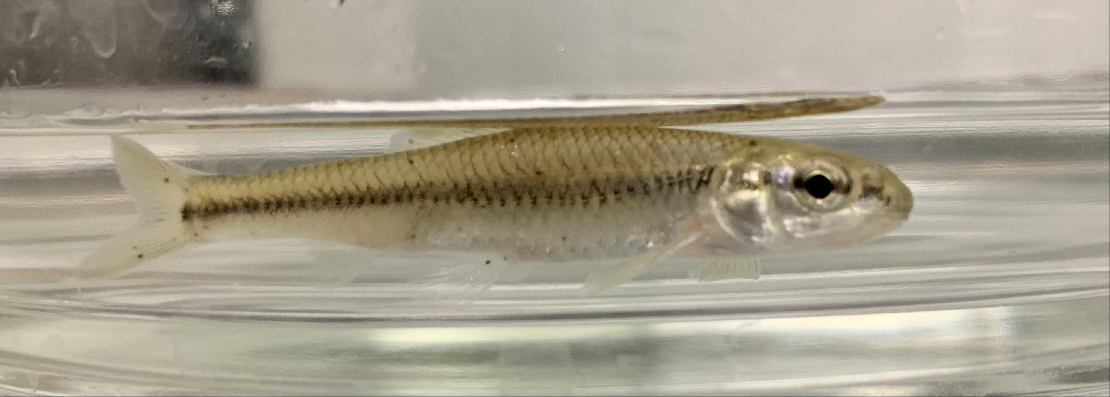
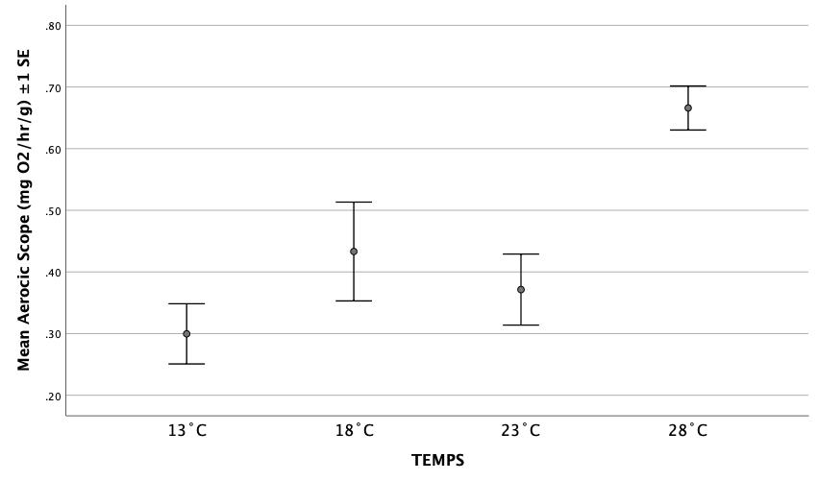
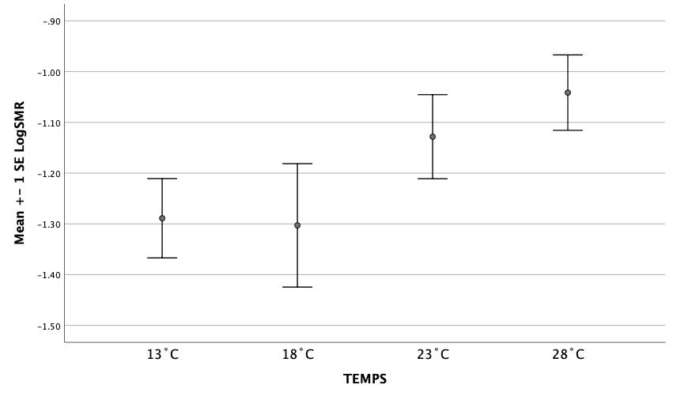
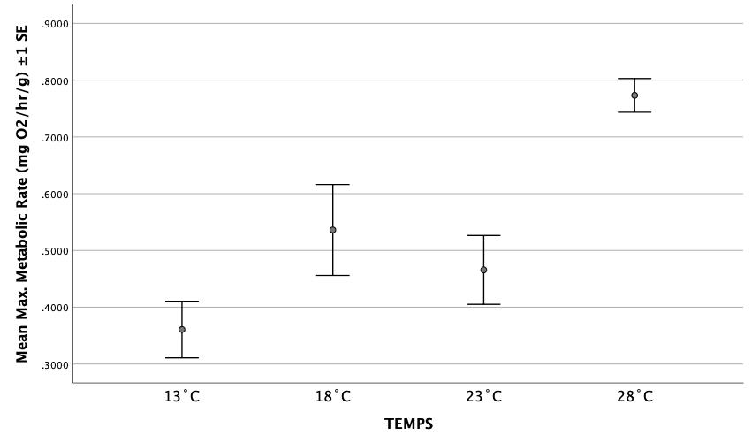
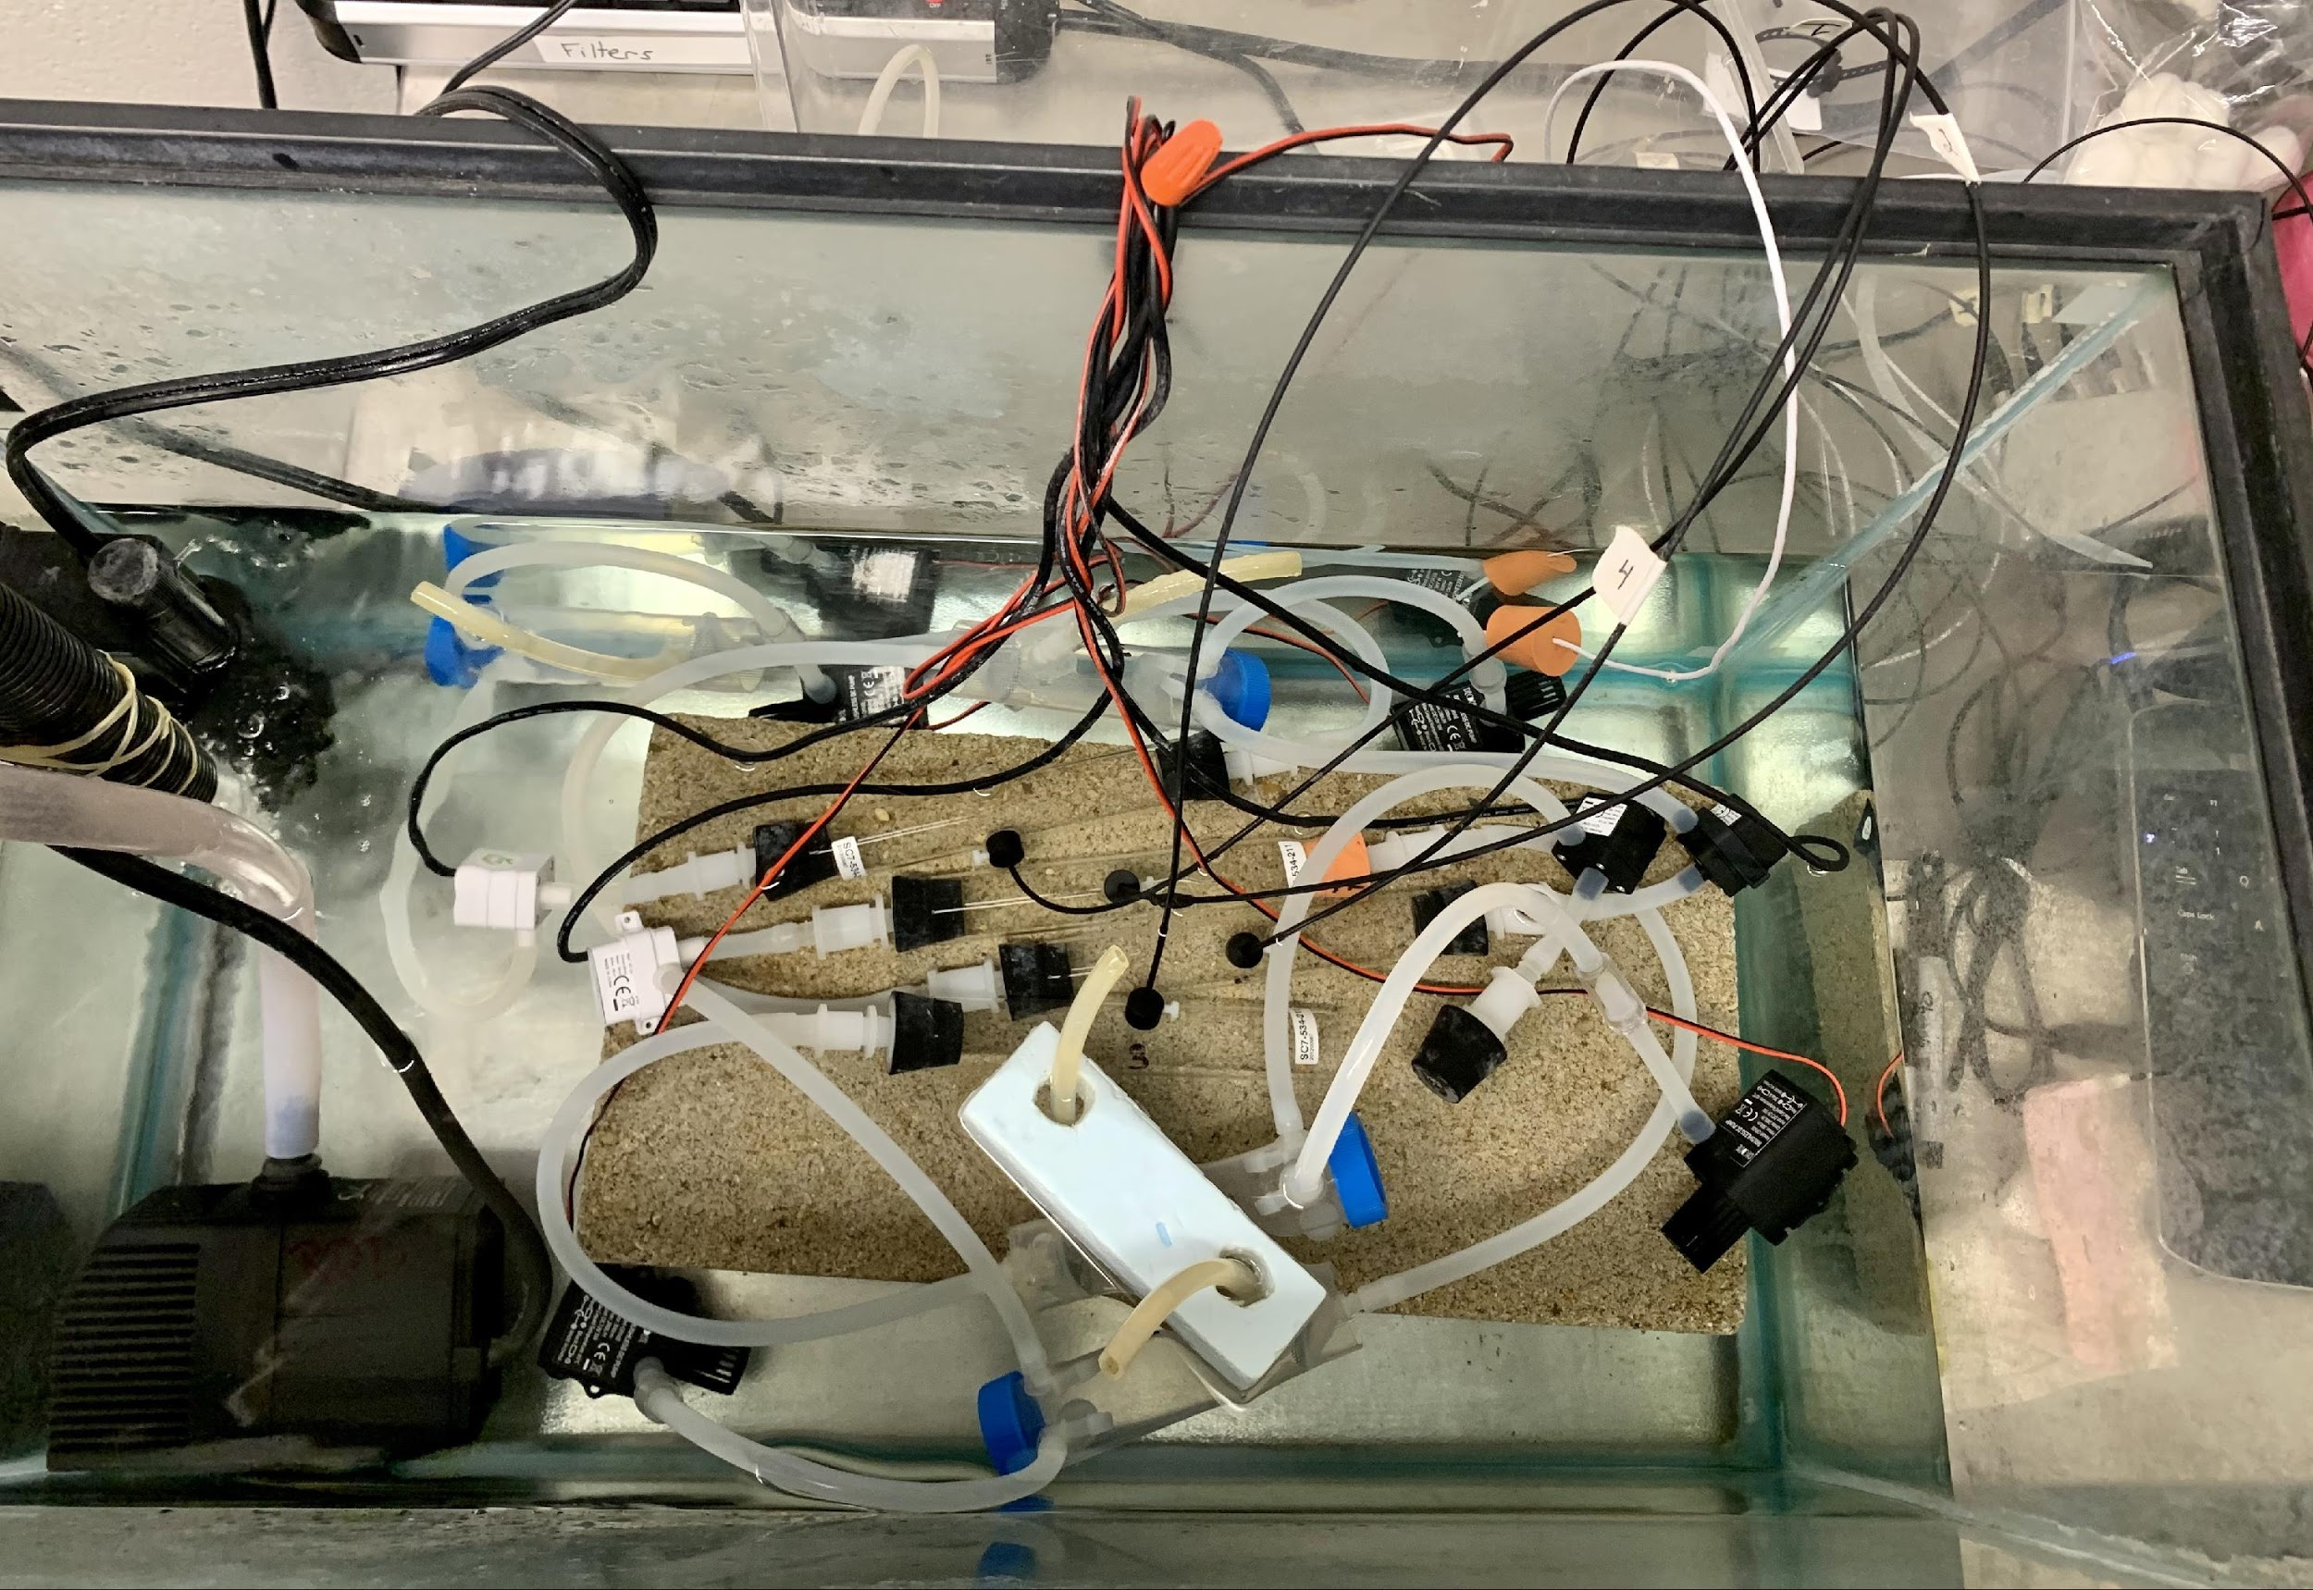
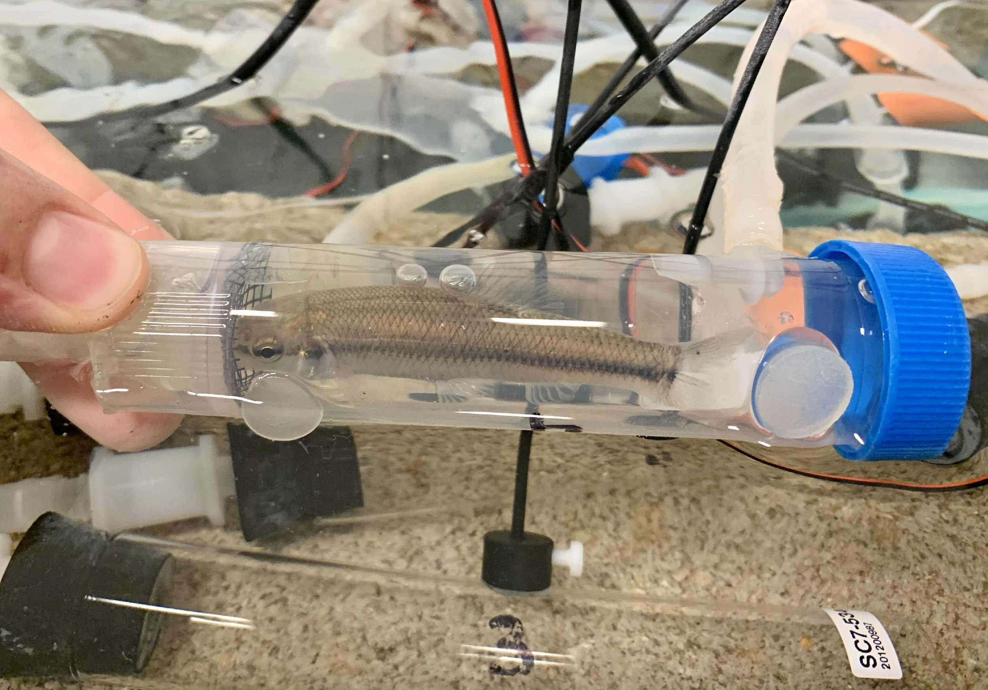
Metabolic responses of adult Bluntnose Minnows (Pimephales notatus) to a range of thermal conditions
Sam P. Bauer, Emily Steele, Olivia Timmerding, and Richard D. Durtsche
NKU Department of Biological Sciences, Highland Heights, KY 41076
Introduction
Alteration in temperatures due to climate change could have a direct effect on the fitness and metabolism, or aerobic scope (AS) of fish. Aerobic scope is the difference between standard metabolic rate [SMR] and maximum metabolic rate [MMR] (Clark et al. 2013). An organism’s standard metabolic rate is the least amount of energy that is used to properly sustain bodily functionality. A maximum metabolic rate is the rate of oxygen consumption at the greatest amount of activity at which an organism can withstand. Metabolic rates show to be influenced by environmental variation; therefore, the climatic temperature fluctuations are pertinent to the noted differences in organisms’ metabolism (Norin and Metcalf, 2018).
Bluntnose Minnows are native to the streams in the north eastern part of America. Their length may range from 40-100 millimeters and are a common stream fish found throughout Kentucky. Given that climates are changing in some areas globally (e.g., arctic and northern temperate regions) at a much faster rate than may have been initially predicted, we were interested to determine the effect of a range of temperatures, including temperatures that might influence fish physiology, for stream fishes in Kentucky. As the bluntnose is a mid-water to lower water column stream fish, we reasoned that this would be a good model fish to evaluate under different thermal conditions. Measuring metabolic rates in these fish is a mechanism to not only determine their physiological response to altered thermal environments, but to make predictions about their fitness under future climatic thermal shifts. We hypothesize that as the temperature (℃) increases, then the fish’s standard metabolic rate, maximum metabolic rate, and aerobic scope will also increase showing a direct correlation between metabolism and temperature. We measured the aerobic scope of adult Bluntnose minnows, Pimephales notatus, at four temperatures (28℃,23℃, 18℃, 13℃).
Graphs
Conclusion
Metabolic Rates were measured at 13C, 18C, 23C, and 28C. The log transformed standard metabolic rate was not found to be significantly different.
Maximum metabolic rates were significantly different, especially for the highest temperature. A tukey post-hoc test indicated that 28C was significantly different than the other temperatures.
Aerobic Scope was also significantly different between 28C and the other temperatures (13C, 18C, 23C). This difference was driven by the larger change in maximum metabolic rate at the highest temperatures.
At warmer temperatures (e.g., future climate change conditions), the fish will be using more energy than normal when they engage in activities outside of resting. Therefore, temperatures that are too high can be detrimental for fish. Under a scenario of a future warmer planet, Kentucky stream fishes, like bluntnose minnows, could lose more energy during daily activities due to high metabolic rates depleting energy reserve which could possibly threaten the species survival.
Figure 1: Bluntnose minnow respiration at 23C. Oxygen respiration (mg/L) per time (sec).
Key:
= Initial Baseline = Standard metabolic rate
= Maximum metabolic rate = Final Baseline
Figure 2:
This shows all 88 regressions as the fish respire.The standard metabolic rate represents the lowest 10% of these values (colored dots). This is the lower metabolism of the fish as it is resting.
Figure 3: In the above graphs, the MMR is highlighted. The fish is recovering after being chased and takes in more oxygen to meet the energetic demands of this high activity level. The steepest point of this regression is the MMR.
Image 1: Bluntnose minnow (Pimephales notatus), the species of fish used in this study.
Image 4: Students Olivia Timmerding, Sam Bauer, and Emily Steele working in the NKU aquatic's lab.
Figure 6:
The aerobic scope (AS) did change significantly with temperature (F_{3,50}= 5.926, p=0.002). A Tukey post-hoc test found the AS at 28˚C to be significantly higher than the at the other temperatures.
Citations
Clark, T. D., Sandbloom, E., & Jutfelt, F. (2013). Aerobic scope measurements of fishes in an era of climate change: respirometry, relevance and recommendations. Journal of Experimental Biology, 216, 2771-2782. doi: 10.1242/jeb.084251 .
Norin T., Metcalfe NB. (2019). Ecological and evolutionary consequences of metabolic rate plasticity in response to environmental change. Phil. Trans. R. S. Soc. B, 317, 20180180. http://dx.doi.org/10.1098/rstb.2018.0180
Figure 4: Standard metabolic rate, log transformation to normalize the data, were not found to be significantly different from each other among temperatures tested, though there was a trend for increased values with temperature (F_{3,50}= 1.699, p=0.179).
Figure 5: The Maximum Metabolic Rate (MMR) did change significantly with temperature (F_{3,50}= 7.183, p< 0.001). A Tukey post-hoc test found the MMR at 28˚C to be significantly higher than the at the other temperatures.
Acknowledgements
We thank the Northern Kentucky Field Station (REFS) administration for allowing us to do some of our sampling at their locations. Also, we would like to thank the vertebrate zoology class of 2020 for helping to collect bluntnose minnows from Wilson Creek. Finally, we would like to thank the Northern Kentucky University’s Center for Integrative Natural Science and Mathematics (CINSAM) and National Science Foundation (NSF) staff for proving the opportunity and funding for us to carry out our studies.
Image 2: The 10-gallon tank, where the chambers with fish, and the fiber optical dissolved oxygen sensors are located.
Image 3: The 50mL chambers used for each individual fish.

