Slide 1
The Effect of TIMP-1 levels, MMP-1 Levels, and Healing Times on the Wound Surface Area
By: Aarini Panzade
Western Kentucky University

Slide 2
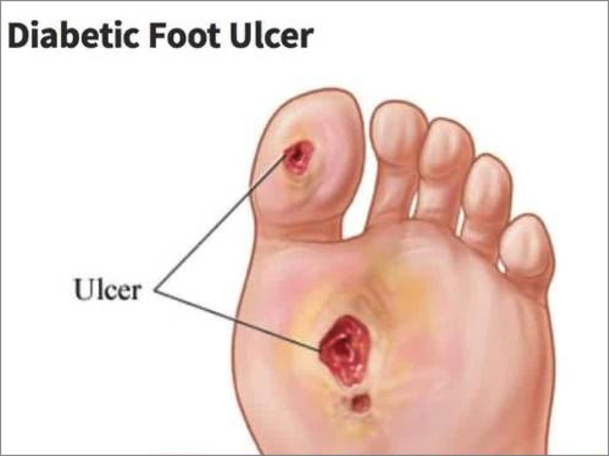
Introduction
Diabetic foot ulcers are a major health problem
They are the leading cause of non traumatic amputations in developing countries
MMPs
Enzymes that degrade all kinds of extracellular matrix proteins
A key element in the wound healing process
TIMPs
A tissue inhibitor of MMPs

Slide 3
Objective
Determine which of the interaction variables combinations have the most correlation with the wound surface area of diabetic foot ulcers

Slide 4
Data
Original data
Different variables that were recorded for each patient
Wound surface area recorded for each patient
Data used (interaction terms)
MMP – 1and TIMP – 1
MMP – 2 Latente and MMP – 9 Latente
TIMP – 1 and Weeks
MMP – 2 and MMP – 9
Sum of MMP – 2 and MMP - 9

Slide 5
Deciding which variables of the interaction terms are appropriate
Linear regression models were made for each one of the interaction terms combinations
Based on the models generated, it was concluded which of the interaction terms had the most effect on the wound surface area

Slide 6
Multi Variable Linear Regression
The two interaction terms were multiplied using excel and then put as the x variables in python and the surface area as the y variable
Using different libraries, plots, and formulas, a model was created for each of the interacted terms comparing it to the wound surface area
Using the correlation coefficient and the error percentage , it was concluded which of the terms had the most correlation

Slide 7
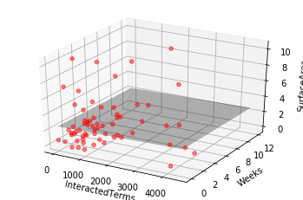
MMP and TIMP
Error % = 5.00
Correlation % = 40

Slide 8
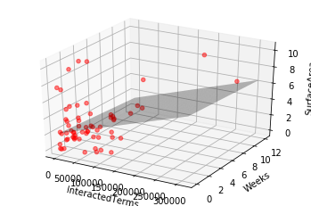
MMP-2 and MMP-9
Error % = 2.00
Correlation % = 70

Slide 9
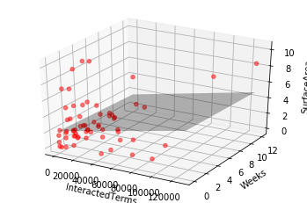
MMP-2 Latente and MMP-9 Latente
Error % = 0.95
Correlation % = 90

Slide 10
Conclusion
The MMP – 2 Latente interacting with the MMP – 9 Latente had the most impact on the wound surface area of diabetic foot ulcers

Slide 11
Questions?

