Slide 1
Aging and the visual perception of texture-defined shape
Abdallah Sher
Western Kentucky University
Department of Psychological Sciences

Slide 2
01
Background Information

Slide 3
Vision is critical to survival
Primitive skills like hunting and gathering
Being able to discriminate objects from each other
How hard is it for us to discriminate shapes?
How does a natural process such as aging affect that?
Older adults struggle to discriminate shapes by motion (Norman et. al. 2020)
Does the same apply to texture?

Slide 4
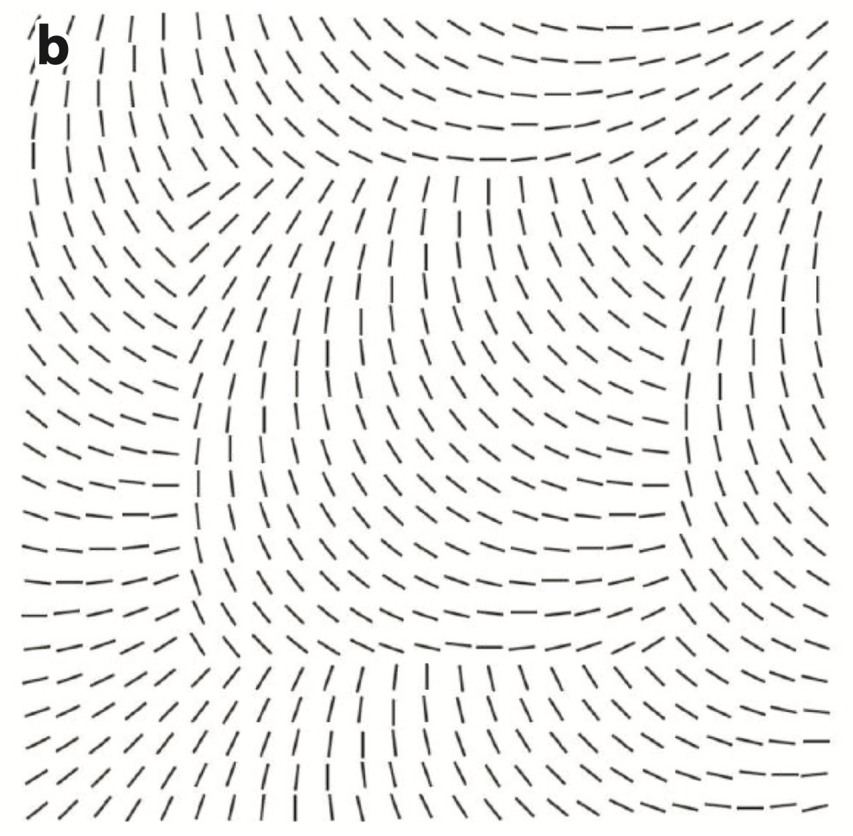
Sometimes it’s easy
Victor, Conte, & Chubb (2017)

Slide 5
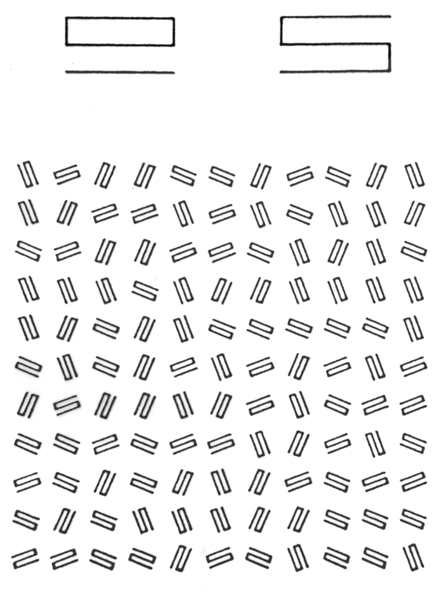
Sometimes it’s not
Julesz (1980)

Slide 6
Sometimes it’s not
Julesz (1980)

Slide 7
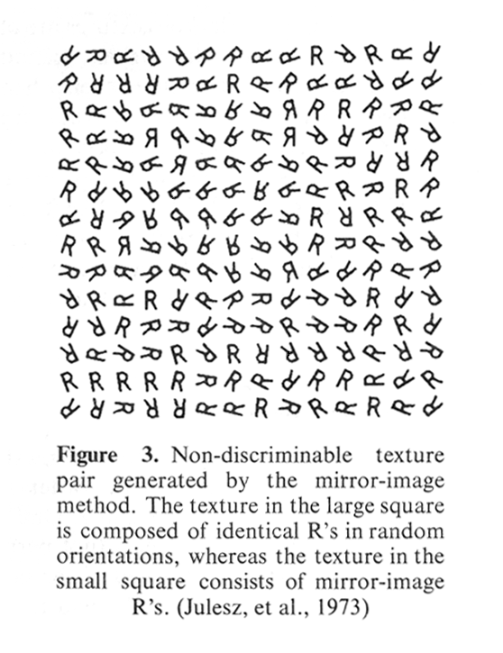
Julesz, Gilbert, Shepp, & Frisch (1973)

Slide 8
Julesz, Gilbert, Shepp, & Frisch (1973)

Slide 9
How is difficulty determined?
Caelli & Julesz (1978) examined a method to alter the difficulty of visual shape discrimination
Examined 2, 3, and 4-point micropatterns
3-point micropatterns were used in a way such that the outer “background” consisted of units of 3 collinear points
Deviation from collinearity within foreground units established distinction from background
The higher the angle of deviation (between 0° and 180°), the easier the shape was to discriminate
Caelli & Julesz (1978)

Slide 10
How is difficulty determined?
Caelli & Julesz (1978) examined a method to alter the difficulty of visual shape discrimination
Examined 2, 3, and 4-point micropatterns
3-point micropatterns were used in a way such that the outer “background” consisted of units of 3 collinear points
Deviation from collinearity within foreground units established distinction from background
The higher the angle of deviation (between 0° and 180°), the easier the shape was to discriminate
Caelli & Julesz (1978)

Slide 11
02
Methodology

Slide 12
14 younger (average 19.0 years old) and 14 older (average 70.4 years old) were presented 15x15 grids of 3-dot micropatterns
A 7 by 4 rectangle was randomly placed in the grid with a deviation from collinearity by $θ°$
3 variations of $θ$ were used to test discrimination
20°, 40°, and 60° for younger adults
40°, 60°, and 80° for older adults
Sample stimulus with $θ=60°$

Slide 13
14 younger (average 19.0 years old) and 14 older (average 70.4 years old) were presented 15x15 grids of 3-dot micropatterns
A 7 by 4 rectangle was randomly placed in the grid with a deviation from collinearity by $θ°$
3 variations of $θ$ were used to test discrimination
20°, 40°, and 60° for younger adults
40°, 60°, and 80° for older adults
Sample stimulus with $θ=60°$

Slide 14
120 total stimuli were displayed for 3 seconds each
40 per variation of $θ$
Participants were to state the orientation (horizontal or vertical) of the rectangle after the 3 second viewing period
Accuracy was calculated and recorded
Preliminary phase ensured that subjects were aware of the task
$θ$ was set trivially high so that rectangle was prominent

Slide 15
120 total stimuli were displayed for 3 seconds each
40 per variation of $θ$
Participants were to state the orientation (horizontal or vertical) of the rectangle after the 3 second viewing period
Accuracy was calculated and recorded
Preliminary phase ensured that subjects were aware of the task
$θ$ was set trivially high so that rectangle was prominent

Slide 16
03
Results/Analysis

Slide 17
ANOVA Testing
p < .000001
F(2, 26) = 175.6
Significant
p = .000002
F(2, 26) = 22.8
Significant
p < .000001
F(1, 26) = 47.9
Significant
p < .000001
F(1, 26) = 44.5
Significant
Bend angle on younger adults
Bend angle on older adults
Overall effect of bend angle
Overall effect of age

Slide 18
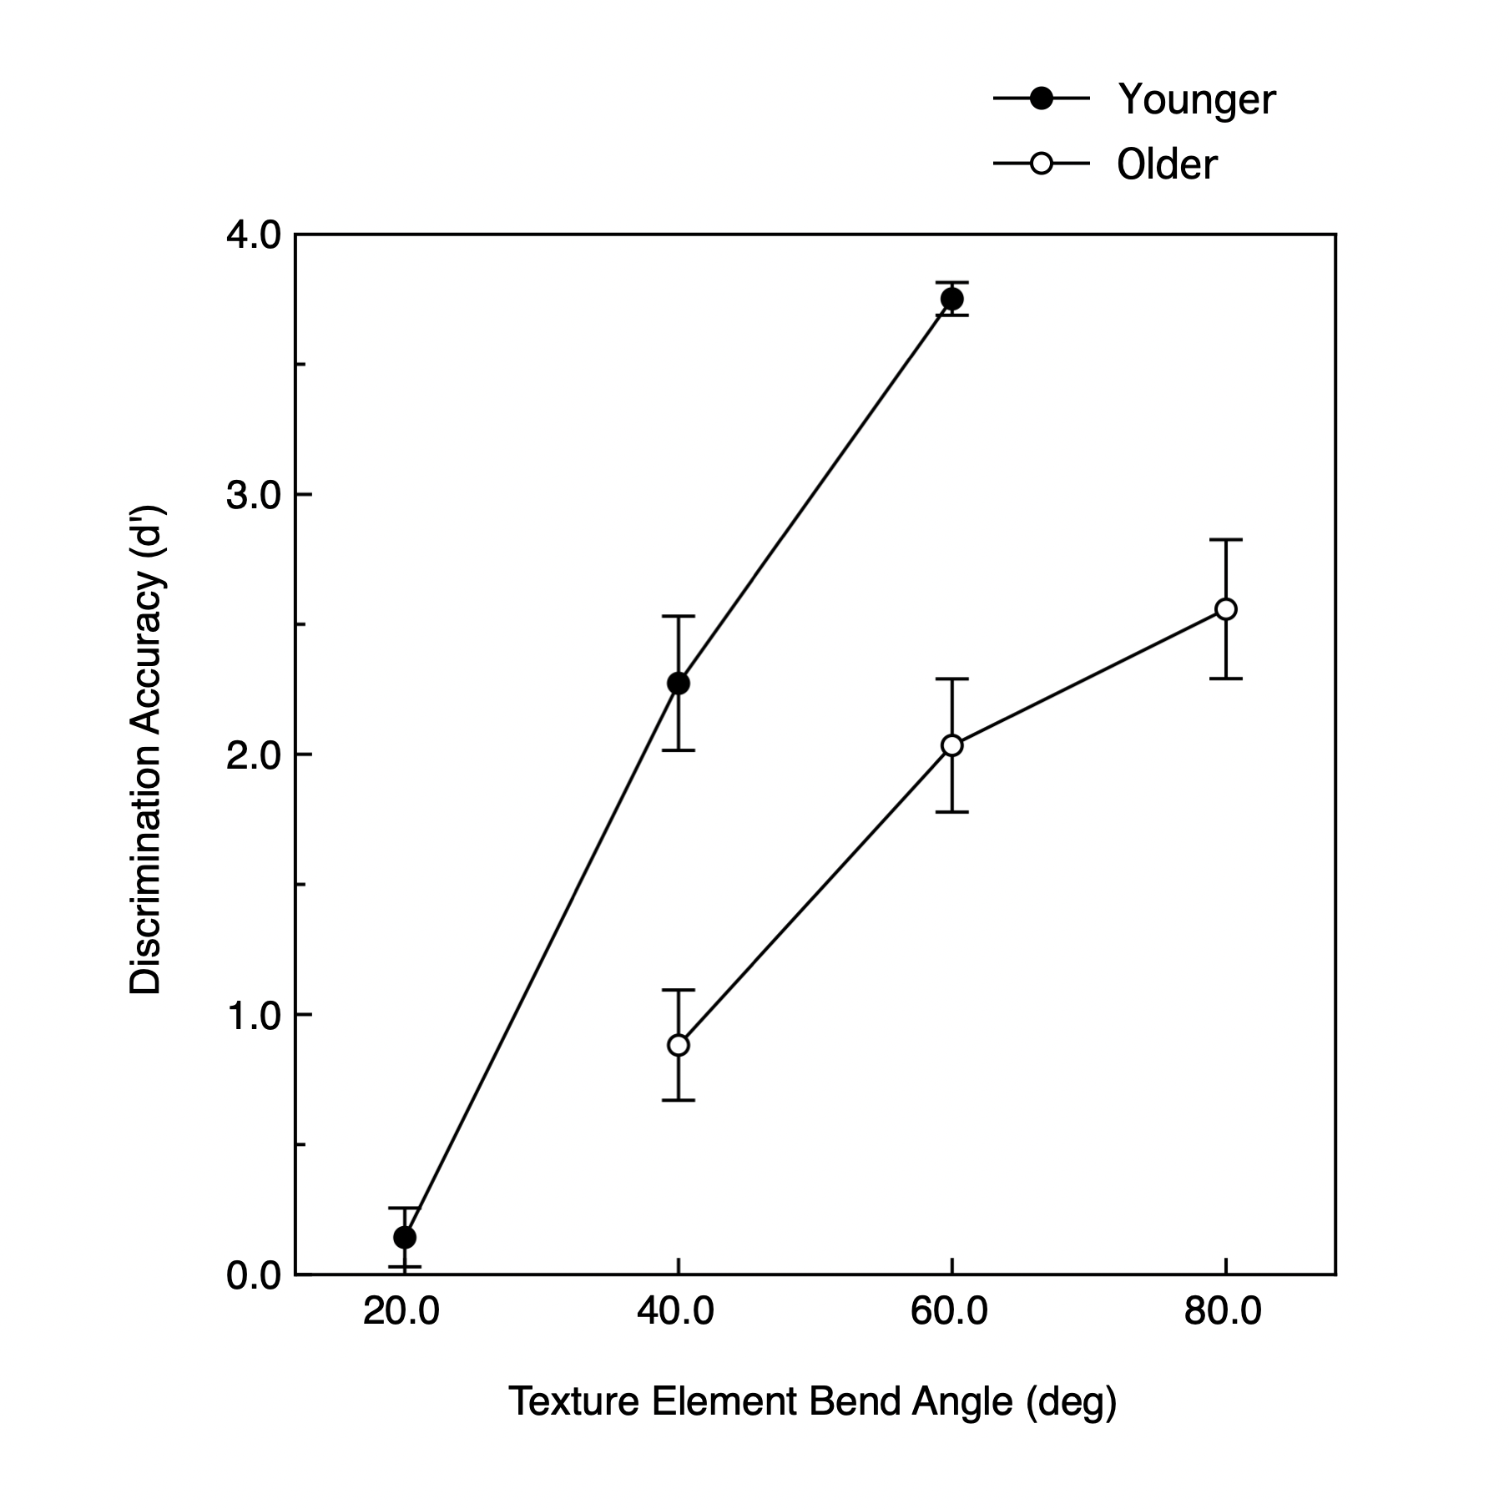
d’ values ranged from 0.0 – 4.0, 0 being guessing, and 4 being certain
Older adults showed about twice as less accuracy

Slide 19
04
Discussion

Slide 20
Why does it matter?
Proves degradation of essential visual skill
Future research might focus on solutions
Shape discrimination is necessary for day-to-day functioning
How might we pinpoint textural perception to a certain part of the brain and further study it

Slide 21
Thanks!
Please keep this slide for attribution

Slide 22
References
Norman, J. F., Sanders, K. N., Shapiro, H. K., & Peterson, A. E. (2020). Aging and the Perception of Motion-Defined Form. Perception, 49(1), 52–60. https://doi.org/10.1177/0301006619887331
Victor, J. D., Conte, M. M., & Chubb, C. F. (2017). Textures as Probes of Visual Processing. Annual Review of Vision Science, 3(1), 275–296. https://doi.org/10.1146/annurev-vision-102016-061316
Julesz, B. (1980). Spatial Nonlinearities in the Instantaneous Perception of Textures with Identical Power Spectra. Philosophical Transactions of the Royal Society of London. Series B, Biological Sciences, 290(1038), 83-94. Retrieved October 31, 2020, from http://www.jstor.org/stable/2395418
Julesz, B., Gilbert, E. N., Shepp, L. A., & Frisch, H. L. (1973). Inability of Humans to Discriminate between Visual Textures That Agree in Second-Order Statistics—Revisited. Perception, 2(4), 391–405. https://doi.org/10.1068/p020391
Caelli, T., Julesz, B. On perceptual analyzers underlying visual texture discrimination: Part I. Biol. Cybernetics 28, 167–175 (1978). https://doi.org/10.1007/BF00337138

