Slide 1
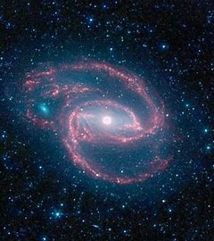

RX J1117.1+65 22
A Narrow-Line Seyfert 1 Galaxy with strong variability
Presentation by: Hunter Hayden
Institution: Morehead State University
Research Professor: Dr. Dirk Grupe

Slide 2
What is an AGN?
Active Galactic Nuclei
- Black Hole

Slide 3
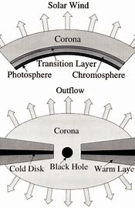
Accretion Disk Corona
Accretion disk has corona like the sun
Inverse Compton scattering

Slide 4
The Source: RX J1117
Narrow Line Seyfert 1
Discovered during ROSAT sky survey
Highly Variable

Slide 5
Fe2 and Optical Spectrum

Slide 6
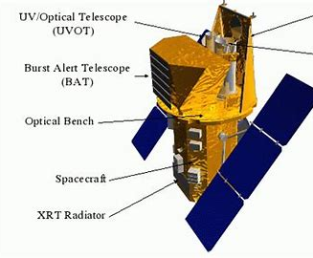
Swift
Satellite that can be on target swiftly
Simultaneous measurements

Slide 7
Spectral Energy Distribution Plot
Energy over a frequency
Notice red and blue lines

Slide 8
Swift Variability
3 sources with increasing luminosity
Left: MKN 335
Middle: RX J1117.1
Right: PG 1211+14
More luminosity= steeper αOx.

Slide 9
XRT and UVOT data
Light Curves obtained from Swift
Top is X-Ray data and bottom is UV and X-Ray spectrum.
Brighter in UV= brighter in X-Ray

Slide 10
Summary
RX J1117 is a highly variable narrow line Seyfert 1 galaxy.
The variability can be expressed by the accretion disk corona weakening and coming back after outflows of narrow line seyfert 1
Future Progression: Analyze source further and see of any drastic variability occurs

Slide 11
Sources
Beckmann, Volker. “Inverse Compton Scattering.” Longair_Radiation3.Pdf, eud.gsfc.nasa.gov/Volker.Beckmann/school/download/Longair_Radiation3.pdf#:~:text=Inverse%20Compton%20scattering%20involves%20the%20scattering%20of%20low,photons%2C%20the%20opposite%20of%20the%20standard%20Compton%20effect.
Grupe, Dirk, et al. “The Simultaneous Optical-To-X-Ray Spectral Energy Distribution Of Soft X-Ray Selected Active Galactic Nuclei Observed By Swift.” The Astrophysical Journal Supplement Series, vol. 187, no. 1, 2010, pp. 64–106., doi:10.1088/0067-0049/187/1/64.
Mary. Seyfert Galaxies, archive.stsci.edu/hut/papers/afdscirev_b/node9.html.

