Slide 1
The Effects of Hydrogen on Hemp Growth in Western Kentucky
Alexandria Riddle

Slide 2
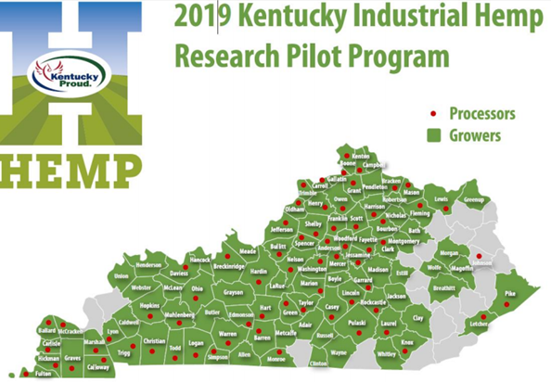

Slide 3
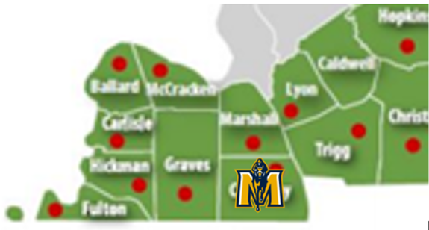

Slide 4
Introduction to Study
Significance:
New Innovation
Benefits
Purpose:
Growth
Production
Cannabinoid development
Problem:
Lack of Research

Slide 5
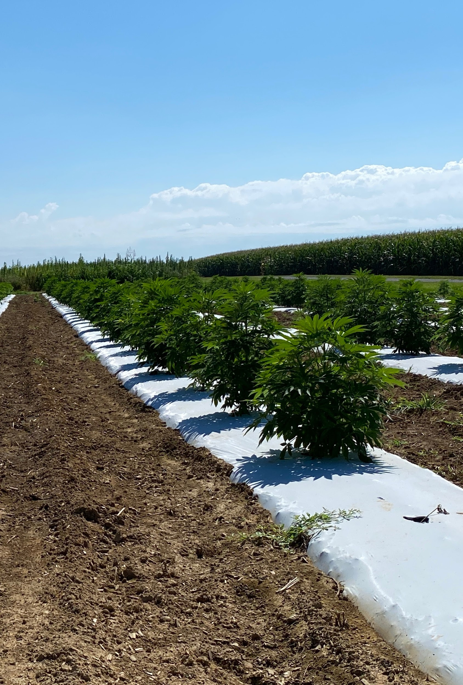
Research Details
12 rows
Transplanted July 16, Harvested October 13

Slide 6
Treatments
Control (n=40): Municipal Water
Treatment 1 (n=40): Municipal H2O, Nanobubbles H2
Treatment 2 (n=40): Municipal H2O, Regular H2

Slide 7
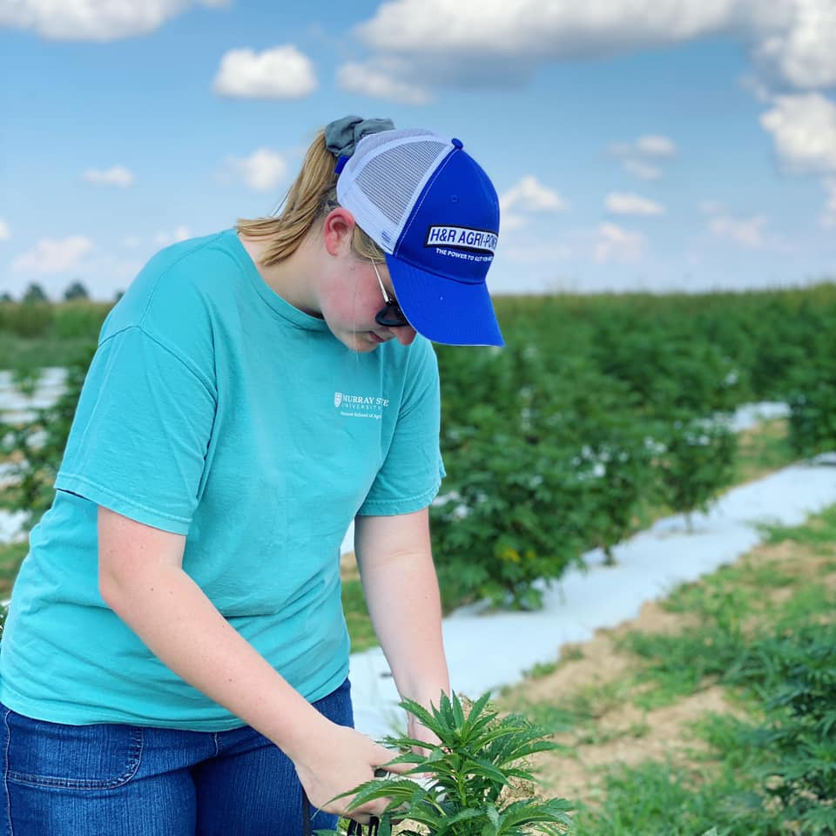
Procedures
Height
Chlorophyll
True Leaf Count

Slide 8
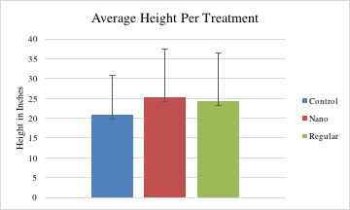

Slide 9
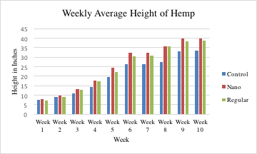

Slide 10
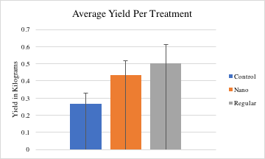

Slide 11
Conclusions
Treatments averaged more growth
H2 could become an incentive for farmers needing higher yield
Drawback: Need more research

Slide 12
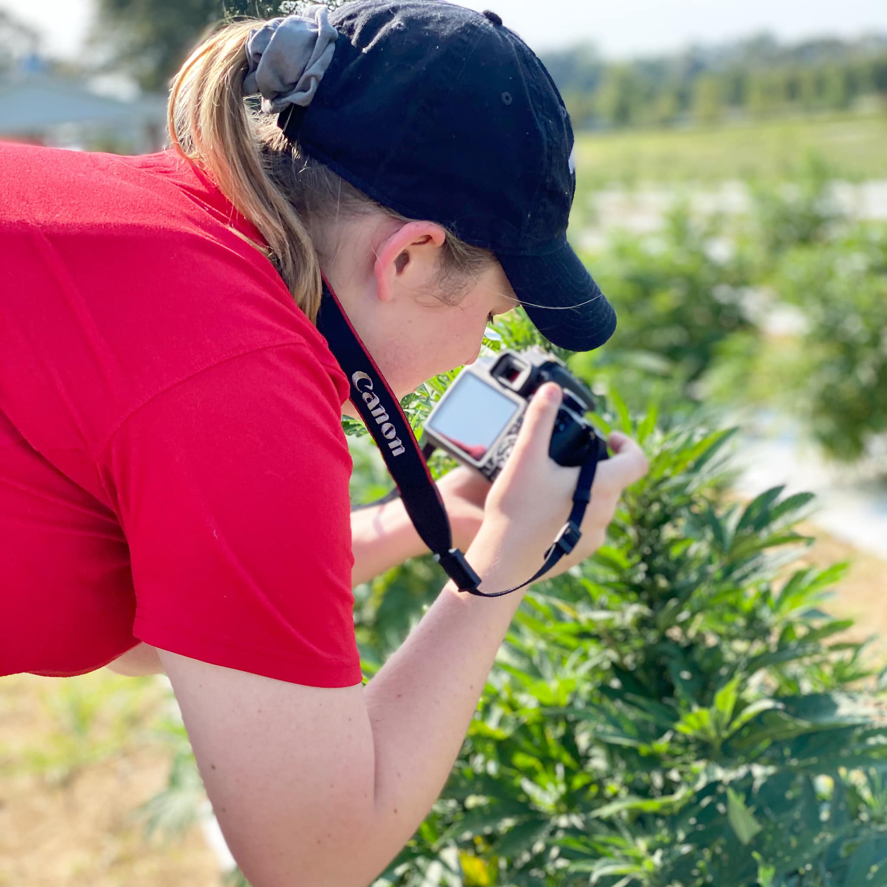

Slide 13
Acknowledgement
Mallorie Snider- Murray State University Center for Agricultural Hemp- Research Coordinator
Bhavesh Mudupu- Murray State University- Graduate Student
Waqas Ahmad- Murray State University- Graduate Student
Dr. Brian Parr- Murray State University Hutson School of Agriculture- Assistant Dean
Dr. Ian Handayani- Murray State University- Professor of Soil Science

