Slide 1
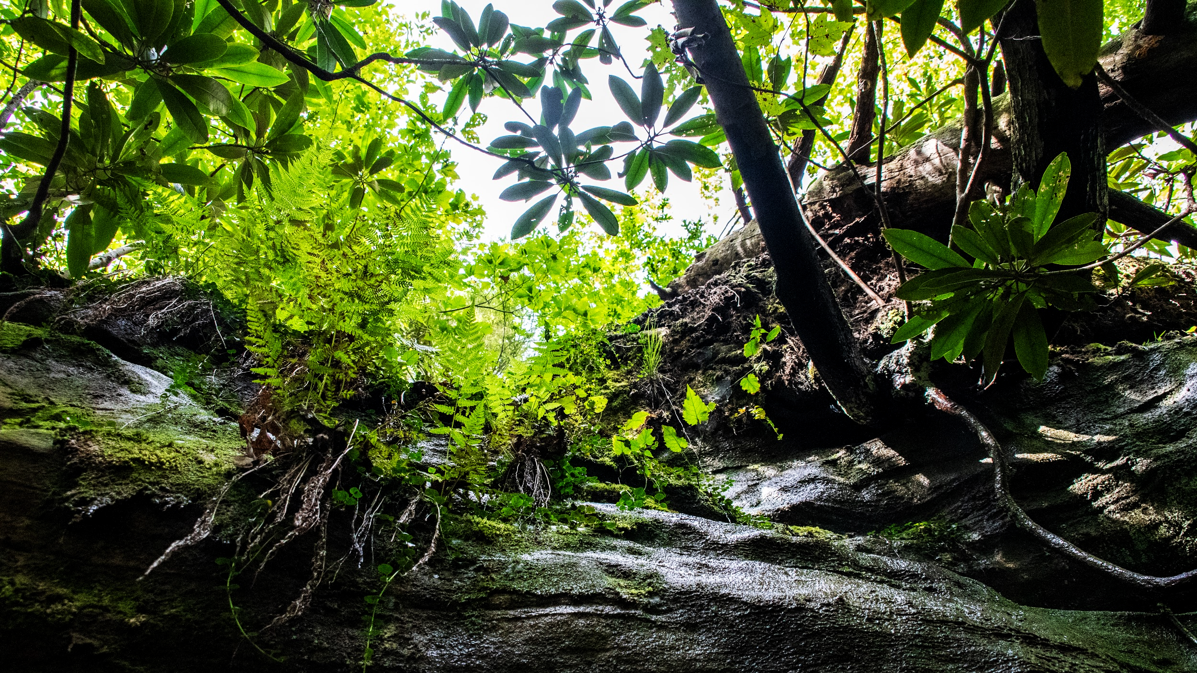
Impacts of Urban Reforestation on Bird Abundance and Diversity
Sabrina Jacobs, Kailey Jensen, John Cox, and Kenton Sena

Slide 2
Reforestation and Restoration Ecology
Restoration Ecology:
The scientific study supporting the practice of ecological restoration, which is the practice of renewing and restoring degraded, damaged, or destroyed ecosystems and habitats in the environment by active human intervention and action.
Reforestation:
Reforestation is a generic term for replanting trees in a specific area with various goals, including ecological restoration.
Why this matters to us:
Reforest the Bluegrass has begun the process of ecological restoration within the sites in the greater Lexington area.

Slide 3
Reforest The Bluegrass
Reforest the Bluegrass has been helping Lexington's urban forests increase in size and overall health since 1999. The program is led by the City of Lexington with the goal to protect the city's watershed and increase the overall tree canopy (City of Lexington).
Over 150,000 tree seedlings have been planted
Over 195 acres of floodplains have been restored
More than 17,500 volunteers have been involved
Higher bird populations may be expected in these areas, as some birds may prefer urban reforested areas (Leston and Rodewald 2006).

Slide 4
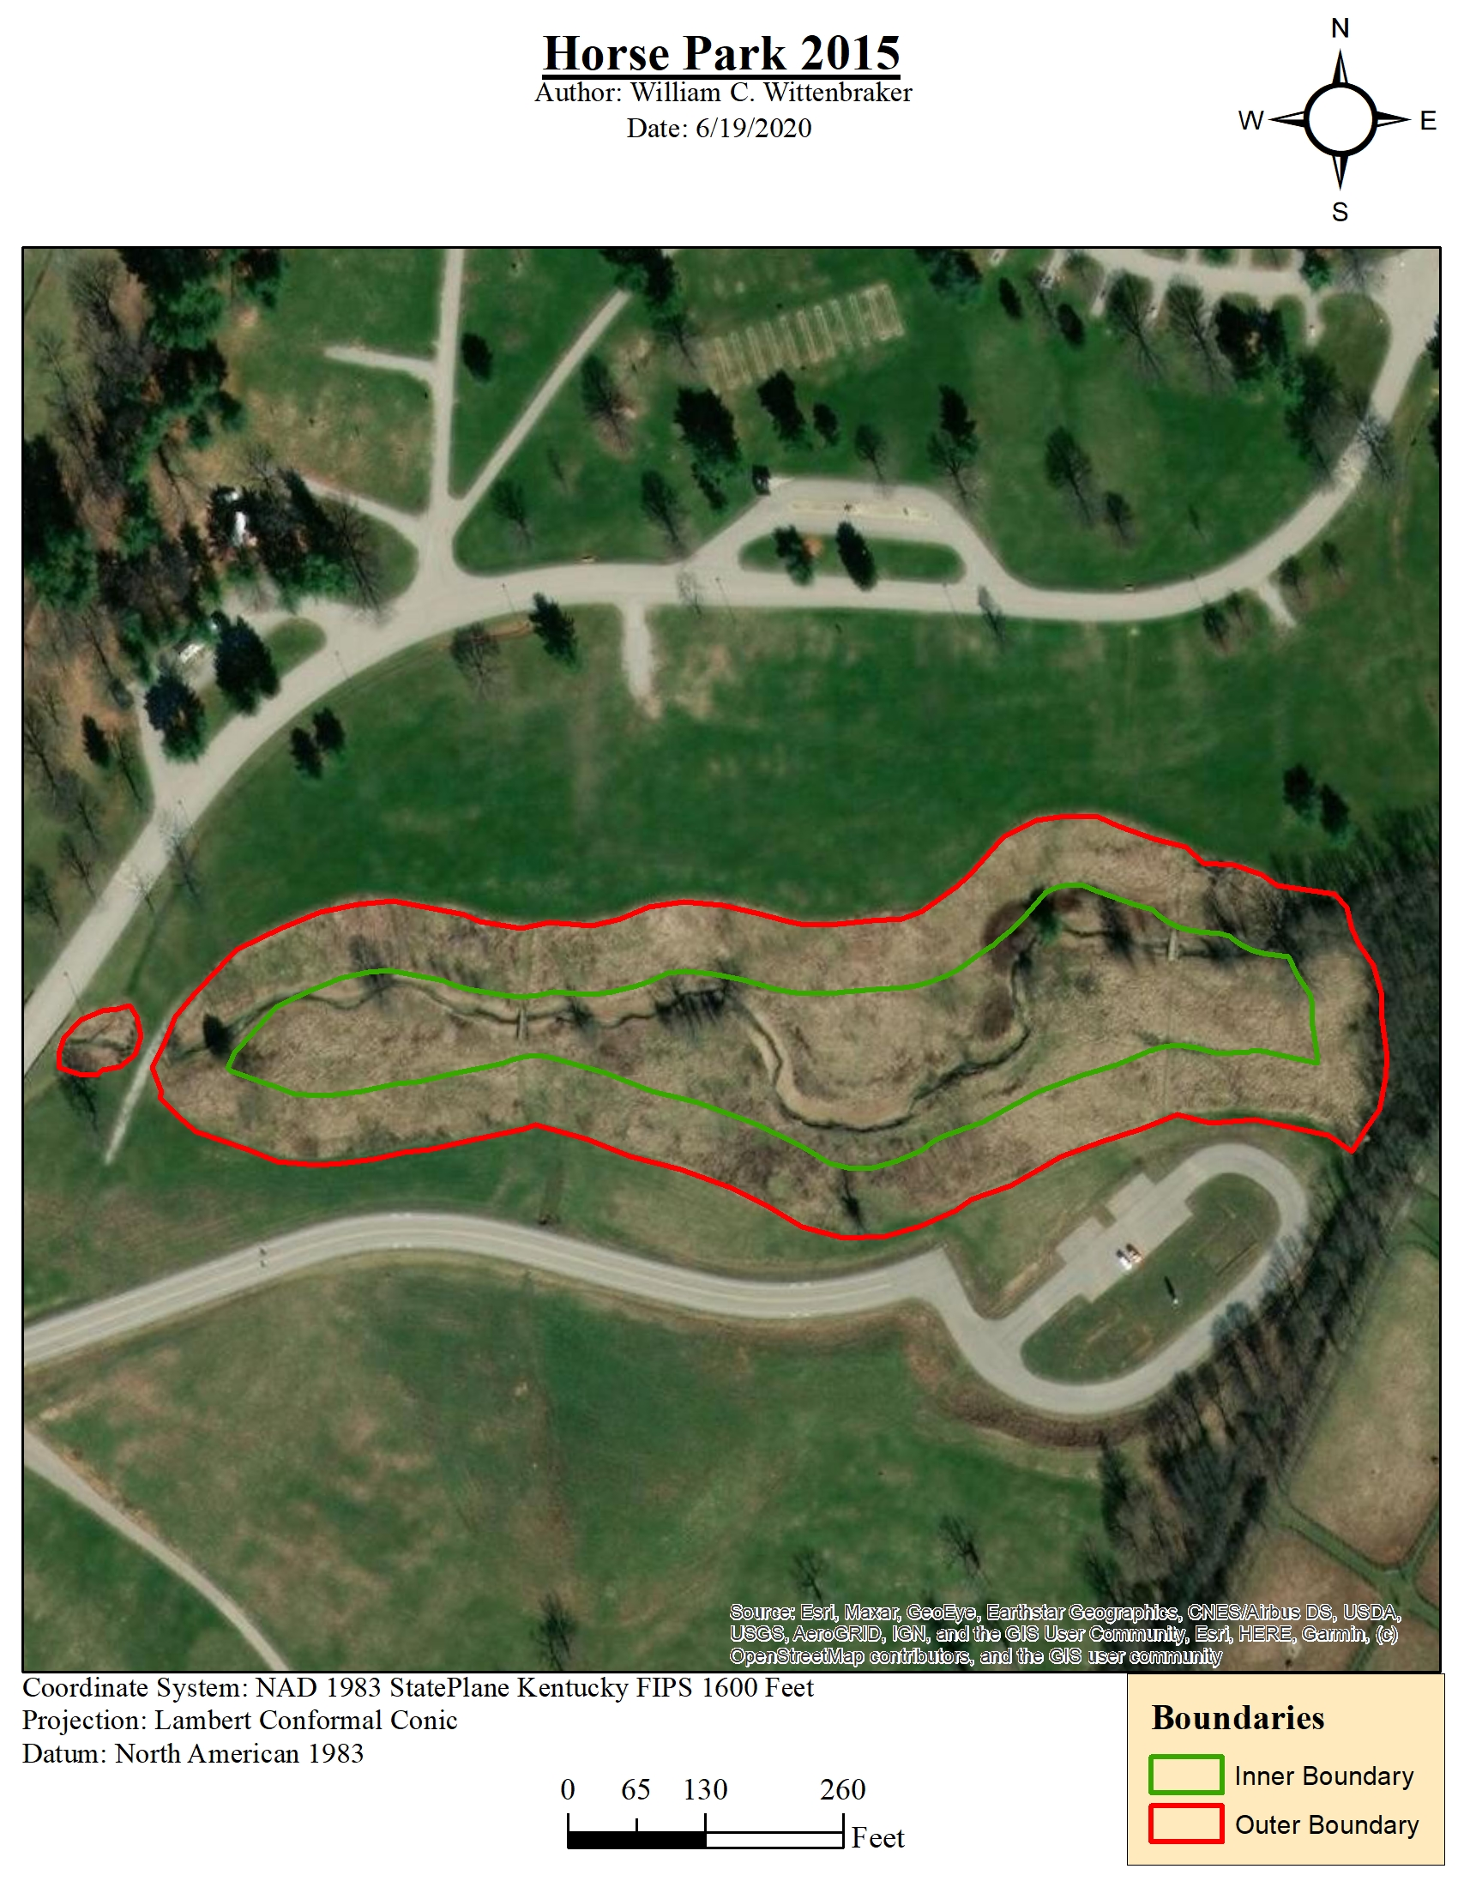
Project Overview
Over the summer of 2020, we monitored overall bird activity at several of the Reforest the Bluegrass sites to characterize the relationship between the age/overall health of the reforested sites and bird abundance/diversity.
Notes:
Reforest the Bluegrass contains # sites that are habitat islands surrounded by an urban matrix

Slide 5
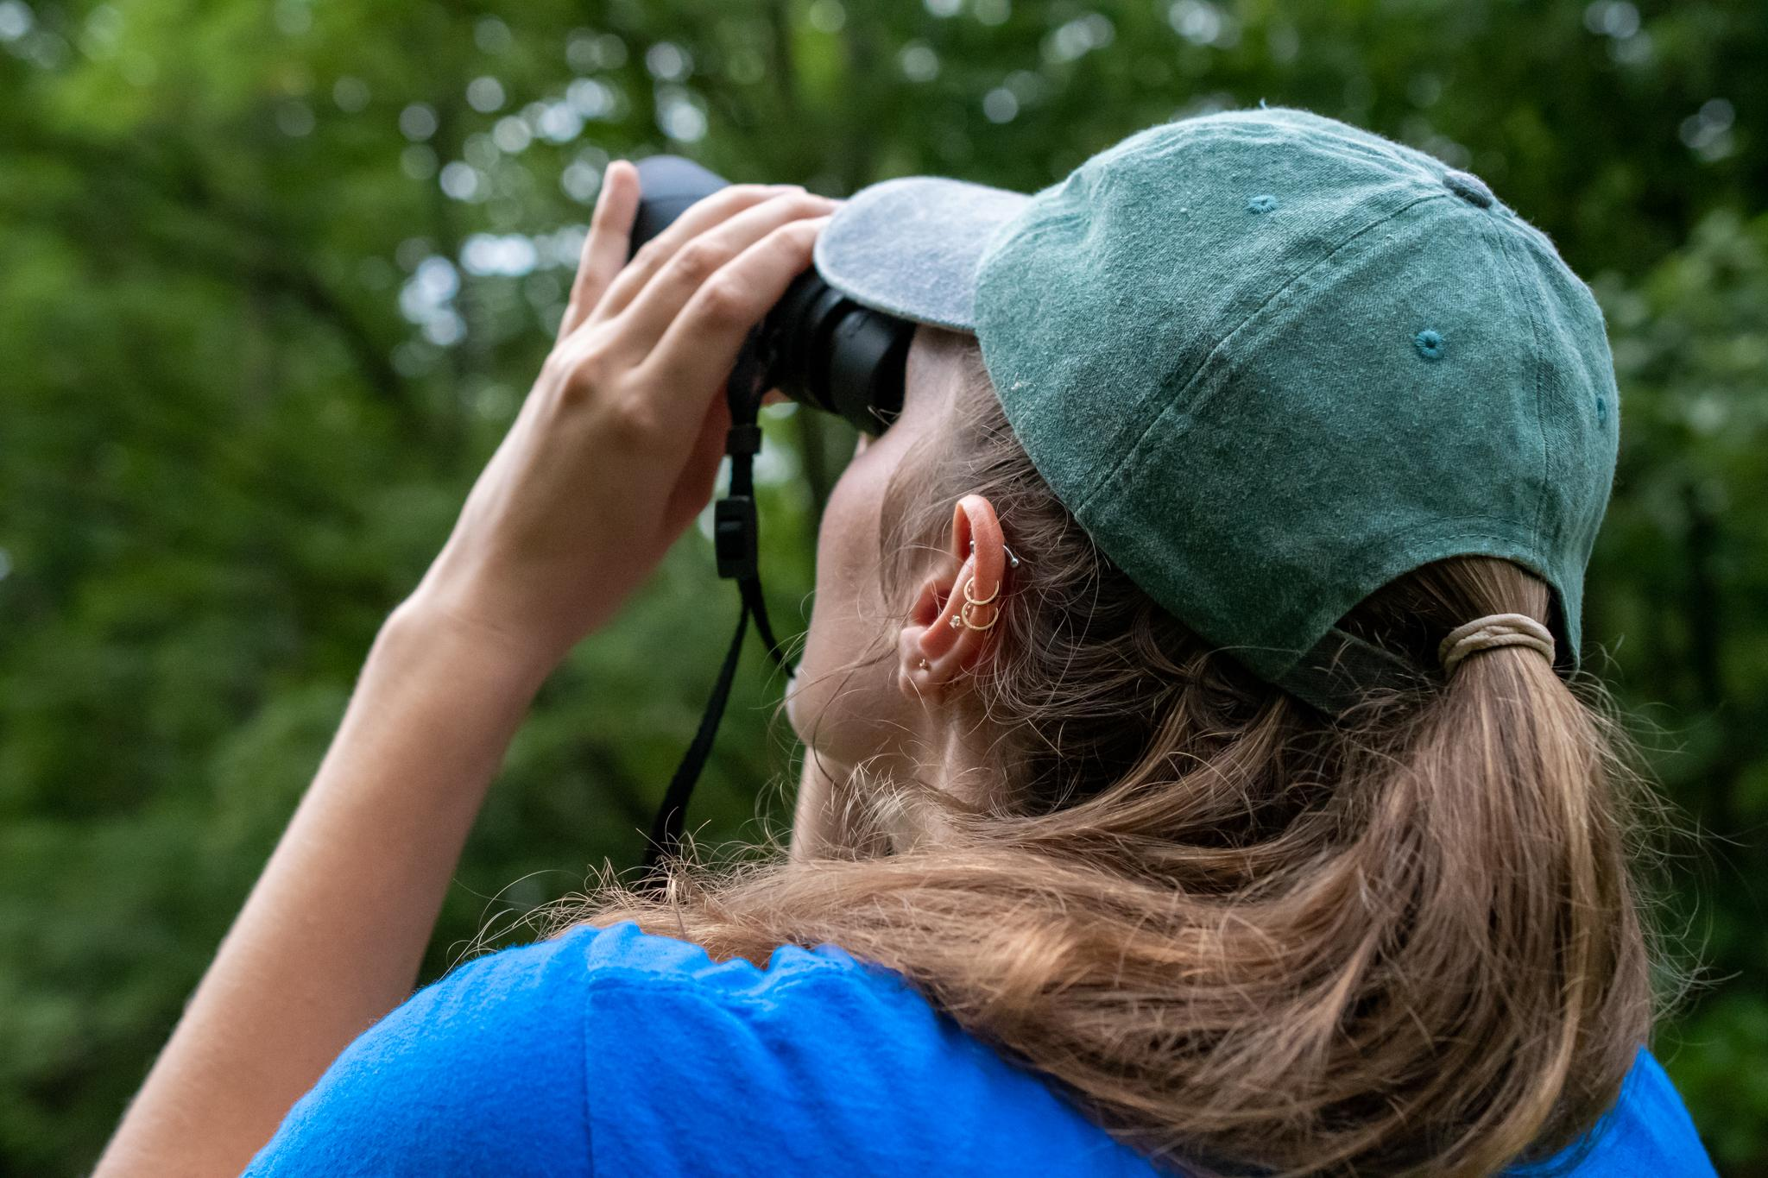
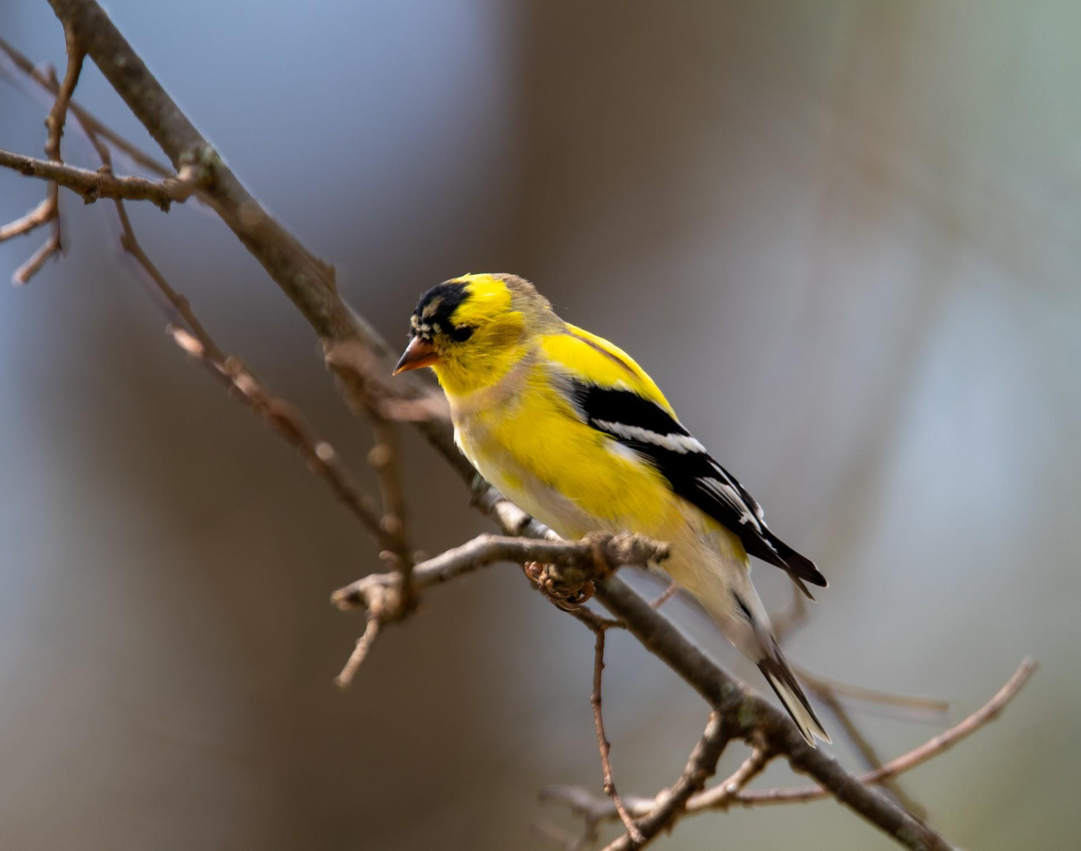
Methods
Bird abundance and species richness were quantified at three patches within each of twenty reforested sites using ten minute point count surveys. 20 sites were surveyed using observations of 100 meters.
From these observations, species richness and the Shannon diversity index were calculated to give comparison between smaller and larger sites, as well as older and newer.

Slide 6
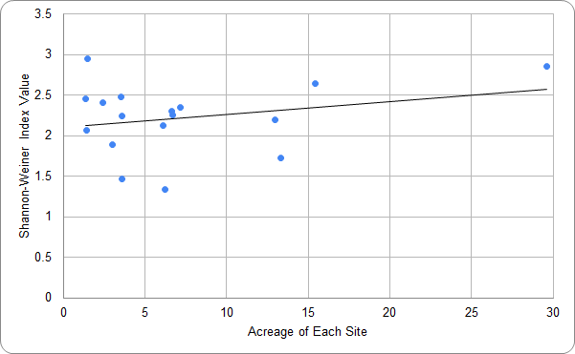
Results
Birds have a slight preference for the aged, larger sites in comparison to the younger, smaller sites.
Species Richness calculations ranged from 4-21 species per site. Quantity of individuals per site ranged from 12-31 birds per site.
Figure 1. Avian diversity shown through the Shannon-Weiner Index H value compared to the acreage of each site. ​

Slide 7
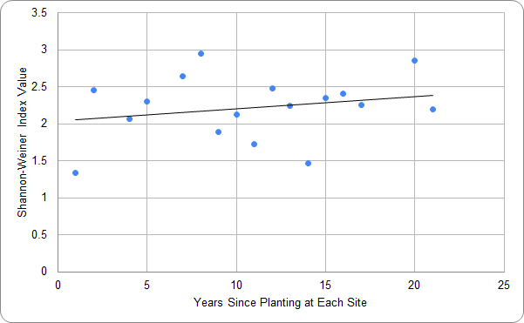
Figure 2. Avian diversity shown through the Shannon-Weiner Index H value compared to the years since planting at each site. ​

Slide 8
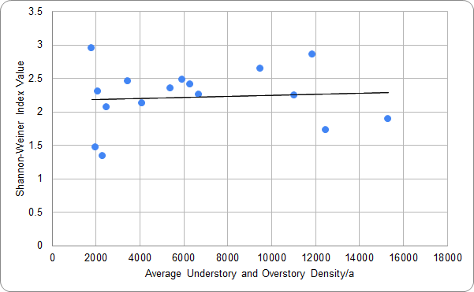
Figure 3. Avian diversity shown through the Shannon-Weiner Index H value compared to the average understory and overstory stem density/ha of each site. ​

Slide 9
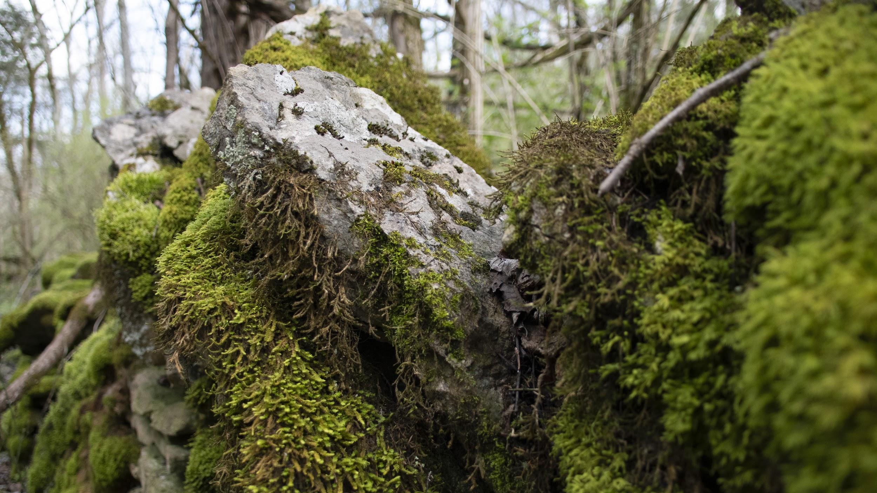
Discussion
These preliminary results suggest that reforested sites that barely had an overstory or smaller sites had a lower bird species diversity and lower total abundance of individuals.
Older sites that were more developed with a closed canopy and/or larger sites had higher species diversity and greater overall abundance.
Hence, our data suggest that reforested sites may improve in quality and become more valuable to birds over time.

Slide 10
Relevant Literature
There was a positive influence between patch size and bird diversity. Remnant patches with low human disturbance had higher rates of diversity over reforested patches with a lot of human disturbance. Vegetation and connectivity of a patch were also positively related to bird species richness and abundance. (Kang et al 2015)

Slide 11
Relevant Literature
Planting native and exotic species that provide food outside the usual seasonal period may benefit urban birds by extending the availability of food and reducing the need for birds to use anthropogenic food sources or feeders, which can alter community composition, spread disease and increase predator/competitor populations. (Gray and Van Heezik, 2016)
Removal of invasive shrub species may also affect other wildlife species. For example, bats were negatively associated with shrub density in this study, but many bird species select habitats with higher shrub densities for nesting and protection from predators. (Smith and Gehrt, 2009)

Slide 12
Relevant Literature
Habitat quality might be maintained or improved if the removal of the exotic understory plants was accompanied by restoration of native shrubs. Other studies have demonstrated that honeysuckle can act as an ecological trap for shrub-nesting songbirds. (Schneider and Miller, 2014)
If native shrubs cannot be reestablished, thinning the understory would likely be more beneficial to the entire avian community than complete clearing of understory vegetation. (Schneider and Miller, 2014)

Slide 13
Acknowledgements
Acknowledgements:
John Saylor – Senior Program Manager at LFUCG
Heather Wilson – Municipal Arborist at LFUCG
Funding for this project was provided by a University of Kentucky Sustainability Challenge Grant

Slide 14
Questions?
Sabrina Jacobs - sabrina.jacobs@uky.edu Kailey Jensen - klje226@uky.edu

Slide 15
Works Cited
City of Lexington. 2020. Reforest The Bluegrass At Home. [online]
Gray, Emily R, and Van Heezik, Yolanda. "Exotic Trees Can Sustain Native Birds in Urban Woodlands." Urban Ecosystems 19.1 (2016): 315-29. Web.
Effects of habitat structure, human disturbance, and habitat connectivity on urban forest bird communities. Urban Ecosystems. 18:857-870
Leston, Lionel F.V, and Rodewald, Amanda D. "Are Urban Forests Ecological
Traps for Understory Birds? An Examination Using Northern Cardinals." Biological Conservation 131.4 (2006): 566-74. Web.
Schneider, Sarah C,. Miller, James R. Response of avian communities to invasive vegetation in urban forest fragments. 2014. The Condor. Vol. 116, No. 3 (August 2014), pp. 459-471
Smith, Debra A, Gehrt, Stanly D. 2009. Bat Response to Woodland Restoration within Urban Forest Fragments. Restoration Ecology Vol.18, No.6, pp. 914–923

