Slide 1
Effects of additives on the lipid oxidation of fish mince from Asian Carp
Lingyu Huang, and Changzheng Wang*
College of Agriculture, Communities and the Sciences, Kentucky State University, Frankfort, KY 40601
Nov. 6, 2020

Slide 2
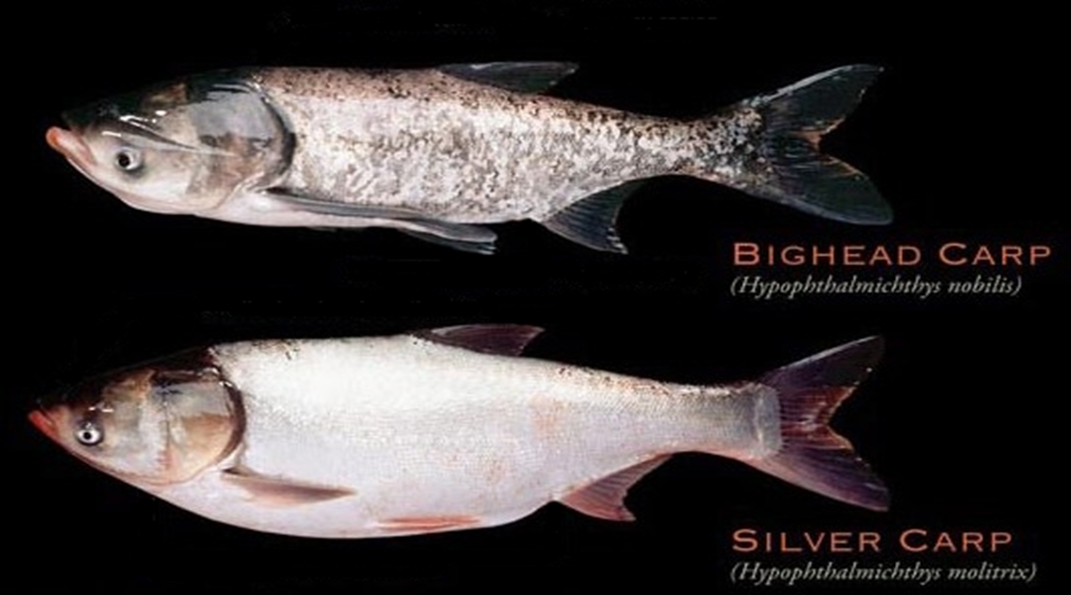
Asian carp is a catchall name for the four species of fish from Southeast Asia:
Introduction
Silver;
Bighead;
Grass;
Black carp.
Two Asian Carp species in Kentucky

Slide 3
Asian carps:
Introduction
Invasive species;
No natural predators in North America;
Account for 97% of the biomass in portions of the Illinois and Mississippi Rivers;
Need to be reduced or eliminated.

Slide 4
Asian carps have
Introduction
Intramuscular bones;
Problems to obtain boneless fillets form;
Almost no consumers in North America.
Deboned Asian carp meat can be processed into gel-based products such as
Meatballs;
Sausages;
Other value-added food products.

Slide 5
Introduction
Any delay in processing fish meat may result in oxidative damages;
Polyunsaturated fatty acids in Asian carp meat are highly susceptible to oxidation;
Lipid oxidation can be monitored by the measurement of thiobarbituric acid reactive substances (TBARS) with malondialdehyde (MDA) as the standard.

Slide 6
Hypothesis
There is a growing interest in using natural ingredients rich in antioxidants in the protection of food products;
Flavoring ingredients such as powdered ginger, sage and rosemary have natural antioxidants;
The natural ingredients might also reduce the lipid oxidation and reduce the degradation of Asian Carp meat or mince.

Slide 7
Objective
To determine the effects of natural flavoring ingredients on the lipid oxidation in deboned Asian carp meat.

Slide 8
Materials
Asian carps were captured from Mississippi River (Two River Fishery, Inc., Wickliffe, KY). Fish mince was prepared from Asian carp by deboning through 3 mm orifice;
Fish mince was mixed with cryoprotectants (40 g of sucrose, 40 g of sorbitol, and 3 g of tripolyphoshate per Kg) or natural ingredients (powdered ginger-G, sage-S and rosemary-R) at 0.5 %, 1%, and 2%, as G1, G2, G3, S1, S2, S3, R1, R2, and R3 represented, respectively;
Fish mince with no additives was used as the control;
Samples of Asian carp mince were mixed with certain amount of ingredients by a blender (Kitchen Aid KSM75WH) with speed setting of 4 for 30 minutes.

Slide 9
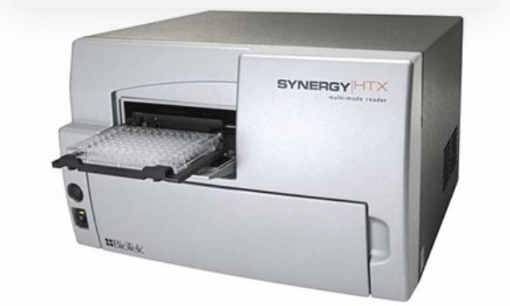
Methods and Instrument
Lipid oxidation can be monitored by the measurement of thiobarbituric acid reactive substances (TBARS) with malondialdehyde (MDA) as the standard;
TBARS values were measured with BioTeK Synergy™ HTX Multi-Mode Microplate Reader;
The samples were stored in freezer at -20⁰C for one month. After the frozen samples were taken out and softened at room temperature, then they were stored in ice cooler for the TBARS measurement.

Slide 10
Thiobarbituric acid reactive substances (TBARS) values in Asian carp meat with or without added natural ingredients*
Results
TBARS
*Natural ingredients: G-Ginger, S-Sage, R-Rosemary (G1, G2, G3; S1,S2,S3; and R1, R2, R3. The number means 1: 0.5%, 2: 1%, and 3: 2%)
Notes:
During refrigerated storage, the TBARS values of the fish mince increased from 0.013 increased to mg 0.048 MDA/kg after 16 days (Control group) and from 0.014 to 0.039 mg MDA/kg (Cryoprotectant group), respectively.

Slide 11
Summary
TBARS value increased steadily over time for Asian carp meat not mixed with any natural ingredients;
TBARS value stayed very lower and did not increase over time indicating lipid oxidation was inhibited by components of the natural ingredients;
No significant differences were observed among the natural ingredients used.

Slide 12
Flavoring ingredients such as ginger, sage or rosemary powders may be used to help to maintain the quality of fish mince from Asian carp during storage.
Conclusion

Slide 13
Thanks!
End of the presentation

