Slide 1
Effect of phytogenic and symbiotic feed additives on performance of pastured broiler chickens
Frederick N. Bebe*¹, Ibukun M. Ogunade², Steven T. Skelton¹, Jerusha Lay¹ and Emily Clement¹
¹College of Agriculture, Community and the Sciences, Kentucky State University Frankfort, KY 40601
²College of Agriculture and Natural Resources, West Virginia University Morgantown, WV 26506

Slide 2
Introduction
Pastured poultry is practice of raising chickens in open bottom pens placed directly on pasture with little or no confinement (Padgham, 2006).
Pastures can provide vegetation, insects, and worms that give sufficient nutrients to replace at least 10% of their prepared diets, enhancing the quality of meat and egg (Burbaugh al., 2010).
Pasture poultry production has become very popular in Kentucky due to good consumer demand, creating supplemental income on limited resource small family farms (Ennis et al., 2008)
Poultry is the number one agricultural commodity in KY and responsible for about 20% of all farm receipts (KY Poultry Ind. Facts).

Slide 3
Introduction
To satisfy increasing demand, nutritional strategies employed by commercial operators to replace antibiotic use ought to be adopted, as viable alternatives.
These include natural growth promoters such as Phytogenics and Synbiotics
Phytogenics – herbal extracts and other preparations of plant origin that function to improve the gut environment, immune function and nutrient digestibility (Mountzouri et al., 2009)
Synbiotics (prebiotics + probiotics) – Prebiotic are non-digestible substances, while probiotics are single or combination of bacteria or yeast. These stimulate growth of beneficial bacteria and prevent GI pathogen adherence (Collins et Gibson, 1999; Nasir and Grashon, 2010: Panda et al., 2006).

Slide 4
Introduction
No studies have examined the potential of phytobiotics and symbiotics for improving the growth performance of poultry in a pasture-based production system, unlike intensive productions systems where positive results have been obtained.
Therefore use in pastured poultry is expected to demonstrate better outcome in growth performance to benefit small-scale limited resource poultry farmers in KY.
Objective:
To investigate efficacy of dietary supplementation of a commercially available phytogenic and symbiotic on performance pasture-based broilers.

Slide 5
Materials and Methods
Day old Cornish Cross chicks, divided into 3 groups and fed regular 19% CP chicken diet (Control)
Diets were supplemented according to manufacturer’s recommendation
- phytogenic (Control-P) at 125mg/kg diet
- symbiotic (Control-S) at 500mg/kg diet
After 2 weeks of acclimation, birds blocked by weight and randomly allocated to dietary treatments in triplicates (45/group; 15/replicate)
Pastured on bottomless pre-fabricated carports in defined replicates
Carports moved to fresh pastures daily, with free access to feed and water
FI and BW measured daily and weekly, respectively

Slide 6
Materials and Methods
Sampling was done on Day 21 and Day 42 (21 birds from each treatment or 7 from each replicate)
Data were analyzed using GLIMMIX procedure of SAS.
Each replicate was considered an experimental unit and the model included the fixed effect of treatment.
Significant effect was declared at P ≤ 0.05, and tendencies were considered when 0.05 < P ≤ 0.10.

Slide 7
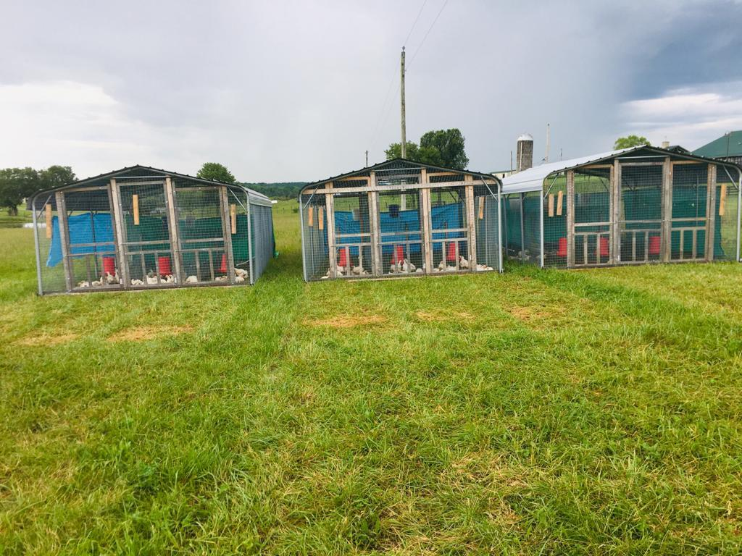
Figure 1. Broilers on pasture in pre-fabricated carports in defined replicates; moved to fresh pastures daily

Slide 8
Results and Discussion
The efficacy of dietary supplementation of phytogenics and synbiotics growth promoters on performance of pastured broilers was investigated.
Table 1. Effect of a phytogenic and symbiotic supplement on growth performance of broiler on pasture (Week 1-3)
Table 2. Effect of a phytogenic and symbiotic supplement on growth performance of broiler on pasture (Week 4-6).
 | CON | PHYT | SYNB | SE | P-value
Final Weight (kg) | 2.85ª | 2.59^{b} | 2.86ª | 0.11 | 0.01
Feed Intake (g) | 102^{b} | 105^{b} | 119ª | 6.23 | 0.05
ADG (g) | 137ª | 123^{b} | 137ª | 5.25 | 0.01
FCR | 0.74 | 0.85 | 0.87
 | CON | PHYT | SYNB | SE | P-value
Final Weight (kg) | 4.05ª | 3.49^{b} | 4.22ª | 0.23 | 0.01
Feed Intake (g) | 168^{b} | 169^{b} | 199ª | 10.7 | 0.01
ADG (g) | 193ª | 166^{b} | 201ª | 8.32 | 0.01
FCR | 0.87 | 1.02 | 0.99

Slide 9
Conclusion
The beneficial effects of phytogenics and synbiotics are well-documented in small and large-scale commercial poultry operations.
This preliminary study reports a lower FCR for the supplemented broilers groups compared to the control and significantly lower performance parameters for phytogenic supplementation.
Studies of broiler performance on pasture using these supplements are rare. Consequently, more studies are required to determine optimum concentrations and performance outcomes of phytogenics and synbiotics under pasture-based conditions.

Slide 10
THANK YOU
Questions?

