Slide 1
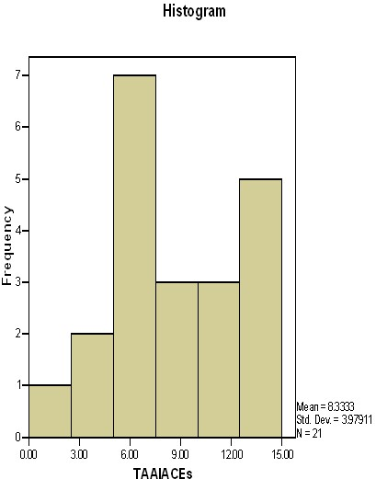
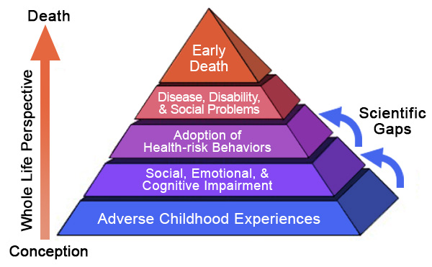
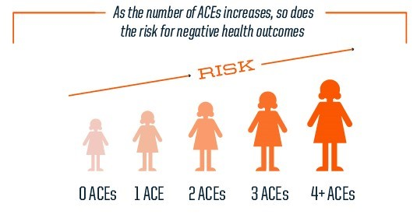
How parenting sensitivity is related to childhood trauma in parents and children Tiffany Hicks, Lauren Oldiges, Savannah Gillis, Ashley Hamm, Abigail McDevitt, & Dr. Shari Kidwell Department of Psychology, College of Science, Morehead State University
Introduction
Adverse Childhood Experiences (ACEs)
Traumatic and/or stressful early life experiences including:
One-time negative events
Maltreatment
Chronic stressors.
The most commonly reported ACEs are:
1) physical abuse
2) parental substance use &
3) parental separation/divorce
(Hays-Grudo & Morris, 2020).
Research has shown that as number of ACEs increases, so too does risk of heath complications and psychopathology (Hays-Grudo & Morris, 2020).
Parenting Sensitivity
Sensitivity is defined as a parent’s ability to notice a child’s signals, interpret them correctly, and respond to them promptly (Mesman, & Emman, 2013).
The CARE-index (Crittenden, 1981) measures caregiver sensitivity through assessing the ‘fit’ between caregiver and child (Mesman & Emman, 2013).
Research has shown maternal sensitivity is associated with child psychological vulnerability (Svanberg, Mennet, & Spieker, 2010).
Research has found a significant correlation between exposure to ACEs and parental distress, even after controlling for poverty (Steele et al. 2016).
Hypotheses
Parents with higher ACES exposure will be less sensitive to their children’s emotional cues.
Parents with higher ACES exposure will have children with higher ACES exposure.
Methods
Participants
17 families from Eastern Kentucky participating in a larger, longitudinal study on attachment
Age range: 16-18; Average age: 16.6
9 male, 8 female
Most were Caucasian and from low-income families
Measures
ACES
ACEs were coded from the Transition to Adulthood Attachment Interview (TAAI; Crittenden, 2005) by noting the presence of each ACE.
Parents also reported adverse life events for self and child on an expanded 55-item version of the Life Experiences Questionnaire (Cowen, Wyman, Work, & Parker, 1990).
Sensitivity
When children were 4 years old, they participated in the Strange Situation separation-reunion procedure (Ainsworth, Blehar, & Waters, 1978).
We coded parent-child synchrony from the procedure, using the Care Index:
Results
Number of TAAI ACEs ranged from 1 to 15 with an average of 8.33. The most common ACE among subjects was caregiver separation or divorce.
ACEs & LEQ Scores
There was a significant correlation between ACEs coded from TAAIs and parent-reported life experiences on the LEQ, as both are significant at p<.01.
ACEs & Sensitivity
Our hypothesis was not supported: there was no correlation between number of ACEs and parental sensitivity.
Discussion
As predicted, there was a significant correlation between parent and child ACEs. Also, ACEs coded from TAAIs and parent-report of child negative events were associated, suggesting that TAAI coding was fairly accurate in identifying ACEs that subjects were willing to report. Unfortunately, there was no significant correlation between number of ACEs and parental sensitivity. There are several possible explanations for this finding:
Some subjects may not have reported or discussed all ACEs.
Lack of correlation could be a result of low sample size and, consequently, low power of our analyses.
We may have a restriction of range in sensitivity scores, as 11 of 17 parents were rated in inept or high-risk ranges.
Future Directions & Implications
Finish coding for all 54 families at age 4.
Code TAAIs for teens’ attachment.
Explore how ACEs coded from TAAIs might relate to unresolved trauma or loss.
Expand training and services in early interventions to increase parental sensitivity and to prevent ACEs.
Selected References
Crittenden, P.M. (1981). The Care Index coding manual. Unpublished document.
Hays-Grudo, J., & Morris, A.S. (2020). Adverse and protective childhood experiences: A developmental perspective. Washington, DC: American Psychological Association Publishing.
Mesman, J., & Emman. R.A.G. (2013). Mary Ainsworth’s legacy: a systematic
review of observational instruments measuring parental sensitivity.
Attachment and Human Development, 15, 485–506.
Svanberg, P. O., Mennet, L., & Spieker, S. (2010). Promoting a secure
attachment: A primary prevention practice model. Clinical Child Psychology
and Psychiatry, 15, 363-378.
This project was funded by grants from MSU and NSF’s Kentucky EPSCOR program.
 | LEQ Child | LEQ Parent
_{ACEsTAAI} | 0.626** | 0.603**
 | Sensitivity
ACEs _{TAAI} | .02
ACEs child_{LE} | -.14
ACEs parent_{LE} | -.08
Risk Level | Scores | N
Adequate | 7-14 | 6
Inept | 5-6 | 6
High-Risk | 0-4 | 5

