Slide 1
An Evaluation of Open Burning Violations in Kentucky in 2019: Examining Contributing Factors
Major Ballard
Kentucky Energy & Environment Cabinet-
Department for Environmental Protection-Division for Air Quality

Slide 2
Background Information

Slide 3
What is Open Burning?
Open burning, also referred to as backyard burning, is defined as the residential burning of household trash on one’s own property (United States Environmental Protection Agency, 2020).

Slide 4
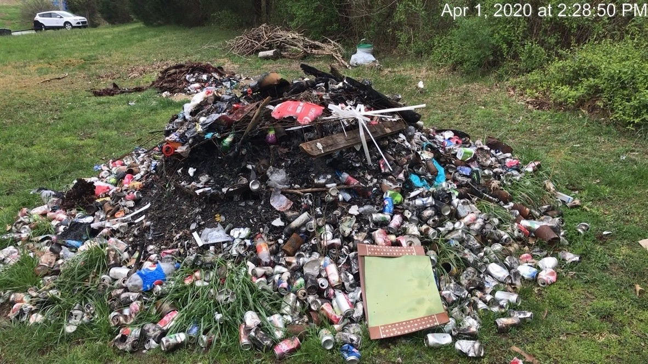

Slide 5
Why is it harmful?
Air Quality – releases various pollutants(PM, CO, NOx, VOC, Dioxin/Furans, Heavy Metals, etc.) into the air and can impact ground level ozone¹.
Water & Soil Quality – chemicals and heavy metals in the smoke can settle into surface water, plants, soils and the food chain¹.
Human Health – smoke from open burning impacts the central nervous system and is especially harmful to children, the elderly, and others with respiratory ailments¹.

Slide 6
Title 401 KAR 63:005
Open Burning in Kentucky is prohibited.
Allowable exceptions: natural growth & brush, camp fires, ceremonial bonfires, cooking, construction site warming, and prescribed land clearing.
Does not apply to counties deemed non-attainment during ozone season (May-September).

Slide 7
Title 401 KAR 63:005
Prohibited Open Burning: construction materials, household garbage, treated lumber, and miscellaneous materials like plastics, rubber, metals, glass, and coated paper.

Slide 8
How DAQ responds to Open Burning
Receive complaint and property address.
Enter information into complaints database.
Site visit generally within 3-5 working days.
Investigation of burn site.
Depending on the findings, a Violations Documented, Letter of Warning (LOW) or Notice of Violation(NOV) may be issued.

Slide 9
Current Study

Slide 10
Objectives
Obtain data on open-burning violations received by KY DAQ in 2019
Aggregate records by county
Match records with Census measures of average socio-economic status (SES)
Analyze violations by county and produce maps to display results
Conduct bivariate analysis on violations and SES measure

Slide 11
Research Questions:
What are the contributing factors to open-burning violations?

Slide 12
Data
DAQ Data on Open Burning Violations in 2019.
American Community Survey Income and Poverty Data 2018
Measures of poverty and median household income
Shapefiles for GIS Analysis
County boundaries
Locations of landfills

Slide 13
Methods and Analyses
Clean DAQ data to compile dataset
Obtain shapefiles for Kentucky counties and locations of landfills
Create geodatabase in ArcGIS Pro with DAQ data, landfills, and county lines
Analyze Violations by County
Begin to look at the bivariate relationship between Violations and Median Household Income

Slide 14
Findings

Slide 15
Violations
Out of 527 complaints that DAQ received in 2019, 294 were issued NOVs, LOW, or violations documented.
Number of Violations by County*:
Range: 1-24 violations
Mean: 3.34 violations
33% of counties had 1 violation each
Five counties had highest number of violations: Fleming (24), Ohio (12), Warren (11), McCracken (11), Daviess (10)
*Out of 120 counties in Kentucky only 88 had a violation, DAQ does not respond to complaints in Jefferson County

Slide 16
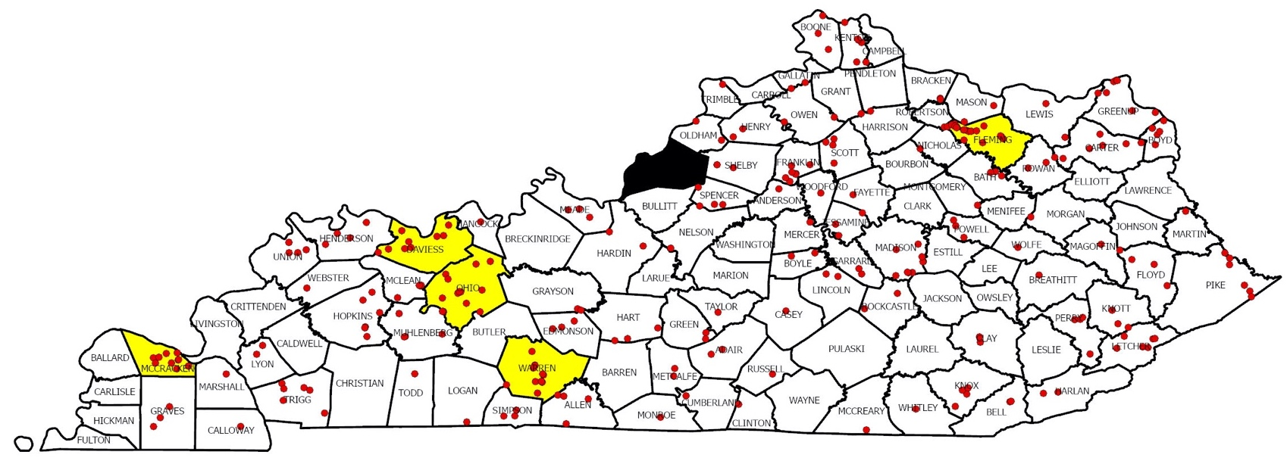
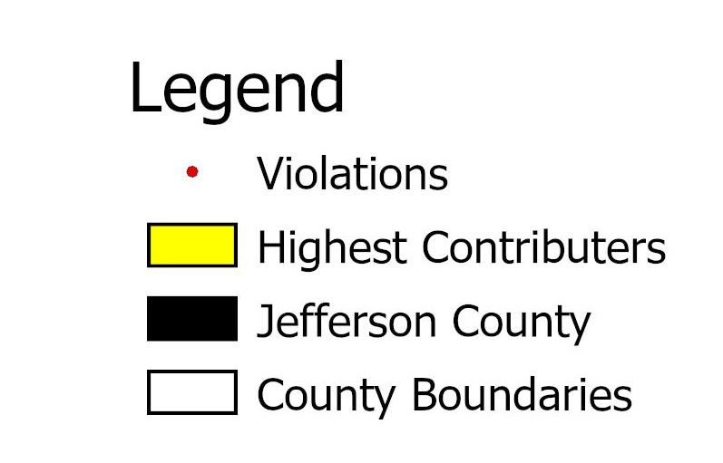

Slide 17
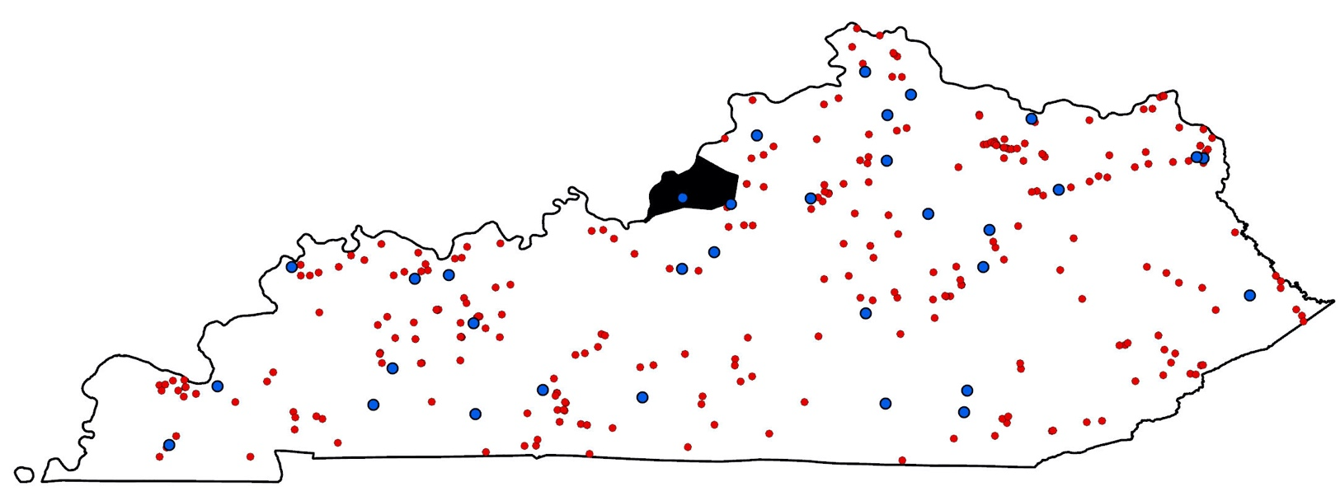

Slide 18
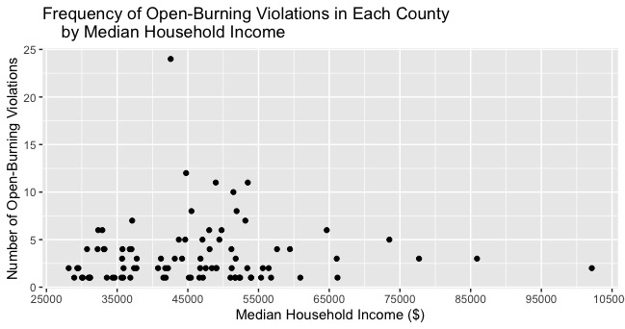
Findings for SES and burn violations

Slide 19
Discussion and Next steps

Slide 20
Discussion and Next Steps
55% of complaints that DAQ received in 2019 resulted in a violation
5 counties were responsible for 23% of violations
Mixed findings for the impact of proximity to a landfill
Some indication of a relationship between income and open-burning violations
Next steps- add in other contributing factors such as controlling for attainment counties, other SES measures, education level, availability of waste removal services, and % urban/rural

Slide 21
References
1.Kentucky Energy & Environment Cabinet - Open Burning . (n.d.). Retrieved October 28, 2020, from https://eec.ky.gov/Environmental-Protection/Air/Pages/Open-Burning.aspx
2. Agriculture and Air Quality. (2020, February 7). Retrieved from https://www.epa.gov/agriculture/agriculture-and-air-quality#backyardburn

Slide 22
Questions?
Contact Information:
Office: 502-782-6312
Mobile: 859-825-8856
Work Email: major.ballard@ky.gov
KSU Email: major.ballard@kysu.edu

Slide 23
Acknowledgements
I would like to acknowledge:
My advisor, Dr. Buddhi Gyawali and my Masters Capstone project Advising Committee members and my colleagues from the Energy and Environment Cabinet,
Kentucky Division for Air Quality for allowing me access to the records for this project,
and
The College of Agriculture, Community, and the Sciences at Kentucky State University.

