Slide 1
Quantification of Neurite Degeneration through Use of an Optimized and Automated Method
Lauren Fuller
Dr. Bradley Kraemer
Eastern Kentucky University
Lauren Fuller

Slide 2
What is neurite degeneration?
Neurites are projections off of the cell body- the axon and dendrites collectively make up neurites, these are for communication between cells
Fragmentation of neurites is a common cellular condition of neurological pathologies like Alzheimer's and Parkinson’s Disease (PD)
In PD, neurons that produce dopamine (dopaminergic) begin to degenerate leading to motor impairment
Axon
Dendrite
Fragmented neuron

Slide 3
Traditional Manual Method
*Scale bar indicates 100 µm

Slide 4
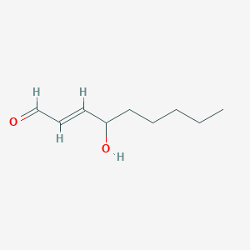
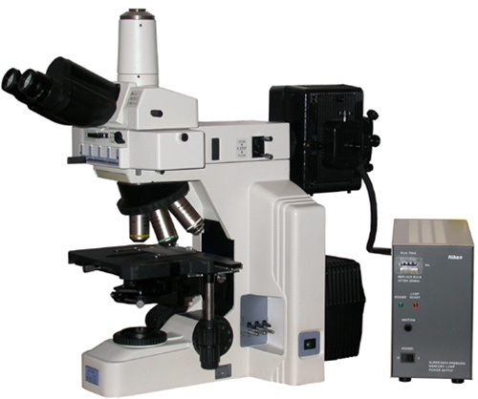
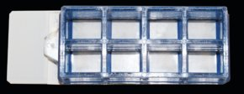
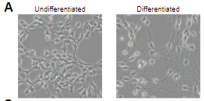
The process
1. Culture dopaminergic neurons
2. Treat cells with stress inducing drugs (HNE or 6OHDA) to cause fragmentation, this type of experiment is acting as a cell culture model of PD
3. Stain cells with a fluorescent antibody
4. Visualize the cells via phase-contrast and fluorescent microscopy
5. Obtain a degeneration index (DI) by scoring and quantifying degeneration using FIJI software
Putting LUHMES cells into “differentiation media” leads to specialization into post-mitotic neurons

Slide 5
Background Correction
*Scale bar indicates 100 µm

Slide 6
Difference in Contrast
*Scale bar indicates 100 µm

Slide 7
Particle Remover
*Scale bar indicates 100 µm

Slide 8
Difference in Particle Detection Size
*Scale bar indicates 100 µm

Slide 9
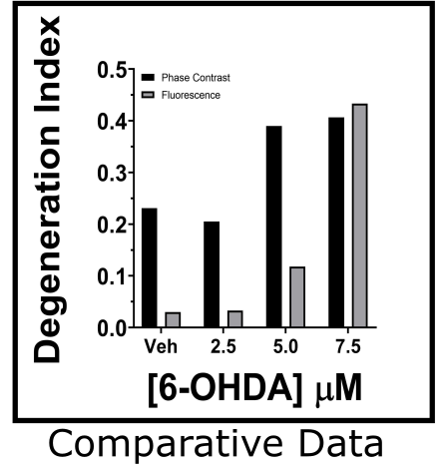
Phase Contrast vs Fluorescence
*Scale bar indicates 100 µm

Slide 10
Automatic Method
*Scale bar indicates 100 µm

Slide 11
Automatic vs Manual Time Data

Slide 12
Overview
Our method is
- more accurate
-more efficient
- more user friendly

