Slide 1
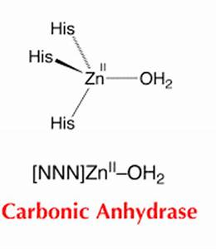
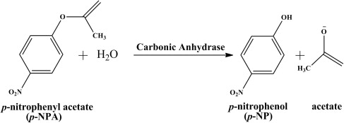
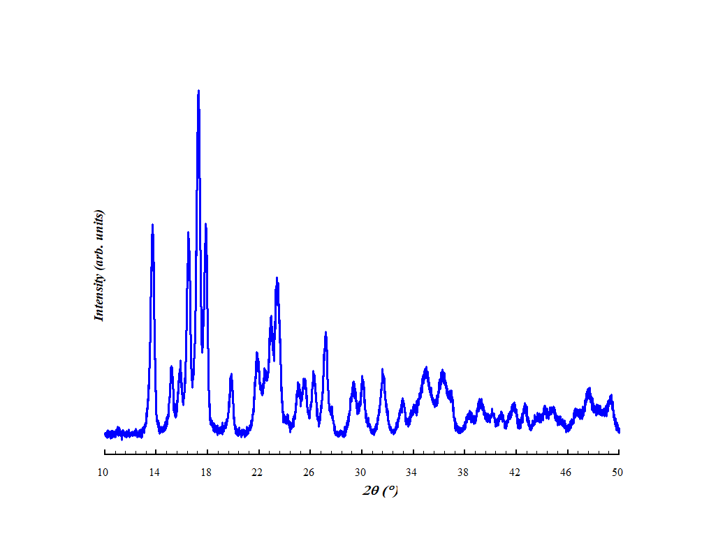
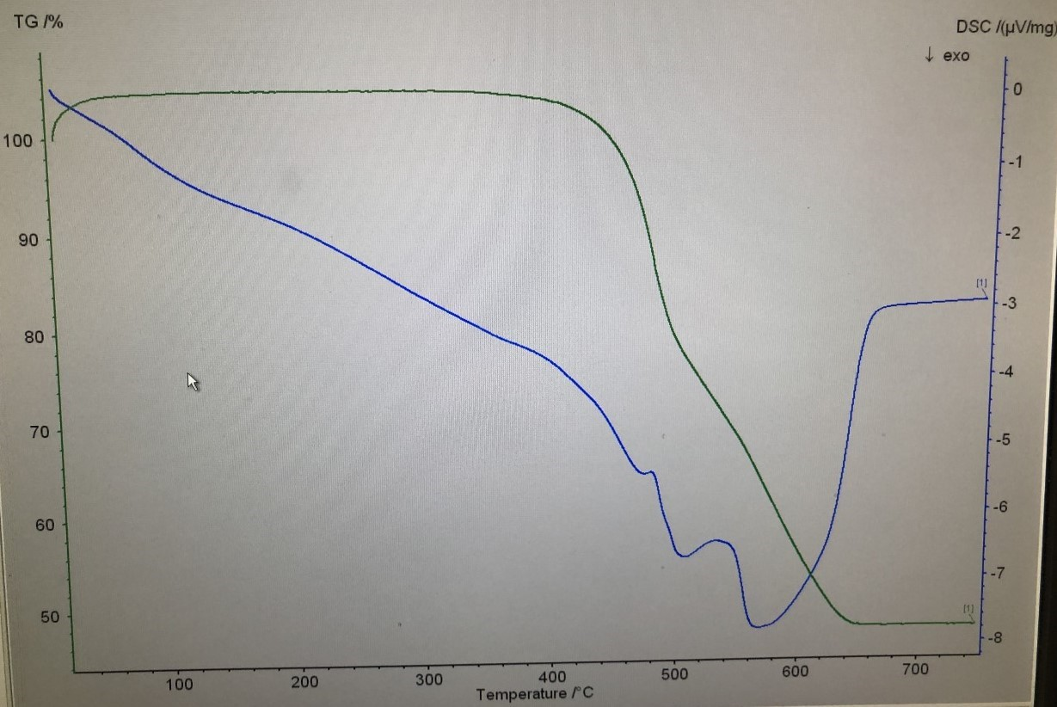
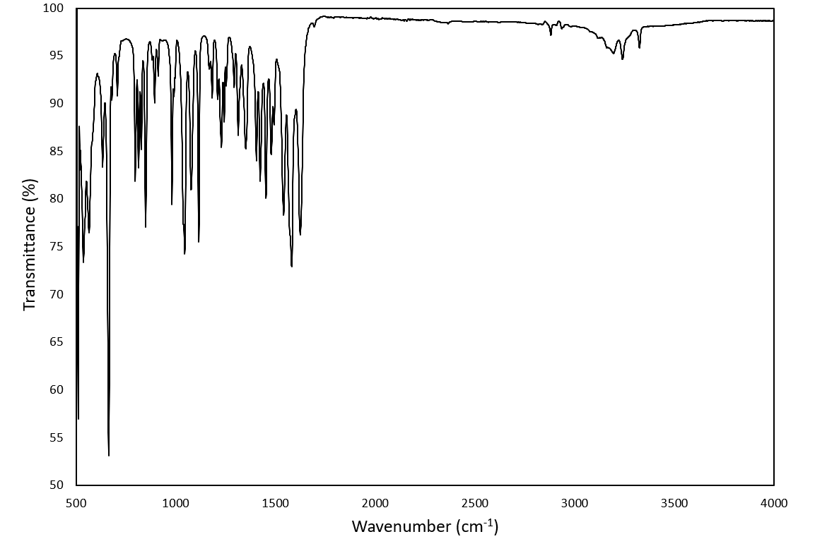
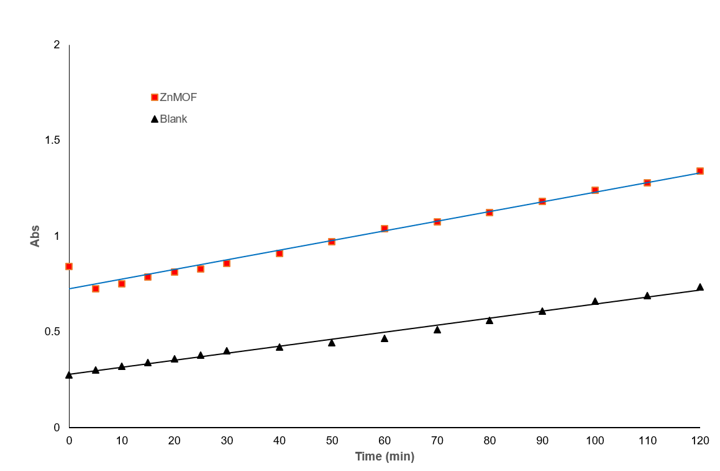
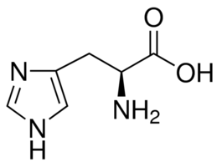
Synthesis and catalytic properties of zinc-histidine framework mimicking carbonic anhydrase
2020 KAS Annual Meeting
Longji Li, Simrat Kaur, Bangbo Yan
Department of Chemistry, Western Kentucky University, Bowling Green, KY 42101
Introduction
Mechanism
Results & Conclusions
The purpose of this research project was to synthesize, characterize, and analyze a zinc-histidine framework mimicking carbonic anhydrase (CA).
CA is an enzyme that assists rapid interconversion of carbon dioxide and water into carbonic acid, protons, and bicarbonate ions.
Due to CA’s activity, there is a growing interest in using CA for industrial applications such as carbon sequestration and biofuel production. The development of CA is necessary to enhance the efficiency of conversion.
Our product has potential in regulating the atmospheric carbon dioxide level and helping to reduce the greenhouse effect.
The FTIR spectrum showed the existence of L-histidine in the framework (amine, cyclic alkene, ester, carboxylic acid, etc.) as well as the Zn-O stretching, confirmed a CA-like crystal structure.
The TGA spectrum showed that the catalyst possesses great thermal stability that there is no significant decrease in mass below 400 ℃. Moreover, the decrease indicated the removal of ligands. In the end, the mass stopped decreasing at 48%, indicating the remaining of the inorganic part.
The catalytic analysis of the decomposition of p-NPA verified the great catalytic ability of the zinc MOF, and the proportional relationship between absorbance and time.
The future research will be focused on the analysis of the crystal structure of the MOF, define the empirical formula of the framework, and testing the performance of CO2 Hydrolysis.
Data
Materials & Methods
X-ray diffraction spectrum
TGA spectrum
Zinc (II) nitrate as a source of zinc
L-histidine as ligand
Solvent – water
KOH – pH regulation
Hydrothermal Method – A process of crystallization – PTFE autoclaves (heated at 120 °C for 72 hours in the oven)
Characterization – Powder X-ray diffraction, thermogravimetric analysis and infrared spectroscopy
Biomimetic Analysis - Hydrolysis of p-NPA
References
Huang, Zhang, et al. A Zinc Coordination Complex Mimicking Carbonic Anhydrase for CO2 Hydrolysis and Sequestration. Inorg. Chem. 2019, 58, 9916-9921.
FTIR spectrum of the MOF
Catalytic Analysis
N-H stretching 3300-3400 cm-1
-OH stretching 2700-3200 cm-1
C=C stretching 1566-1650 cm-1
Carboxylic acid bending 1395-1440 cm-1
-OH bending 1330-1400 cm-1
Ester stretching 1163-1260 cm-1
Zn-O stretching 518-682 cm-1
Jin, Zhang, et al. Mimic Carbonic Anhydrase Using Metal–Organic Frameworks for CO2 Capture and Conversion. Inorg. Chem. 2018, 57, 4, 2169–2174.
Acknowledgements

