Slide 1
Growth Performance of Lotus Plants Started with Different Types of Propagates in Containers
Changzheng Wang
College of Agriculture, Community, and the Environment
Kentucky State University

Slide 2
Lotus tubers are considered valuable food products in China and other Asian countries.
Introduction

Slide 3
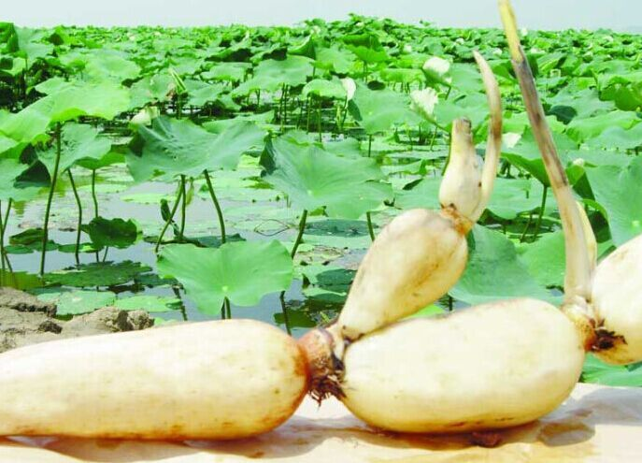
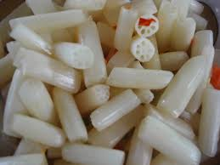
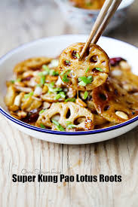
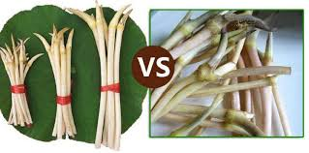
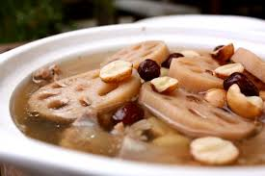
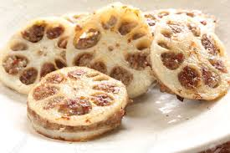
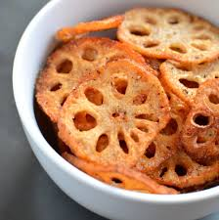
Introduction
Lotus roots can be used to make delicious soups and many other treats

Slide 4
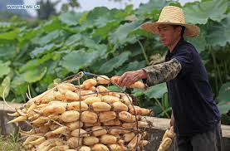
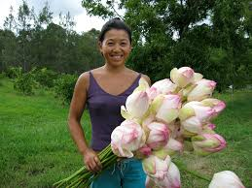
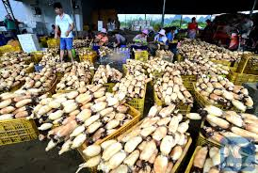
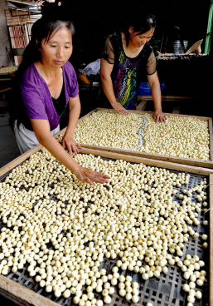
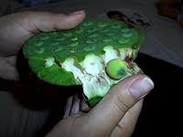
Lotus industry in China >$1,000,000,000 value >1,000,000 acres

Slide 5
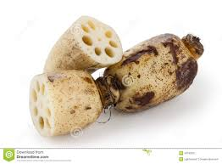
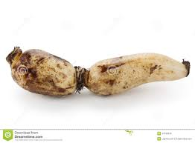
Lotus in Kentucky
Growing demand from Asian immigrants
Potential interest from local population
Imports from other states and countries
Prices range from $2-$4/lb.
Quality is poor due to long holding times for transportation and storage

Slide 6
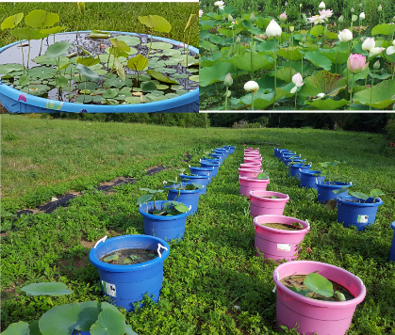
Lotus in Kentucky
KY production can meet local demands and supply to customers in Chicago, New York, Boston, and other cities where the Asian population is large and lotus production is limited by cold weather
Kentucky climate supports lotus growth in ponds and containers; information is lacking on fertilization and management of lotus

Slide 7
Starting Lotus from Lotus Seeds or Seed Lotus
Lotus seeds can be used to start new lotus plants but the resulting plants may be different from the plants that produced the seeds;
Using Lotus tubers can produce new lotus plants that will have the same genetic characteristics of the starting lotus tubers;
Each lotus tuber has multiple nodes with a main growing tip and each node may have a branch with a separate growing tip;
Using tips of the branch may help to increase the number of seed materials to expand production and reduce the lotus tubers needed to be used for propagation;
It is not clear whether the growth performance will be different among plants started from different parts of lotus tubers

Slide 8
Objective
To determine the growth performance of lotus plants started with different types of propagates in containers.

Slide 9
Materials and Methods
10 plastic containers (18-gallon volume) were filled with garden soil to 40 cm deep;
Rain water collected from a barn roof was added to cover the soil to a depth 10 cm below the rim of the containers.

Slide 10
Materials and Methods
Each container was planted with branch lotus with 3 nodes, side bud or tip of a branch lotus, side bud or tip of a main lotus tuber;
Each container was fertilized with 15 g of 10-10-10 for vegetables from Southern State Cooperative in June and July;
The number of floating leaves, standing leaves, flower and seed pods were counted each week.
Tubers were harvested in Oct. 2020.
Data were analyzed with the proc GLM procedure using fertilization rate as the class variable.

Slide 11
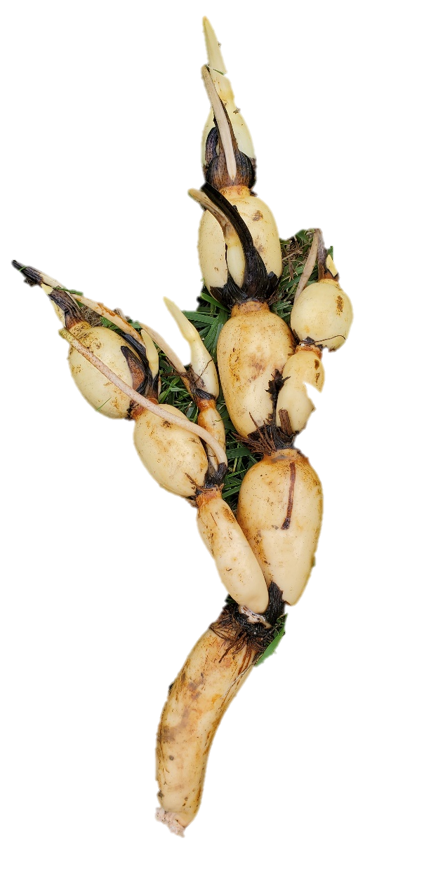
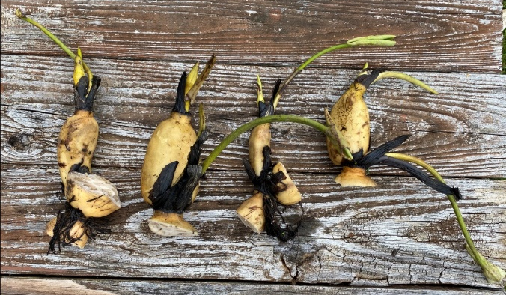
Parts of lotus used as propagates
Tip
Side bud
1, 2 – Branch lotus
3, 5 – Side bud of branch lotus
4, 6 – Tip of branch lotus
7,9 – Side bud of main lotus
8, 10 – Tip of main lotus
1 2
3 4 5 6
Branch lotus tuber
Lotus tuber
7 8 9 10

Slide 12
Results

Slide 13
Number of Floating Leaves at the Peak of Growth

Slide 14
Number of Standing Leaves at the Peak of Growth

Slide 15
Yield of Lotus Tubers

Slide 16
Summary
There were no significant differences among the groups in the number of floating or standing leaves at the peak of growth;
Branch lotus with 3 nodes resulted in the best yield of lotus tubers; side bud of branch lotus gave the second best yield of lotus tubers, but the tip of the branch lotus, side bud or tip of the main lotus appeared to give poor yield of lotus.

Slide 17
Conclusion
All parts of lotus with a growing tip could be used to start new lotus plants;
Branch lotus with three nodes should be used if a main lotus is not available for best yield of lotus tubers.

