Slide 1
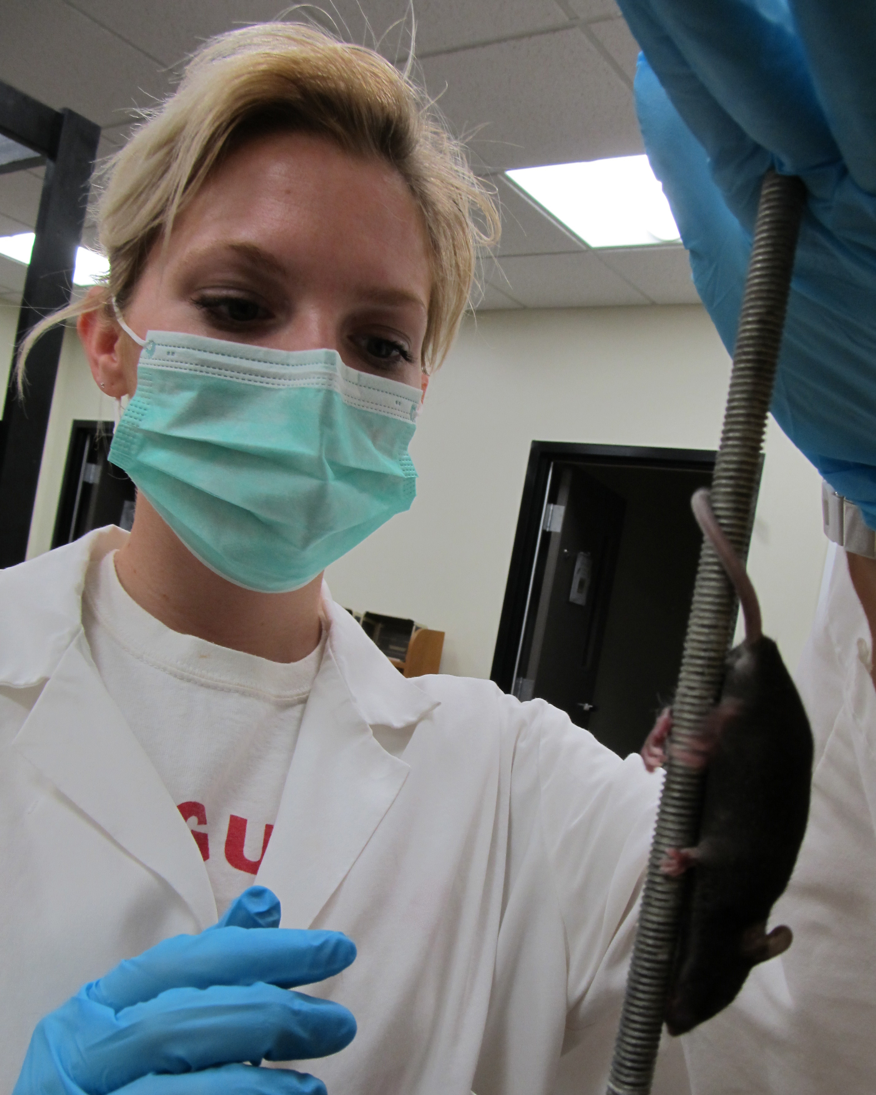
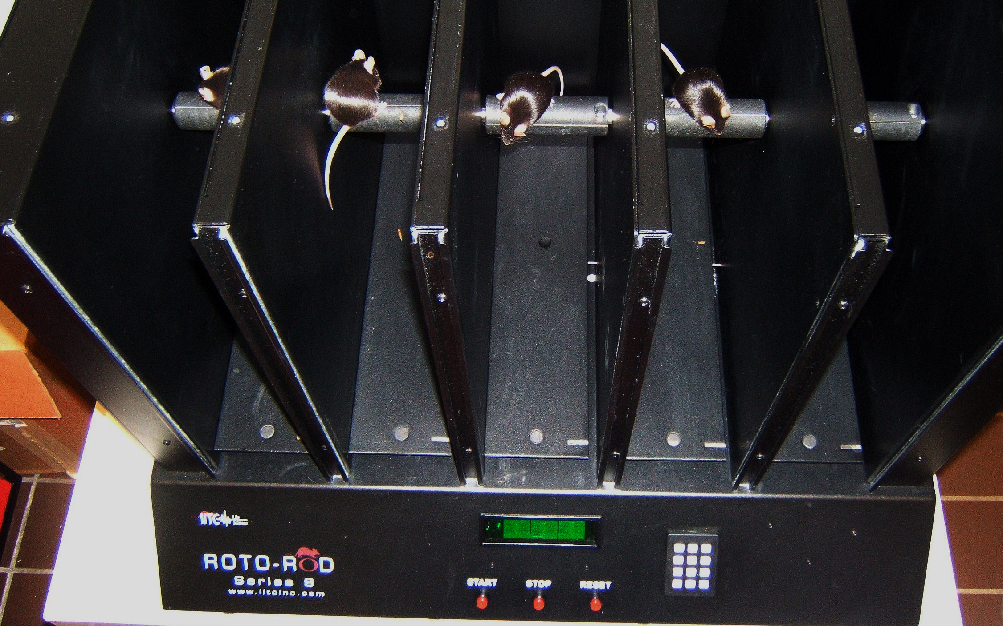
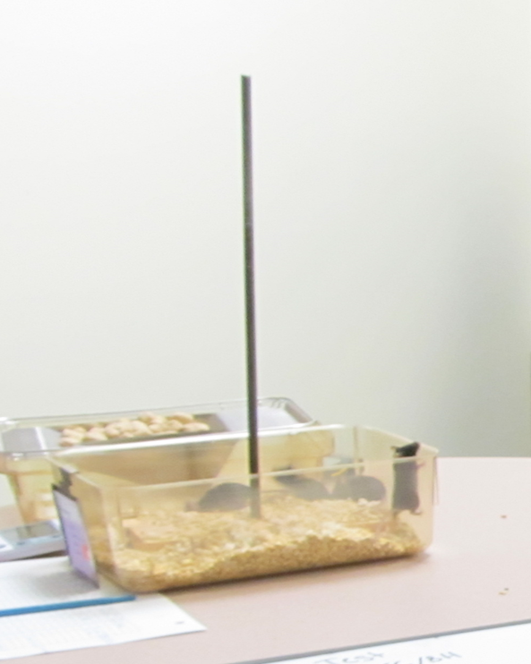
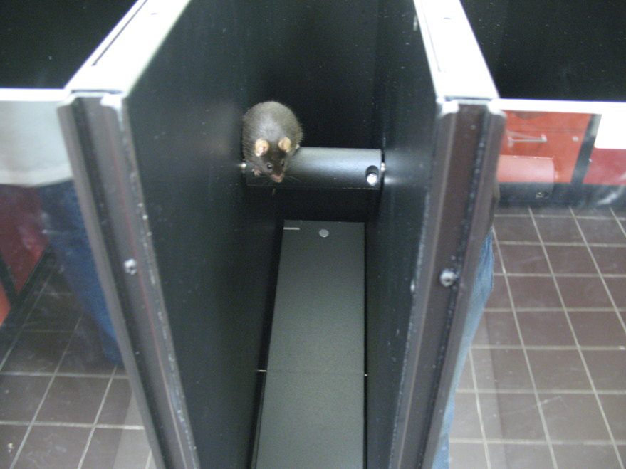
Assessing Adult Motor Function in Three Genotypes of Mice Exposed to Benzo[a]Pyrene During Early Brain Development Connor Perry; Diarra Niang; Emma Foster; Katelyn Clough; Jayasree Mullaguru; Emma DeBurger; Kayla Jenkins; Victoria Ferguson; Tyler Forrest; Christine Perdan Curran
Department of Biological Sciences
Pole Climb Test
The pole climbing test is used to examine the motor coordination of the mice. The mice are placed facing upward at the top of a 50 cm pole, within the home cage. The mice are trained to turn around and climb down the pole back to the home cage. The time to run and descend the pole are recorded.
Results
In the pole climbing test, there was a significant main effect of genotype with Ahr^{b}Cyp1a2(-/-) mice having significantly faster turn and descent tiems ( P< 0.001). .
In the rotarod test, there was also a main effect of genotype with both groups of Cyp1a2(-/-) mice showing impaired motor function on four days of testing. The deficits were most pronounced in Ahr^{b}Cyp1a2(-/-) mice (P < 0.05).
Background
BaP or Benzo[a]pyrene is a carcinogenic polycyclic aromatic hydrocarbon. BaP is a common part of many actively consumed activities. A few examples being traffic-related air pollution, tobacco smoke, and grilled foods. BaP is linked to learning deficits and to neurodevelopmental delays in humans as well as in animal studies.
***
***
Fig. 1 Molecular structure of the BaP molecule and some common sources of exposure.
***
Materials and Methods
We are using a mouse model to determine if genetic differences increase susceptibility to BaP exposure during brain development. We used wild type mice as control and used mice lacking the CYP1A2 metabolic enzyme for testing. All mice were housed in shoebox cages with corncob bedding and one nestlet for enrichment changed each week. Food and water was given as needed, along with a 12 to 12 hours light-dark cycle. Once mated, pregnant dams were assigned to the BaP treatment group (10mg/kg/day) or to the control group (corn oil only). The exposure to BaP began on gestational day 10 and continued until pups are weaned at postnatal day 25. The mice were tested on motor function tests once they had reached young adulthood, day 60. We used a pole climb test and rotarod to assess motor function and motor learning.
Fig. 3 Apparatus used for the Pole Climb test.
Rotarod Test
The rotarod is a week-long test that consists of evaluating endurance and moment coordination. The mice are placed on a rod that will begin to turn; the mice are timed for how long they are able to stay on without falling off the rod. The mice are trained for one day at 0rpm and another day at 2rpm. The next 5 days, each mouse received 3 trails perday with the rotarod set to accelerate from 1-20rpm, with a maximum of 300s.The time for each individual mouse is collected once they have fallen.
*
*
*
*
Summary
We did not find any adverse effects of developmental BaP exposure on motor function in adult mice; however, we did find differences based on genotype. We are now using additional tests of anxiety to determine if the faster time in the pole climb test indicate anxiety or hyperactivity.
Acknowledgements
Society of Toxicology internship and NKU UR-STEM Fellowship
National Institute of Environmental Health Sciences R15ES020053
Kentucky Biomedical Research Infrastructure Network (KBRIN) P20 GM103436
NSF Experimental Program to Stimulate Competitive Research (EPSCoR) RSF-034-07
NKU Faculty Development Project Grant
NKU Center for Integrative Natural Science and Mathematics (CINSAM) Research Grant
We gratefully acknowledge the donation of Cyp1a2(-/-) mice from Dr. Daniel W. Nebert, University of Cincinnati Medical Center. Cincinnati, OH.
Fig. 2 Setup of the pole climb test and rotarod setup.
Fig. 4 Apparatus used for Rotarod testing

