Slide 1
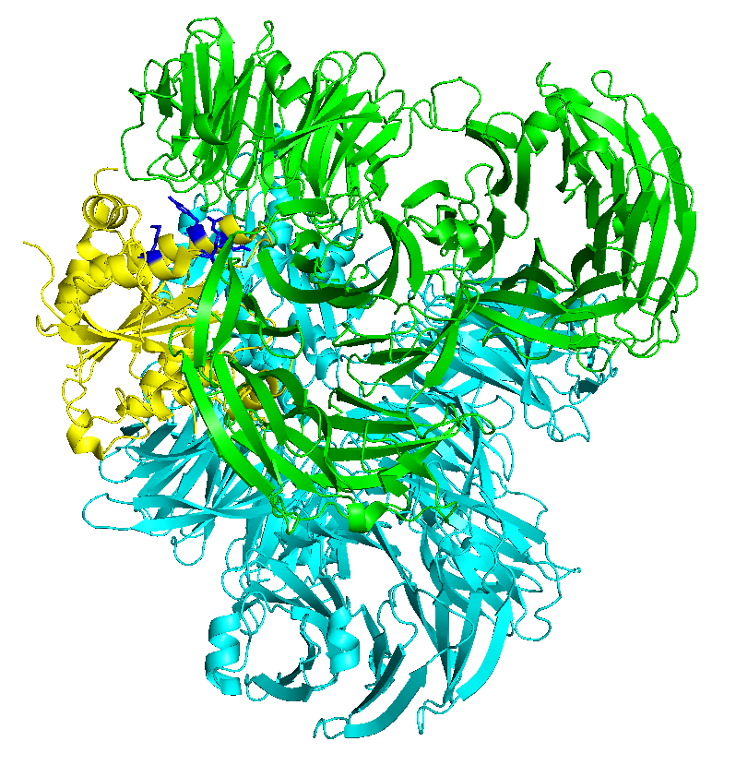
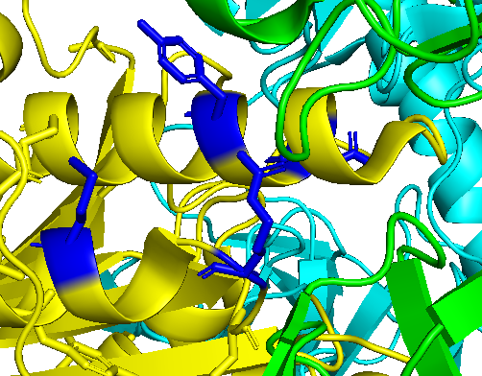
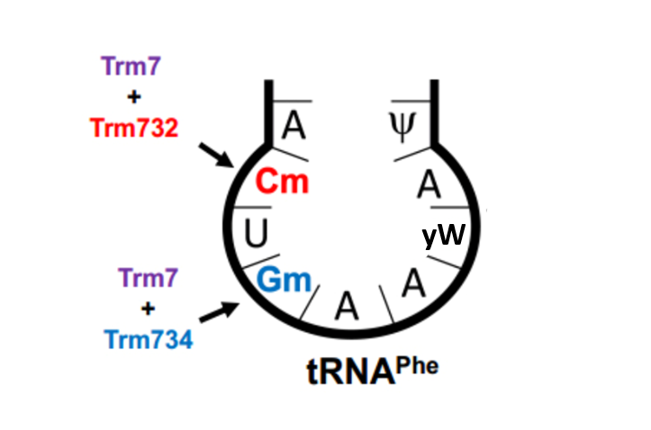
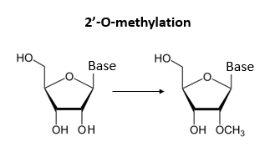
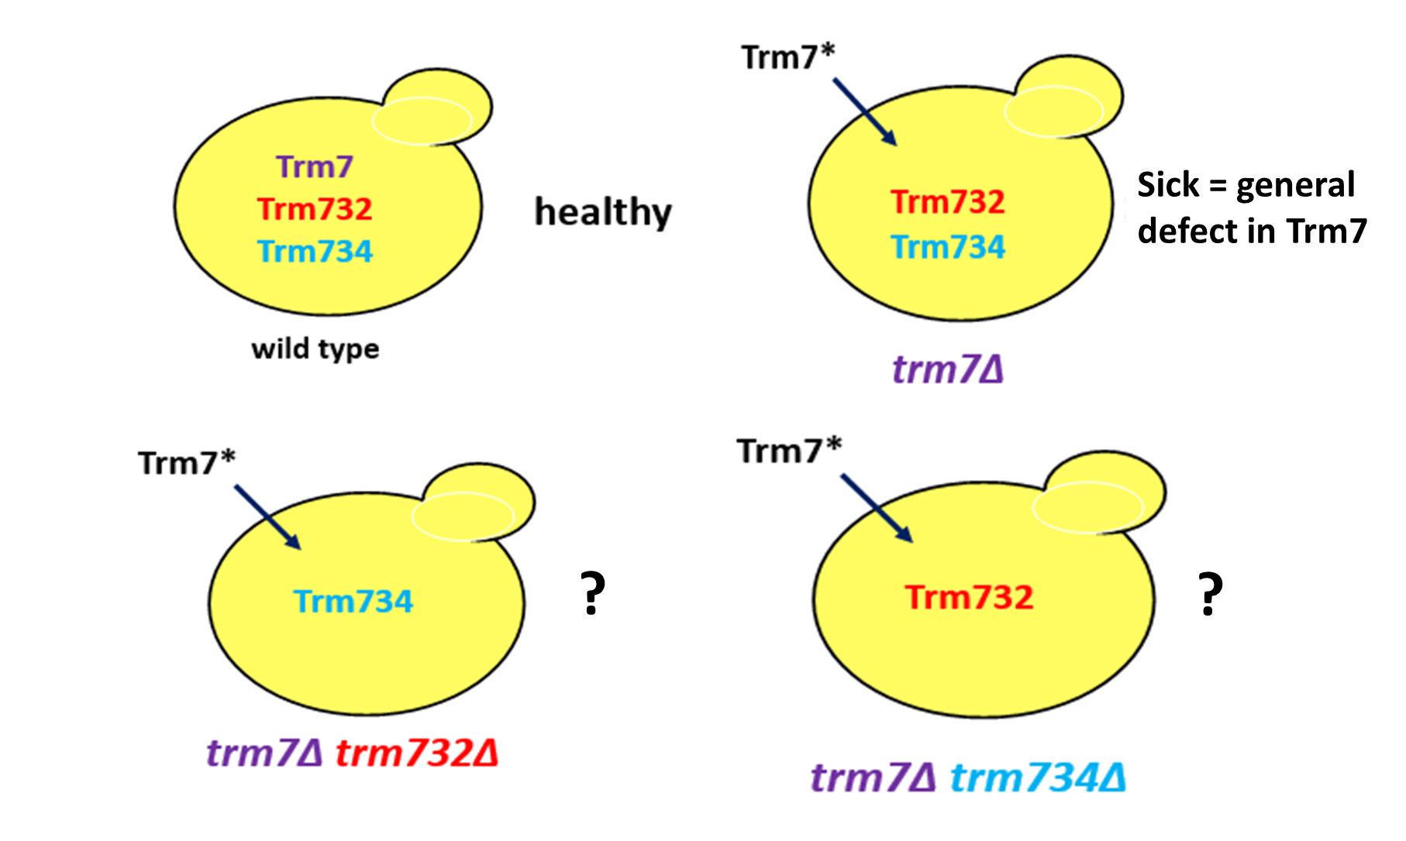
;
Identification of Trm7 residues required for Trm732 and Trm734 binding for tRNA methyltransferase in yeast
Kellyn R. Dolezal, Holly M. Funk, Adrian R. Guy, and Michael P. Guy
Department of Chemistry and Biochemistry, Northern Kentucky University, Highland Heights, KY 41099
Background
tRNA are molecules used for protein synthesis that transport amino acids to the ribosome
Trm7 forms individual complexes with Trm732 and Trm734 that modify tRNAs at specific positions at the anticodon loop^{1.2}
The regions required for the specific binding of Trm7 to Trm732 and Trm734 are unknown
Crystal Structure of Trm7-Trm734 Complex⁵
Site-directed mutagenesis was performed to mutate selected candidate residues and develop a spot test assay to analyze the role of Trm7 residues such as Y138 and R169 in binding
Growth assay for Trm7 activity: Trm7 variants are expressed in mutant strains and growth is assayed to test functionality
Y138
Modification of the anticodon loop
Trm7 performs a 2’-O-ribose methylation of tRNA^{Phe 1,2} in yeast at positions C32 and G34 of tRNA
The reaction requires interaction between Trm7 and Trm732 to 2’-O-methylate C₃₂ and Trm734 to modify G₃₄
In yeast, lack of these modifications at C₃₂ and G₃₄ cause growth defects^{1,2}
Mutations in the the Trm7 human homolog, FTSJ1, cause non-syndromic X-linked intellectual disability^{3,4}
Future Direction:
1. Two Trm7 homologs are found in Drosophila melanogaster, which interact exclusively with Trm732 or Trm734. By comparing these Trm7 proteins with other eukaryotic Trm7 homologs, potential new candidate residues can be identified.
2. Use immunoprecipitation to analyze binding of TAP-tagged Trm7 variants with 9-myc tagged Trm732 or Trm734 to determine if binding of Trm7 variants to Trm732 and Trm734 is defective
By analyzing these mutants, we hope to continue to determine exact binding sites of Trm7 with Trm732 and Trm734. This will lead to future discovery of potential treatment of tRNA modification disorders
M173
R169
Methods
Which Trm7 residues are important for binding to Trm732 and Trm734?
1. Trm7 homologs from various eukaryotes were aligned with E. coli FTSJ to locate conserved amino acid residues
2. The candidate residues were analyzed using crystal structures of Trm7-Trm734 complex in Pymol to identify possible protein interactions
3. Based on sequence alignments and the crystal structure, candidate residues were selected to mutate
Results
Y138 in Trm7 is required for interaction with Trm734 and I144 is required for interaction with Trm732
Acknowledgements
Thanks to the National Institutes of Health, Kentucky Biomedical Research Infrastructure Network, and NKU for funding. We also thank the NKU Department of Chemistry & Biochemistry for its support, as well as all members of the Guy research team for their assistance throughout the project.
References
Pintard, L., Lecointe, F., Bujnicki, J. M., Bonnerot, C., Grosjean, H., and Lapeyre, B. (2002). Trm7p catalyses the formation of two 2'-O-methylriboses in yeast tRNA anticodon loop. Embo J 21, 18112.
Guy, M.; Podyma, B.; Preston, M.; Shaheen, H.; Krivos, K.; Limbach, P.; Hopper, A.; Phizicky, E. Yeast Trm7 Interacts With Distinct Proteins For Critical Modifications Of The Trnaphe Anticodon Loop. RNA 2012, 18, 1921-1933.
Freude, K., Hoffmann, K., Jensen, L. R., Delatycki, M. B., des Portes, V., Moser, B., Hamel, B., van Bokhoven, H., Moraine, C., Fryns, J. P., et al. (2004). Mutations in the FTSJ1 gene coding for a novel S-adenosylmethionine-binding protein cause nonsyndromic X-linked mental retardation. Am J Hum Genet 75, 305-309
Ramser J, Winnepenninckx B, Lenski C, Errijgers V, Platzer M, Schwartz CE, Meindl A, Kooy RF. A splice site mutation in the methyltransferase gene FTSJ1 in Xp11.23 is associated with non- syndromic mental retardation in a large Belgian family (MRX9). J Med Genet. 2004 Sep;41(9):679-83.
Hirata, A., Okada, K., Yoshi, K., Shiraishi, H., Saijo, S., Yonezawa, K., Shimizu, N., Hori, H. (2019). Structure of tRNA methyltransferase complex of Trm7 and Trm734 reveals a novel binding interface for tRNA recognition. Nucleic Acids Res. 47(20), 10942-10955.

