Slide 1
Observing if Anxiety Negatively Influences Academic Performance
Evan Charles

Slide 2
Background of subject
Anxiety and stress have been thought to be negatively associated with academic achievement/performance
It is believed that when someone becomes stressed, or is dealing with anxiety, their performance in academics is impaired.
Many studies have observed this phenomenon, and in this study we compared our meta-analysis findings to that of a similar meta-analysis from 1991.

Slide 3
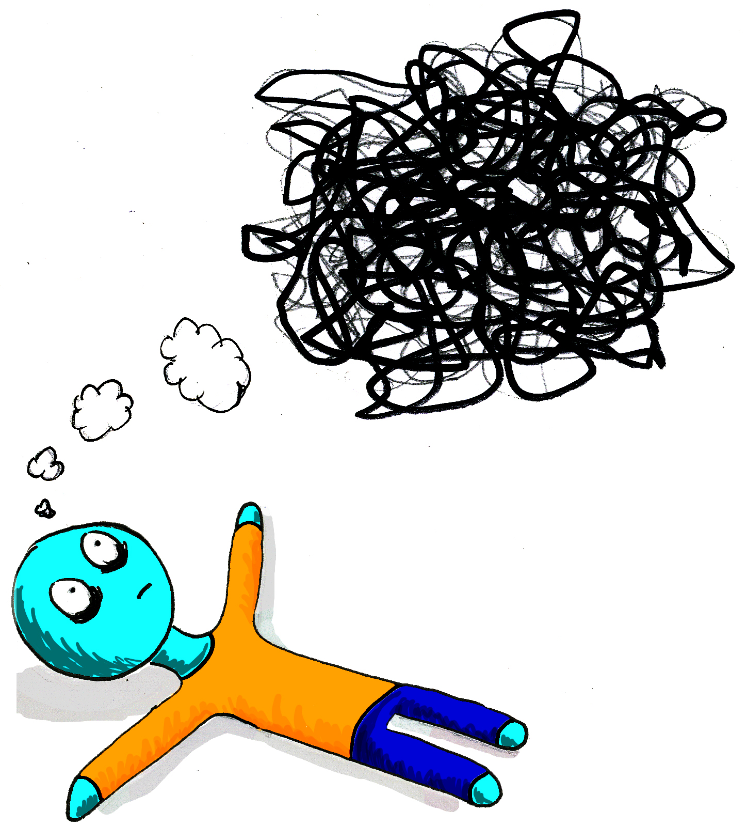
Research Question
How strongly are anxiety/stress and academic performance related?
The previous meta-analysis shows an effect size of r = -.212

Slide 4
The Meta-analysis Method
Meta-analysis is the process of combining together similar studies to form a more powerful conclusion
Form Research Question
Literature Search
Computing effect sizes
Meta-analytical calculations

Slide 5
The Meta-analysis method
Computing effect sizes
We use correlation r for the effect sizes
Correlations were reported in the studies
Copied to an Excel file to find overall effect size and moderating variables
(Correlations were computed from tabulated M and SD)
Weak | Moderate | Strong
-.10 or +.10 | -.30 or +.30 | -.50 or +.50

Slide 6
The Meta-analysis method
Meta-analytical calculations
Compute weighted average effect size
Weighted based on the sample size
Larger studies count more towards the average
In this meta-analysis we found one study to have over 70,000 participants.

Slide 7
Results
The overall weighted average effect size
R = -.07.
According to Cohen’s guidelines, this is a weak effect size.
As people are more anxious, or stressed, their academic performance seems to worsen.
Weak | Moderate | Strong
-.10 or +.10 | -.30 or +.30 | -.50 or +.50

Slide 8
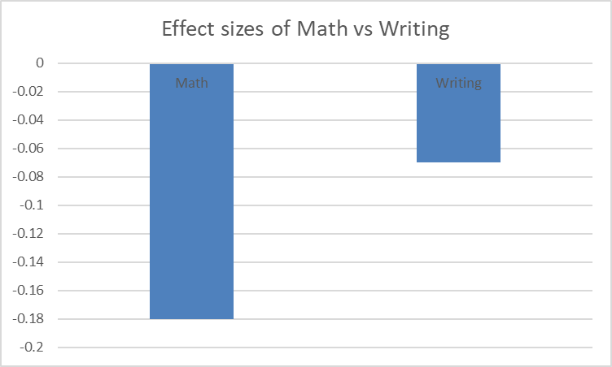
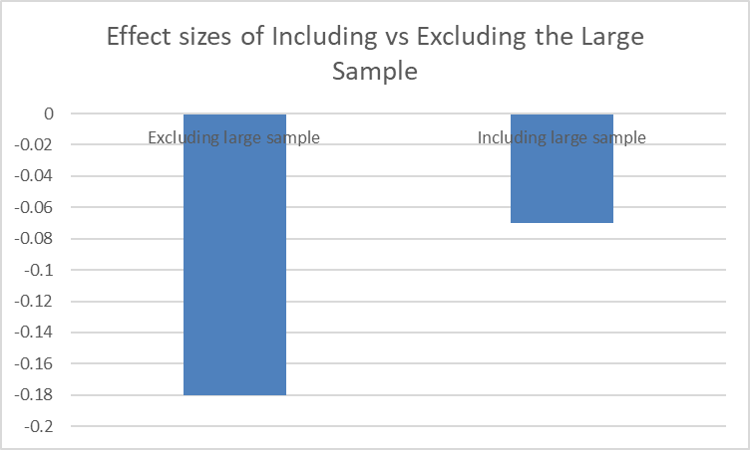
Results
Moderator Variables
Some of the studies included a difference in stress between writing and math performances.
One study in this meta analysis may have skewed the results due to its sample size (n=74,186)

Slide 9
Summary and Implications
There is a weak, negative relationship between stress/anxiety and academic performance
The implications for this research should be in assessing how other, external factors may exasperate the negative effect that stress/anxiety have on academic performance.
A truly astonishing finding is that since 1991, the effect size has gone down in magnitude, showing that anxiety/stress isn’t having as much of a negative effect in academics.

