Slide 1
On the Design of a Database for the Linguistic Atlas Project
Simon Harris-Palmer
Paul Laurence Dunbar High School, Lexington, KY 360 Hour Capstone Research Project
Mentored at University of Kentucky
Kentucky Academy of Science
Annual Meeting: November 6-7, 2020

Slide 2
Linguistic Atlas Project (LAP)
Serves to catalogue American English
Most thorough and expansive study of American English
Founded in 1929
American Dialect Society

Slide 3
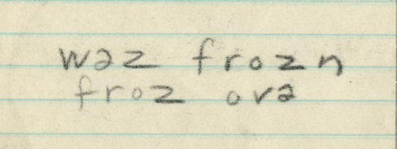
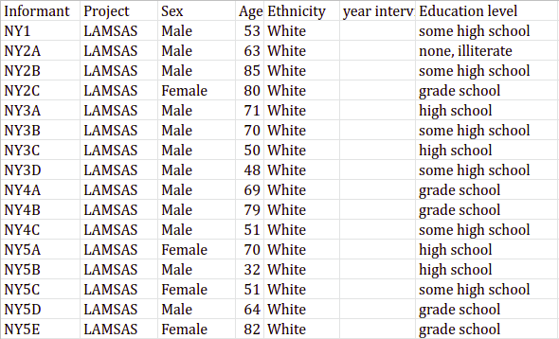
LAP’s data
Divided by geographical region
Mix of CSV, Excel, and image files
Legacy Issues
Hard to navigate
Inconsistencies in information
Missing information

Slide 4
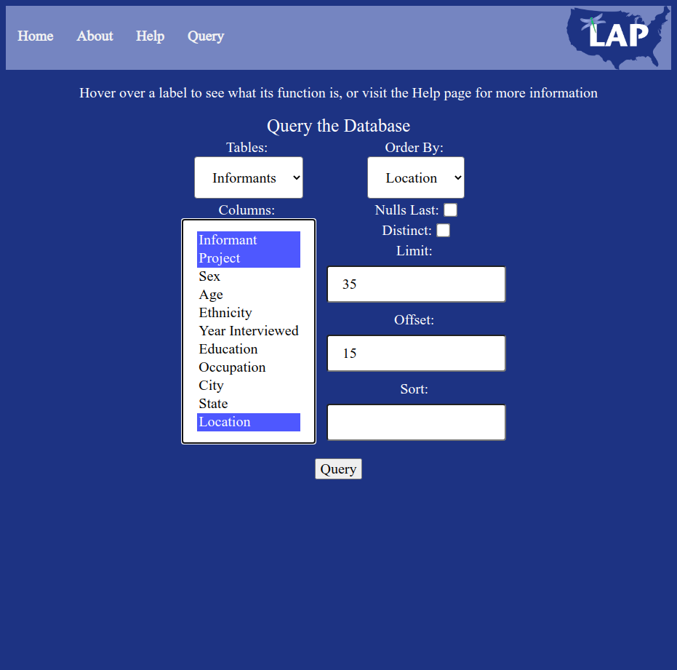
My Project Goals
Provide easy access to the information the LAP has collected
Searchable database for the LAP
Access through a web application
Contribute to the uniform data organization

Slide 5
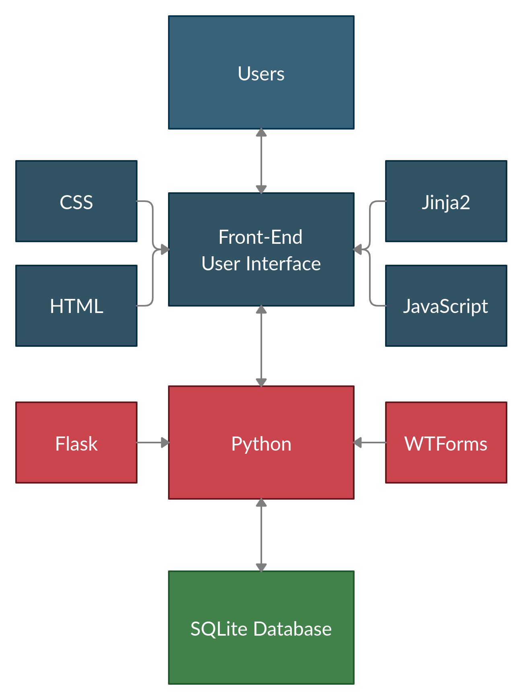
Project Architecture
Users interact with the front-end interface in the web app
Interface communicates query to Python
Python queries the database and returns the result
Python returns the result to the user

Slide 6
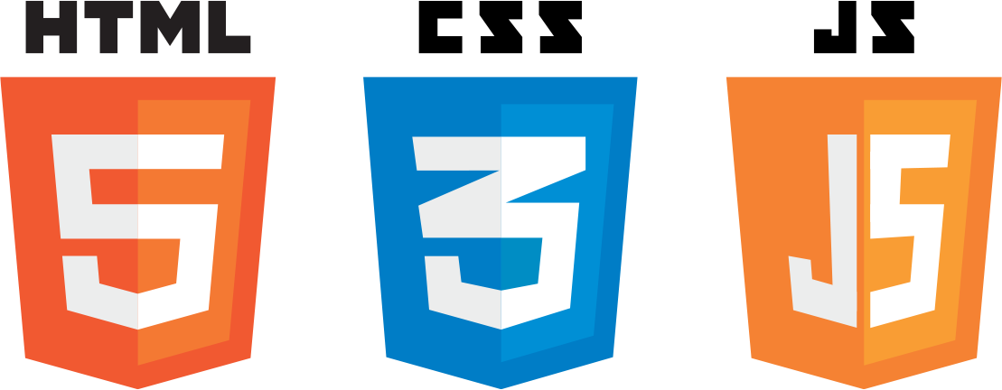
Technologies
Python (Database access)
Flask
WTForms
SQLite (Database system)
Web Design (Interface)
HTML
CSS
JavaScript
Jinja2

Slide 7
Development Stages and Procedures
Data Cleaning
Develop tools to unify data
Compile data and create database
Front-End Interface Design
Use HTML elements to represent queries
Translate into data query
Display results in table
Web Design
Add design elements to improve overall appearance

Slide 8
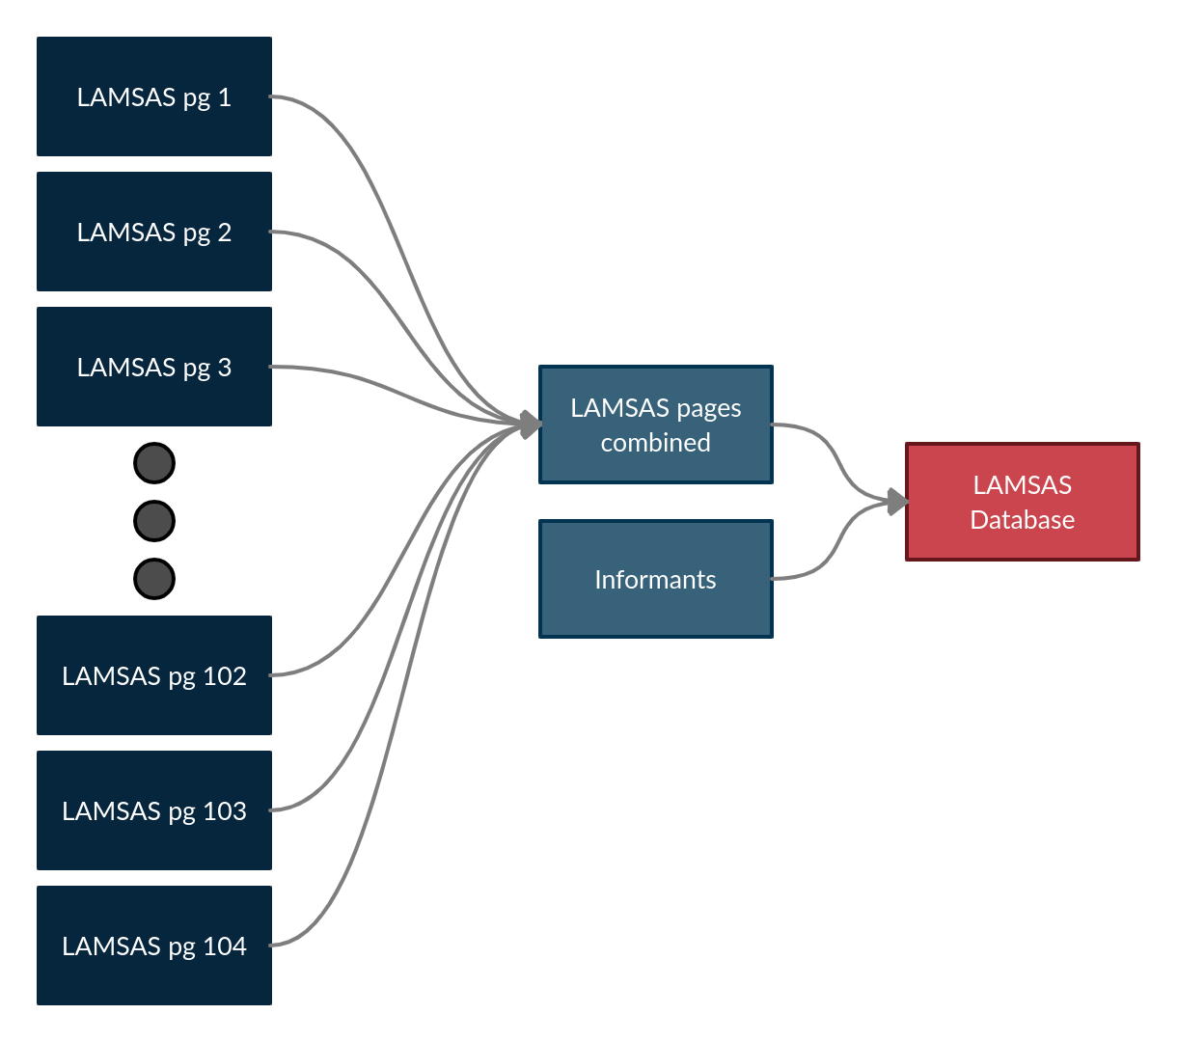
Procedures - Data Cleaning
Using LAMSAS subset of data during development
Create tools to unify data
Compose data into CSV files
Convert CSV to SQLite database

Slide 9
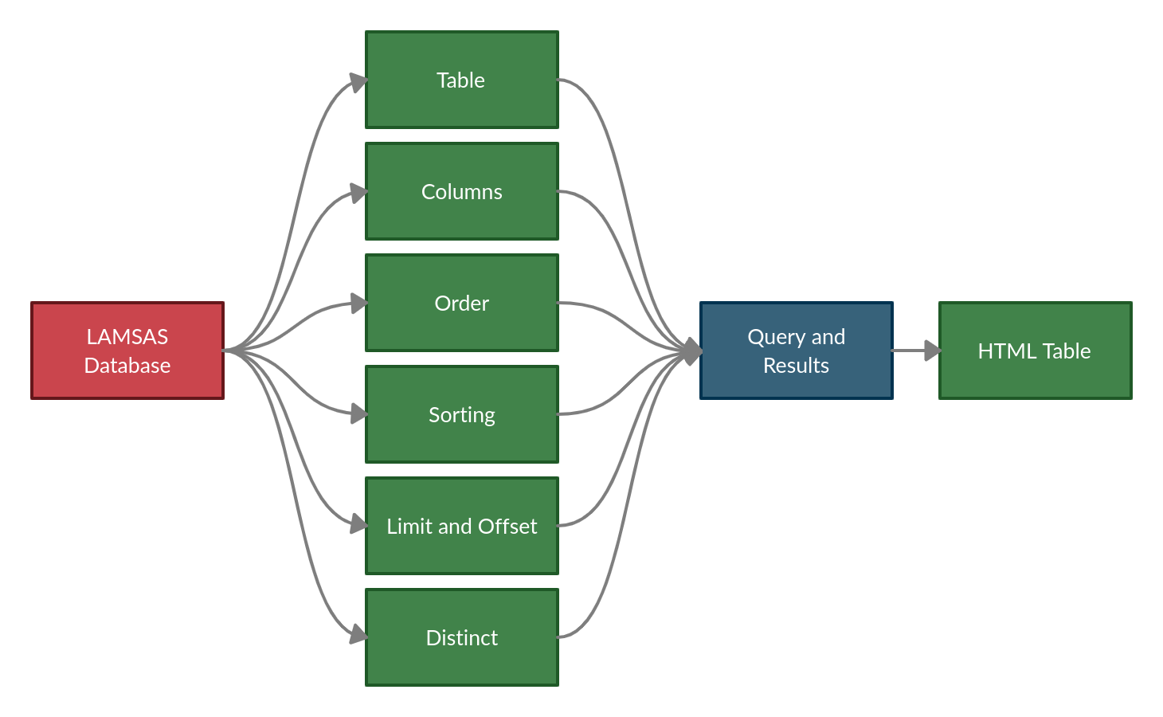
Procedures - Front-End Interface Design
Create a web framework
Decompose query into fields
Translate query fields to HTML forms
Compose query and send to database
Display results in HTML table

Slide 10
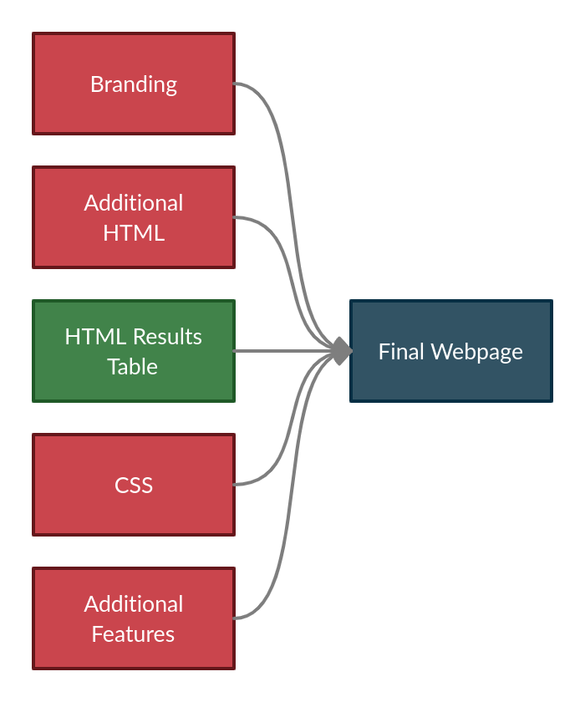
Procedures - Web Design
Make interface visually appealing
Optimize performance and speed
Graphical elements
Embedded map linked to coordinates in data
Branding

Slide 11
Current Status and Summary
Progress
Current data is cleaned with developed tools
Most of HTML query elements added
Branding and affiliation with LAP established
Next Steps
Add final elements to webpage
Make site more visually appealing
Expand the data the site covers

Slide 12
Thanks to mentors at the University of Kentucky
Dr. Jerzy W. Jaromczyk
Department of Computer Science
Research mentor
Dr. Allison Burkette
Department of English
Curator of the LAP

