Slide 1
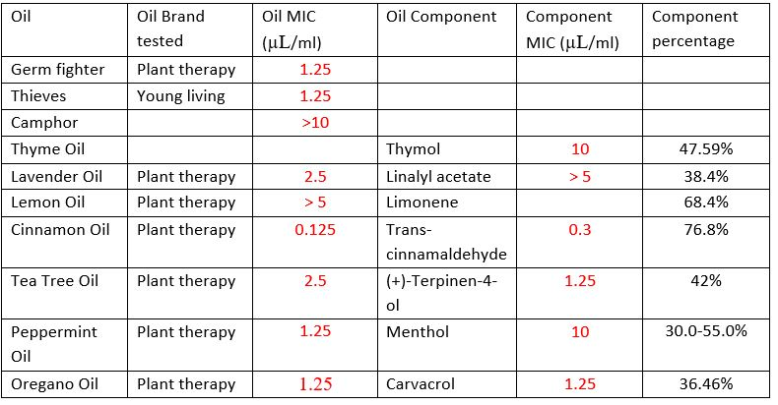
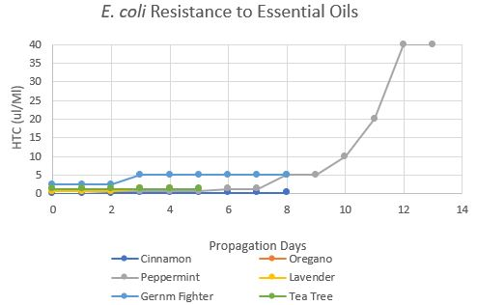
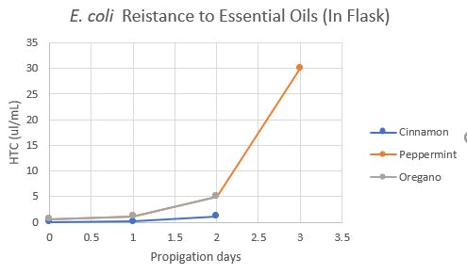
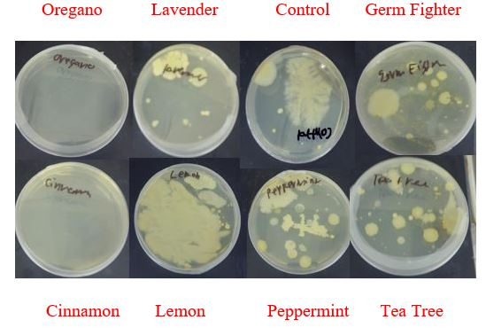
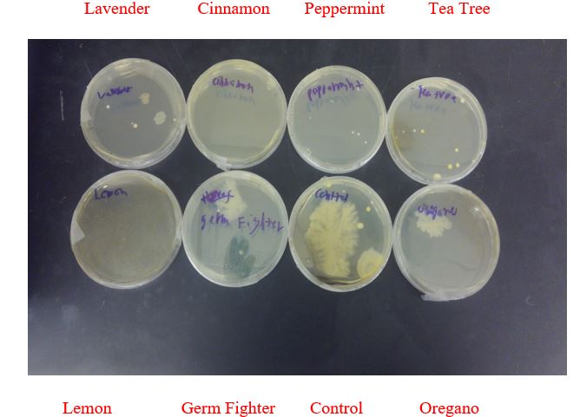
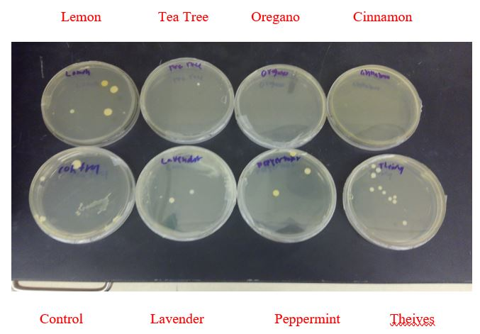
Investigation into the Antibiotic Properties and Resistance Patterns of Essential Oils with E. coli
Michael Bates and Dr. Daniel Marous
Department of Chemistry, Wittenberg University, Springfield Ohio
Abstract
Antibiotics have been used for years to treat infections and save lives. Unfortunately, antibiotic use has also led to bacterial resistance. This research focuses on the use of essential oils (EOs) as alternatives to traditional antibiotics and investigates whether similar resistance patterns are observed. Our work focused on seven oils: oregano, peppermint, cinnamon, lavender, tea tree, lemon, and a disinfecting oil blend, as well as seven oil components: thymol, linalyl acetate, limonene, trans-cinnamaldehyde, (+)-terpinen-4-ol, menthol, and carvacrol. Our work verified that the oils possess bactericidal effects against E. coli (ATCC 25922) and examined the bacteria’s ability to resist them. The MICs of most oils were generally in the range of 0.125 µL/mL to >5 µL/mL. The MICs of the primary components were in the range from 0.3 µL/mL to 10 µL/mL. Resistance propagations indicated a rise in resistance for the majority of oils before either becoming stagnant or experiencing resistance collapse. The bacteria required more days to develop resistance to peppermint than some other oils, while different oils, such as tea tree, never showed resistance.
Results
Methods
MICs and Resistance Testing:
All resistance trials used E. coli ATCC 25922 grown in 10% Tween 80 and LB Broth medium
Growth was assessed by optical density and presence of a visible pellet after centrifugation.
After each MIC trial, the bacteria that grew in the highest tolerable concentration (HTC) were used to inoculate a new trail and propagate resistance.
Agar plating:
Sterile swabs were used to obtain bacteria from locations around the BDK science center. The bacteria were plated with EOs to determine the oil’s ability to act as a general disinfectant.
Table 1: MICs for Oils and Components
Figure 1: Resistance patterns to six oils (E. coli grown in test tubes)
Figure 2: Resistance patterns to three oils (E. coli grown in Erlenmeyer flasks)
Figure 3: Bacteria swabbed from Science Center entrance door. Oil added inside agar.
Figure 4: Bacteria swabbed from Science Center stockroom desk.
Oil added after the bacteria.
Figure 5: Bacteria swabbed from Science Center stockroom door handle. Oil added before bacteria.
Conclusion
Most essential oils have the capability to kill bacteria, although at higher concentrations then traditional antibiotics.
Resistance collapse tends to occur more frequently in resistance trials involving essential oils than traditional antibiotics.
Some essential oils can act as general disinfectants.
Cross resistance between oils is possible.
Introduction
Antibiotic resistance is a worldwide health care threat
Essential oils are a possible solution to some of these problems
This study aims to further understand
The effectiveness of essential oils
The resistance patterns of essential oils
References
1. All antibiotic classes | A.r. patient safety portal https://arpsp.cdc.gov/profile/antibiotic-use/217 (accessed Aug 13, 2020).
2. Kohanski, M. A.; Dwyer, D. J.; Collins, J. J. How Antibiotics Kill Bacteria: From Targets to Networks. Nat. Rev. Microbiol. 2010, 8 (6), 423–435.
3. 3.1: Horizontal Gene Transfer in Bacteria https://bio.libretexts.org/Bookshelves/Microbiology/Book%3A_Microbiology_(Kaiser)/Unit_2%3A_Bacterial_Genetics_and_the_Chemical_Control_of_Bacteria/3%3A_Bacterial_Genetics/3.1%3A_Horizontal_Gene_Transfer_in_Bacteria (accessed Aug 13, 2020).
4. Martinez, J. L.; Baquero, F. Mutation Frequencies and Antibiotic Resistance. Antimicrob. Agents Chemother. 2000, 44 (7), 1771–1777.
5. http://www.public.asu.edu/~laserweb/woodbury/classes/bch561/student/Raffai1.htm (accessed Aug 13, 2020).
6. Yap, P. S. X.; Yiap, B. C.; Ping, H. C.; Lim, S. H. E. Essential Oils, a New Horizon in Combating Bacterial Antibiotic Resistance. Open Microbiol. J. 2014, 8, 6–14.
7. Deans, S. G.; Ritchie, G. Antibacterial Properties of Plant Essential Oils. Int. J. Food Microbiol. 1987, 5 (2), 165–180.
8. Man, A.; Santacroce, L.; Jacob, R.; Mare, A.; Man, L. Antimicrobial Activity of Six Essential Oils against a Group of Human Pathogens: A Comparative Study. Pathogens 2019, 8 (1). https://doi.org/10.3390/pathogens8010015.
9. Sandasi, M.; Leonard, C. M.; Viljoen, A. M. The Effect of Five Common Essential Oil Components on Listeria Monocytogenes Biofilms. Food Control 2008, 19 (11), 1070–1075.
10. Siddiqua, S.; Anusha, B. A.; Ashwini, L. S.; Negi, P. S. Antibacterial Activity of Cinnamaldehyde and Clove Oil: Effect on Selected Foodborne Pathogens in Model Food Systems and Watermelon Juice. J. Food Sci. Technol. 2015, 52 (9), 5834–5841.
Table 2: Cross Resistance MICs
Oil | 20 µL/ml Peppermint Resistant Strain MIC (µL/ml) | Wild type Strain MIC (µL/ml)
Tea Tree | 5 | 2.5
Cinnamon | 0.3 | 0.125

