Slide 1
A Comprehensive Literature Review of the Design, Processing, and Application of Bioinspired Materials
By Avery Lenihan and Dr. Seyed M. Allameh

Slide 2
Biomimicry vs. Bioinspiration
Biomimicry is any design that directly replicates a structure found in nature.
Bioinspiration is a broader term that refers to any design that draws from ideas found in nature.

Slide 3
Sources of Inspiration and Applications
Inspirations
-Strong materials like limpet teeth, nacre, and spider silk
-Arrangement and/or fusion of materials that make them more dynamic and tough
-Mechanisms used in animals or plants that have unique effects
Applications
Improved manufacturing
Stronger buildings
Safer medical procedures

Slide 4
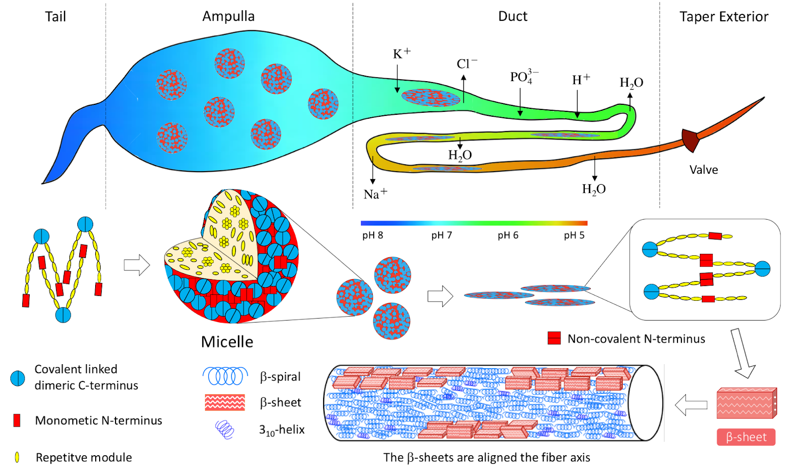
Case Studies of Strong Natural Materials Spider Silk
Made entirely of special proteins called spidroins
Dragline silk is the strongest
Composite of two proteins organized into three regions
An amorphous region connected to a crystalline region by a slightly less crystalline region

Slide 5
Case Studies of Strong Natural Materials Polychaete Worm Jaw
Gradient from harder materials at tip to softer materials to connect to the tissue of the jaw
Dynamic crosslinks between proteins and metallic ions
Inspired scientists to replicate the gradient by controlling the amount of metallic ions available for bonding
Saw stiffness multiply by up to two hundred

Slide 6
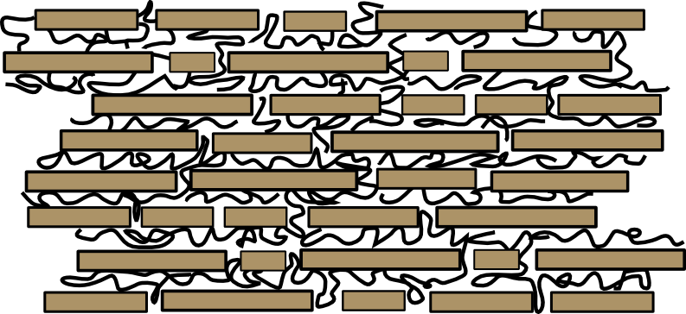
Case Studies of Strong Natural Materials Nacre
“Brick and mortar” structure
Nanolayers of aragonite with organic materials in between
Allows the organic materials to squish under pressure
Stronger than a traditional sheet of aragonite

Slide 7
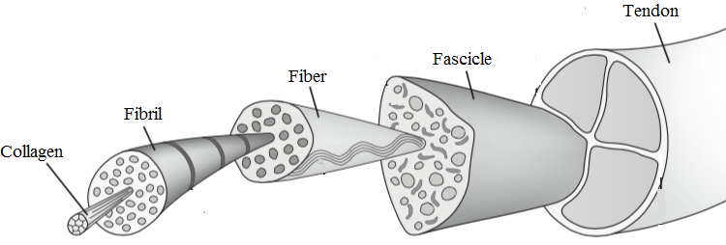
Case Studies of Strong Natural Materials Collagen
Most abundant protein in skin, which composes up to 75%
Arranged in tendrils
Tendrils in twisted triple-helical models
Young’s Modulus of 4.8 GPa
Explains why skin tears in non-linear manner

Slide 8
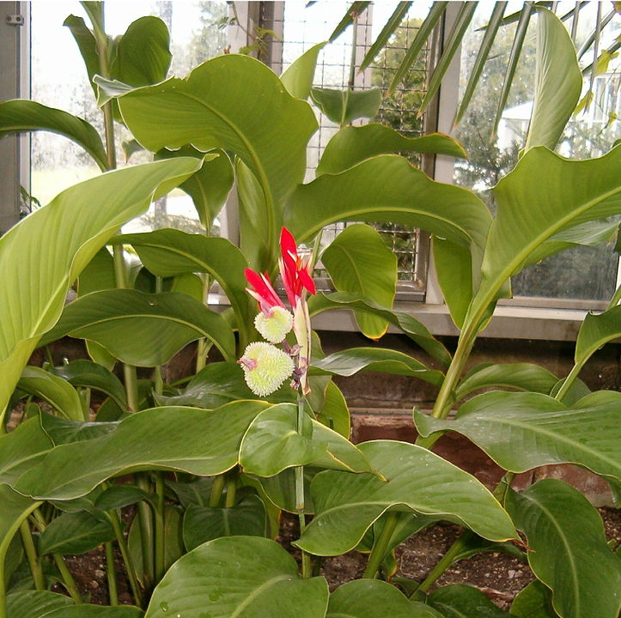
Case Study of a Biomimicked Polymer : Canna Indica
Materials have been created specifically to mimic the properties of the seed, leaf, and pod of canna indica.
Their extreme hydrophobia leads to them having self cleaning properties.
They barely reflect any wavelengths of light, leading to them being a cheap coating for solar panels.

Slide 9
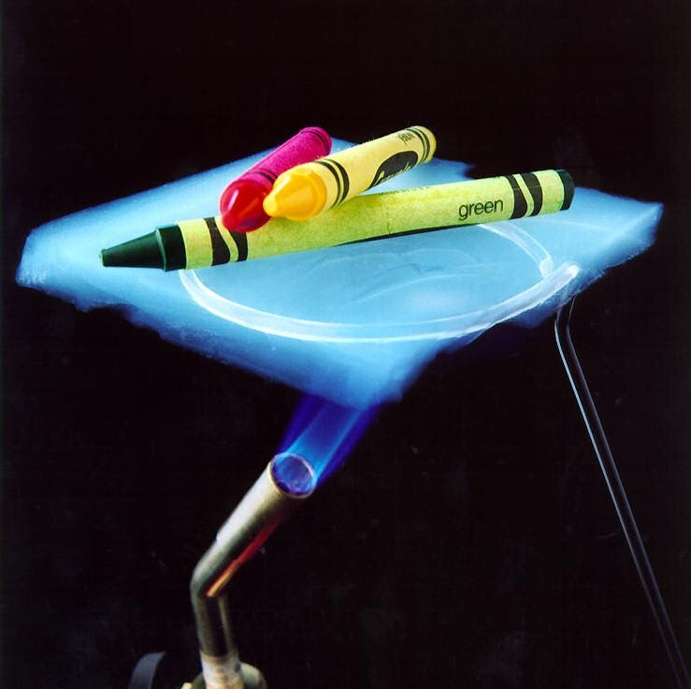
Soft Materials
Resides in the gap between fluids and crystals
Examples include polypeptides and DNA.
Defined as an ordered array of repeating units of monomeric building blocks formed by reversible and directional non-covalent interactions
Aerogels are synthetic soft materials that are super lightweight and insulating.
Weak intermolecular forces and few covalent bonds
Mainly held together by fibers and crosslinking

Slide 10
Thin Film Biocatalysts
Enzymes can be immobilized into thin films.
Uses a Vinylidene Fluoride (VFD)
Increase stability, effectiveness, and reusability.
Makes biocatalyzation more economically feasible in manufacturing processes.

Slide 11
Thin Film Immobilization: Protamine Immobilization
When blood is circulated out of the body (extracorporeal) during medical procedures, keeping it at the right viscosity is vital.
Two chemicals can be administered to the blood to control this.
Protamine thickens the blood.
Heparin thins the blood and prevent coagulation.
In order to easily control both substances, protamine can be immobilized and placed at the end of the circuit.
This allows for easier control of both substances and could reduce possible complications

Slide 12
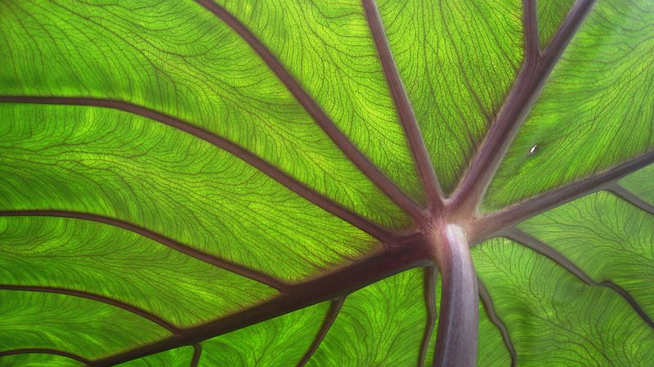
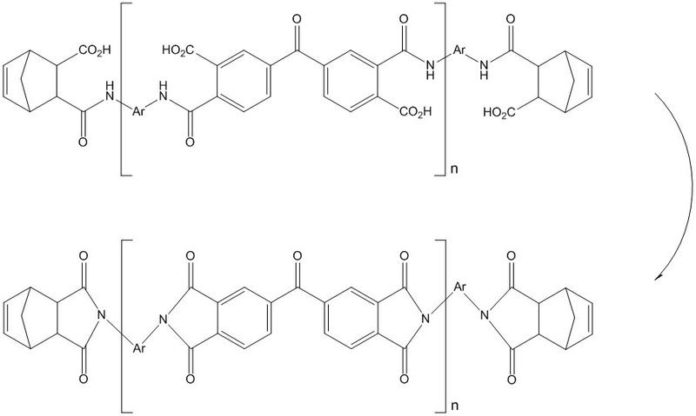
Self-Healing Materials
Manually healing a polymer is already completely possible.
For example, heating both ends of the divided material to their glass transition and letting them diffuse across the interface can result in a material of equal strength to the original.
However, self-healing polymers have increased utility due to the decrease in maintenance.
Thermoset materials get more rigid when heated, making them extremely useful in cases where other materials are becoming weaker.
The most bioinspired method of healing a material is to already have a microfluidic system, similar to a leaf, allowing actual microcracks that are formed to be more easily filled by a resin.

Slide 13
Self-Healing Coats
Corrosion in metal can be reduced by applying a self-healing coat.
The self-healing coat is made out of two different parts: a catalyst and some sort of healing agent, such as siloxane.
There are two different types of coats.
One has both the healing agent and the catalyst encapsulated.
The other has the healing agent present as phase-separated droplets.
Whether the coat is worn down by friction, corrosion, or mechanical degradation.

Slide 14
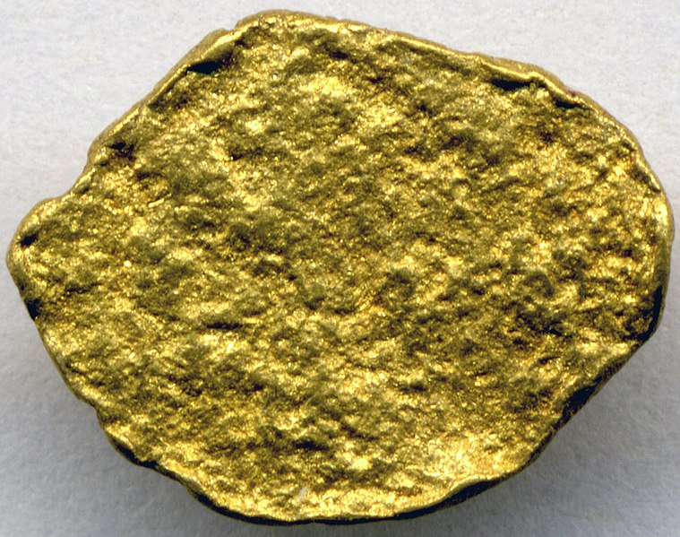
Other Ways to Self Heal Metal
Alloying Iron With Gold
When iron is alloying with gold, the mobile gold atoms precipitate into cavities until they can progress to microcracks.
If there is already a grain boundary, it is easier for the gold atoms to travel to the cavity.
This works best at low stress levels.
Titanium Microstructures
Under external pressure, titanium shifts into different microstructures, reducing free energy and stabilizing the structure.
Martensitic transformations are of particular interest because of their speed and existence in solid phases.
Used to form Shape Memory Alloys, which will martensitically transform back to their original shape when put under too much stress.

Slide 15
Self-Organizing Tribological Systems
When under extreme stress, some tribological self-organize into a completely different microstructure.
Theorized that the structure sacrifices its microstructure in order to keep order at a macroscale.
During the transient stage, it is observed that friction decreases.
A common concept known as self organizing criticality (SOC) is often compared to the final grain of sand being added to a cone of sand, causing the whole cone to slope down into pile.
This illustrates the idea that there is a single point that causes the whole system to self-organize.

Slide 16
Self-Cleaning and The Lotus Effect
Extreme hydrophobicity of surface is sometimes called the “Lotus Effect”
Named after the leaves of the Lotus Plant
The surface is ultra-rough to encourage the water to cohere to nearby water as opposed to adhere to the surface.
Allows water to roll off, carrying any dirt and debris with it.
The same properties are used by organisms such as geckos and “water striders”

Slide 17
Sources
van Leeuwen, Johan. “Biomimicry, Bio-Inspired Design.” Wageningen University and Research, Wageningen University and Research, 2019, www.wur.nl/en/Dossiers/file/Biomimicry-Bio-inspired-Design.htm.
Wang, Qijue, and Hannes Schniepp. “Strength of Recluse Spider's Silk Originates from Nanofibrils.” ACS Macro Letters, American Chemical Society, 29 Oct. 2019, pubs.acs.org/doi/10.1021/acsmacrolett.8b00678.
J.A. Neal, N.J. Oldenhuis, A.L. Novitsky, E.M. Samson, W.J. Thrift, R. Ragan, and Z. Guan, "Large continuous mechanical gradient formation via metal–ligand interactions ." Angewandte Chemie International Edition Volume 56, (2017)
Gim, J., Schnitzer, N., Otter, L.M. et al. Nanoscale deformation mechanics reveal resilience in nacre of Pinna nobilis shell. Nat Commun 10, 4822 (2019). https://doi.org/10.1038/s41467-019-12743-z
Grant C. A., Brockwell D. J., Radford S. E., Thomson N. H. Tuning the elastic modulus of hydrated collagen fibrils. Biophysical Journal. 2009;97(11):2985–2992. doi: 10.1016/j.bpj.2009.09.010.
Grant C. A., Brockwell D. J., Radford S. E., Thomson N. H. Tuning the elastic modulus of hydrated collagen fibrils. Biophysical Journal. 2009;97(11):2985–2992. doi: 10.1016/j.bpj.2009.09.010.

Slide 18
Sources (cont.)
S. Mattaparthi, Innovation in Materials Engineering submitted to “Indian Institute of Technology,” 2014, http://gyti.techpedia.in/project-detail/biomimicked-polymer-surfaces-exhibiting-superhydrophobic-and-anti-reflective-properties/2010, visited Sept. 15th 2020.
P. Saini “Polymeric and Soft Materials” http://www.nplindia.in/polymeric-and-soft-materials#:~:text=%20Polymeric%20and%20S oft%20Materials,of%20mild%20steel...%20More CSIR-National Physical Laboratory N/A (Accessed 9/17/20)
B. Burdick and J. Schaeffer “Application of Thin-Film Biocatalysts to Organic Synthesis” Biomimetic Polymers, 1990, pp. 15-37.
J. Britton, C. Raston, and G. Weiss “Rapid Protein Immobilization for Thin Film Continuous Flow Biocatalysis” Chemical Communications, Issue 66, 2016
V. Yang, F. Port, J. Kim, C. Teng, G. Till, and T. Wakefield “The Use of Immobilized Protamine in Removing Heparin and Preventing Protamine-Induced Complication during Extracorporeal Blood Circulation” Anesthesiology, Volume 75(2), August 1991, pp.288-297

Slide 19
Sources (cont. part 2)
B Aïssa, D. Therriault, E. Haddad, and W. Jamroz “Self-Healing Materials Systems: Overview of Major Approaches and Recent Developed Technologies” Advances in Materials Science and Engineering, Volume 2012, 2012, 17 pages
C. Kwakernaak, W. Sloof, and E. Brück “Self-Healing of Creep Damage by Gold Precipitation in Iron Alloys” Advanced Engineering Materials, Volume 17(5), May 2015
P. Sunday Nnamchi and C. Sunday Obayi “Self-Healing in Titanium Alloys: A Materials Science Perspective”https://www.intechopen.com/online-first/self-healing-in-titanium-alloys-a-materials-scienc e-perspective Intechopen, May 19th 2020 (Accessed 9/17/20)
Michael, Nosonovsky, et al. “Self-Organization at the Frictional Interface for Green Tribology.” Philosophical Transactions of the Royal Society A: Mathematical, Physical and Engineering Sciences, 28 Oct. 2010, royalsocietypublishing.org/doi/10.1098/rsta.2010.0179.
Montazer, Majid, and Tina Harifi. “Nanofinishes for Self-Cleaning Textiles.” Nanofinishing of Textile Materials, Woodhead Publishing, 22 June 2018, www.sciencedirect.com/science/article/pii/B9780081012147000091.
All images sourced from Wikimedia Commons.

