Slide 1
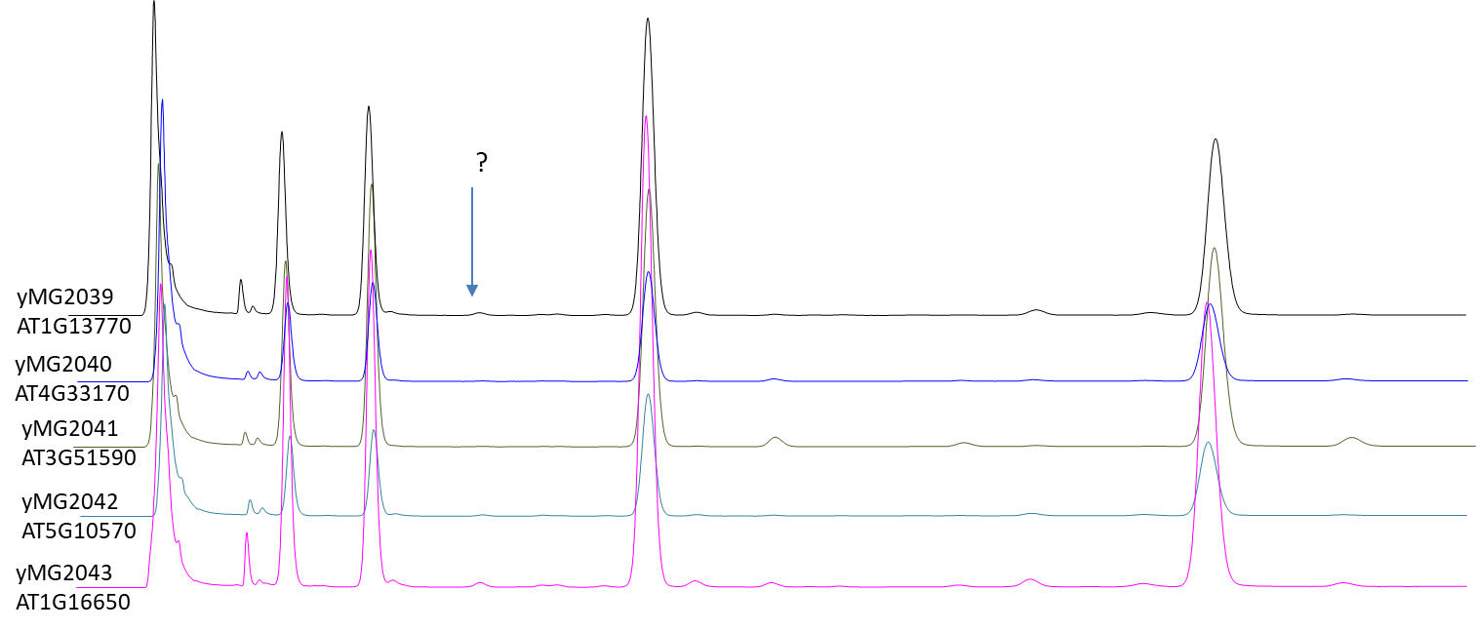
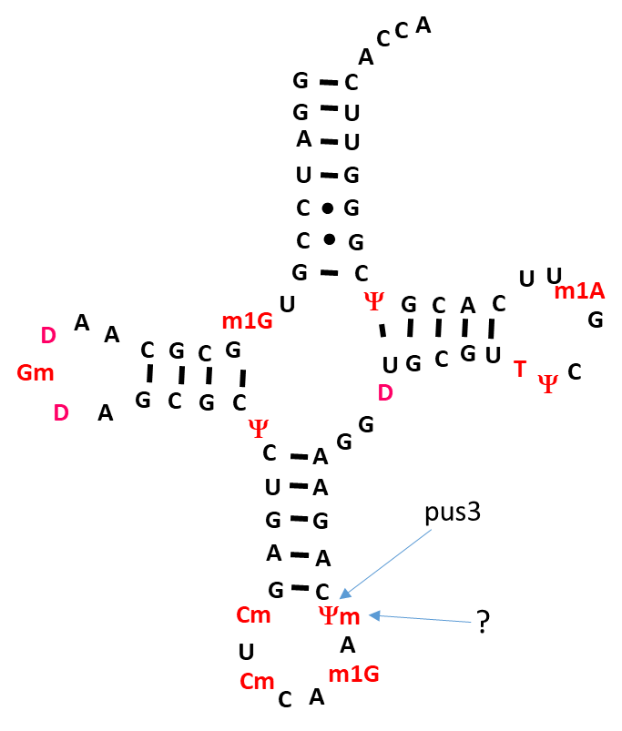
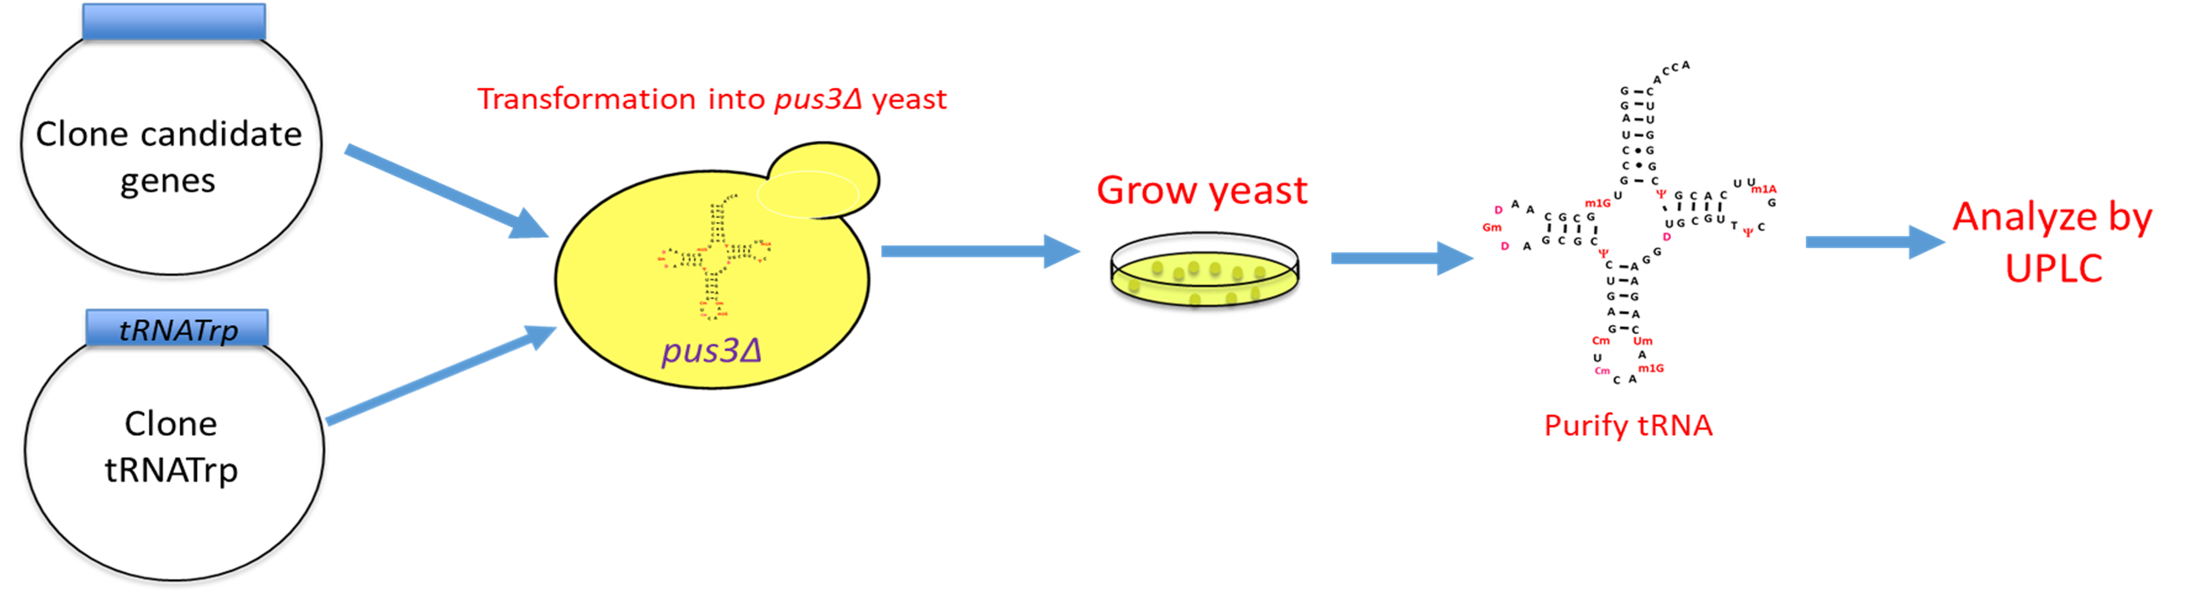
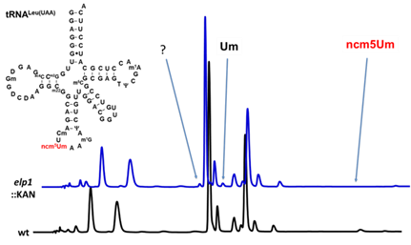




Identification of the enzyme responsible for 2’-O methylation of tRNA residue 39 in plants
Alex Keith, Morgan Fraley, Rachel Morgeson, Ramey Hensley, Michaela Vogel, Holly Funk, and Michael Guy
¹Department of Chemistry & Biochemistry, ²Department of Biological Sciences, Northern Kentucky University, Highland Heights, KY 41099
Abstract
Cloning Arabidopsis candidate methyltransferases
UPLC analysis of Arabidopsis tRNA from yeast expressing candidate genes
Modification of tRNA is important for cell growth and translation, and errors can lead to disease. Of the nearly 100 known tRNA modifications, enzymes responsible for several modifications are not known. One such modification is 2’-O-methlyation of residue 39 (Nm39) in plants and animals. The goal of this research is to identify the enzyme responsible for Nm39 in plants by expressing plant tRNA and candidate genes in yeast, which do not form the modification. Presence of Nm39 on tRNA would indicate that the candidate gene is responsible for the modification. Once identified, the human homolog will be identified using bioinformatics.
The candidate genes have been selected from unknown methyltransferases that have no known specific molecular function. The genes are then analyzed using Basic Local Alignment Search Tool (BLAST) against yeast, plants, and mammalian genomes. Candidate genes selected will have homologs in humans, fruit flies, and tobacco but none in yeast (Table 1). These genes from tobacco have been cloned onto a plasmid and transformed into yeast cells. The expression of the candidate genes was determined by Quantitative Real Time Polymerase Chain Reaction (qRT-PCR).
The plasmids have been co-transformed into S. cerevisiae pus3∆ cells (Figure 2), so the uridine will be present at position 39 and not pseudouridine. The cells have been grown, and RNA has been extracted and tRNA^{Trp} has been purified from these samples. The tRNA was digested with P1 nuclease and phosphatase and analyzed by UPLC to determine if Um is present. The retention time of the Um peak was first determined by analyzing tRNA^{Ser(AGA)} from wild type and trm44∆ cells (Figure 3). It is important to note that this was not performed within met22Δ cells, but it does indicate that tRNA can be purified from yeast.
Background
Arabidopsis tRNA^{Trp} expression in yeast
tRNA modifications are important for cell growth and protein translation
tRNA modifications are essential for all domains of life.
defects can lead to diseases in humans and growth defects in other organisms
  Such Diseases include cancer, type 2 diabetes, and many neurological conditions
2’-O-methylation on the nucleotide at position 39 (Nm₃₉) (Figure 1)
Occurs on some tRNAs in plants and animals, and this modification occurs in yeast
the enzyme that catalyzes this modification is unknown in animals and plants
occurs on tRNA^{Trp} from tobacco (Nicotiana tabacum), wheat and fruit flies in the form of 2’-O-methylated pseudouridine (Ψm)
In plants, animals, and yeast, the enzyme Pus3 changes uridine into pseudouridine⁴
The tRNA^{Trp} from Arabidopsis (tobacco) has been cloned onto a plasmid. Tobacco tRNA is used because it likely obtains the Nm₃₉ modification. The gene of tRNA^{Trp} was amplified using PCR. The purified product was then ligated into a yeast expression plasmid. The plasmid was transformed into yeast cells containing one of the candidate genes. These cells were grown at 24°C. Purification of tRNA from yeast grown at the lower temperature yielded greater amounts of tRNA^{Trp} than yeast grown at 30°C, likely due to rapid tRNA decay because the tRNA is in foreign met22Δ cells .
Figure 2. Schematic of approach to identify Nm₃₉ enzyme from Arabidopsis
Figure 4. Preliminary UPLC traces of tRNA^{Trp} from strains expressing candidate genes and Arabidopsis tRNA^{Trp}. Question mark represents possible detection of Um.
Figure 1. tRNATrp of Tobacco at Position 39
Future Work
Use met22∆ strains to block the rapid tRNA decay pathway to obtain better tRNA yields and continue testing candidate genes for Nm₃₉ activity in yeast
Once gene is identified from Arabidopsis, identify and verify human homolog
Once the enzyme is identified, use site-directed mutagenesis experiments to determine the active site of the enzyme.
Search for potential guide RNAs that may be required for this modification.
Analysis of plant tRNA and candidate genes expressed in yeast cells by UPLC
This project focuses on finding the enzyme responsible for modifying nucleotides on position 39 (Nm₃₉) in plant tRNAs
We will express a plant tRNA that would normally have the Nm₃₉ modification along with candidate methyltransferases (Table 1) in yeast, to identify the enzyme
  This works because yeast do not perform this modification
Presence of the enzyme on the plant tRNA when expressed with a candidate gene within met22Δ cells will indicate that the candidate gene codes the enzyme responsible for the modification
Acknowledgments
Plasmids will be co-transformed into S. cerevisiae lacking the PUS3 gene (pus3∆) (Figure 4). Experiments will be done in pus3∆ cells so a uridine will be present at position 39 instead of a pseudouridine. Cells will be grown, RNA will be extracted, and A. thaliana tRNA^{Trp} will be purified. The tRNA will be digested with P1 nuclease and phosphatase and analyzed by UPLC to determine if Um is present. We have previously anlayzed Um levels using UPLC (Figure 5).
Thanks to the Greaves Fellowship, Center for Integrative Natural Science and Mathematics (CINSAM), Kentucky Biomedical Research Infrastructure Network (KBRIN), the National Institutes of Health (NIH), and NKU for funding. We also thank the NKU Department of Chemistry & Biochemistry for its support, as well as all our fellow lab mates for their support throughout the project.
References
Table 1. Selected Arabidopsis genes encoding methyltransferases of unknown function
Figure 5. UPLC analysis of tRNA^{Leu(UAA)} from wild type and elp1∆ S. cerevisiae mutants showing detection of Um. (Previous work from D. Divita and J. Brooks).
1.Phizicky EM, Hopper AK. tRNA biology charges to the front. Genes Dev. 2010 Sep 1;24(17):1832–60
2. Torres, Adrian Gabriel, et al. Role of TRNA Modifications in Human Diseases. Trends in Molecular Medicine 2014 June 20(6):306–314
3.Machnicka MA, Milanowska K, Osman Oglou O, Purta E, Kurkowska M, Olchowik A, et al. MODOMICS: a database of RNA modification pathways--2013 update. Nucleic Acids Res. 2013 Jan;41(Database issue):D262-267.
4. Lecointe F, Simos G, Sauer A, Hurt EC, Motorin Y, Grosjean H. Characterization of yeast protein Deg1 as pseudouridine synthase (Pus3) catalyzing the formation of psi 38 and psi 39 in tRNA anticodon loop. J Biol Chem. 1998 Jan 16;273(3):1316–23.
Biological Sciences

