Slide 1
TeloReport
extraction and clustering of telomeric raw reads
identification of potential de novo telomere formation
Seth Baunach and Trey Stansfield
7/31/2020
Jerzy W. Jaromczyk, Mark Farman

Slide 2
Background
Telomeres are repetitive sequences of DNA that occur at chromosome ends. The properties of telomeric regions of DNA are often of great relevance to the study of the organism’s evolution and adaptation.
A particular fungus Magnaporthe oryzae, which infects several kinds of crops, has been extensively studied for its telomeres. Some strains of M. oryzae demonstrate highly unstable chromosome ends that undergo frequent rearrangements, often attributed to the presence of retrotransposons inserted into the telomeres.
Telomeres are often poorly represented in fully assembled genomes; thus, it is necessary to investigate the raw reads from which the genome was assembled. Some of these reads may give a closer look at how telomeres change.

Slide 3
Goals
Classify raw telomeric reads
Extract telomeric reads from a raw read dataset
Cluster telomeric reads based on telomere-adjacent sequence
The sequence immediately following the telomere repeat allows us to group reads which most likely came from the same part of the genome, corresponding to telomere ends
Investigate clusters
Observe frequency of clusters
Investigate whether telomere-adjacent sequence corresponds to known retrotransposon sequence in certain clusters
Generate a consensus sequence for each cluster
Identify potential de novo telomeres
Look at small clusters and singleton reads for potentially newly-formed telomere sequence
BLAST potential de novo telomeres against the assembled genome and identify matches

Slide 4
Methods
Two methods were used to find telomeres in raw reads and cluster the telomere-adjacent sequences: fuzzy and exact.
The fuzzy method uses a scoring algorithm both for extracting raw reads and for determining clusters. The algorithm does not require exact matches, but enforces high similarity in clusters.
The exact method uses exact string matching at all stages, from extracting raw reads to the generation of clusters.
Reads that did not cluster were blasted against the consensus sequences generated from each cluster.
This is to ensure that they were not falsely marked as singletons.
De novo telomeres were then confirmed by blasting singletons against the assembled genome.

Slide 5
Results - Exact method vs Fuzzy method
Matching Method | Forward telomeres | Reverse telomeres | Runtime (first component) (m) | Clusters | Well-represented clusters | Potential de novo telomeres | De novo telomeres
Fuzzy | 897 | 411 | 6.58 | 17 | 9 | 66 | 3/2
Exact | 438 | 118 | 8.38 | 20 | 4 | 42 | 0/1
Fuzzy method was able to better recognize reverse telomeres (ending with TTAGGG)
Recognizing reverse telomeres is often more difficult with exact matching due to sequence quality drop-off
Fuzzy method output less clusters than exact method
Exact method often generated clusters which should have been included in other clusters
Fuzzy method found more de novo telomeres
Fuzzy method had more clusters with high representation

Slide 6
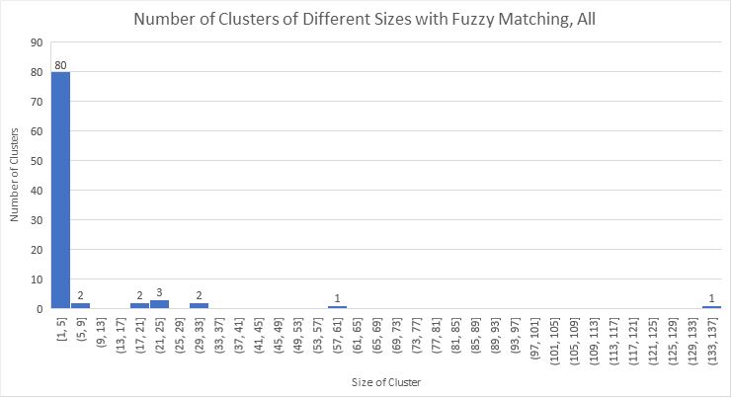
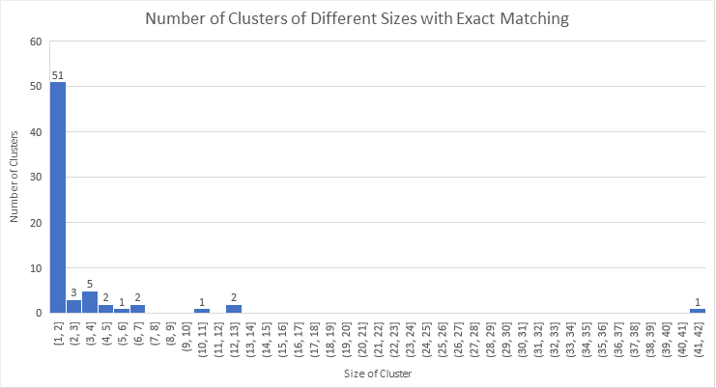
Results - Exact method vs Fuzzy method cont.
Both methods found a somewhat similar distribution of telomere-adjacent sequence, but the fuzzy matching shows much more clear differences between the representations of telomeres.
From the cluster sizes alone with exact matching, it is unclear whether low-represented clusters should correspond to other clusters or potential de novo telomeres.
Blasting low-represented clusters against the better-represented clusters could alleviate this.

Slide 7
Results - Preliminary de novo telomere analysis
Of the de novo telomeres that had matches to the assembled genome:
Two reads matched the same M. oryzae retrotransposon in the genome, one matching in reverse orientation and one in forward orientation, corresponding to M. oryzae retrotransposon, MoTeR1.
Another two reads matched a M. oryzae retrotransposon, in the same orientation, corresponding to the middle of M. oryzae retrotransposon, MoTeR1.
One read matched the genome in four different contigs. These contigs do not correspond to any well-represented telomere ends. Additionally, the sequence does not match any known M. oryzae transposon element.
Potentially a new M. oryzae transposon or represents a new method of telomere recombination?

Slide 8
Interesting results
The fuzzy matching, theoretically, should’ve needed many more computations than the grep command used for exact matching. However, due to the compiler optimization of C++, it ran faster (by about two minutes for a 24 million sequence raw read dataset, with sequence lengths of 150bp).
M. oryzae has 7 chromosomes and, therefore, 14 telomere ends. With nine very large clusters (sizes 134, 60, 32, 31, 25, 24, 22, 20, 18), and with the next largest being size 8, these nine clusters probably correspond to the 14 telomere ends. The largest (134) probably appears on four or five ends, and the second largest (60) probably appears on two or three ends, for this strain in particular.
Not all of the de novo telomeres matched up with known M. oryzae retrotransposons, which may potentially suggest a new M. oryzae retrotransposon element, or another method of recombination may be occurring near chromosome ends.

Slide 9
Conclusions and Comments
The fuzzy method for interrogating telomeres seems to perform much better than known rudimentary algorithms which use exact matching.
This is to be expected, because the fuzzy method accounts for potential small errors in raw reads.
The methods used can effectively be put to use in characterizing telomeres using raw reads as well as finding de novo telomeres
There is more work to be done before the methods used can be applied rigorously

Slide 10
Future work
Improve the pipeline so that the potential de novo telomeres and clusters can more easily be interrogated and blasted against the genome.
Currently, the process requires manual interrogation
Blast low-representation clusters in addition to singleton reads to confirm they are not supposed to be a part of other clusters.
Some low-representation clusters may correspond to de novo telomeres as well.
Confirm that the significantly large clusters probably correspond to telomere ends
blasting to the genome and investigating results
Integrate the confirmation and analysis of de novo telomeres to the genome
Finally, in the long term, we would like to run our methods on more genomes and investigate the results

